Slide 1

Basic Details of the Team and Problem Statement
Ministry/Organization Name: Ministry of coal
PS Code: SIH1316
Problem Statement Title: Application of Image Analytics for Tree enumeration for diversion of Forest Land.
Team Name: EcoWarriors
Team Leader Name: Mr. Rahul Sanjay Tetwar
Institute Code (AISHE): C-34399
Institute Name: Maharashtra Institue of Technology, Chh.Sambhajinagar
Theme Name: “Where Nature Meets Pixels”

Slide 2

Idea/Approach Details
Solution :
The web-based system's primary objective is to support informed and responsible decision-making concerning forest land diversion. To achieve this, it will create the following key components:
Counting Tree: Implement advanced algorithms to accurately count individual trees in forested areas using machine learning.
Categorization of Trees: Train models to recognize and classify tree species for a comprehensive understanding of forest composition.
Area covered by Forest Land: Utilize image analysis to calculate the precise extent of forested land, ensuring accurate spatial data.
Tree Analysis: Conduct detailed tree analysis, extracting attributes like size, height, density, and distribution to provide valuable insights.
Outcome: By developing these components, the web-based system will provide stakeholders with accurate, transparent, and actionable information. This will enable them to make informed decisions regarding forest land diversion and support sustainable environmental management.
Technology Stack :
Product Status :
70% product built completed and further build is
on progress. Testing and validation process are
next to be undergone.

Slide 3
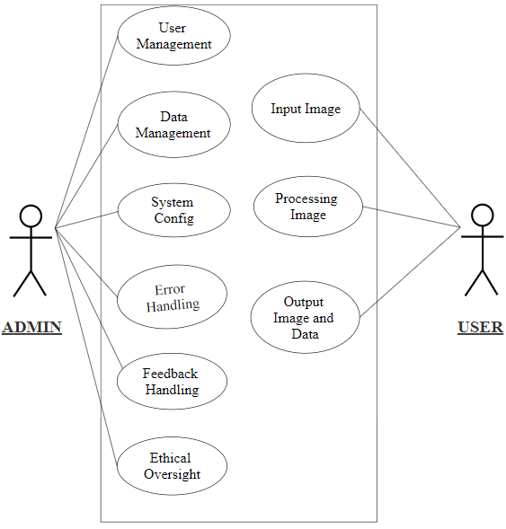
Idea/Approach Details
Show Stopper :
Data Quality: Inability to access high-quality imagery.
Inaccurate Analytics: Failure to provide precise results.
Funding Shortage: Insufficient financial resources.
Regulatory Challenges: Compliance and permitting issues.
Technical Limitations: Constraints hindering efficient data processing.
Privacy and Ethics: Concerns regarding sensitive data.
Stakeholder Opposition: Strong resistance.
Use Cases :
Vegetation Mapping: Analyzing and mapping vegetation for natural resource management.
Climate Impact Assessment: Studying vegetation changes to assess climate impact.
Continuous Monitoring: Regularly analyzing Earth's surface for environmental insights.
Forest Land Diversion Assessment: Assessing the impact of land diversion on forests.
Deforestation Detection: Real-time monitoring to detect and combat deforestation.
Cost and Manpower Reduction: Reducing costs and labor in tree counting and land-use planning.
Agriculture Sector Support: Providing insights into crop health and land usage.
Government Decision-Making: Supporting data-driven decisions in land management and conservation.
Region Monitoring and Mapping: Monitoring and mapping specific regions for various purposes.
Data Collection and Analysis: Facilitating data collection and analysis for ecological research.

Slide 4
Team Member Details
Team Leader Name : Mr. Rahul Sanjay Tetwar
Branch : MCA Stream : Computer Science Year : II
Team Member 1 Name : Mrs. Akanksha Atul Kasar
Branch : MCA Stream : Computer Science Year : II
Team Member 2 Name : Mr. Pranjal Shankar Jadhav
Branch : MCA Stream : Computer Science Year : II
Team Member 3 Name : Mr. Prajwal Mohan Chapke
Branch : MCA Stream : Computer Science Year : II
Team Member 4 Name : Mr. Govind Madan Ambade
Branch : MCA Stream : Computer Science Year : II
Team Member 5 Name : Mr. Vedant Vivek Koleshwar
Branch : MCA Stream : Computer Science Year : II
Team Mentor 1 Name: Dr. Shubhashree Savant
Category : Academic Expertise : Medical Image Processing , AI and Programming Domain Experience : 10 years

