Slide 1

Basic Details of the Team and Problem Statement
Ministry/Organization Name: Ministry of Home Affairs
PS Code: SIH1505
Problem Statement Title: Aerial Location of Hazardous Atmosphere in Industries
Team Name: EcoWarriors
Team Leader Name: Mr. Rahul Sanjay Tetwar Institute Code (AISHE): C-34399
Institute Name: Maharashtra Institute of Technology, Chh.Sambhajinagar
Theme Name: “Where Nature Meets Pixels”

Slide 2
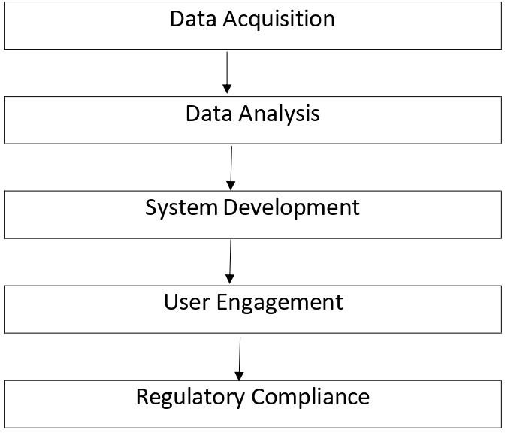

Idea/Approach Details
Amid rising industrialization, effective fire prevention is crucial to protect lives and assets. This presentation delves into the role of aerial location in identifying hazardous atmospheres within industries, vital for comprehensive fire prevention.
Aerial Technology Utilization: Employ aircraft or drones to survey industrial areas for hazard identification.
Precise Hazard Identification: Locate flammable, toxic, and threat
areas within the facility.
Advanced Techniques: Use remote sensing, data analysis, and geospatial technology for data collection and mapping.
Technology Stack :
Hazard Zone Maps: Create maps categorizing areas into
flammability, toxic, and threat zones.
Fire Pre-Plans: Develop proactive strategies to prevent fires and manage emergencies.
Enhanced Safety: Improve safety and emergency response
preparedness.
Economic Loss Reduction: Minimize potential economic losses
result₂ing from industrial fires.

Slide 3
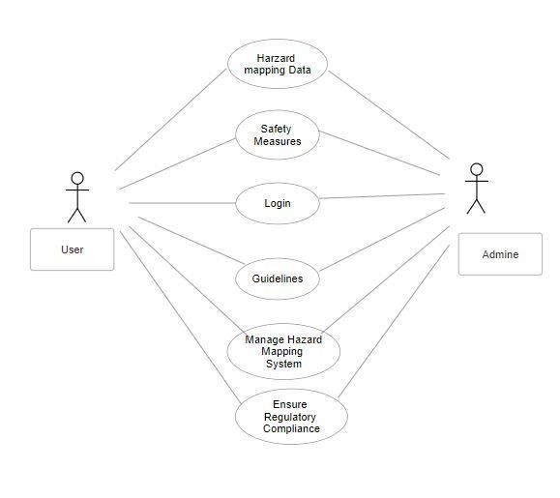
Idea/Approach Details
Show Stopper :
Data Accuracy: Ensure precise data for effective risk
equipment is
Use Cases :
Industrial Safety: Enhance workplace safety by proactively managing fire and safety risks.
Emergency Response: Aid first responders in
minimizing risks during fire emergencies.
Environmental Protection: Identify and contain environmental threats to prevent hazards.
Regulatory Compliance: Ensure adherence to safety
regulations and demonstrate commitment to public safety.
Preventive Maintenance: Mitigate risks through
timely maintenance measures.
Urban Planning: Safely integrate industrial areas into urban landscapes.
Insurance Assessment: Accurately assess and
underwrite policies based on hazard mapping data.
Environmental Impact Studies: Conduct research and address environmental impacts associated with industrial activities.
3
assessment.
Technology Reliability: Dependable aerial
essential for uninterrupted mapping.
Privacy Concerns: Address privacy issues and adhere to
Data Security: Protect collected data from unauthorized access.
regulations.

Slide 4
Team Member Details
Team Leader Name : Mr. Rahul Sanjay Tetwar Branch : MCA
Team Member 1 Name : Ms. Akankasha Atul Kasar Branch : MCA
Team Member 2 Name : Mr. Pranjal Shankar Jadhav
Branch : MCA
Team Member 3 Name : Mr. Prajwal Mohan Chapke Branch : MCA
Team Member 4 Name : Mr. Govind Madan Ambade Branch : MCA
Team Member 5 Name : Mr. Vedant Vivek Koleshwar
Branch : MCA
Team Mentor 1 Name: Dr. Shubhashree Savant
Stream : Computer Science
Year : II
Stream : Computer Science
Year : II
Stream : Computer Science
Year : II
Stream : Computer Science
Year : II
Stream : Computer Science
Year : II
Stream : Computer Science
Year : II
Category⁴: Academic Expertise : Medical Image Processing , AI and Programming
Domain Experience : 10 years

