Slide 1
A PROJECT PRESENTATION ON “CLOUD-BASED TICKET BOOKING SYSTEM”
Presented By :-
1) Prajwal Choudhary (URN No.: 2020-B-19022000)
2) Abhishek Kolte (URN No.: 2020-B-28022000B)
Specialization :-
BCA Cloud Technology & Information Security (CTIS)
Guided by :-
Prof. Ranjana Singh

Slide 2
Contents
Abstract
Problem Statement
Proposed System
Methodology
Future Scope
System Output’s
Conclusion
Reference’s

Slide 3
Abstract
The Cloud-Based Ticket Booking App, which provides a convenient way for users to book tickets for various events, such as concerts, movies, and sports matches, from anywhere in the world.
This app is designed to be user-friendly, that allows users to search for events by location, date, and category. It also enables users to view the availability of tickets, select their seats, and pay for their tickets using various payment options, including credit/debit cards, mobile wallets, and net banking.
The app also provides users with real-time updates on the status of their bookings and sends them notifications about any changes or updates to their tickets. This helps to reduce the possibility of double bookings or any confusion regarding the event.

Slide 4
Problem Statement
Single Platform Multiple Booking Types:
If we are willing to book multiple platforms then we need to get different system for different event.
Slot Management: Close Bookings
There is an issue if we plan vacation and want to prevent booking on specific days.
In this case definitely require an system to solve this issue.
Booking cancellation and schedule of bus, shows etc:
There is an need of system which provide cancellation for tickets, also the upcoming
bus and event schedules.

Slide 5
Proposed System
To overcome the existing issues we have developed a solution, which is named as “Cloud-Based Ticket Booking App”.
Which is an web-application that don’t any installation you can use this platform just by single click on your current internet browser.
The use of cloud technology ensures that the app is scalable, secure, and accessible from anywhere, making it an ideal choice for anyone looking to book tickets for their favorite events.

Slide 6


Methodology
Front End:
HTML : Hypertext Markup Language (HTML) is the standard markup language for creating web pages and applications. Each page contains a series of connections to other pages called hyperlinks. HTML describes the structure of a web page semantically and originally included cues for the appearance of the document.
CSS : Cascading Style Sheets (CSS) is a style sheet language used for describing the presentation of a document written in a markup language. CSS is designed primarily to enable the separation of presentation and content.

Slide 7


Back End
PHP:
Is a widely used open source general purpose scripting language that is especially suites for web development and can be embedded into html basically, a server-side scripting language designed primarily for web development but also used as a general-purpose programming language.
Database
MYSQL:
MySQL is a widely used relational database management system (RDBMS). MySQL is free and open-source. MySQL is ideal for both small and large applications.

Slide 8
Future Scope
The GPS of the smart phone will be used to identify the locations . The GPS will play the role of the checker, where the user buys the ticket, the source geo points, destination geo-points, ticket type, expiry time & date are stored in the database.
We can visualize that M-Ticket system will have an application portfolio with a mix of cloud-based services delivered across a combination of private, hybrid, and public cloud-based infrastructure deployment models.
Thus, using cloud computing technology in train and bus system is the most efficient, cost-saving, time-saving and sterilisable technique for waiting ticket holders.

Slide 9
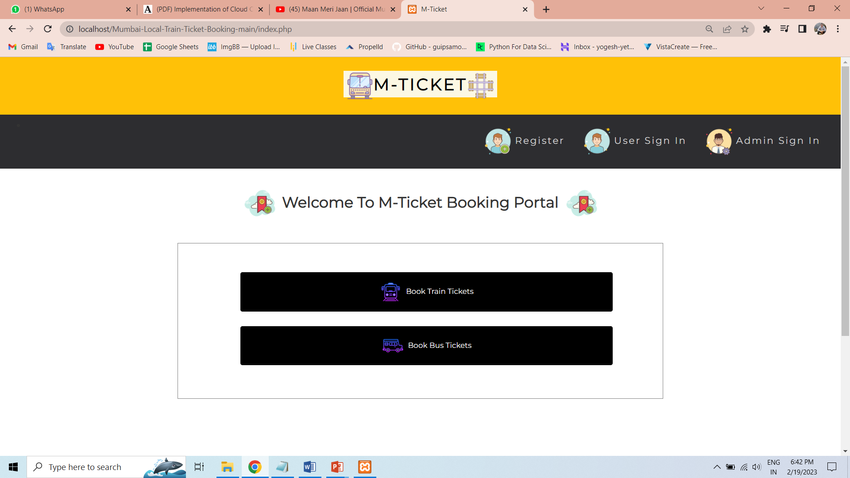
System’s Output
Index Page:

Slide 10
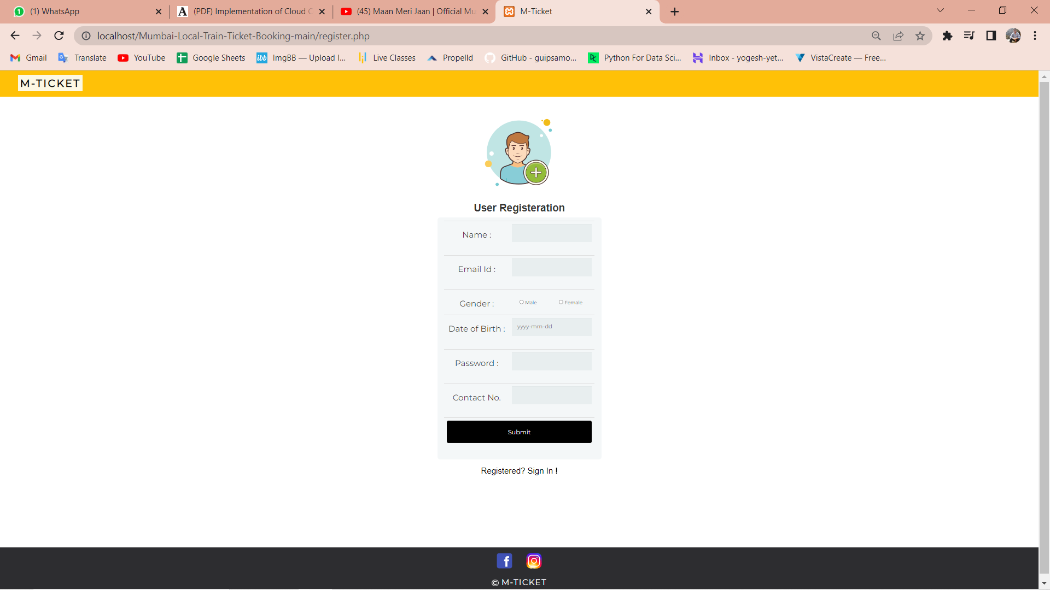
User Registration Page:

Slide 11
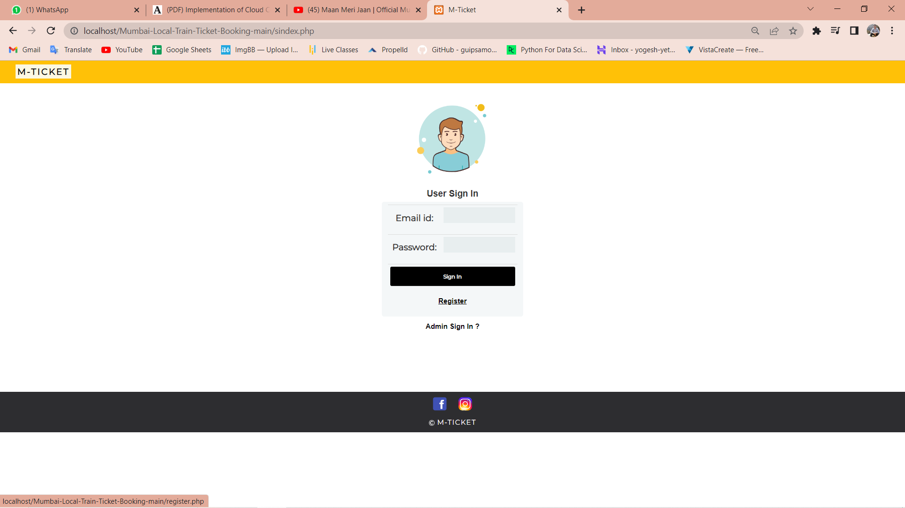
User Login Page:

Slide 12
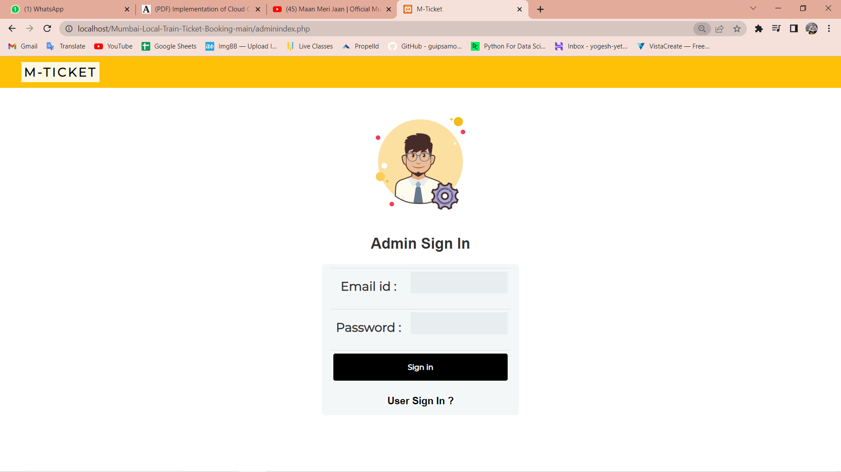
Admin Login Page:

Slide 13
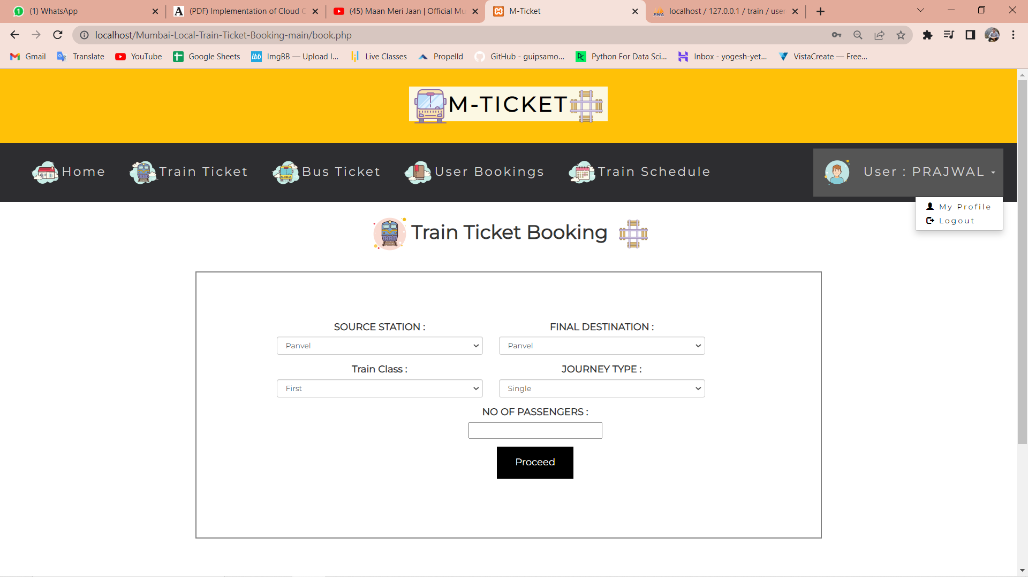
User Dashboard:

Slide 14
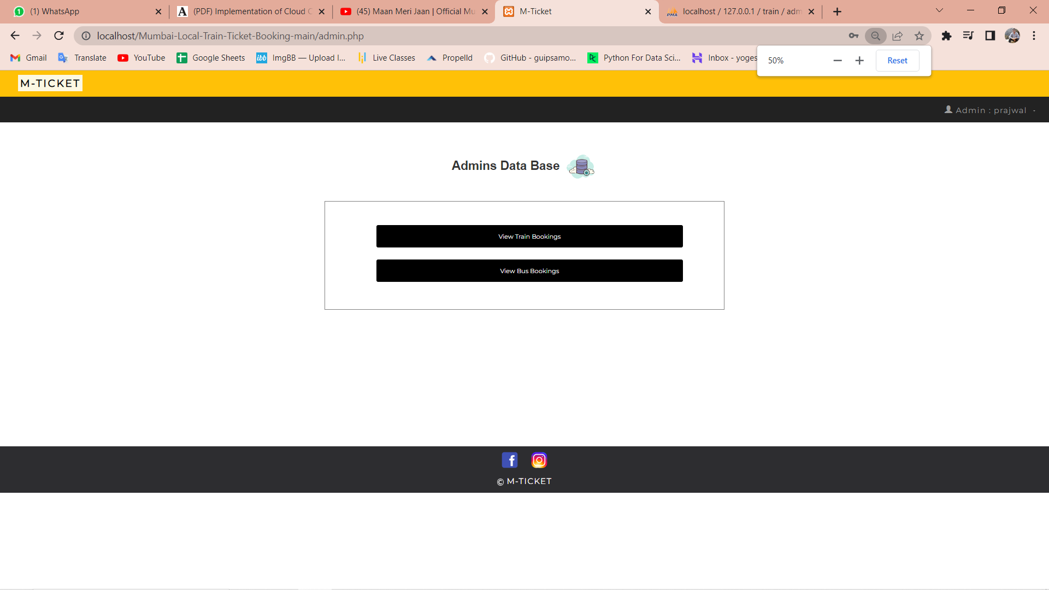
Admin Dashboard:

Slide 15
Conclusion
So thus we have developed “The Cloud-Based Ticket Booking System” which is a game-changer in the ticket booking industry, providing users with a seamless and convenient way to book tickets for events, while also offering valuable insights to event organizers.
The use of cloud technology ensures that the app is scalable, secure, and accessible from anywhere, making it an ideal choice for anyone looking to book tickets for their favorited events.

Slide 16
References
Development of Online Ticket Booking Application for Ferry Crossing Website Based in Toba Lake Area
https://ieeexplore.ieee.org/document/9166636
Author: Ferlin Firdaus Turnip; Arjon Turnip
Software Implementation of Movie Ticket Booking System
https://ieeexplore.ieee.org/document/9468015
Author: Mykola Pasyeka; Andrew Malitchuk
www.google.com
www.Wikipedia.com

Slide 17


