Slide 1
Veterans Health Administration- Availability of services, Quality of care and Medical center staffing
CS 6301 - Semantic Web
Dr. Jeffrey Partyka
by
Kiran Bhat Gopalakrishna
Prajwal Halasahally KeshavaReddy

Slide 2
Agenda
Project Overview
Technologies
Datasets
Implementation
Challenges
Observation
Target Audience
Demo

Slide 3
Overview
Analysis of staff distribution across different veteran hospitals.
Distribution of availability of services across different states in U.S
Information about patient satisfaction rating which provides the information about quality of service.
Interrelation between patient satisfaction rating, availability of services and availability of staff.

Slide 4
Resources & Technologies
SPARQL
LOGD SPARQL Endpoint
Google Visulaization API
Javascript & JQuery
Twitter Bootstrap

Slide 5
Datasets
Dataset 1205: This dataset contains the data about staffing for Nurses, Physicians, and other Healthcare Professionals
Link: http://data-gov.tw.rpi.edu/wiki/Dataset_1205
Dataset 1210: This dataset defines the scope of services provided at a facility such as number of emergency rooms, ICU availability.
Link: http://data-gov.tw.rpi.edu/wiki/Dataset_1210
Dataset 1212: This dataset defines the quality of care in defined hospital settings: Inpatient, Outpatient and Emergency Room.
Link: http://data-gov.tw.rpi.edu/wiki/Dataset_1212

Slide 6
Implementation
SPARQL queries are run on LOGD SPARQL end point.
The tuples obtained so are filtered using the necessary conditions and are given as input to the Google geo map instance.
Google visualization API’s have been used to represent the data distribution across different states.
An interactive User Interface is developed using Bootstrap libraries.
The different datasets and mashup data are shown in a single page.

Slide 7
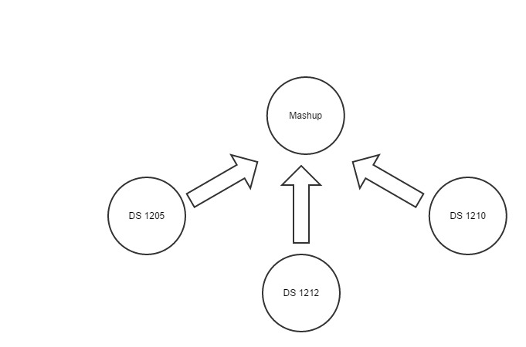

Slide 8
SPARQL Queries
Query 1 - 1205
http://www.utdallas.edu/~pxh140930/queries/dataset1205.sparql
Query 2 - 1210
http://www.utdallas.edu/~pxh140930/queries/dataset1210.sparql
Query 3 -1212
http://www.utdallas.edu/~pxh140930/queries/dataset1212.sparql
Mash-up Query
http://www.utdallas.edu/~pxh140930/queries/datasetcombined.sparql
LOGD SPARQL Endpoint
http://logd.tw.rpi.edu/sparql

Slide 9
Mashup Data
Datasets are combined using different values obtained after executing SPARQL queries on all 3 data sets.
Average staffing, Availability of services and Patients satisfaction rating are the parameters which are considered to determine the point distribution
The values are normalized by using the average values which are computed based on the dataset values
Veteran Point = (ServiceNormalized + StaffNormalized + PatientRatingNormalized).
The mashup geo map is designed based on the Veteran point distribution.

Slide 10
Challenges
Executing SPARQL queries locally with rdf datasets returned unexpected tuples.
Certain columns retrieved after executing SPARQL queries contained NULL or Not a number Values.
Few data fields either contained incomplete information or not clearly defined.
Writing macros to cross verify data from csv files.

Slide 11
Demo
http://www.utdallas.edu/~pxh140930/semanticweb/

Slide 12
Observations
North-Eastern states have ample availability of Staff.
Availability of services like Emergency Beds and ICU’s are good in western and northern part of the United States.
Patient Satisfaction rate has more than an average value in the central part of the United States.
Overall, The mashup data obtained is in accordance with the 3 data sets that have been considered.
Western states have higher scores compared to other states.

Slide 13
Target Audience
VHA Administrators, who could use the data to enhance the VHA system as a whole.
Veterans, who may face choices of where to live in terms of the quality of healthcare available.
Federal Government, to see if allocated funds are being utilized to their maximum.

Slide 14
Thank you!

