Slide 1



rbc_churn
View in Power BI
Last data refresh:
11/14/2022 2:58:53 AM UTC
Downloaded at:
11/14/2022 5:26:17 AM UTC

Slide 2
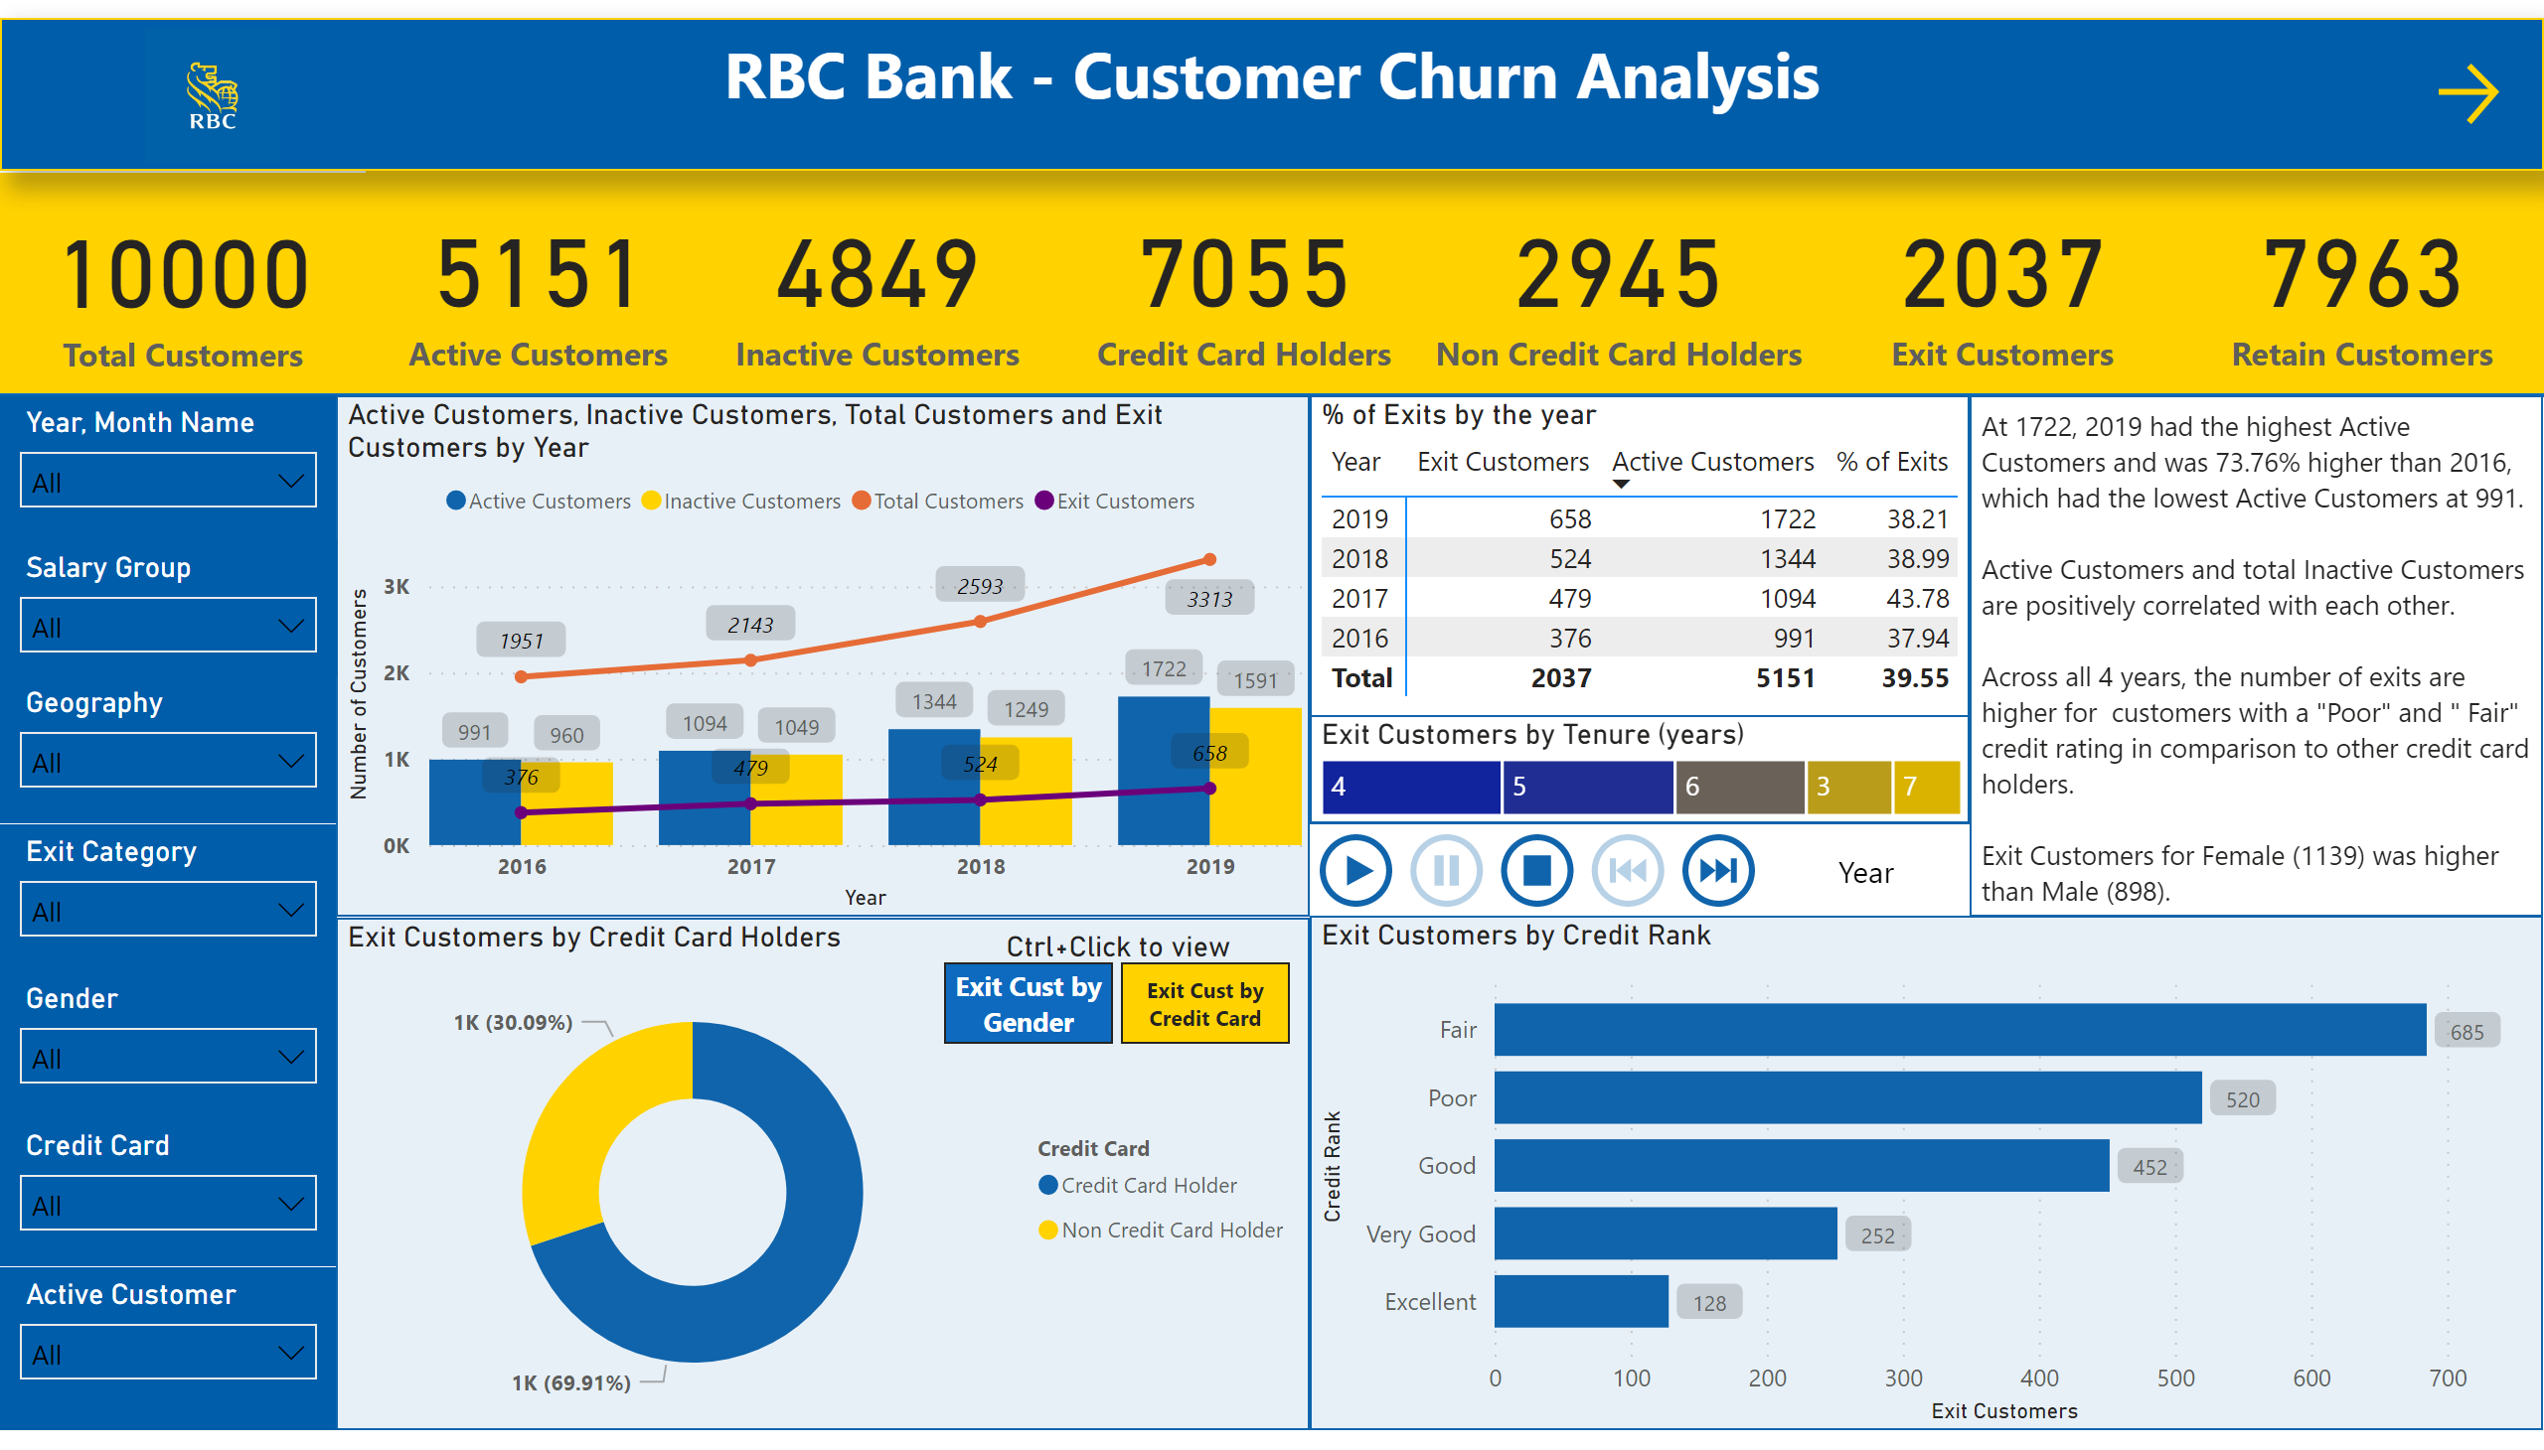
Overview
Notes:
card
No alt text provided
card
No alt text provided
card
No alt text provided
card
No alt text provided
card
No alt text provided
card
No alt text provided
card
No alt text provided
textbox
No alt text provided
image
No alt text provided
shape
No alt text provided
slicer
No alt text provided
slicer
No alt text provided
slicer
No alt text provided
slicer
No alt text provided
slicer
No alt text provided
slicer
No alt text provided
lineClusteredColumnComboChart
No alt text provided
PBI_CV_16948668_E17D_454B_8664_2F2C470EA8C1
No alt text provided
donutChart
No alt text provided
clusteredBarChart
No alt text provided
Exit Customers by Credit Card Holders
No alt text provided
% of Exits by the year
No alt text provided
slicer
No alt text provided
textbox
No alt text provided
Exit Customers by Tenure (years)
No alt text provided
Ctrl+Click to view
No alt text provided
actionButton
No alt text provided

Slide 3
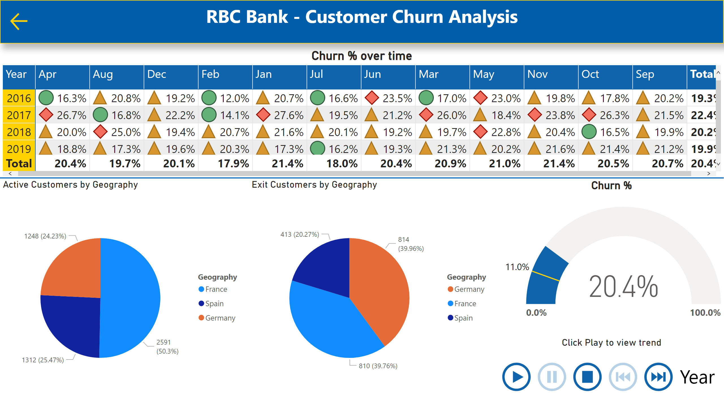
Churn %
Notes:
Churn % over time
No alt text provided
textbox
No alt text provided
actionButton
No alt text provided
gauge
No alt text provided
Active Customers by Geography
No alt text provided
Exit Customers by Geography
No alt text provided
shape
No alt text provided
Click Play to view trend
No alt text provided

