Slide 1

Project Title –Seasonal Agriculture Performance Analysis
Student Name – Prajwal Sachin Kalbhor
College Name – Navsahyadri Group of Institutions, Pune
AICTE STU ID : STU68617c651e7b51751219301

Slide 2

PROBLEM STATEMENT
Agricultural activities are influenced by seasonal variations in environmental conditions, farming practices, resource availability and market conditions. As a result, agricultural performance may differ from one season to another. However, raw agricultural data does not clearly explain how agricultural performance changes across seasons or what patterns can be observed in different seasonal conditions. The problem is to analyze the given agricultural dataset and investigate seasonal differences in agricultural performance by identifying meaningful patterns, trends, relationships and variations within the available data.

Slide 3
Project Description
In this project I have studied data to see how farming performance changes with different seasons. I have mainly focused on crop yield, profit, water usage and irrigation methods.
I cleaned the dataset and used graphs to compare crops and seasons. I also checked how factors such as rainfall, temperature and soil moisture relate to crop yield. Finally I used correlation and other analysis to find the patterns, in the data.

Slide 4

WHO ARE THE END USERS?
Farmers – Farmers can use the analysis to understand how crops perform in seasons and make better decisions when it comes to farming.
Agricultural Officers – Agricultural officers can use the findings to look into crop yield, profit and water usage, in seasons.
Researchers – Researchers can use the analysis to look at trends and how different factors relate to crop yield.
Students & Data Analysts – Students and data analysts can use the project to learn how real agricultural data can be analyzed and shown through visualizations.

Slide 5

Technology Used
  Python – Python was used to do the analysis of the agricultural dataset.
  Pandas – Pandas was used to load the dataset clean the data and analyze it.
  NumPy – NumPy was used to do calculations while working on the analysis.
  Matplotlib – Matplotlib was used to make graphs to show the results.
  Seaborn – Seaborn was used to make visualizations and the correlation heatmap.
  Jupyter Notebook – Jupyter Notebook was used to write the code run the code and keep the project organized.

Slide 6
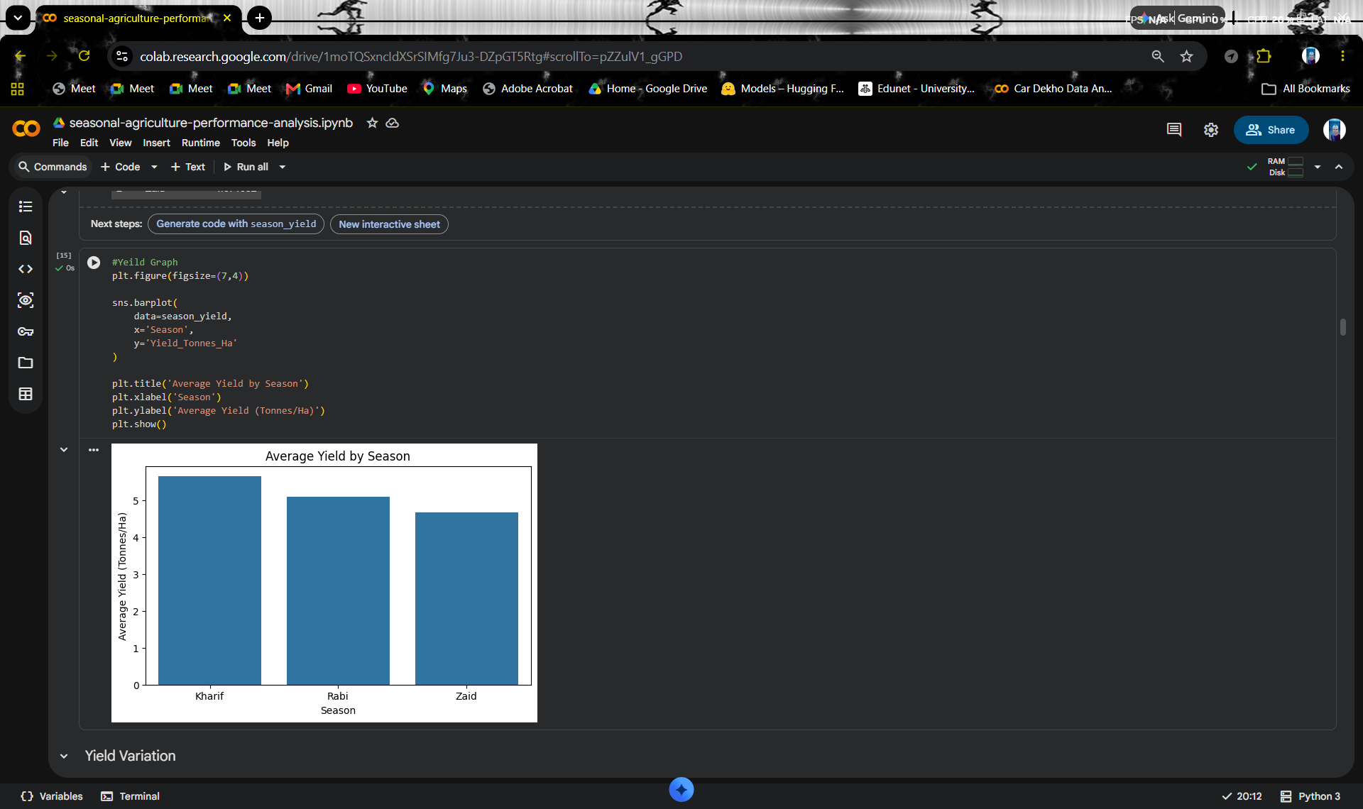
RESULTS

Slide 7
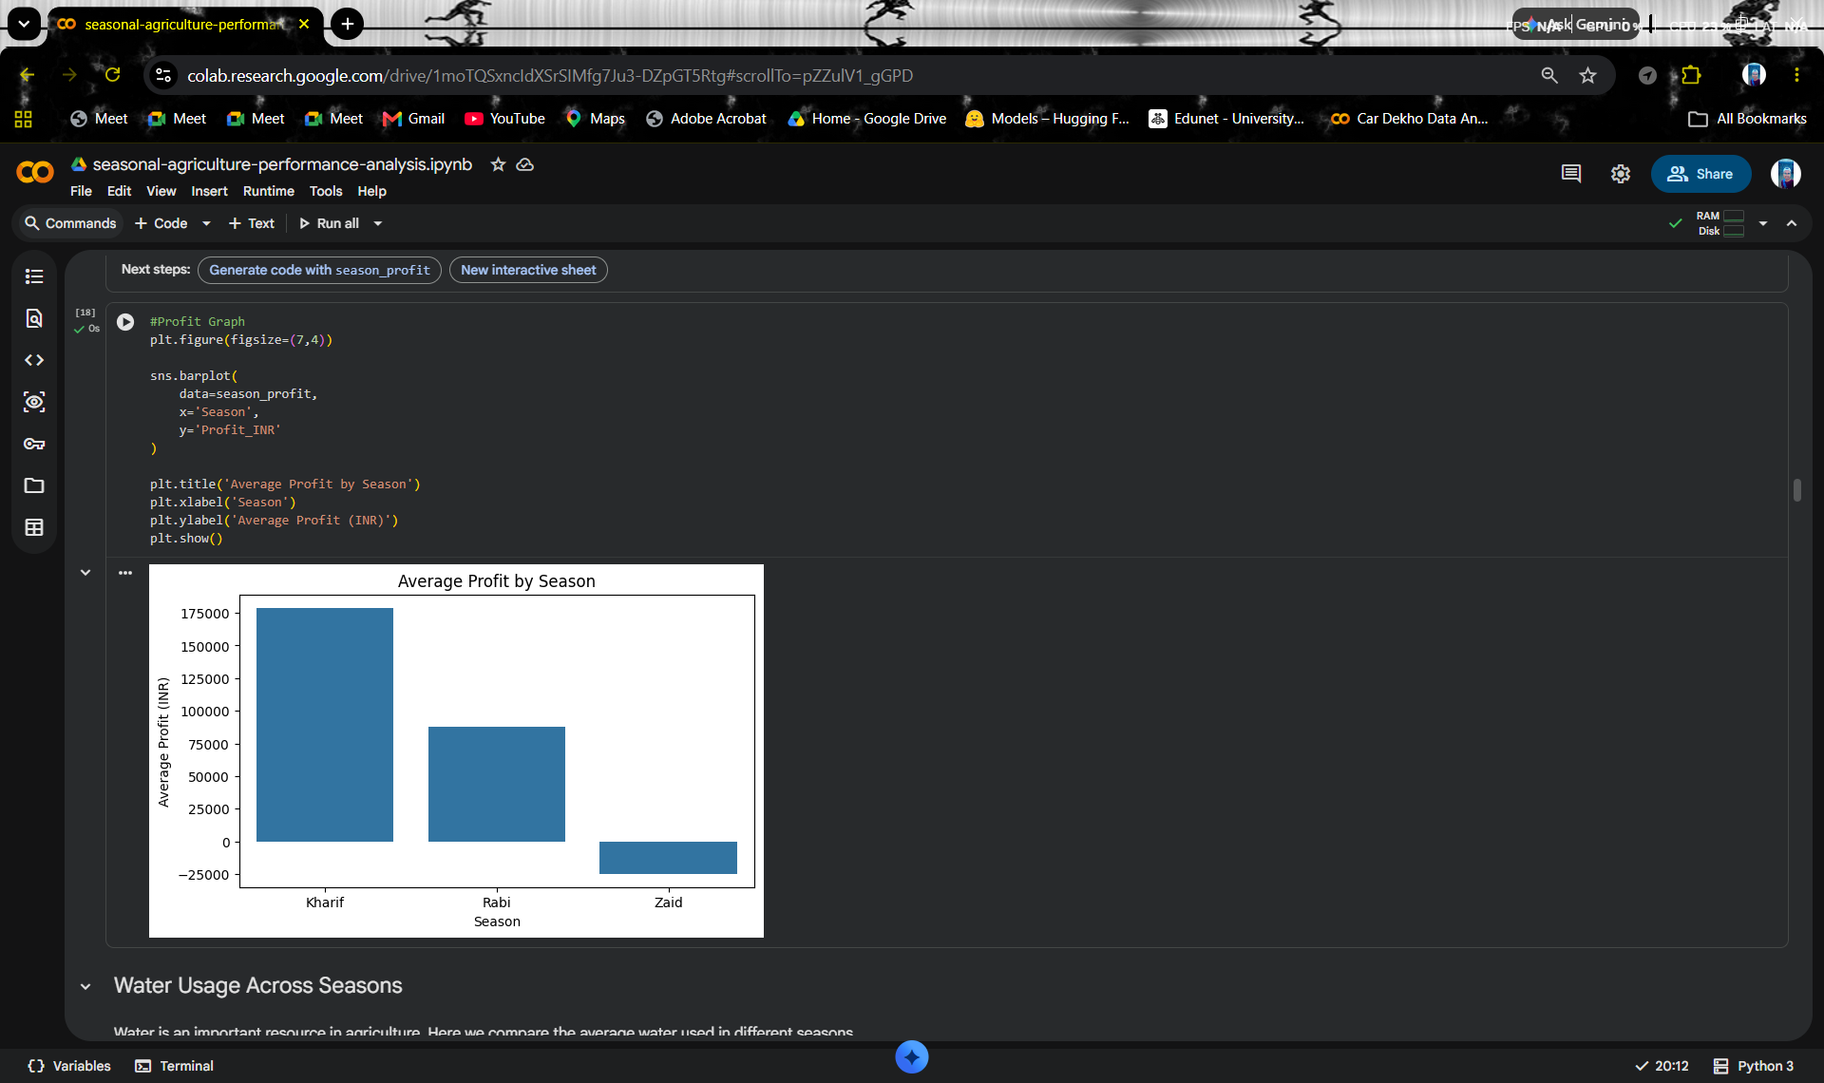
RESULTS

Slide 8
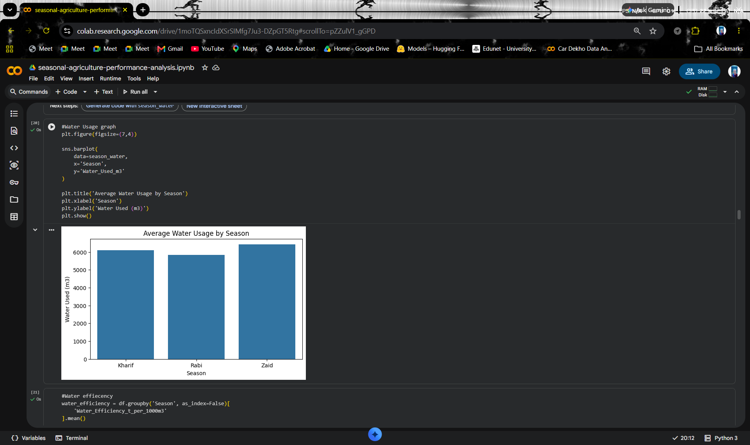
RESULTS

Slide 9
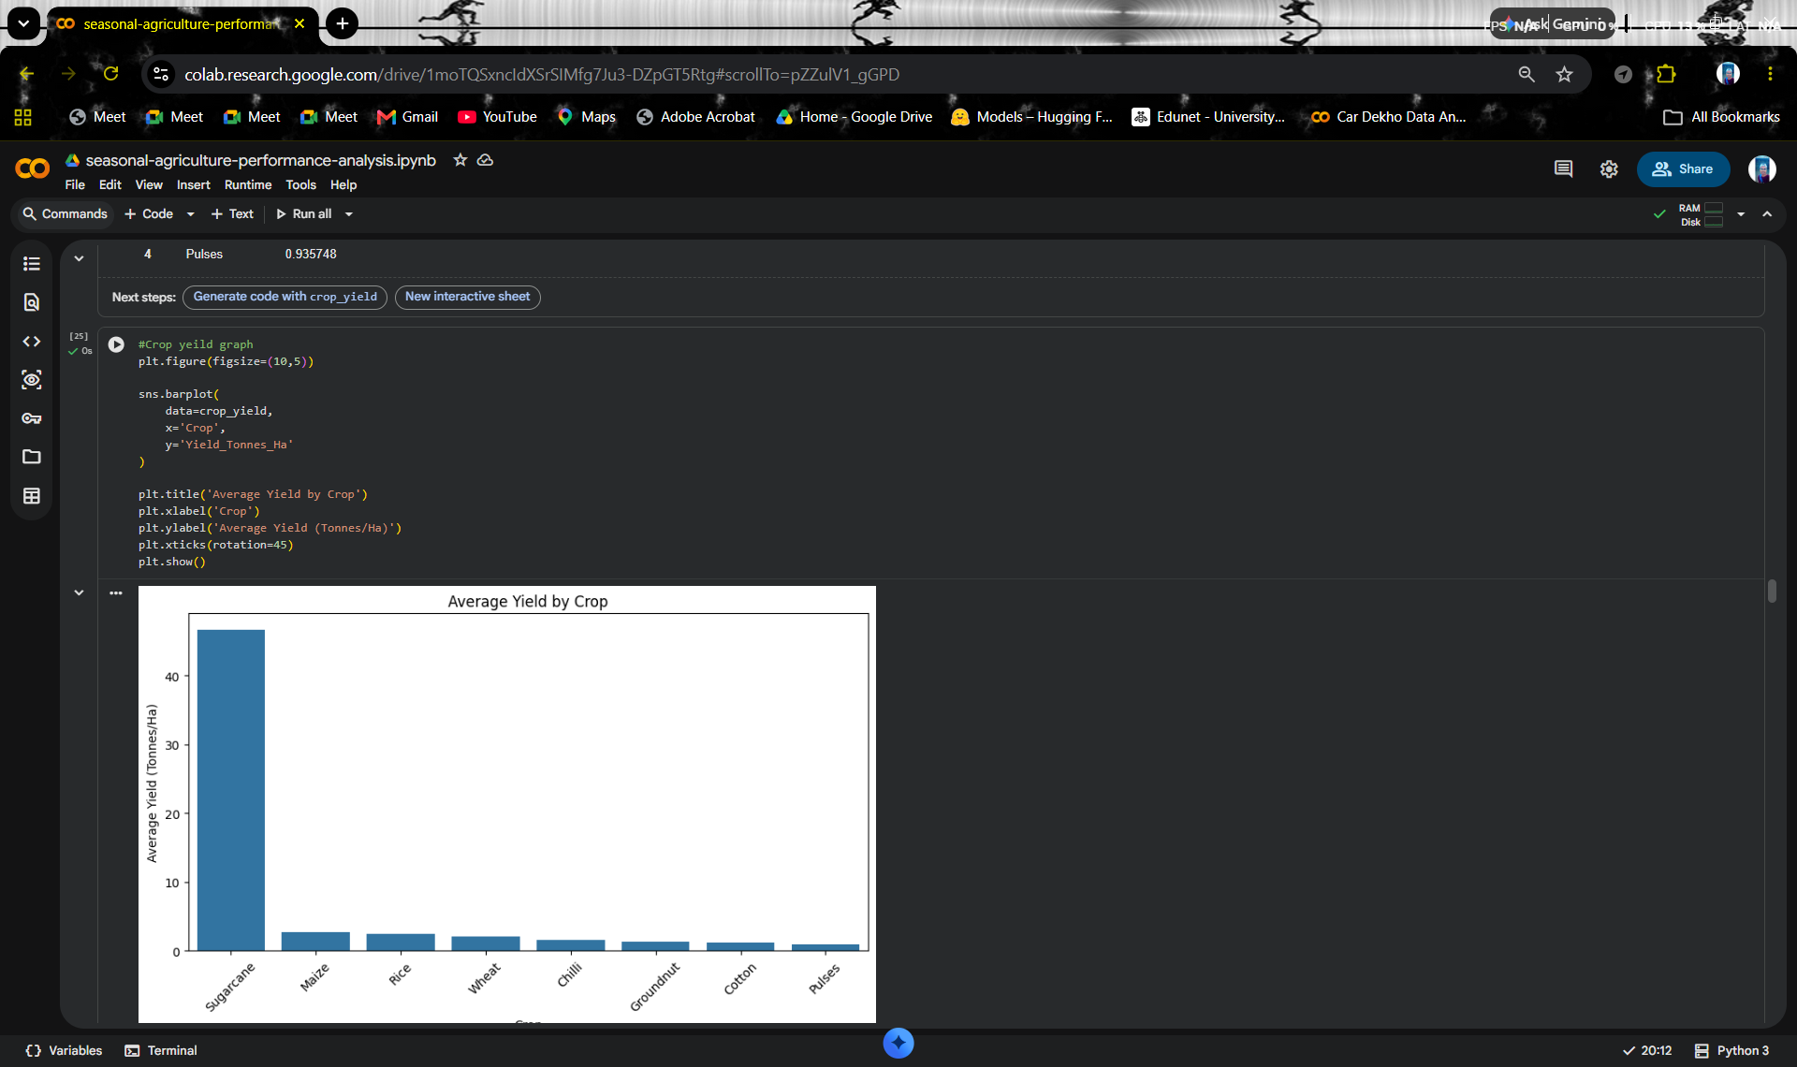
RESULTS

Slide 10
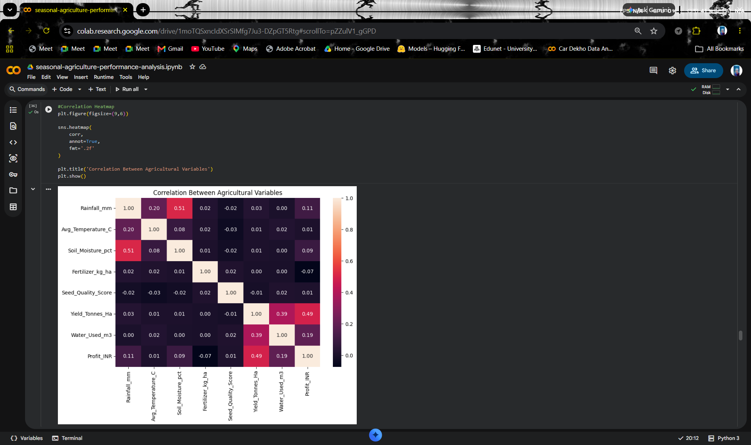
RESULTS

Slide 11
Future scope
In the future this project can be improved by using data from more years different regions and a wider variety of crops. Adding information about soil, rainfall, temperature and irrigation can help in understanding the factors that affect crop performance more clearly.
The analysis can also be extended by using machine learning techniques to predict crop yield and profit based on agricultural conditions. This can help in comparing crops and different seasons and can provide more useful insights for future farming decisions.
The project can further be developed into a dashboard where users can easily select a crop or a season and view its yield, profit and water usage. With updated and accurate data the project can become more useful for farmers for agricultural officers and, for researchers.

Slide 12
GitHub Link
https://github.com/prajwalkalbhor/seasonal-agriculture-performance-analysis.git

Slide 13

VOIS Course completion certificate -
Course name- Data Visualization

Slide 14
Thank you
.
.

