Slide 1
VIJAYA VITTALA INSTITUTE OF TECHNOLOGY
Mini Project on
Design of a Hardware
Error Detection and Correction
Engine for Reliable Computing
PROJECT PRESENTATION
Presented by
Prajwal I K
USN: 1VJ23EC039
Srushti D S
USN: 1VJ23EC051

Slide 2
Introduction
Why reliable hardware matters
Reliable Computing
Error Detection
Error Correction
Digital systems must continue to produce trustworthy results even when unwanted faults affect stored or processed data.
The hardware checks the data and generates an indication when an error condition is identified.
When supported by the architecture, the corrupted information is reconstructed and the corrected result is delivered.
• Our work focuses on implementing this process as an RTL hardware engine and evaluating its FPGA-oriented characteristics.
Design of a Hardware Error Detection and Correction Engine

Slide 3
Problem Statement
• Digital hardware may experience transient faults, bit flips, noise and other sources of incorrect data.
• An error that passes through a processing system can produce an incorrect final result.
• A practical solution should detect the fault quickly and, where possible, correct the affected information.
• The design must also remain suitable for hardware implementation with reasonable resource usage, timing and power.
Design of a Hardware Error Detection and Correction Engine

Slide 4
Objectives
Design
Verify
Develop an RTL hardware engine for error detection and correction.
Use a testbench to exercise normal and error conditions.
Analyze
Demonstrate
Check FPGA utilization, timing and power after synthesis/implementation.
Show that the engine responds correctly to the tested error conditions.
Design of a Hardware Error Detection and Correction Engine

Slide 5
Proposed System Architecture
Input Data
Detection Logic
Correction Logic
Corrected Output
• The input is checked for consistency. If an error is detected, the correction path is enabled; otherwise the valid data follows the normal path.
• The corrected output is then verified through simulation and FPGA design analysis.
Design of a Hardware Error Detection and Correction Engine

Slide 6
Methodology
Implementation flow followed in the project
1
RTL Design
Defined the hardware architecture and described the detection/correction logic in Verilog/SystemVerilog.
2
Testbench
Applied normal input patterns and introduced controlled error conditions.
3
Simulation
Checked the error flag and corrected output using waveform analysis.
4
Synthesis & Implementation
Mapped the RTL to FPGA resources and performed placement/routing with constraints.
5
Design Analysis
Reviewed utilization, timing and power reports to evaluate the implementation.
Design of a Hardware Error Detection and Correction Engine

Slide 7
Error Detection
Identifying an incorrect data condition
Input
Checking
Error Flag
The incoming data is presented to the detection stage.
The selected checking mechanism determines whether the data is consistent.
An error indication is generated when the check fails.
• This flag controls the next stage of the architecture and provides a clear indication that the data needs correction.
Design of a Hardware Error Detection and Correction Engine

Slide 8
Error Correction
Recovering the intended data
• When the error flag is asserted, the correction logic uses the available redundant or check information.
• The correction stage reconstructs the intended value for the supported fault condition.
• The corrected value is forwarded to the output, while valid data can bypass unnecessary correction.
• This creates a hardware path from fault detection to recovery rather than only reporting an error.
Design of a Hardware Error Detection and Correction Engine

Slide 9
Simulation & Verification
Functional validation before hardware analysis
Testbench
Waveform
Verification
Stimulus is applied to verify both normal and error conditions.
Input, error indication and corrected output are observed with respect to time.
The observed sequence is compared with the expected behaviour.
clk
data
error
output
Design of a Hardware Error Detection and Correction Engine

Slide 10
FPGA Implementation Flow
RTL Source
Synthesis
Constraints
Implementation
Timing / Power / Utilization
Bitstream
• After RTL verification, the design is synthesized into FPGA resources. Constraints guide clock and I/O requirements; implementation performs placement and routing. The resulting reports are then used to evaluate the design.
Design of a Hardware Error Detection and Correction Engine

Slide 11
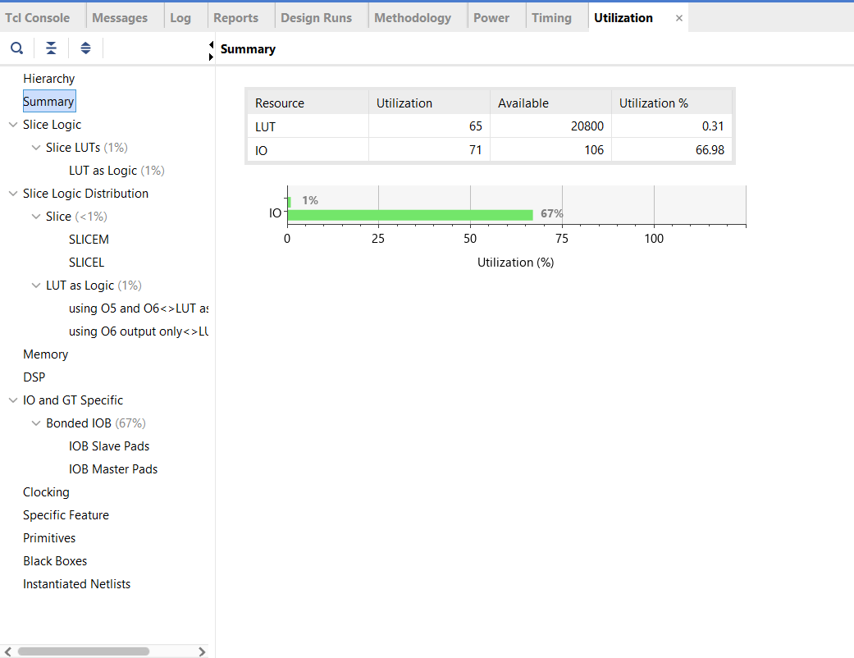
Utilization Analysis
RESOURCE UTILIZATION REPORT
Report output
Key observation
Design implication
LUT utilization is only 0.31%, using 65 LUTs out of 20,800 available.
I/O utilization is 66.98%, with 71 of 106 I/O resources used.
The design uses very little internal FPGA logic.
The low LUT usage indicates that the proposed error detection and correction engine has a compact hardware implementation.
The relatively high I/O usage is mainly due to the number of input and output signals connected to the design.
Design of a Hardware Error Detection and Correction Engine

Slide 12
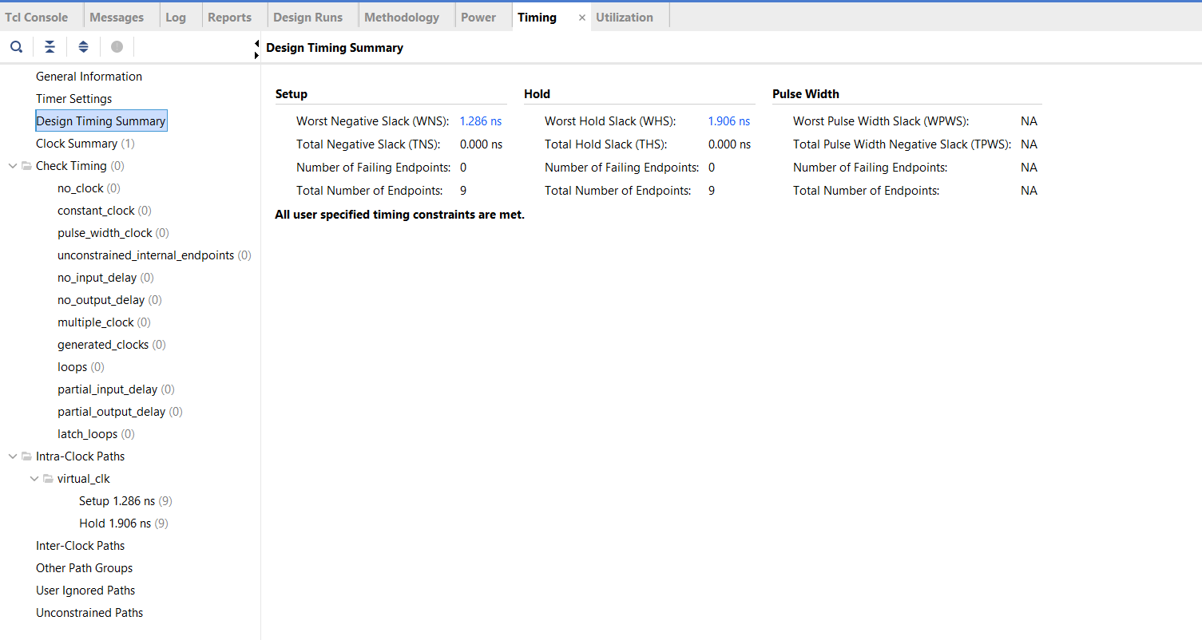
Timing Analysis
TIMING SUMMARY
Report output
Key observation
Design implication
Worst Negative Slack (WNS): 1.286 ns
Worst Hold Slack (WHS): 1.906 ns
Total Negative Slack (TNS): 0.000 ns
Total Hold Slack (THS): 0.000 ns
Failing Endpoints: 0
Since TNS and THS are 0 and there are no failing endpoints, the design satisfies the specified timing constraints.
The positive WNS and WHS indicate that the implemented design has timing margin and can operate reliably under the applied constraints.
Design of a Hardware Error Detection and Correction Engine

Slide 13
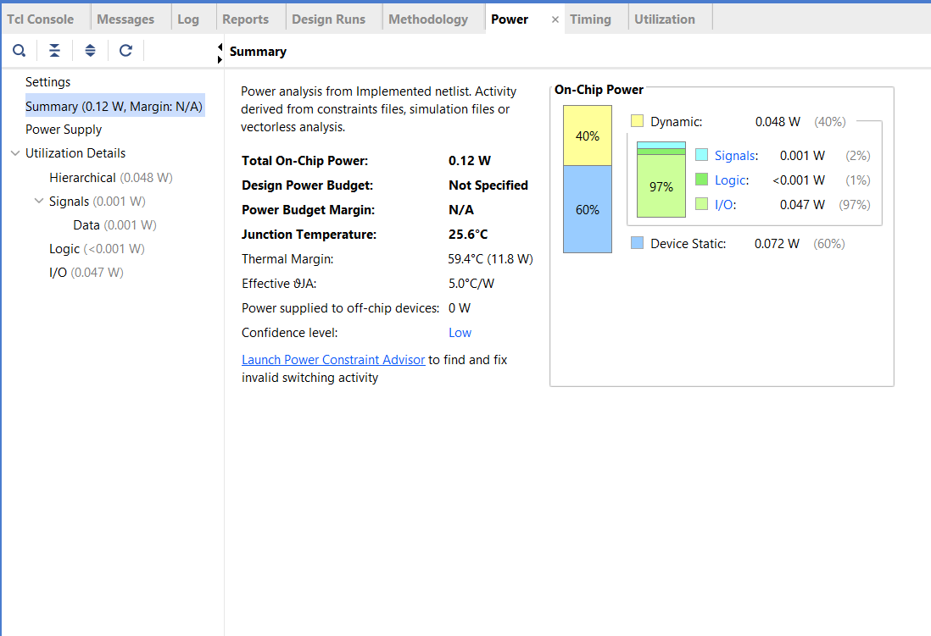
Power Analysis
POWER REPORT
Design implication
Report output
Key observation
The estimated 0.12 W total on-chip power indicates low overall power consumption for the implemented design.
Most of the dynamic power comes from I/O activity, while the internal logic contributes very little power. This suggests that further optimization should mainly focus on I/O activity and switching if lower power is required.
Total On-Chip Power: 0.12 W
Dynamic Power: 0.048 W (40%)
Device Static Power: 0.072 W (60%)
I/O Power: 0.047 W (97% of dynamic power)
Logic Power: <0.001 W
Signal Power: 0.001 W
Junction Temperature: 25.6°C
Design of a Hardware Error Detection and Correction Engine

Slide 14
Results & Discussion
• Simulation verifies the intended detection and correction behaviour for the tested cases.
• Utilization analysis shows how the RTL design maps onto FPGA resources.
• Timing analysis is used to confirm clock feasibility and identify the critical path.
• Power analysis provides the implementation-level estimate needed to discuss energy efficiency.
• The final discussion should quote the actual values from the Vivado reports generated for this design.
Design of a Hardware Error Detection and Correction Engine

Slide 15
Applications
Reliable Digital Systems
Communication Hardware
Systems where incorrect data can affect the final computation.
Data integrity checks in communication and processing paths.
Embedded Systems
FPGA Prototyping
Fault-aware control and monitoring applications.
Evaluation of reliability mechanisms before a dedicated-chip implementation.
Design of a Hardware Error Detection and Correction Engine

Slide 16
Conclusion
• The project demonstrates a hardware-based approach to improving computing reliability through error detection and correction.
• The RTL design was verified through simulation and taken through the FPGA-oriented synthesis and implementation flow.
• Utilization, timing and power analysis provide quantitative evidence for evaluating the implemented hardware.
• The architecture can be extended to support more complex fault models and higher levels of reliability.
Design of a Hardware Error Detection and Correction Engine

Slide 17
Future Scope
• Extend the design to support multiple-bit and more complex fault conditions.
• Optimize the architecture for lower area, timing and power.
• Improve correction capability and throughput for larger data paths.
• Evaluate the design across different FPGA families and operating frequencies.
• Explore integration with processors, memories and safety-critical computing systems.
Design of a Hardware Error Detection and Correction Engine

Slide 18
References
• AMD/Xilinx Vivado Design Suite documentation for synthesis, implementation, timing and power analysis.
• IEEE literature on hardware fault tolerance, error detection and error correction in digital systems.
• Verilog/SystemVerilog references for RTL modelling and functional verification.
• FPGA-based digital design and verification laboratory resources.
Design of a Hardware Error Detection and Correction Engine

Slide 19
Thank You

