Slide 1
Churn Prediction

Slide 2
Data Preprocessing
The Dataset is spread across multiple sheets.
Demographic Data
Account complaints ( Call Centre data)
Payment's data
Defaults data
Use patterns
Grouping similar account and adding corresponding values.
Merging all the data to a single data frame with account number as the metric.
Analyzing categorical features and numerical features to the target variable.

Slide 3
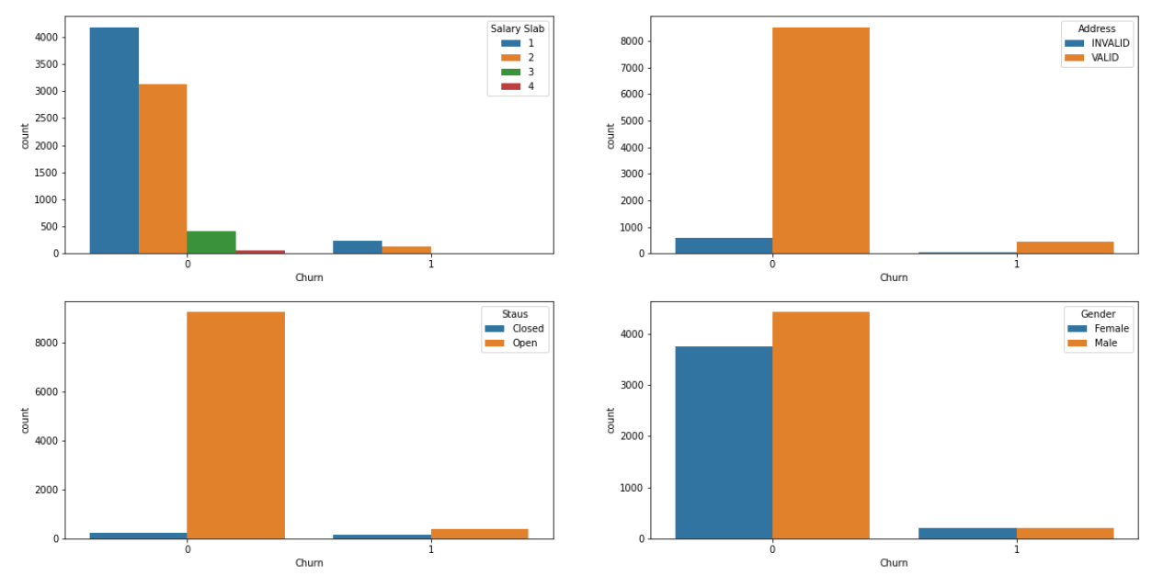
Data analysis
Salary slab with 1 and 2 have the most churn possibility.

Slide 4
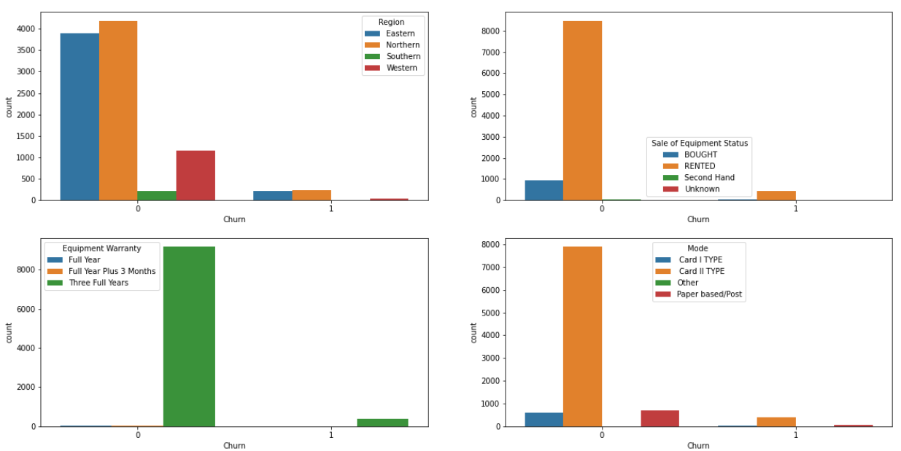
Data analysis
Rented Customers churn.
Equipment Warranty with three years churn.

Slide 5
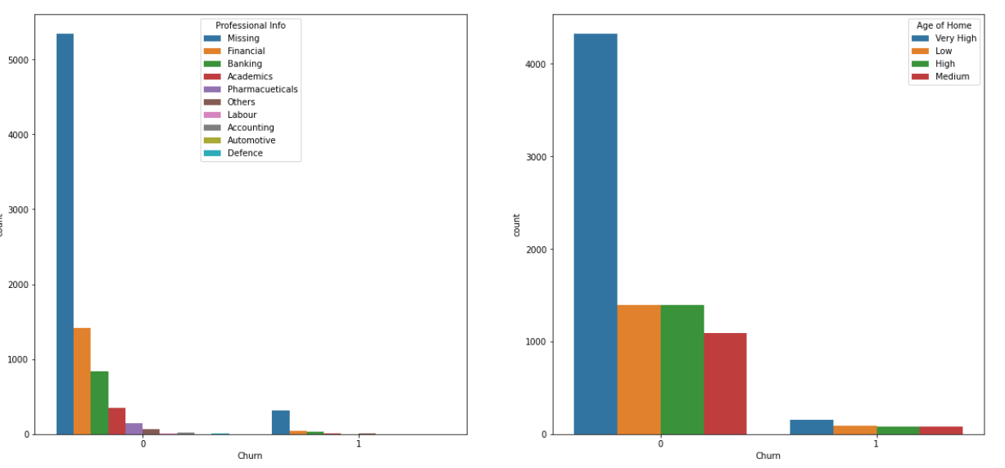
Data analysis
Low age of home needs concern.

Slide 6
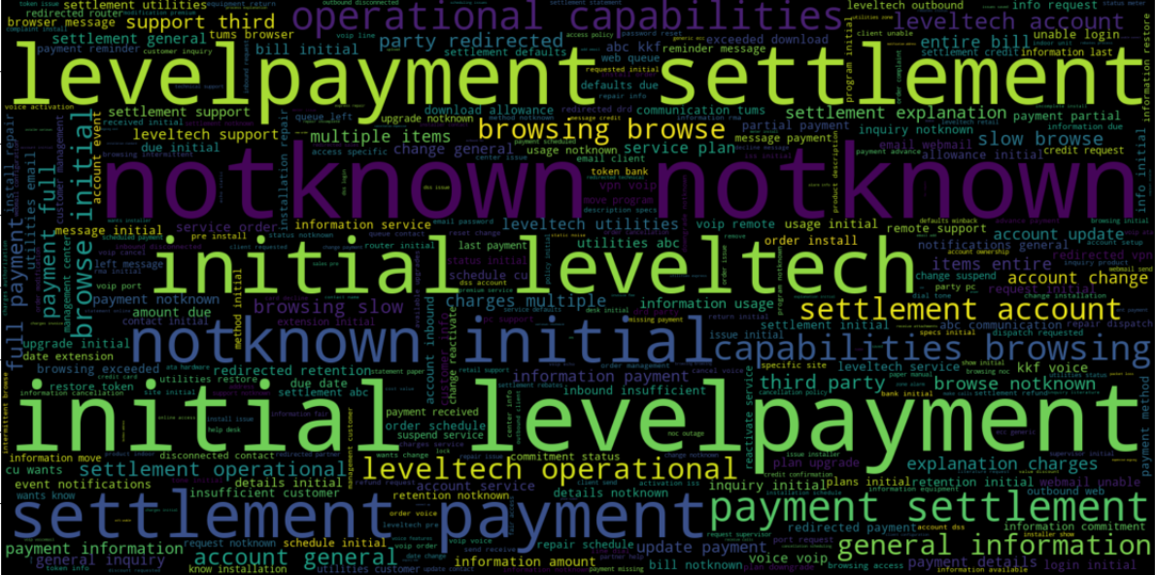
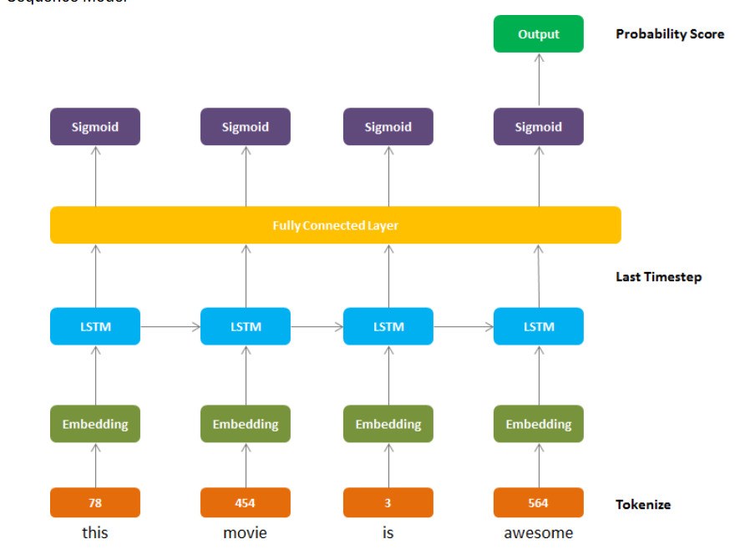
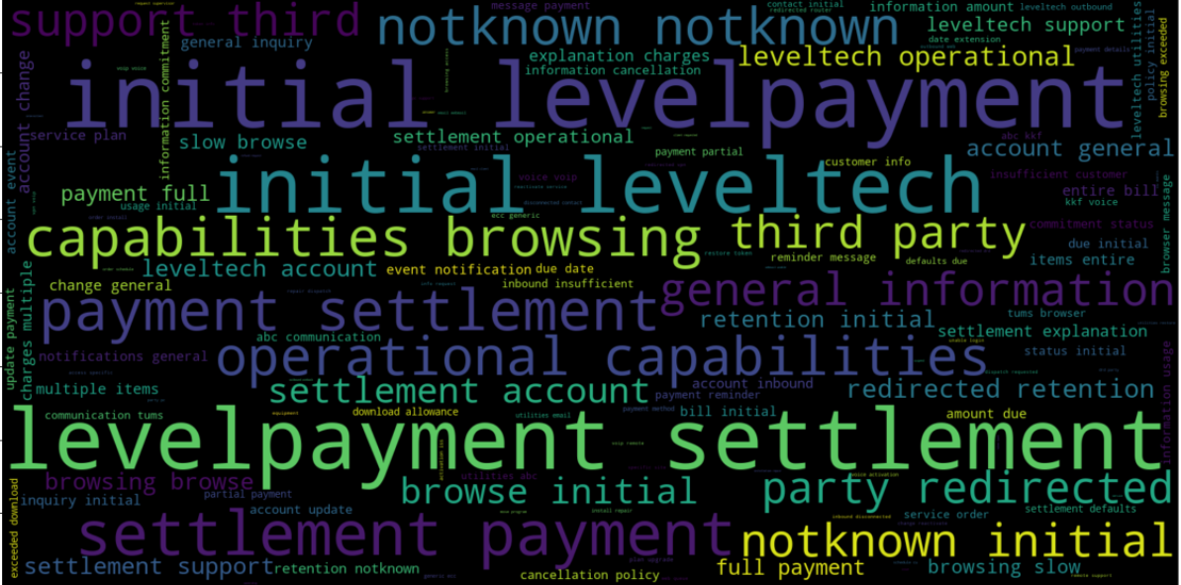
text Preprocessing
Cleaning the text by removing symbols, characters.
Performing Stemming / Lemmatization.
Performing Tokenization
Plotting Positive words and Negative words.
Performing Word Embedding using Glove.

Slide 7
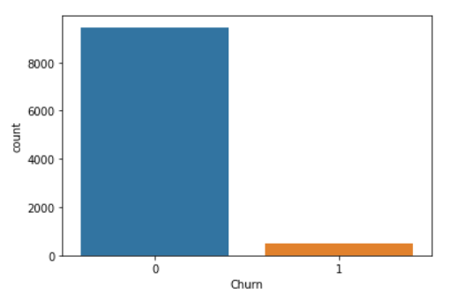
Handling class imbalance
Using class weights while training neural network to balance out the imbalance.
Using imblearn from sklearn to under sample and oversample the dataset.
RandomUnderSampler ( with majority)
RandomOverSampler ( with majority)

Slide 8
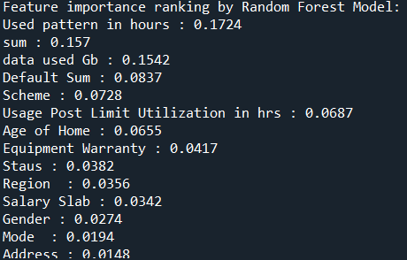
feature importance using random forest
Used Random Forest to extract important features making sense to the prediction.
The following figure shows the feature ranking.

Slide 9
Modelling choices
The use case is solved using following models:
Multi-Modal Neural Network
Random Forest Classifier
K-means and Random Forest
Thresholding by checking accuracy for each threshold value returned from ROC curve.
Choosing the best threshold based on accuracy.

Slide 10
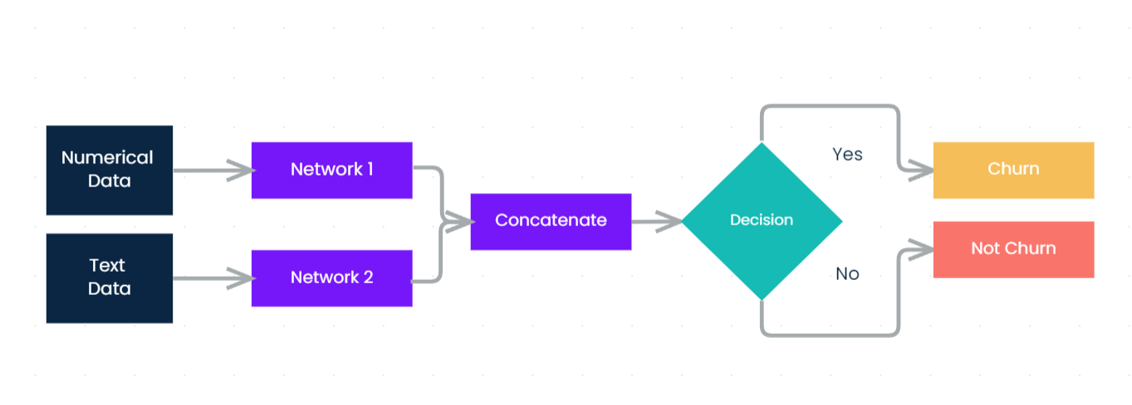
Multi-Modal Architecture
Using two networks to extract features and classify as shown below.
Network 1 is an ANN with 3 Dense layers.
Network 2 is an Bi-Directional LSTM

Slide 11
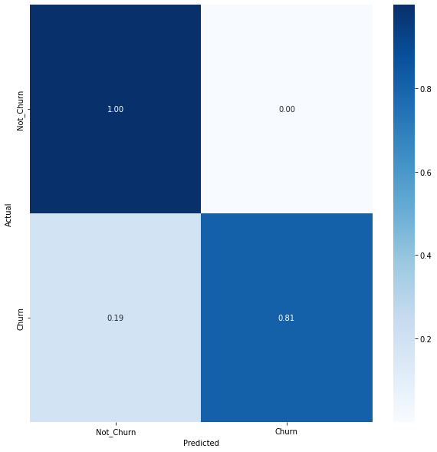
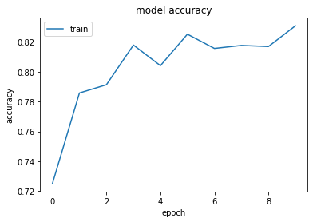
Multi-Modal Performance
Following figures shows the performance of the model.
The performance of the model on the test dataset is of following metrics:
Accuracy – 0.92 (Train)
F1 score – 0.80

Slide 12
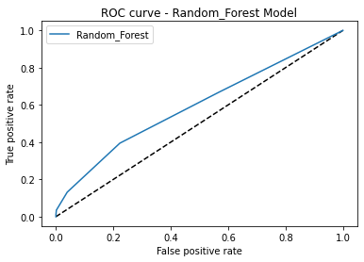
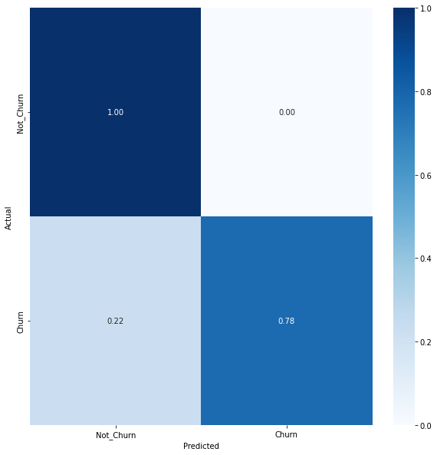
Random Forest Classifier
The performance of the model on the test dataset is of following metrics:
Accuracy – 0.94
F1 score – 0.91

Slide 13
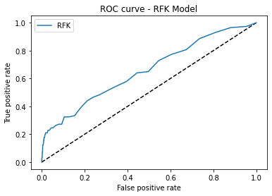
Random forest + knn
Feature importance computed from RandomForest.
K-means clustering to find the cluster centroids which features samples are similar.
This prediction is used as new feature.
The performance of the model on the test dataset is of following metrics:
Accuracy – 0.94
F1 score – 0.94

Slide 14
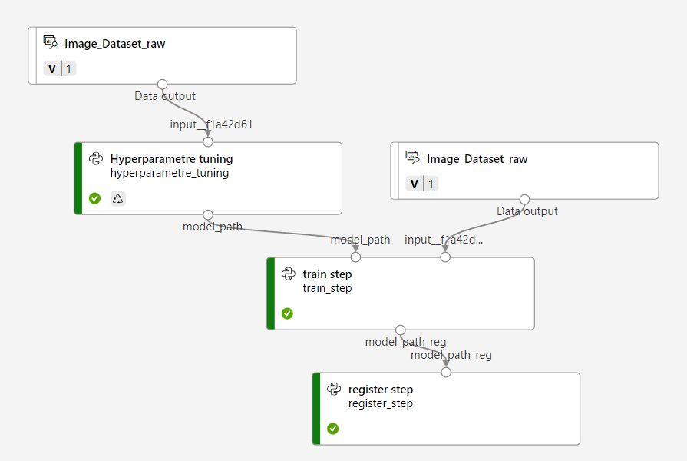
Mlops
Azure MLOps pipeline for automation of the process.
CI CD model deployment.

Slide 15
Model evaluation
Test the model on the validation set.
Analyze which parameters are affecting the churn of customers.
Target those customers and avoid possible churn.

Slide 16
Business task
The model predicts the churn for the dataset.
Target the customers belonging to salary slab 1 and 2.
Discounts for customers in the field of post data utilization.
Discount for defaults sum.
Increasing the discounts for equipment warranty.

