Slide 1

Seasonal Agriculture Performance Analysis
Name: Prajwal N P
College: Presidency University
Course: BTech CSE 2nd Year
STU ID: STU6a1d9f35236261780326197
Internship ID:
INTERNSHIP_17830691666a4779eecfe8a

Slide 2

PROBLEM STATEMENT
Agricultural performance can change from season to season due to differences in weather, soil conditions, irrigation, farming practices and resource availability. These changes can affect crop yield, production, profit and water usage. The project analyzes the agricultural dataset to compare seasons, crops and farming conditions, and identify useful patterns and relationships related to agricultural performance and efficient use of resources.

Slide 3
Project Description
Main Focus
This project studies seasonal agricultural performance using farm-level data covering locations, crops, environmental conditions, farming practices, production, costs, revenue, profit and resource usage. Python, Pandas, NumPy, Matplotlib and Seaborn are used for data cleaning, statistical analysis and visualization.
• Compare yield, production and profit across seasons.
• Study crop and irrigation performance.
• Examine environmental conditions, resource usage and efficiency.
• Identify patterns, differences and unusual values.

Slide 4

WHO ARE THE END USERS?
• Agricultural data analysts and researchers – to study seasonal patterns.
• Farm and resource planners – to compare yield, water usage and economic performance.
• Agriculture-related decision makers – to support evidence-based planning.
• Students and mentors – as an example of a complete data analytics workflow.

Slide 5

Technology Used
Programming
Libraries
Analytical Methods
• Python – analysis and workflow
• Google Colab / Jupyter Notebook – execution
• Pandas – data handling
• NumPy – numerical operations
• Matplotlib – plotting
• Seaborn – statistical visualization
• Data quality checks, descriptive statistics, univariate/bivariate/multivariate analysis, outlier analysis and seasonal comparison.

Slide 6
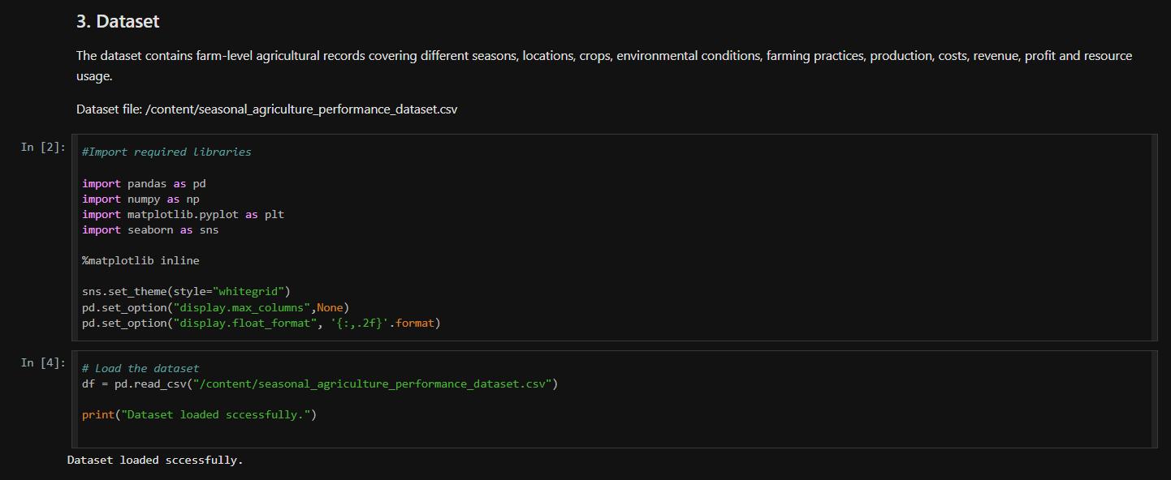
RESULTS

Slide 7
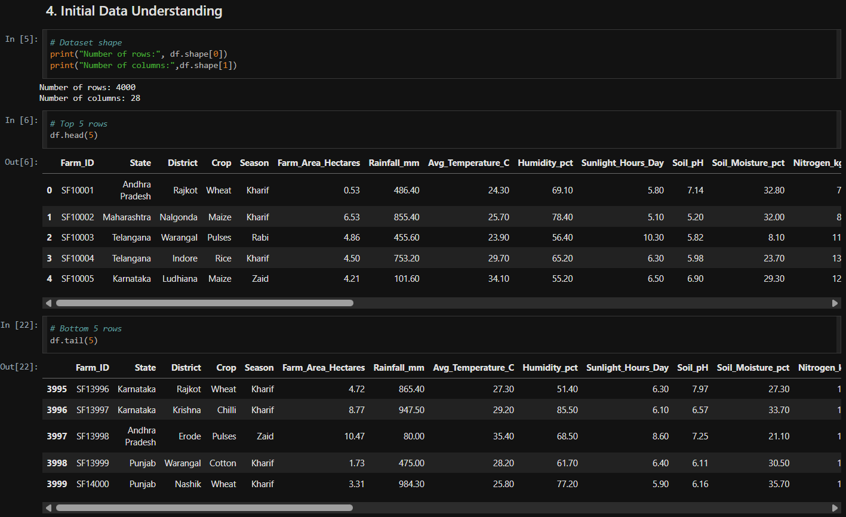
RESULTS

Slide 8
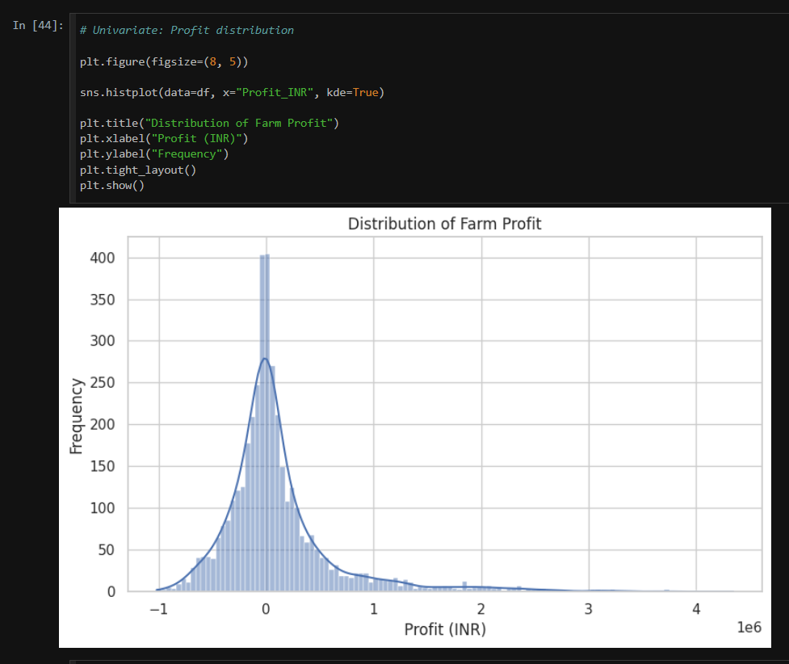
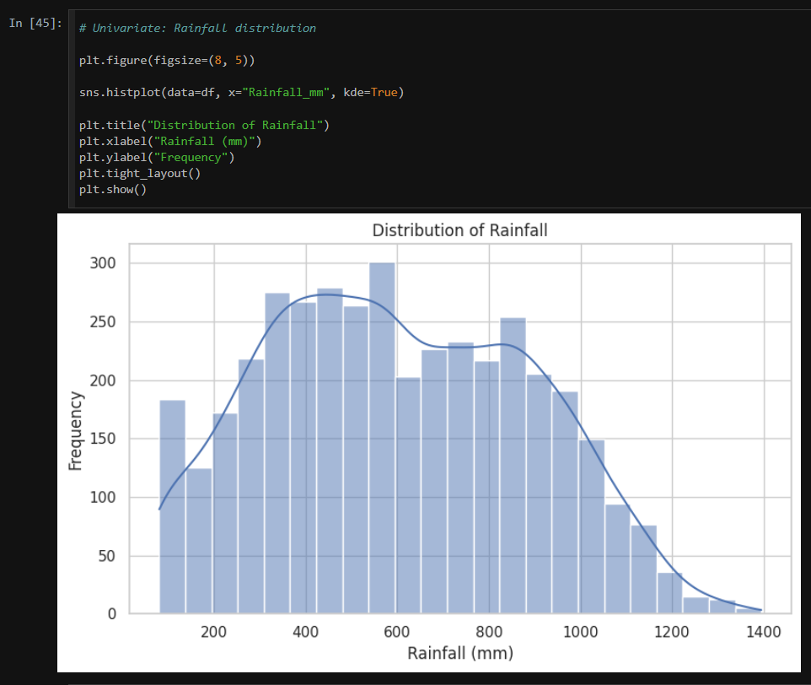
RESULTS

Slide 9
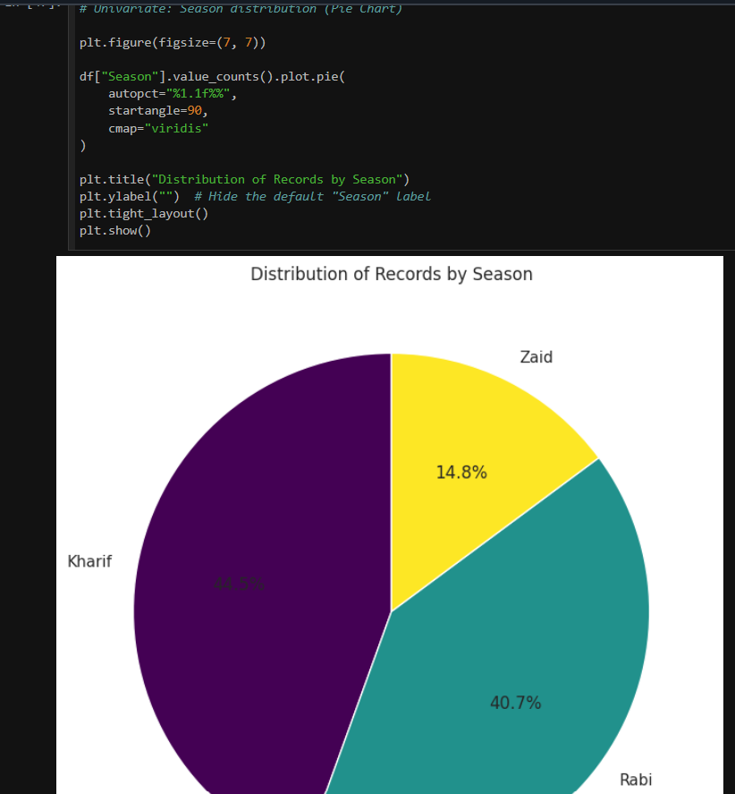
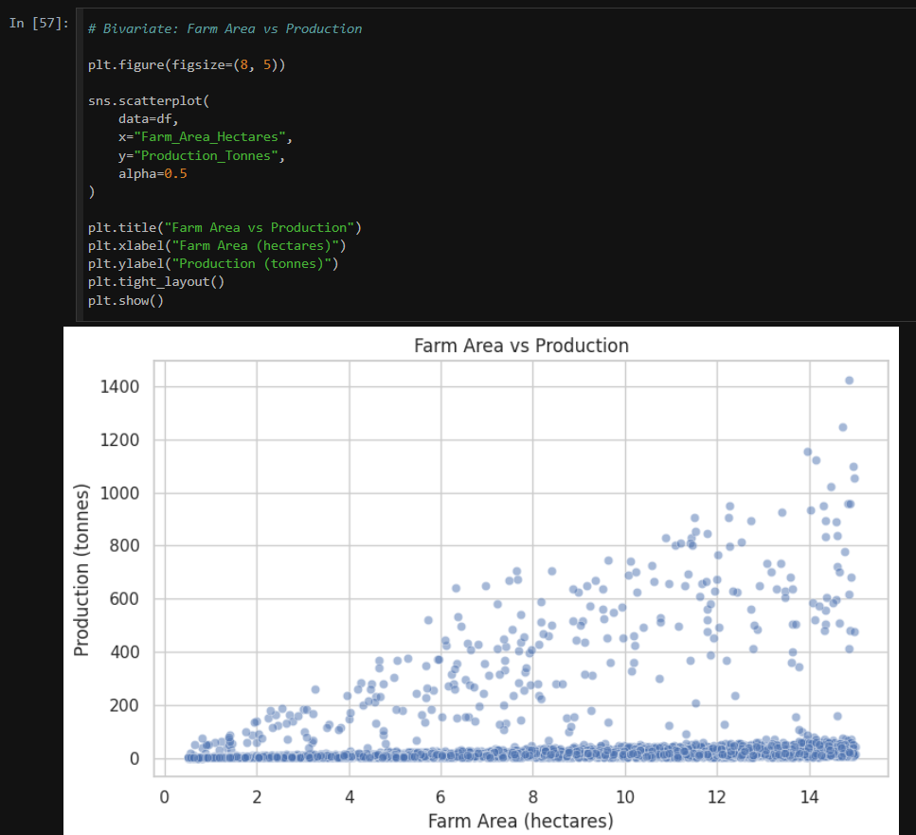
RESULTS

Slide 10
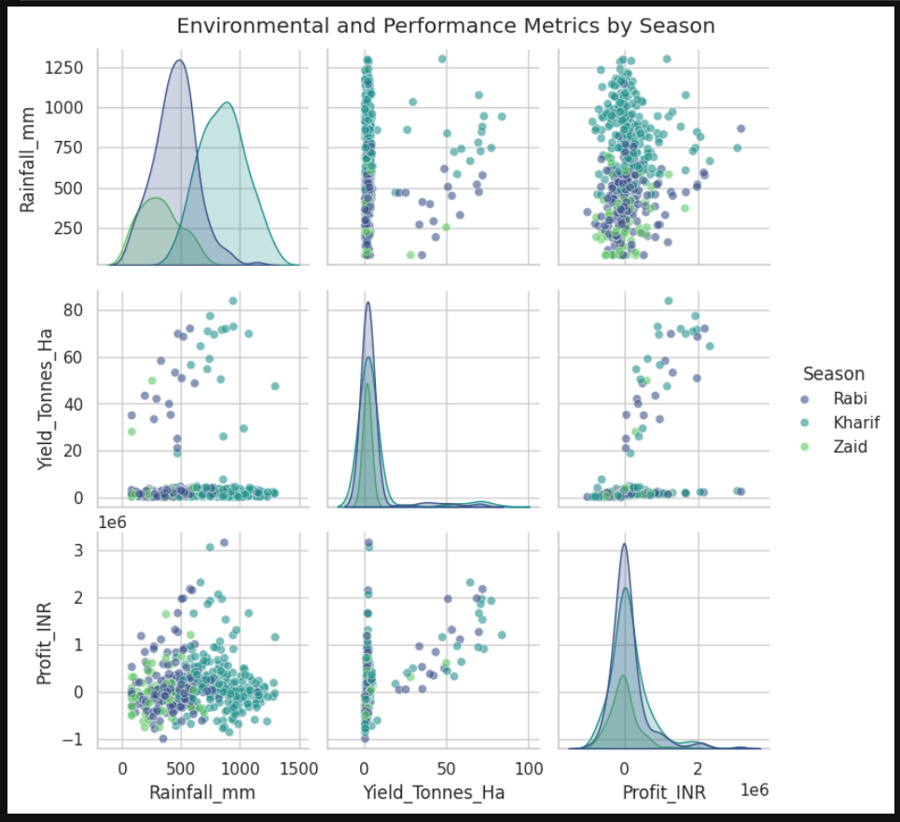
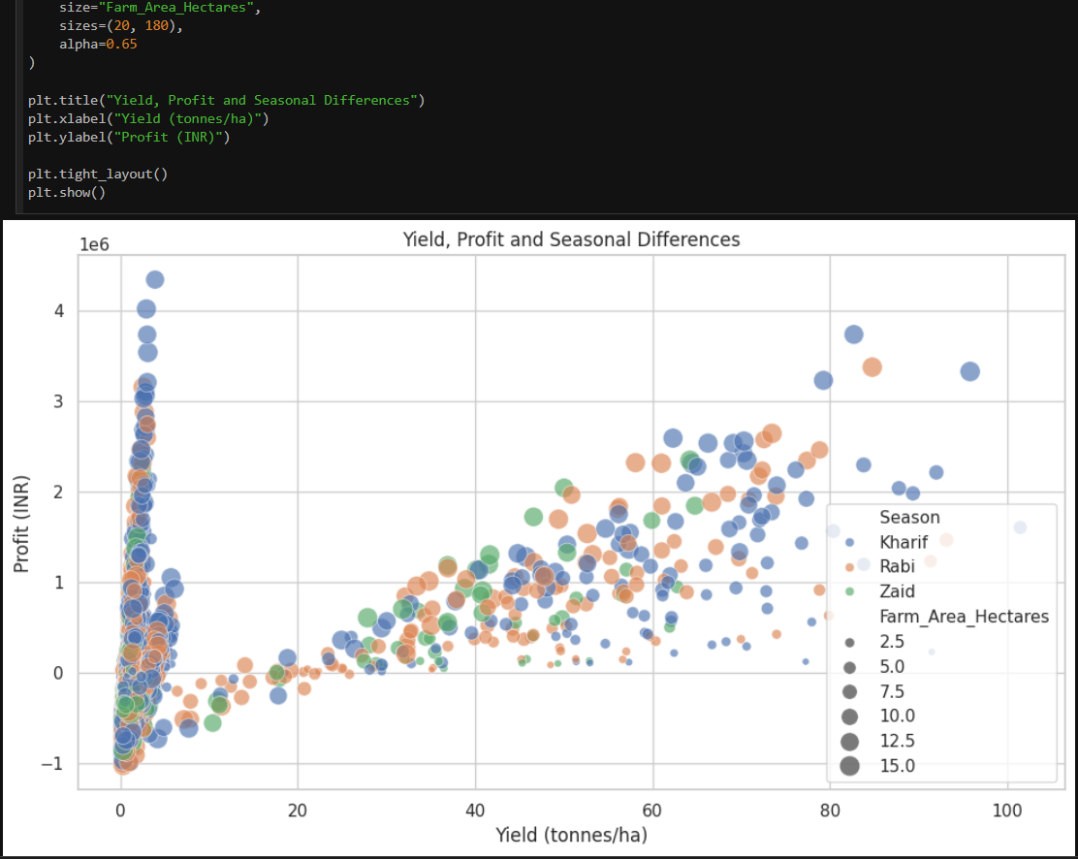
RESULTS

Slide 11
RESULTS
• Seasonal performance differs in yield, production, profit and water usage.
• Crop-season combinations show different performance levels.
• Rainfall is associated with differences in yield, but the analysis does not establish causation.
• Farm area is positively related to total production, but not necessarily to yield per hectare.
• Irrigation methods show differences in average yield and water efficiency.
• Environmental and farming variables show substantial variation across the dataset.
• Findings should be interpreted as associations and considered alongside other factors.

Slide 12
Future scope
• Add multi-year and more detailed regional data to study long-term seasonal trends.
• Combine external weather and soil datasets for deeper environmental analysis.
• Investigate crop-season combinations at a finer regional level.
• Extend the analysis with advanced statistical or predictive methods as a separate future study.
• Develop an interactive dashboard later if a decision-support interface is required.
• Validate the observed relationships using additional real-world agricultural data.

Slide 13
GitHub Link
Seasonal Agriculture Performance Analysis – Project Repository
https://github.com/prajwalnandalike/Seasonal-Agriculture-Performance-Analysis

Slide 14
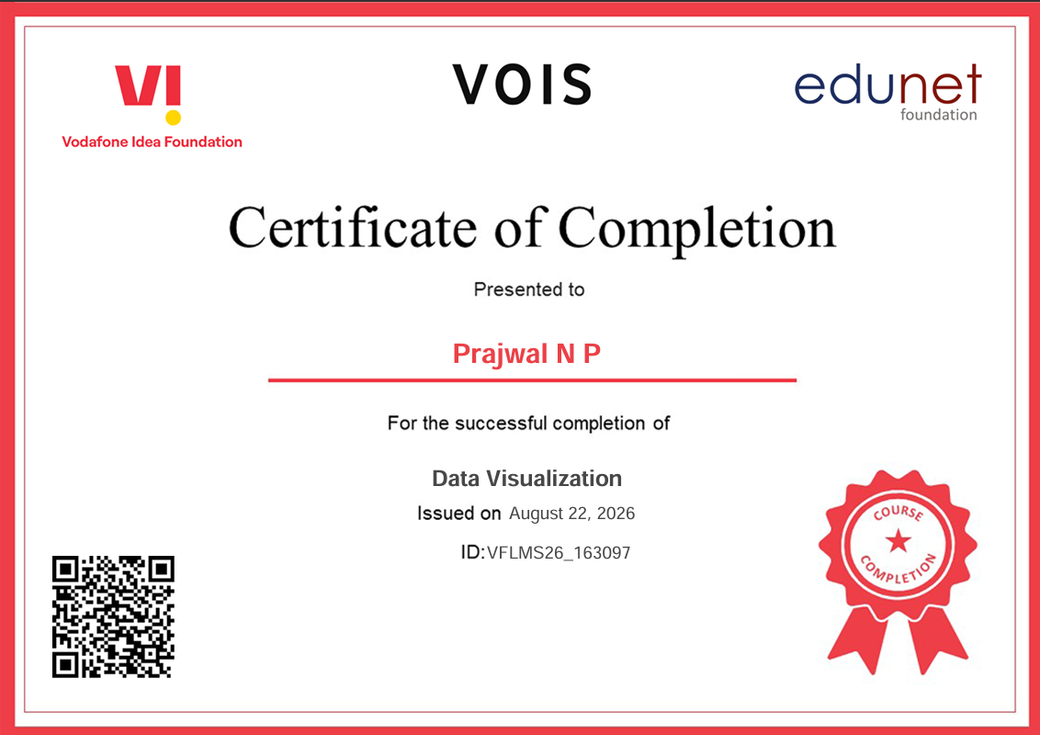
VOIS Course completion certificate - Course name- Data Visualization

Slide 15
Thank you
Name: Prajwal N P
College: Presidency University
STU ID: STU6a1d9f35236261780326197
Internship ID: INTERNSHIP_17830691666a4779eecfe8a
.
.

