Slide 1
SQL Injection Using MYSQL Database Queries
By - Prajwal Nimkarde

Slide 2
Content
1. Introduction to SQL Injection
2. Types of SQL Injection Attacks
4. Preventing SQL Injection Attacks
5. Database Structure and Setup
6. Example Queries for SQL Injection Testing
7. Execution and Results
8. Conclusion

Slide 3
Introduction to SQL Injection
SQL Injection (SQLi) is one of the most common forms of cyberattacks that exploit vulnerabilities in web applications. An attacker can execute arbitrary SQL code by inserting it into an application's query fields, such as forms, URL parameters, cookies, or HTTP headers. The success of an SQL Injection attack stems from improper validation of user inputs, enabling attackers to interact with the database and potentially access, manipulate, or delete sensitive information.
SQLi attacks have been around for over two decades, but they remain a severe threat to web applications. This attack method exploits the fact that databases are a central component of most web applications, making them an attractive target for malicious actors. An SQLi can lead to the following types of attacks:
• Unauthorized access to protected data.
• Database modification, including adding, updating, or deleting records.
• Execution of administrative operations on the database.
• Denial of service or complete system compromise.

Slide 4
Types of SQL Injection Attacks
1. Classic or In-Band SQL Injection: Classic SQL Injection involves injecting SQL code directly into a web application’s input fields (e.g., login forms). This is one of the easiest types of attacks to detect since it exploits the same communication channel used to submit the malicious code. Attackers can directly interact with the database, retrieve data, or make modifications.
Example: SELECT * FROM users WHERE username = 'admin' -- ' AND password = 'password';
2. Blind SQL Injection: In this type of attack, the attacker sends SQL queries to the database but does not directly receive data in response. Instead, they infer information based on the behavior of the application (e.g., timing, error messages, or Boolean outcomes). Blind SQL Injection is harder to detect since it doesn't return data immediately, but it can still compromise sensitive information over time.
Example:
SELECT * FROM users WHERE id = 1 AND 1=1;
SELECT * FROM users WHERE id = 1 AND 1=2;
3. Time-Based SQL Injection: Time-based SQL Injection relies on the delay in the database's response to specific queries. An attacker sends SQL code that intentionally delays the database's response if a condition is true. This type of attack is often used when other techniques do not work due to limited feedback from the application.
Example:
SELECT * FROM users WHERE IF (username='admin', SLEEP (5), 0);

Slide 5
4. Out-of-Band SQL Injection: Out-of-band SQL Injection sends data via an external channel, such as HTTP or DNS. This type of attack is less common but can be very effective when the database has restricted responses or the attacker needs a separate channel to exfiltrate data.
Example:
The attacker may use a DNS-based approach to send sensitive data to a remote server.

Slide 6
Preventing SQL Injection Attacks
1. Use Prepared Statements: Prepared statements ensure that SQL code and data are
separated. The SQL query is defined first, and then user inputs are passed
separately, preventing direct manipulation of the SQL query.
Example: SELECT * FROM users WHERE username = ? AND password = ?;
2. Parameterized Queries: Parameterized queries work similarly to prepared
statements and prevent SQL Injection by ensuring user input is treated strictly as
data and not executable code.
3. Input Validation and Sanitization: Input validation ensures that only valid data is
accepted from users. Implement strict validation rules for input fields, such as using
regex patterns to filter out potentially dangerous characters like ';--.
4. Use ORMs (Object-Relational Mappers): Using ORM frameworks such as Hibernate
or SQLAlchemy can abstract away manual SQL query building, thereby reducing the
likelihood of SQL Injection.
5. Escaping Special Characters: If you're unable to use prepared statements, you must
escape special characters (e.g., quotes and semicolons) in the user input to prevent
them from altering the SQL query.
6. Database Privilege Management: Ensure that database accounts used by your
application have the least privileges necessary. Avoid giving the web application's
database user excessive permissions, such as full administrative access.

Slide 7
Database Structure and Setup
Database 1: User_Authentication
Tables used in this databases
1. users
2. use_roles
3. login_attempts
4. user_sessions
5. password_resets
Tables:
1. users (id, username, password, email)
2. user_roles (id, role_name, description)
3. login_attempts (id, username, attempt_date, success)
4. user_sessions (id, user_id, session_start, session_end)
5. password_resets (id, user_id, reset_date, reset_token)

Slide 8
Example Queries for SQL Injection Testing
1. Simple SQL Injection:
In a vulnerable application, attackers could manipulate input fields to alter the SQL query. For example, consider the following login query:
SELECT * FROM users WHERE username = '$username' AND password = '$password';
SELECT * FROM users WHERE username = 'admin' -- ' AND password = ‘';
This query effectively bypasses the password check by commenting out the rest of the SQL code. As a result, the attacker is logged in as the admin user without knowing the actual password.
2. Union-based SQL Injection:
Union-based SQL Injection is another attack method where an attacker can retrieve data from other tables by combining multiple SQL queries using the UNION operator.
Example:
SELECT username, password FROM users WHERE username = 'admin' UNION SELECT database(), version();
This query retrieves not only the username and password of the admin user but also information about the current database and MySQL version.

Slide 9
Example Queries for SQL Injection Testing
3. Error-Based SQL Injection:
Attackers can exploit SQL errors to gain information about the database structure. For instance, they might intentionally input incorrect queries to trigger an error message that reveals useful data.
Example:
SELECT * FROM users WHERE id = 1' AND 1=2;
By submitting this malformed query, the attacker can observe the database's response, which may leak internal information such as table names or field structures.
4. Blind SQL Injection:
In cases where the database does not return visible errors or data, attackers may rely on Blind SQL Injection techniques. This involves sending queries that change the application's behavior without displaying results.
Example:
SELECT * FROM users WHERE username = 'admin' AND IF(1=1, SLEEP(5), 0);

Slide 10
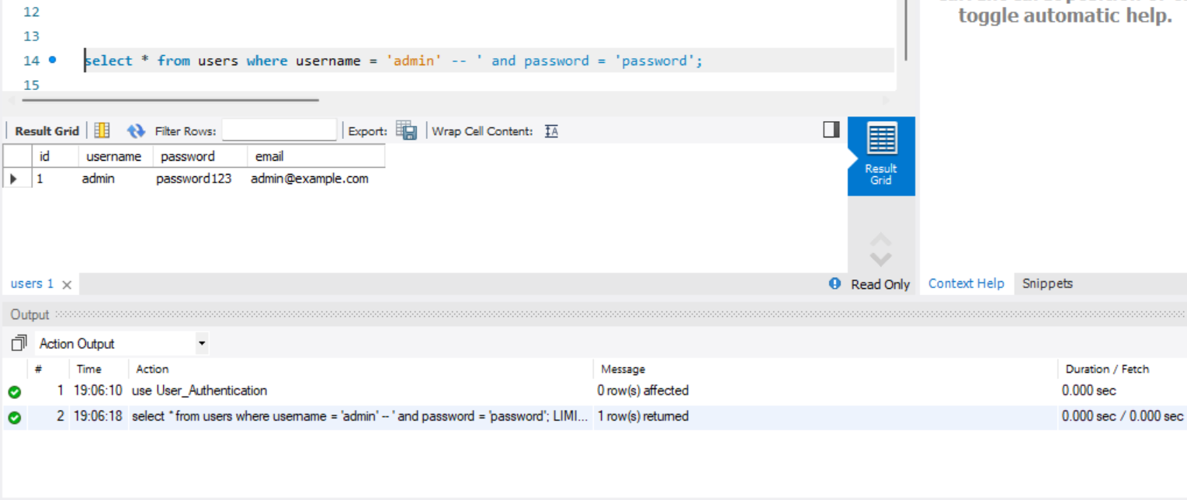
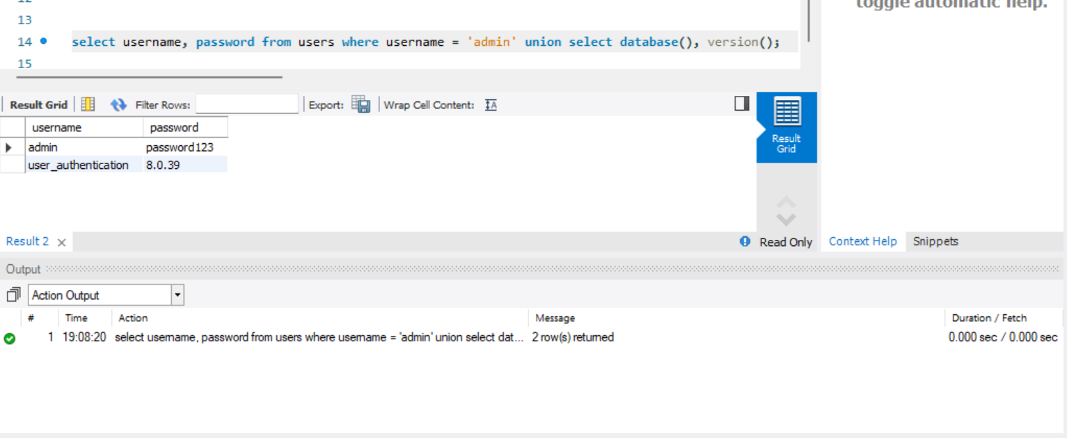
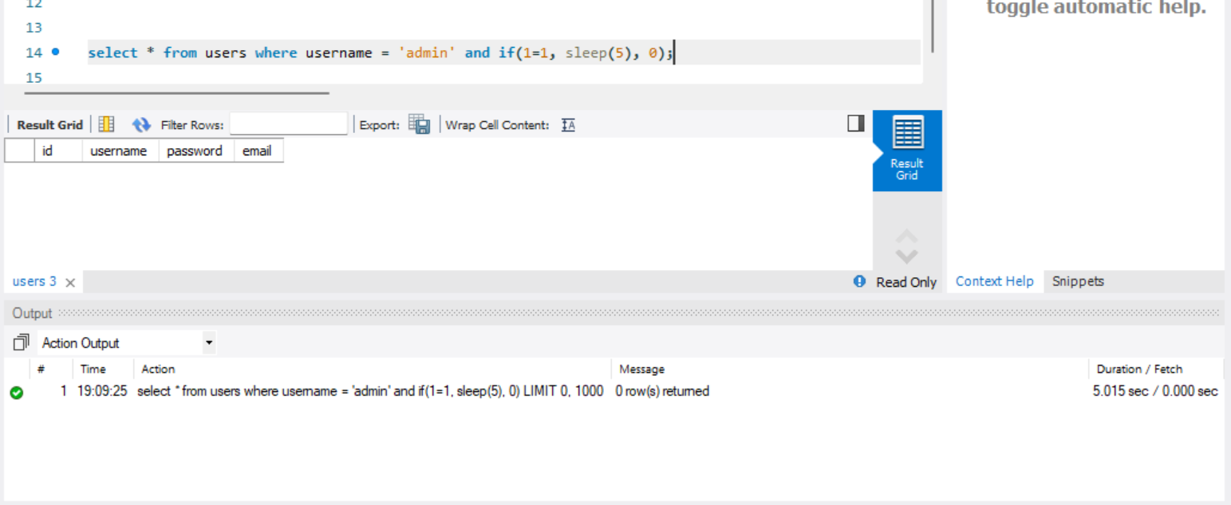
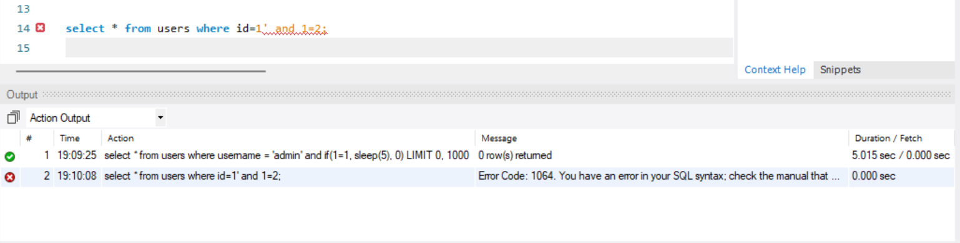
Results
1. Simple SQL Injection: 2. Union-based SQL Injection:
3. Error-Based SQL Injection: 4. Blind SQL Injection:

Slide 11
Conclusion
SQL Injection continues to be one of the most dangerous and prevalent vulnerabilities in web applications today. As demonstrated in this project, SQL Injection exploits weaknesses in user input validation, allowing attackers to execute unauthorized SQL queries. The consequences of a successful SQL Injection attack can be devastating, ranging from data theft to complete system compromise.
From the examples and techniques outlined in this project, it’s clear that even a simple application can be vulnerable if proper security measures are not taken. We showed how common SQL Injection methods, such as union-based and error based attacks, can easily compromise a database.
The project also highlighted the importance of preventive measures, such as:
Using prepared statements and parameterized queries to ensure that user
inputs are treated as data rather than executable SQL code.
Implementing input validation and escaping special characters to reduce the risk of SQL Injection.
Limiting database permissions to minimize the impact of an attack if it occurs.

