Slide 1

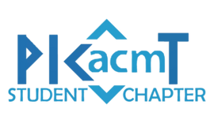


Problem Statement:
Category: Senior
Team Name: CodeScriptors
Team Leader: Prajwal Padole
AI-Powered Code Demo Documentation System
Member 1: Sakshi Marbhal
Member 2: Pratik Patil
Member 3: Gayatri Pillai
Drive Link
GitHub Prototype

Slide 2
Proposed Solution
Overview of the Solution :
Our solution is an AI-powered platform designed to generate explanations, instructions, Code Snippets and documentation of a code using LLM.
The system enables users to write and test code within an integrated environment with collaboration features or upload source code files, reducing the manual effort needed to generate detailed documentation.
It includes simplified creation of interactive, step-by-step coding tutorials (Codelabs), contains an integrated IDE for testing code directly on the website, and includes interactive elements such as quizzes.
How it Addresses the Problem :
Automates explanations and instructions from code snippets, reducing the need for manual documentation.
AI-driven content generation and formatting let developers focus more on coding.
Generated documentation is stored in a database for future access.
Allows users to create step-by-step tutorials that can be useful for others.
Innovation and Uniqueness :
1. AI-Driven Documentation using LLM
2. IDE Integration
3. Collaborative Coding
4. Document Storage and Retrieval
5. Version Control
6. Interactive and Engaging:

Slide 3
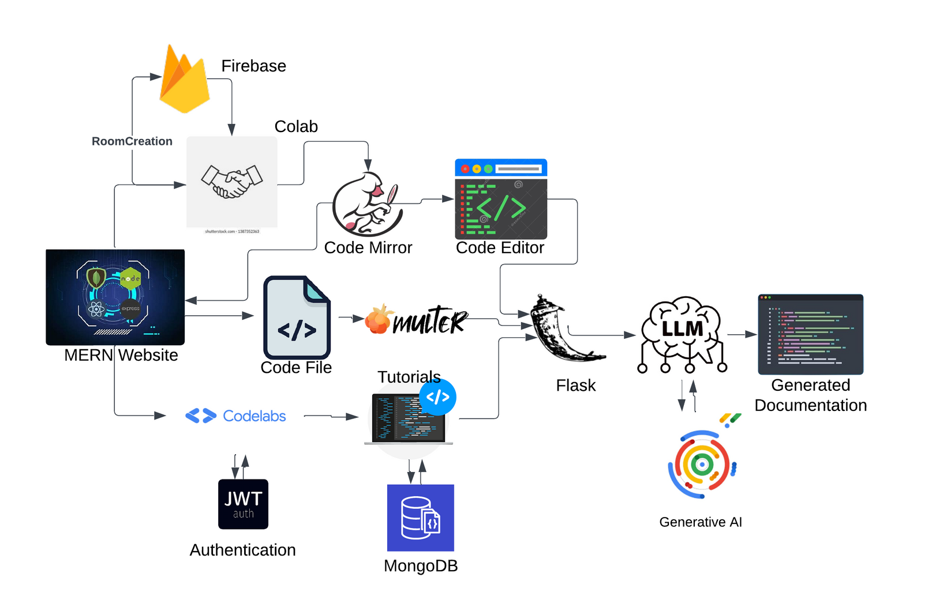


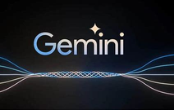
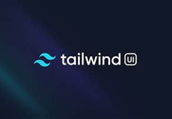
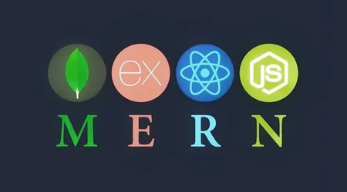
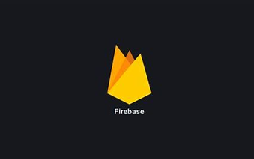

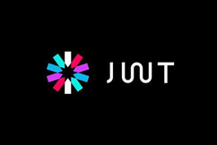

Solution Architecture
Tech-Stack

Slide 4
Detailed Technical Approach
Key Technologies/Frameworks : LLM ,MERN , generative AI,Tailwind, JWT, Flask , Firebase ,GitLab
Key Algorithms/Processes: Code entered in the IDE or uploaded file is sent to a Google Generative AI LLM model hosted on a Flask server, which generates human-readable documentation with code snippets. The generated documentation is returned to the Node.js server, displayed on the website, and stored in a database for later access.
The Codelabs section retrieves tutorials filtered or searched by the user from a MongoDB database, where tutorials created by other users are stored.
A user creates a room, with the room ID stored in Firebase Realtime Database. Another user joins via the same ID, connecting both users through WebSockets, with real-time code modifications synced and displayed using Firebase.
Integration & Scalability:
Seamless GitLab integration for version control, allowing users to track changes, collaborate, and manage repositories effortlessly
Modular architecture that supports AI-driven documentation, IDE integration, and collaborative coding environments
Supports version control and document storage for multiple versions of the same project, ensuring scalability as projects evolve.

Slide 5
Feasibility and Viability
The project is feasible due to advancements in natural language processing and the availability of LLMs capable of understanding and generating code-related content. Integration with MERN allows for smooth real-time user interaction. AI’s role in automating repetitive tasks like documentation generation will save time and resources.
Challenges
Solutions
Multi-Language Support : Multiple programming languages and frameworks, each with unique syntax and quirks.
Performance: Generating documentation in real-time could slow down with complex code or high user activity.
User Trust : Developers might be hesitant to rely on AI-generated content instead of manually written documentation.
Multi-Language Support : Integrate popular code completion tools like OpenAI Codex or GitHub Copilot for multi-language support.
Performance Optimization : Use techniques like caching and asynchronous processing to keep the system fast.
User Control : Allow developers to manually edit AI-generated content, giving them control over the final output.

