Slide 1
GSoC 2021 Evaluation Exercise
Prajwal Ranjan

Slide 2


Project Repository
https://github.com/prajwalranjan/GSoC-Assignment
The data was read from the CSV file that was provided. For this, the notebook provided in the GitHub repository was modified
The data was first loaded and then processed such that only the data for the jets was available. Then, the values were normalized and further plots were obtained.

Slide 3
Plots
From the plots obtained by running the provided dataset, it can be observed that,
Maximum number of jets had a normalized value of transverse momentum (pt) lying between 0.4 and 0.8. The normalized value of the Pseudorapidity (eta), which is the angle of the particle relative to the beam axis was spread out uniformly between 0 and 1.
The normalized Azhimuthal Angle (phi), expressed in (rad/3) was mostly between 0 and 0.2. A similar trend was observed in the Energy distribution (m),.

Slide 4
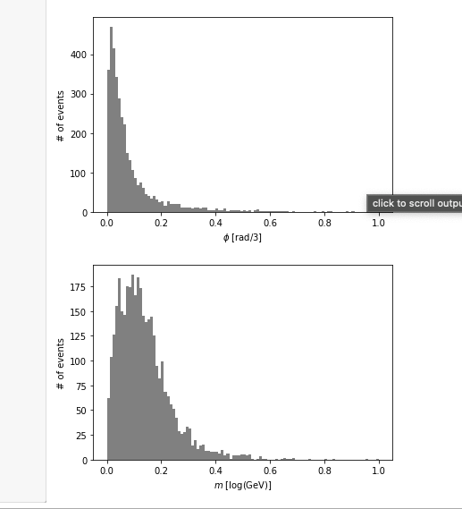
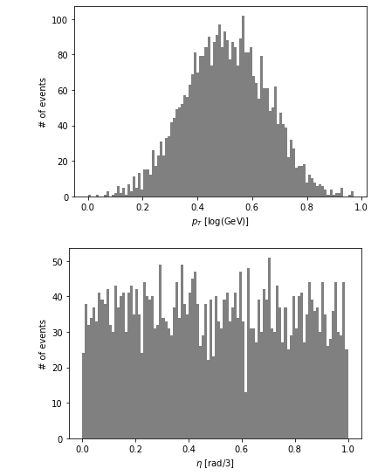

Slide 5
My CV
My CV can be downloaded from: https://drive.google.com/file/d/1rWYW6-dEutgqtFdxZXkI0V7T52FG2fCW/view?usp=sharing
Other contact links:
GitHub: github.prajwalr.com
LinkedIn: linkedin.prajwalr.com

Slide 6
Motivation
I am currently pursuing a double majors in Mathematics and Electronics and Instrumentation Engineering. My area of interest lies in Generative Modeling. I am currently working on a research project, Biometric Deephashing Techniques using Autoencoders. This motivated me to work on contributing to this project and try to improve my knowledge on autoencoders.

Slide 7
Other Projects
Biometric Deephashing Techniques using Autoencoders
Currently Ongoing
Currently leading the website development team at the Maths Association, BITS Pilani
Repository in GitHub (Maths-Assoc-Web)
Worked on other miscellaneous projects.
Repositories available in GitHub

