Slide 1

BY
D. PRAJWAL REDDY – 086
B. RAHUL – 087
J . PRANAVI –184

Slide 2
Problem Statement
Problem Statement
Home-made Textile Waste management is still a hazardous problem that has been ignored and untackled since ages. India Produces 1 million ton of such household textile waste, ending up in landfills. Reshop is a sustainable, environment friendly web application addressing societal problems such as fast fashion, landfills etc.

Slide 3
Problem Statement
Objective
Main Objective:
The Main Objective of this Project is to bring platform to many people who own abundant quantity of minimal used redundant clothes. This also serves to people who are interested in buying clothes at cheaper prices just for occasions or daily usage.
Specific Objectives:
Reshop is a sustainable, environment friendly web application addressing societal problems such as fast fashion, landfills etc.
Our Project Provides platform for everyone to re-sell old clothes or for needy to buy at cheaper prices.

Slide 4
Problem Statement
Abstract
The projects aspire to create a web application that brings existence to a platform that would facilitate users to purchase or rent exquisite outfits from other users. With Fast Fashion these days, youth tend to buy many clothes and may wear them just for once or twice. All these “Minimal Used Outfits” would just lie in closets or thrown out, even if they were expensive. India Produces 1 million ton of such household textile waste, ending up in landfills. We aim to create a network where someone’s minimal used outfits could become beneficial for users in need, buying them at cheaper price or renting for a few days. Most of the existing online shopping websites act as intermediator between ‘manufacturers’ and ‘customers’, where as we act as intermediator between clients as such that anyone can sell their outfits and anyone can buy them, benefitting both parties where seller could earn from forsaken clothes and buyer could bypass spending huge amounts for temporarily needed clothes. Reshop is also a sustainable, environment friendly application addressing societal problems such as fast fashion, landfills etc.

Slide 5



Problem Statement
Actors
Buyer
Seller
Admin

Slide 6
Problem Statement
Use Cases
Buyer
Seller
Admin
Register
Login
View Catalogue
Search for clothes
Buy Clothes
Add to Cart
Profile View
Transaction
Write Reviews
Register
Login
Upload Product
Upload Product Details
Buy clothes
Read Reviews
Login
Add/Edit/Delete User details
Add/Edit/Delete Product details

Slide 7
Problem Statement
Tech Stack
Frontend :
PHP
CSS
Bootstrap
JavaScript
Backend :
MySql
Package :
XAMPP

Slide 8
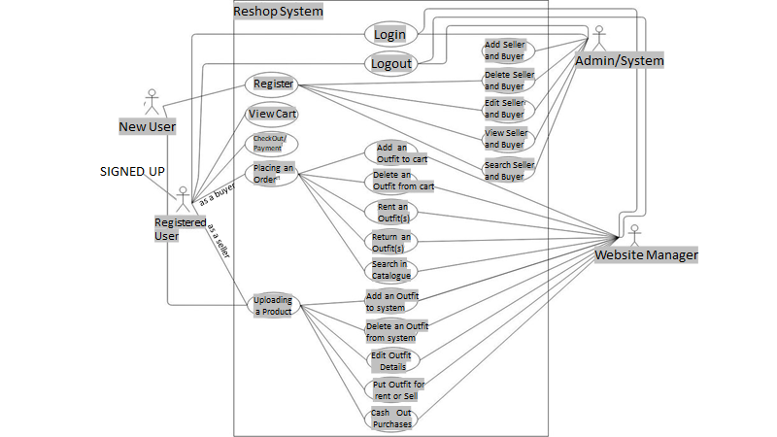
Problem Statement
USE CASE DIAGRAM

Slide 9
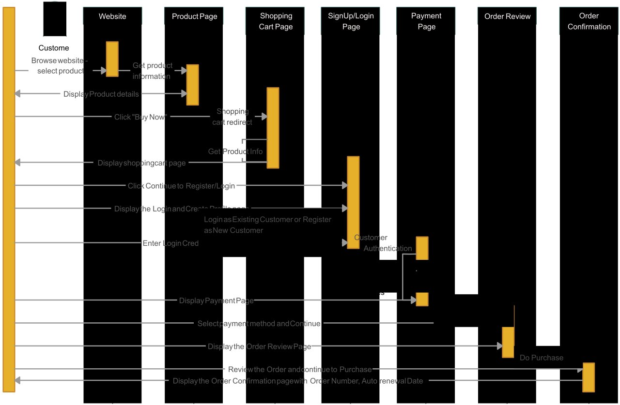
Problem Statement
SEQUENCE DIAGRAM

Slide 10
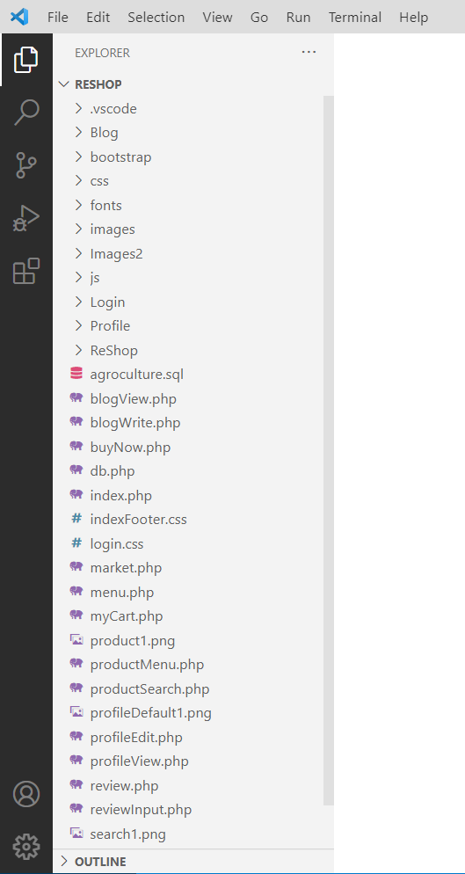
Problem Statement
DIRECTORY STRUCTURE

Slide 11
IMPLEMENTATION

Slide 12
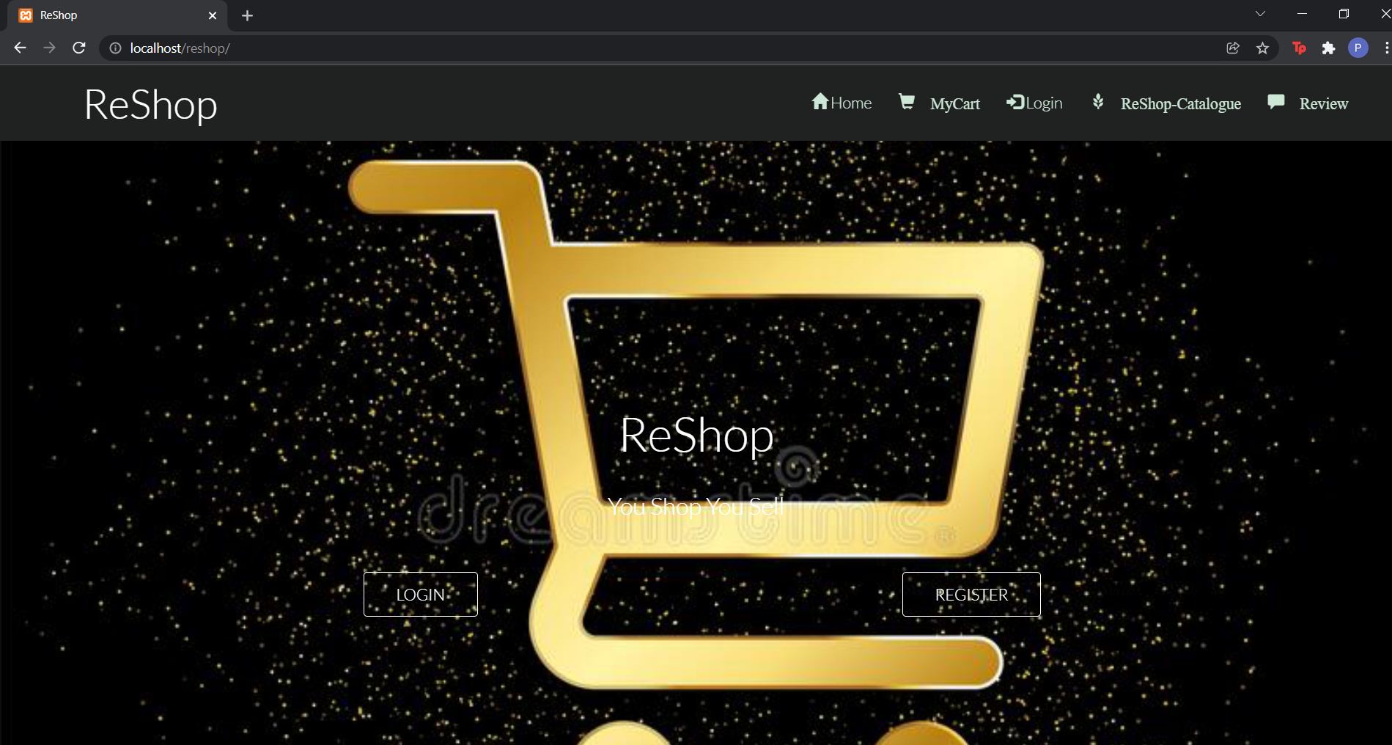
HOME PAGE

Slide 13
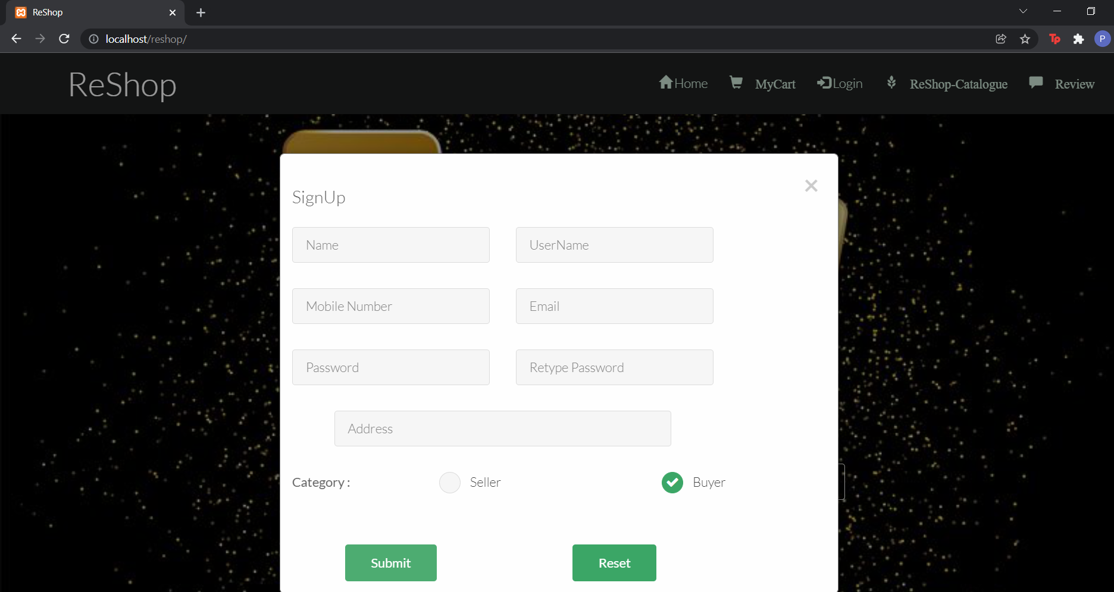
SIGN UP

Slide 14
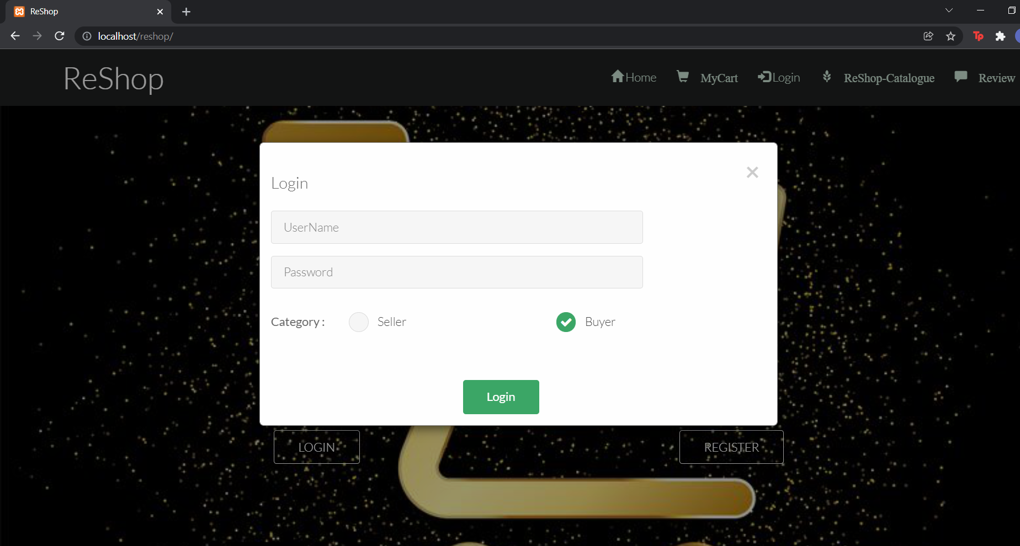
LOGIN

Slide 15
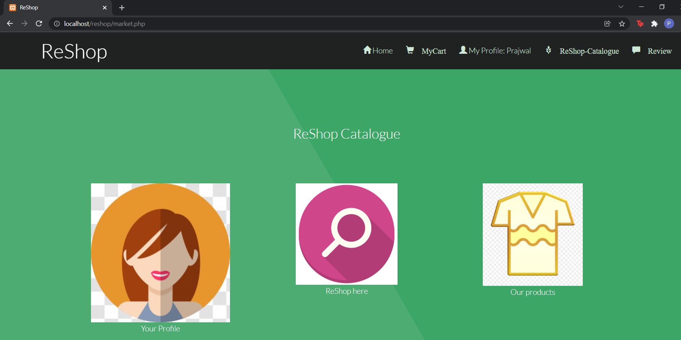
CATALOGUE

Slide 16
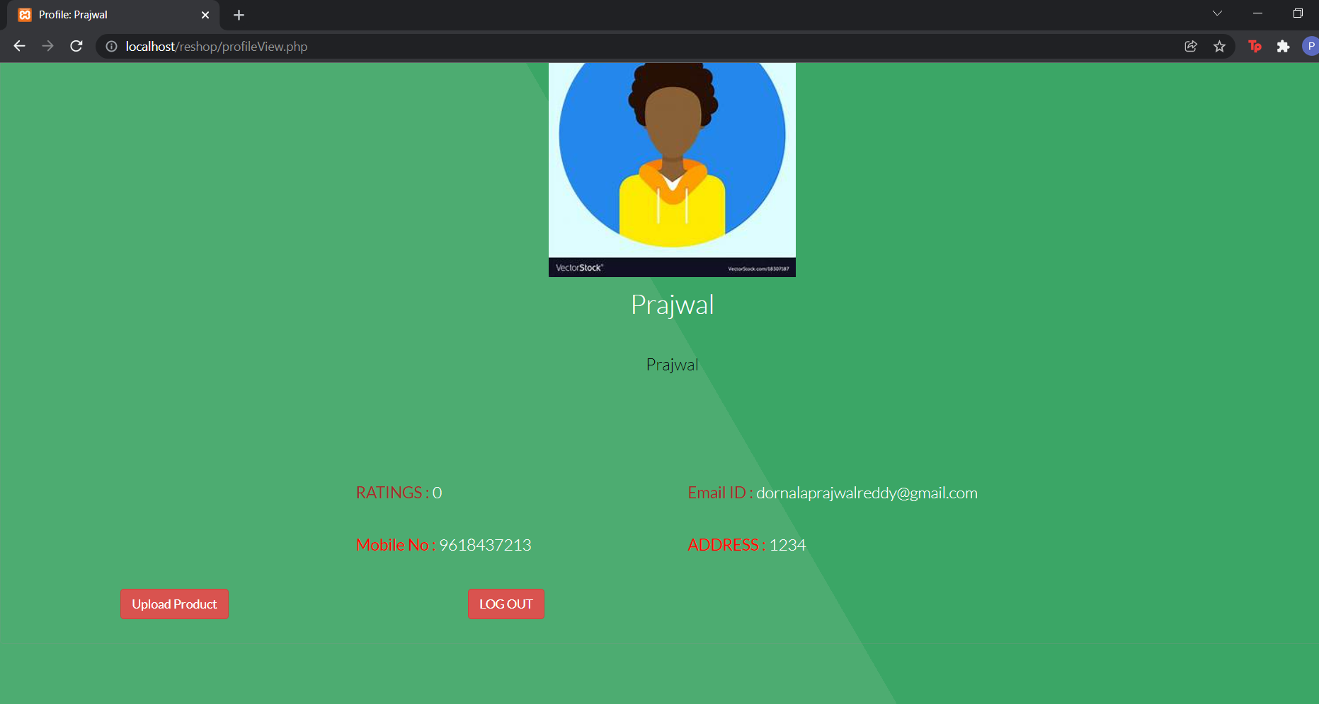
PROFILE

Slide 17
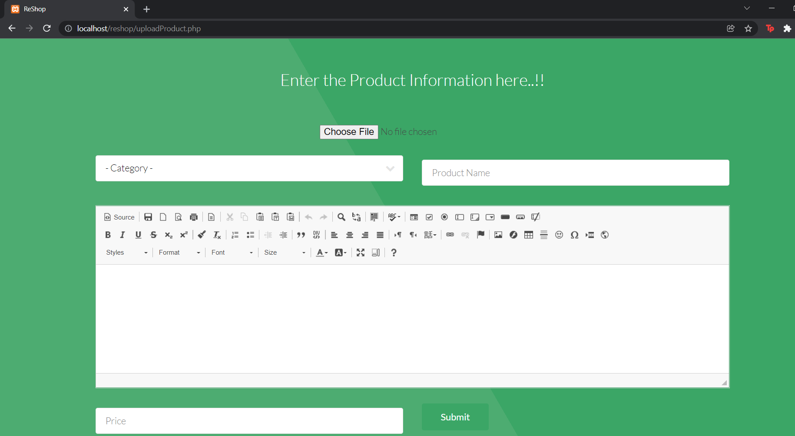
UPLOAD NEW PRODUCT

Slide 18
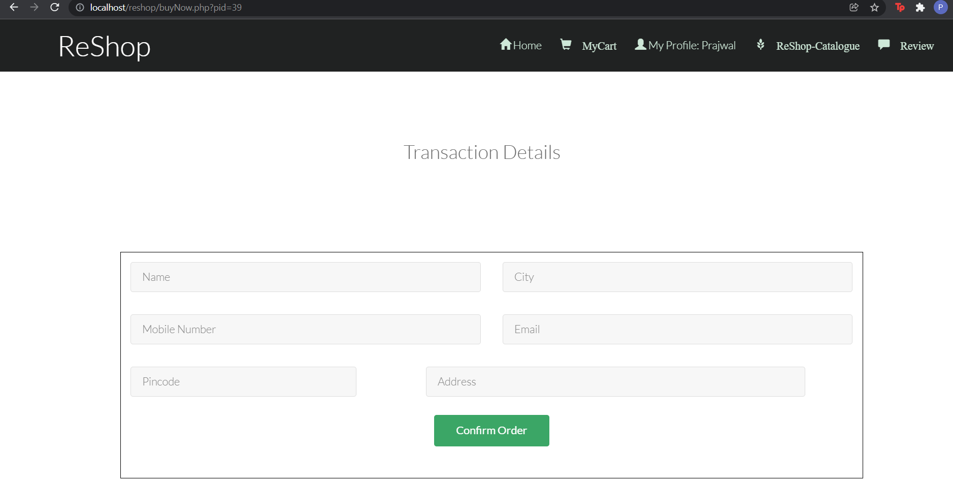
TRASACTION DETAILS

Slide 19
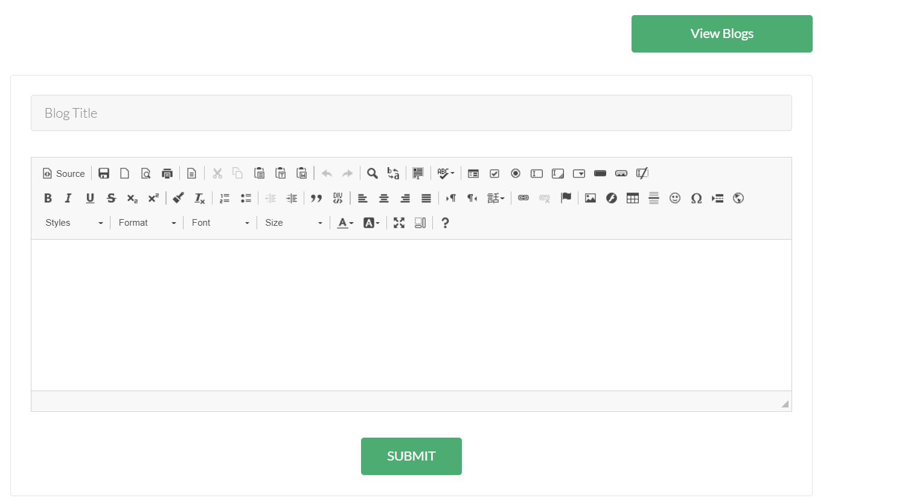
REVIEW

Slide 20
Problem Statement
CONCLUSION
We have successfully developed a secure, user-friendly web application. This system is
capable of letting users be sellers and buyers of their own.
It uses a client/server architecture based on the HTTP protocol. It is developed in Microsoft’s Visual Studio. The buyer performs a search for clothes either on search bar or from catalogue. The business logic tier communicates with the database tier
requesting the results of the query sent by it. The results obtained by the database are
displayed on the data grid, by refreshing the grid rather than refreshing the entire web page.
The Seller performs upload a product and database updates according to it.

Slide 21
Problem Statement
REFERENCES
1. PHP DOCUMENTATION - https://www.php.net/docs.php
2. HTML DOCUMENTATION - https://www.php.net/docs.php
3. BOOTSTRAP REFERENCES - https://getbootstrap.com/docs/4.1/getting-started/introduction/
4 Problem Statements on SIH - https://www.sih.gov.in/sih2020PS
5 Sample Ecommerce Application http://www.NewEgg.com
6 Ajax Toolkit controls http://asp.net/ajax
7 i-SHOP: A Model for Smart Shopping, Journal by Authors- Anal Kumar; A.B.M. Shawk : https://ieeexplore-ieee-org-vce.knimbus.com/document/7941952
8 Online re-purchase intention: Testing expectation confirmation model ECM on online shopping context in Iran :https://ieeexplore-ieee-org-vce.knimbus.com/document/6836757
9 The Design and Implementation of the Online Shopping System -https://ieeexplore.ieee.org/document/5571623

Slide 22
Thank You…

