Slide 1





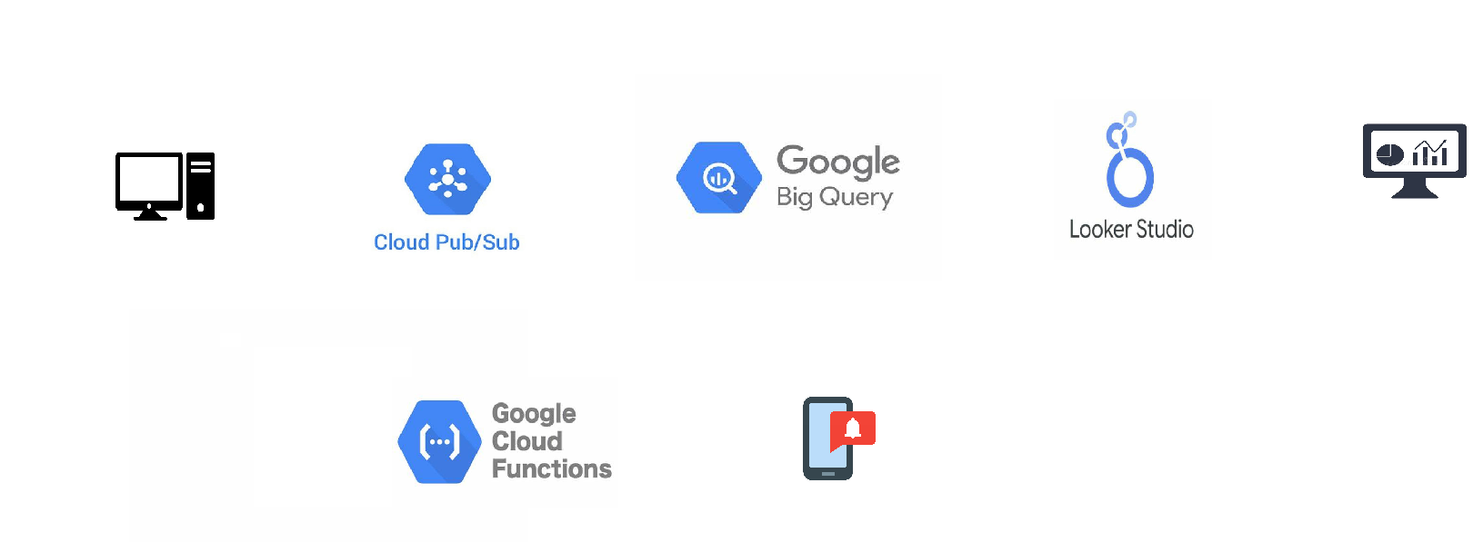
Architecture Diagram
Soc ,Cycle_Count,Temp,Voltage ,Current ,Health Status
47.85,884,37.44,3.27,17.58,mid
33.9,1262,57.42,3.08,28.96,risk
Classification
biquery client python
Dashboard
{
"timestamp": “2024-09-21 11:48:00”
"vehicleid": 1,
"voltage": 400.5,
"current": 150.0,
"temperature": 25.3,
"stateofcharge": 85.0,
"poweroutput": 75.0
}
battery data
(from local computer)
Risk Notification
Currently logs in gcp console
(can integrate third party mail/sms service)

Slide 2
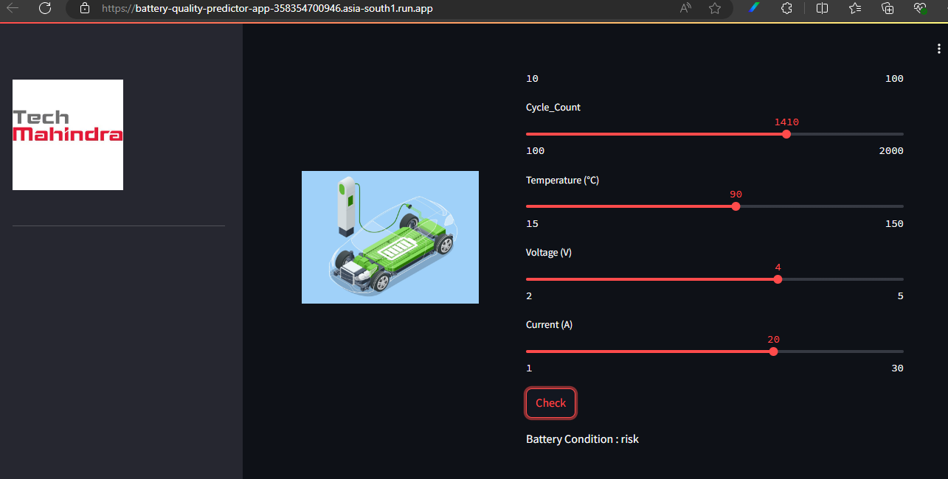
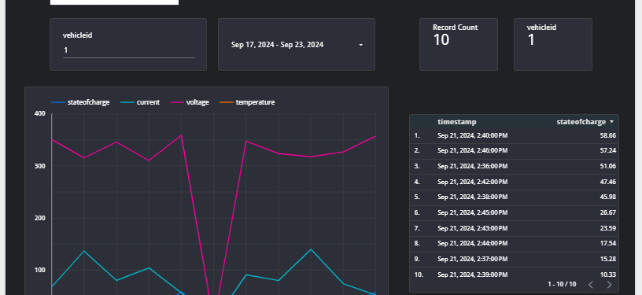
1.Classifier :
EV BATTERY QUALITY CHECKER (
battery-quality-predictor-app-358354700946.Asia-south1.Run.App
)
2.Visulatization :
https://lookerstudio.Google.Com/reporting/5f59df7c-d5bf-45b8-b4d7-885afef96d17

