Slide 1
Text Mining Techniques for Sentiment Analysis of Social Media and Networking
Presented by :
Jayandran Girisala ( 110094016)
Varshitha Kambham (110087679)
Prajwal Saleena Prakash (110093111)

Slide 2
INTRODUCTION
Objective: Use natural language processing and machine learning techniques to identify the sentiment of tweets.
Purpose: To provide relevant public opinion data for use by corporations, governments, individuals, and social media content moderators.
Background of Twitter Sentiment Analysis: Social media platforms, like Twitter, contain vast amounts of unstructured text data, requiring various analysis methods.

Slide 3
MOTIVATION & APPLICATION
Business Intelligence: Understanding customer perspectives for product enhancement.
Reputation Management: Monitoring brand sentiment and quick response to negative feedback.
Political Analysis: Informing policymakers about public opinions on policies.
Customer Service: Enhancing satisfaction by addressing concerns promptly.
Brand Monitoring: Engaging with customers and tracking brand reputation.

Slide 4
BACKGROUND WORKS & RELATED STUDY
Techniques Used: Bag of Words (BoW) for representing text data and TF-IDF (Term Frequency-Inverse Document Frequency) for assessing word relevance.
Machine Learning Models Employed: Naive Bayes, Decision Trees, Support Vector Machines, and Neural Networks.
Model Tuning: Enhancing performance and promoting better generalization to new data for accurate sentiment analysis.

Slide 5
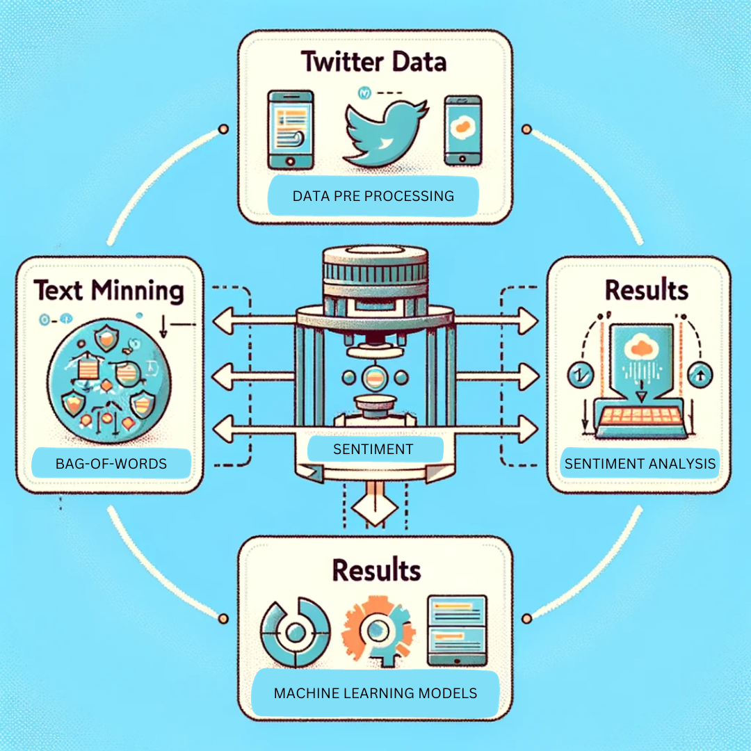
Proposed architecture/ model - Workflow

Slide 6
Demo

Slide 7
Conclusion
NLP and Machine Learning: Significant advancement in using NLP and machine learning for analyzing Twitter sentiments.
Data Preparation: Involved meticulous cleaning, tokenizing, and stemming of tweet data.
Algorithms: Utilized XGBoost, Random Forest, SVM, and Logistic Regression; XGBoost was most effective.
Visualization: Used word clouds for easy interpretation of sentiment trends.
Application: Demonstrated machine learning's potential in deriving insights from social media for diverse applications.

Slide 8
Future Direction
Advanced NLP Techniques: Plans to adopt more sophisticated methods like transformer models and word embeddings.
Real-Time Analysis: Aiming to develop a system for immediate sentiment analysis from tweets.
Multilingual Support: Expanding to include multiple languages for broader applicability.
Deep Learning Enhancements: Exploring advanced neural networks and deep learning techniques for improved performance.
Sophisticated Applications: Laying the foundation for real-time, multilingual sentiment analysis using AI.

Slide 9
Thank You

