Slide 1

LinkedIn Business Intelligence for Student Career Guidance
A data-driven approach to empower students with actionable insights for career planning and skill development.

Slide 2




Organization Overview
$
Professional Network
LinkedIn Learning
Sales Navigator
Comprehensive online learning platform for professional skills.
Premium sales tool for lead generation and relationship management.
Largest social media and professional networking platform worldwide.
Talent Solutions
Recruitment platform connecting employers with potential candidates.

Slide 3
Business Problem
The Challenge
Our Proposal
Students lack direction when starting their job search — they’re unsure what skills to build, what jobs to pursue, or where to look.
LinkedIn’s current job and learning tools don’t fully serve younger users who are still exploring career paths.
This leads to lower platform engagement from students and underutilization of LinkedIn Learning.
Use job market data and BI dashboards to guide students in making informed career decisions.
Provide personalized, data-driven recommendations for roles, industries, and learning paths.
Turn LinkedIn into the go-to platform for career exploration, not just job search.

Slide 4
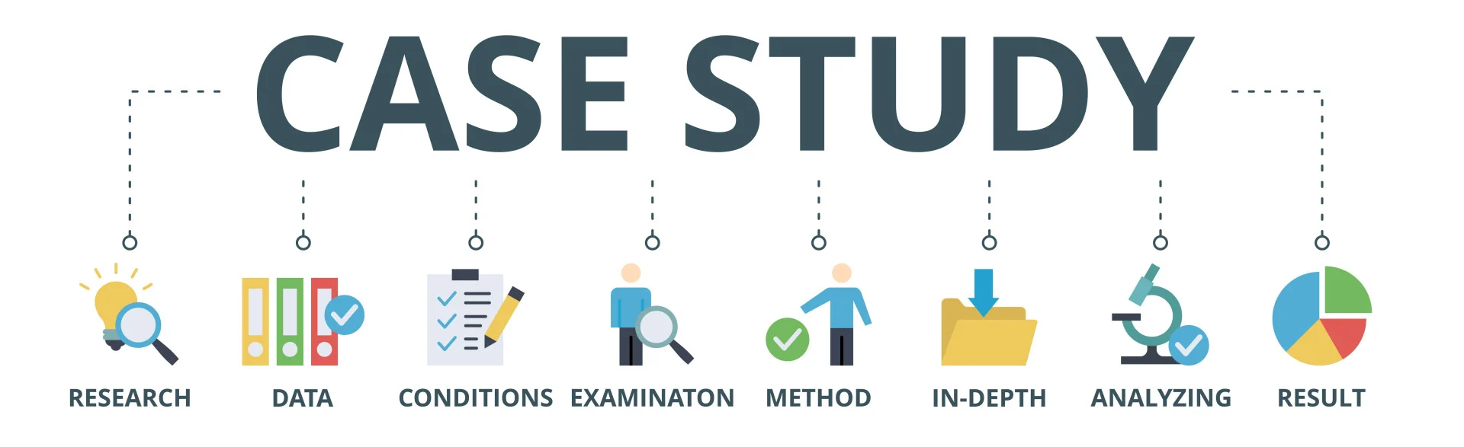
Similar Case Studies
Glassdoor Sentiment Analysis
Indeed Job Posting Analytics
Used NLP to extract sentiment scores from employee reviews.
Identified real-time trends in job openings and required skills.
Created HR dashboards to benchmark satisfaction across companies.
Created dashboards for workforce development and education institutions.
LinkedIn can incorporate similar analytics into Talent Solutions.
LinkedIn can enhance recommendation algorithms with similar insights.

Slide 5








Proposed BI Solution
Impact
Enhanced user engagement and platform value
Personalization
Filtering by location, role type, and experience level
Data-Backed Guidance
Aligning learning with real-world demand
Actionable Insights
Job market trends and in-demand skills

Slide 6
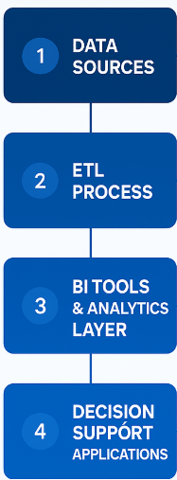
BI Framework
Data Sources
Internal LinkedIn datasets: job postings, skills, salaries, applications
ETL Process
Extract from LinkedIn databases, transform data, load into structured schema
BI Tools & Analytics
Tableau for visual analytics, Python for predictive modeling
Decision Support
Insights for students, career centers, and LinkedIn product teams

Slide 7


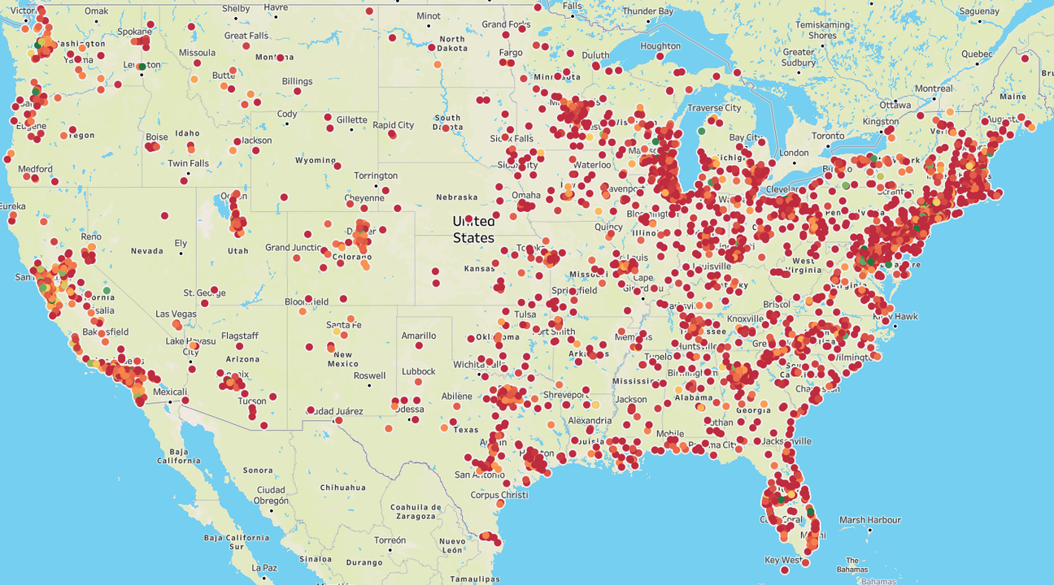

BI Prototypes Overview
Student Job Market Explorer
Employer & Skill Demand Dashboard
Tracks job postings by industry, skill, and location with interactive visualizations.
Highlights top companies hiring students and tracks skill demand by region.
Predictive Salary Model
Uses ML to predict salaries based on skills, titles, and benefits data.

Slide 8

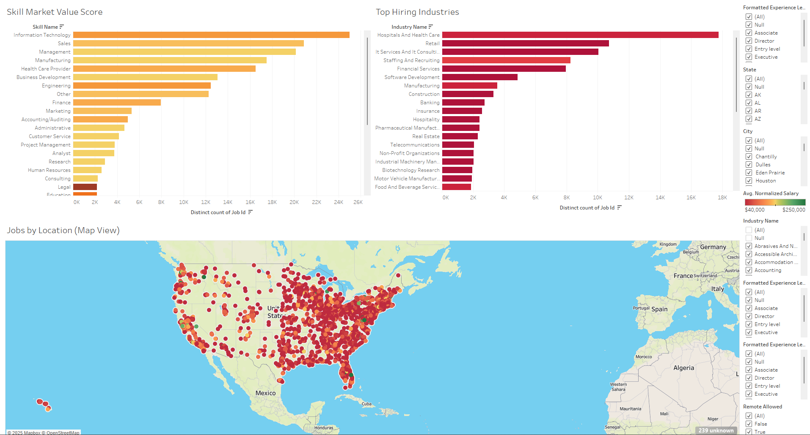



Prototype 1: Student Job Market Explorer
Track Postings
Monitor active student job postings by industry, skill, and location
Visualize Distribution
Interactive maps and bar charts show job concentration
Identify Trends
Highlight top in-demand skills and high-salary regions
Filter Results
Refine by work type, experience level, and remote options

Slide 9
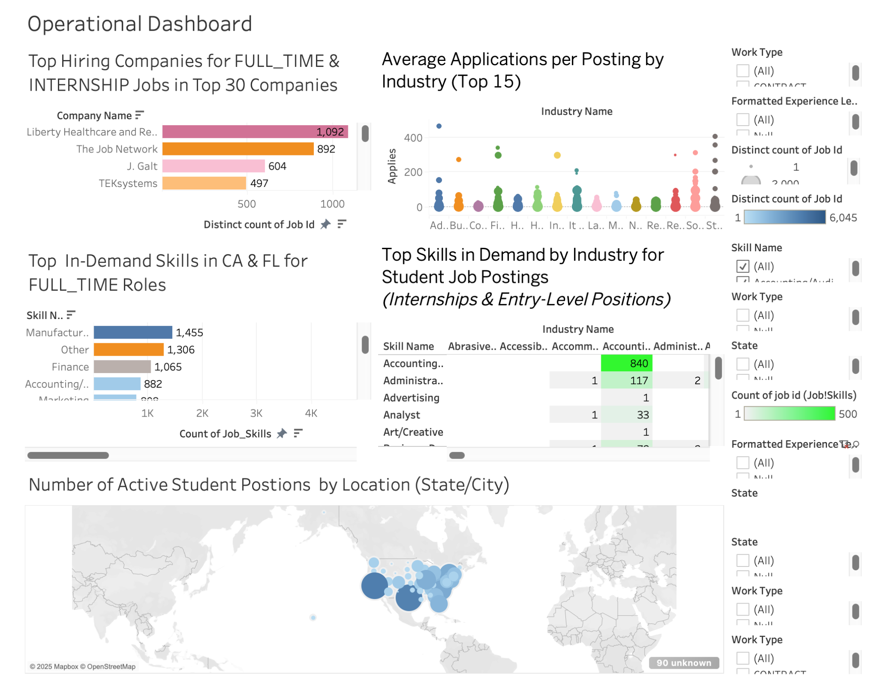
Prototype 2: Employer & Skill Demand Dashboard
Highlights top companies hiring students across different position types. Tracks skill demand in key states using interactive visualizations. Measures industry engagement through application metrics.
Track Employers Identify top companies hiring students across full-time, internship, and volunteer roles.
Analyze Skill Demand View in-demand skills by region and role type to align learning with hiring trends.
Compare Engagement Use scatter plots and charts to analyze average applications by industry and job type.
Filter Insights Apply dynamic filters for state, experience level, and work type for targeted analysis.

Slide 10








Prototype 3: Predictive Salary Model
Data Collection
Feature Engineering
Load and clean job data from multiple sources
Create meaningful features from skills and benefits data
Evaluation
Model Training
Measure performance using R² and RMSE metrics
Train ML models like Random Forest and Gradient Boosting

Slide 11






Implementation Process
Data Collection & Loading
Gather relevant datasets from LinkedIn's internal sources
Feature Engineering
Create meaningful variables from raw data
Data Cleaning & Preparation
Handle missing values and normalize data formats
Model Training
Develop and refine predictive algorithms
Evaluation & Analysis
Test model performance and extract insights
Visualization & Insight Extraction
Create intuitive Plots for end users

Slide 12




Potential Challenges
Data Quality Issues
Inconsistent or missing job data across sources
Integration Complexity
Difficulty merging multiple datasets effectively
Limited Salary Data
Reduced model training effectiveness
Bias Risks
Potential reinforcement of salary or skill biases

Slide 13



Opportunities
Personalized Insights
Stronger Engagement
Aligned Education
Tailored job and skill recommendations based on individual profiles and goals.
Enhanced connections between employers, universities, and students.
Academic programs that reflect current market demands and skill needs.

Slide 14










Final Summary
Interactive Dashboards
Predictive Models
Exploration tools for roles, locations, and compensation
Mission Alignment
ML algorithms to guide career choices and skill development
Supporting LinkedIn's goal to connect people with opportunity
Student Empowerment
Market Insights
Student-focused data on job trends and salary expectations
Data-driven tools that inform and educate the next generation

Slide 15

Thank You
3
6
Prototypes
Implementation Steps
Comprehensive BI solutions for student career guidance
Structured approach to building effective BI tools
5+
Key Benefits
Advantages for students, universities, and LinkedIn
Questions? We're happy to discuss our approach in more detail.

