Slide 1

Introduction to
Artificial Intelligence
A complete guide covering AI fundamentals, historical milestones, capability classifications, nested ML/DL concepts, life cycle, and future horizons.

Slide 2

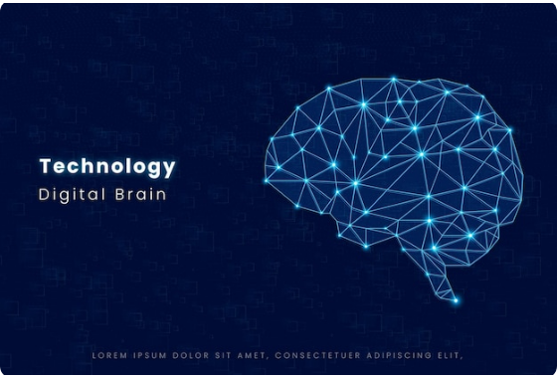
What is Artificial Intelligence?
Core Definition
Artificial Intelligence (AI) is a branch of computer science focused on building machines and software capable of performing tasks that normally require human intelligence.
➔
Learning: Improving performance using experience and data.
➔
Reasoning: Making logical decisions via algorithms.
➔
Perception: Understanding environment through visual and audio inputs.
➔
Language: Comprehending and generating human language.

Slide 3

Human vs Artificial Intelligence
Human Intelligence
Artificial Intelligence
Learning: Absorbs knowledge from direct experience and sensory inputs.
Learning: Learns patterns from mathematical models and large datasets.
Common Sense: Inherently understands real-world context and social nuance.
Execution: Operates strictly on mathematical algorithms and data points.
Emotions: Guided by empathy, feelings, and moral reasoning.
Emotions: Lacks true emotion or subjective consciousness.
Creativity: Naturally invents, imagines, and creates without training data.
Creativity: Generated outputs depend entirely on underlying training patterns.

Slide 4
Evolution & Milestones of AI
1956
2012+
Dartmouth Conference: John McCarthy coins "Artificial Intelligence".
Deep Learning & GenAI era begins with GPUs, LLMs, and ChatGPT.
1950
1997
Alan Turing proposes the Turing Test to evaluate machine intelligence.
IBM Deep Blue defeats world chess champion Garry Kasparov.

Slide 5
Types of AI by Capability
Capability Type | Status | Key Characteristics | Real-World Examples
Narrow AI (Weak AI) | Active / Present | Designed for a specific task; cannot function outside domain. | Siri, ChatGPT, Google Maps, Spam Filters
General AI (AGI) | In Research | Matches human intellect across learning, reasoning, and planning. | Hypothetical human-equivalent system
Super AI (ASI) | Theoretical | Surpasses human intelligence in every scientific and creative field. | Futuristic theoretical concept

Slide 6



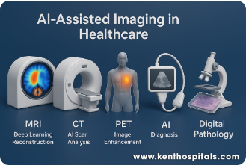

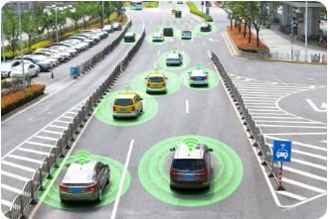

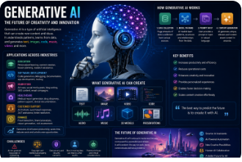
Applications of AI in Real World
Healthcare
Transportation
Generative Tech
Rapid MRI/CT scan analysis, early disease prediction, robotic surgery, and accelerated drug discovery.
Self-driving vehicles, real-time traffic prediction, intelligent route planning, and logistics automation.
Automated software generation, personalized study tutors, smart assistants, and content creation.

Slide 7





AI vs Machine Learning vs DL
Artificial Intelligence
Machine Learning
Deep Learning
Broadest Field: The overall science of building smart machines capable of performing human-like cognitive tasks.
Subset of AI: Systems that learn patterns directly from structured data to make decisions without explicit programming.
Subset of ML: Uses multi-layered artificial neural networks to extract complex features from massive unstructured data automatically.

Slide 8
Why We Need AI: Scale & Speed
Overcoming Human Limitations
100x
Humans face physical speed limits, fatigue, and cognitive overload when analyzing big data.
Medical Example: A physician might take 15 minutes to review a single MRI scan, while an AI model can process thousands of scans in minutes with 24/7 consistency and high diagnostic accuracy.
Processing Efficiency

Slide 9

The AI Development Life Cycle
1. Preparation Phase
2. Execution & Deployment
Problem Identification: Define business goals and outcomes.
Model Training: Feed algorithms historical training data.
Evaluation: Measure Precision, Recall, Accuracy, and F1-score.
Data Collection: Gather raw data from databases, APIs, and sensors.
Deployment & Maintenance: Integrate into apps and monitor continuously.
Data Cleaning: Remove duplicates, handle nulls, and encode features.

Slide 10
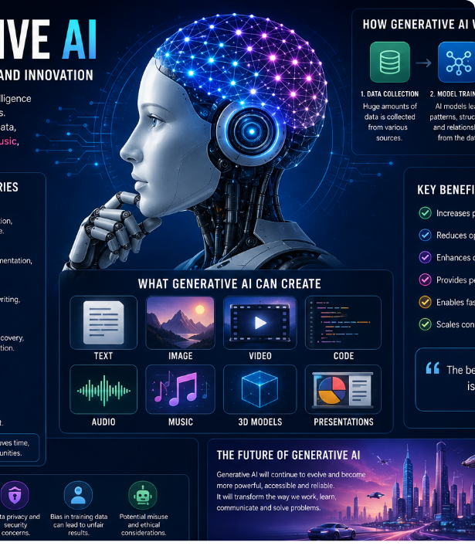
Future Horizons in AI
Emerging Frontiers
Autonomous AI Agents: Systems executing multi-step planning, tool usage, and complex reasoning independently.
Healthcare Revolution: Early tumor detection, custom gene therapies, and robotic surgical assistants.
Responsible & Ethical AI: Worldwide focus on reducing model bias, ensuring privacy, and maintaining transparency.

Slide 11
Module 1 Key Takeaways
Core Purpose: AI enables systems to learn, reason, make decisions, and perceive environments autonomously.
Current State: We currently live in the age of Narrow AI (task-specific systems), while General AI remains a future research goal.
Nested Hierarchy: Deep Learning is a subset of Machine Learning, which is itself a subset of Artificial Intelligence (AI ⊃ ML ⊃ DL).
Lifecycle Approach: Successful AI solutions require systematic data collection, preprocessing, feature engineering, model training, and continuous monitoring.

Slide 12
Questions & Discussion
Thank you for participating in Module 1!
Module 1: Introduction to Artificial Intelligence • Classroom & Corporate Training Series

Slide 13




Image Sources
https://img.magnific.com/premium-vector/abstract-digital-brain-illustration-representing-artificial-intelligence-machine-learning-technological-innovation_1050143-4289.jpg
Source: www.magnific.com
https://kenthospitals.com/wp-content/uploads/2025/08/AI-in-Imaging1-1024x683.jpg
Source: kenthospitals.com
https://www.geotab.com/CMS-Media-production/Blog/NA/September_2019/future-of-transportation/blog-smart-car-and-autonomous-selfdriving-mode-vehicle-on-metro-city-road-picture-id877349122-hero@2x.jpg
Source: www.geotab.com
https://softgrid.solutions/uploads/1782800925132-ChatGPT-Image-Jun-30--2026--11-28-35-AM.png
Source: www.softgrid.solutions

