Slide 1

Mathematics for AI
Module 3: Core Mathematical Foundations
Building mathematical intuition before formulas—understanding why Artificial Intelligence requires each fundamental concept.

Slide 2


Basics of Statistics in AI
What is Statistics? The science of collecting, organizing, analyzing, and interpreting data.
•
Descriptive Statistics: Summarizes existing data features (e.g., average viewing duration or user age).
•
Inferential Statistics: Makes predictions about a larger population using sample data (e.g., predicting election outcomes).
•
AI Role: Converts raw numbers into structured understanding before training ML models.
•
Real World: Spotify & Netflix analyze billions of logs to discover listening patterns and optimize recommendations.

Slide 3






Mean, Median, and Mode
Mean (Average)
Median (Middle)
Mode (Frequent)
Sum of all values divided by total count.
The exact center value of sorted data.
The value that occurs most often.
Identifies top customer choices & category peaks.
Handles skewed distributions smoothly.
Google Maps: Ignores isolated accident spikes for realistic travel estimates.
Essential for discrete user choices and classification targets.
Highly sensitive to extreme outliers.

Slide 4


Standard Deviation
Measuring Data Dispersion
Standard Deviation ( ) quantifies how spread out numbers are from the average value.
Small SD: Data points cluster tightly near the mean.
Large SD: Data points are widely distributed.
AI Fraud Detection: If a user spends ₹500–₹1,000 daily but suddenly attempts ₹2,00,000, high SD triggers an automatic AI alert.

Slide 5


Probability in Machine Learning
Core Concept & Formula
AI Applications
Probability measures the likelihood of an event occurring, scaled bounded between 0 (impossible) and 1 (certainty).
Spam Classification: Models assign probabilities such as Spam (0.98) vs. Important (0.02).
Medical AI Diagnostics: AI models calculate probability of disease presence (e.g., Cancer: 92%, Healthy: 8%) to assist doctor decisions.
Forms the baseline of statistical inference and confidence metrics.

Slide 6

Linear Algebra Basics
The mathematical language of AI—converting images, text, and voice signals into structured numerical matrices.

Slide 7
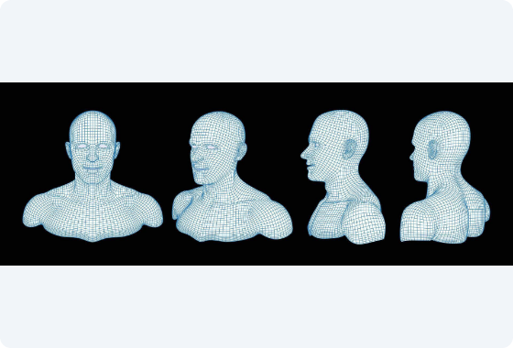
Matrices in Computer Vision
Representing Visual Data
•
An image is composed of thousands of pixel intensity values.
•
A grayscale image of size 100 × 100 pixels becomes a 2D matrix of shape 100 × 100.
•
Facial Recognition: AI compares facial feature matrices against database templates to verify identities.
•
Matrix operations (addition, multiplication, transpose) enable real-time image filtering and neural layer transformations.

Slide 8






Vectors and Word Embeddings
Vector
Word Embeddings
Matrix Transformations
A 1D array of numbers representing features in spatial dimensions.
Google Translate converts words into dense numerical vectors.
Operations combine inputs and weights inside neural network layers.
Example: [2, 4, 6] representing user attributes or coordinate points.
Mathematical distance between vectors reflects semantic word relationships.
Matrix-vector multiplication computes decisions across millions of neurons.

Slide 9

Calculus and Rate of Change
How Quantities Change
dy / dx
Calculus studies continuous change. AI relies on Differentiation to calculate how prediction errors respond to weight changes.
Derivative Function
Self-Driving Cars: Vehicle control systems compute rate of change in speed, steering angle, and braking to guarantee dynamic trajectory stability.

Slide 10
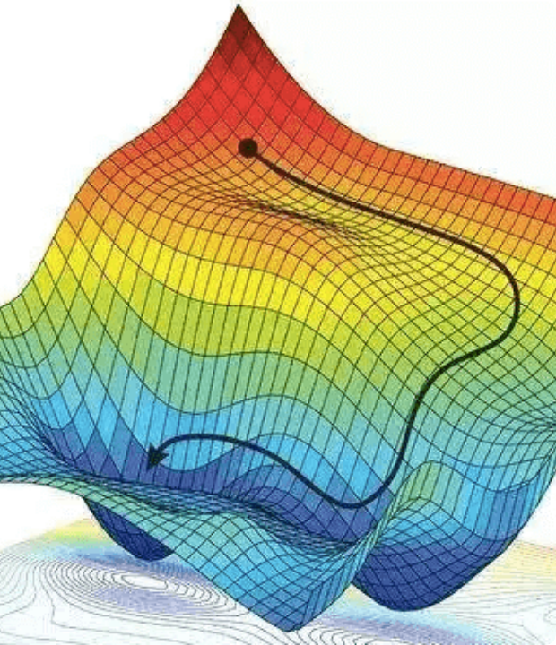
Gradient Descent Optimization
The Learning Engine of AI
Gradient Descent minimizes model error (loss) by iteratively adjusting weight parameters downhill.
Mountain Fog Analogy: Standing on a misty peak, you feel the steepest slope underfoot and step downward until reaching the valley bottom.
= Learning Rate | = Loss Function | = Gradient Slope

Slide 11




Gradient Descent Iteration
2. Loss Calculation
4. Accuracy Tuning
Calculates error gap (Loss J) and gradient slope direction.
Millions of iterations yield highly precise recommendations.
1. Initial Guess
3. Parameter Update
YouTube model predicts user watches video for 10 min (actual: 2 min).
Updates weight:

Slide 12
Questions & Discussion
You have mastered Module 3: Mathematics for AI
Statistics • Linear Algebra • Calculus • Gradient Descent

Slide 13




Image Sources
https://dashthis.com/media/4142/data-visualization-dashboard-google-analytics.png
Source: dashthis.com
https://thefintechtimes.com/wp-content/uploads/2020/10/iStock-585806700-960x681.jpg
Source: thefintechtimes.com
https://static.vecteezy.com/system/resources/previews/076/868/526/non_2x/3d-wireframe-mesh-of-digital-human-head-and-bust-from-multiple-perspectives-artificial-intelligence-facial-recognition-technology-and-biometric-scanning-data-visualization-concept-vector.jpg
Source: www.vecteezy.com
https://miro.medium.com/0*x9C6wHN5BHuqOS4E.png
Source: medium.com

