Slide 1
PGC MINI PROJECT
OpenMP vs MPI for Data Processing
Same dataset operations, three implementations: sequential, shared-memory (OpenMP) and distributed-memory (MPI)
OpenMP
MPI
Parallel and GPU Computing (26ECAC304)
Notes:
Theme: OpenMP vs MPI for data processing. Same operation, three implementations. Colour code used on every graph: blue = OpenMP, orange = MPI.

Slide 2
Problem and dataset
Operations (one pass over the array)
47.2 M
378 MB
Mode 0, light: count, min, max, mean, std, trips over 10 miles, histogram
Mode 1, heavy: Mode 0 plus log-transform mean and std
trip-distance records
binary array of doubles
4 files
122
Why two modes?
Mode 1 does about 10x more arithmetic per byte than mode 0. That lets us test when parallelism pays off.
NYC Yellow Taxi, 6.9 GB CSV
invalid rows removed
Sequential baseline: read the file, one loop over all N values, update the running statistics.
Notes:
Dataset: four months of NYC yellow-taxi CSVs (Jan 2015, Jan-Mar 2016). Only trip_distance was extracted into one binary file of 47,248,723 doubles. Results are identical across sequential, OpenMP and MPI, which validates the parallel versions.

Slide 3
Parallel design and setup
OpenMP: shared memory
MPI: distributed memory
All threads see one array in memory
Loop split among threads
Partial results merged at the end
No data movement
Rank 0 reads the file
Scatter: array split across processes
Each process computes on its chunk
Reduce: partial results sent back to rank 0
EXPERIMENT SETUP
Intel i5-12450H (12 logical CPUs), 7.6 GB RAM, WSL2 Ubuntu 24.04, GCC 13.3 -O2, Open MPI 4.1.6. Sizes: 1, 5, 10, 25, 47.2 M records. Workers: 1, 2, 4, 8, 12. Every point is the mean of 5 runs. Parallel time excludes file reading; MPI time includes scatter, compute and reduce.
Notes:
Key design difference: OpenMP threads already share the array; MPI must scatter 378 MB from rank 0 to the other processes. That scatter is a serial cost that does not shrink as processes are added.

Slide 4
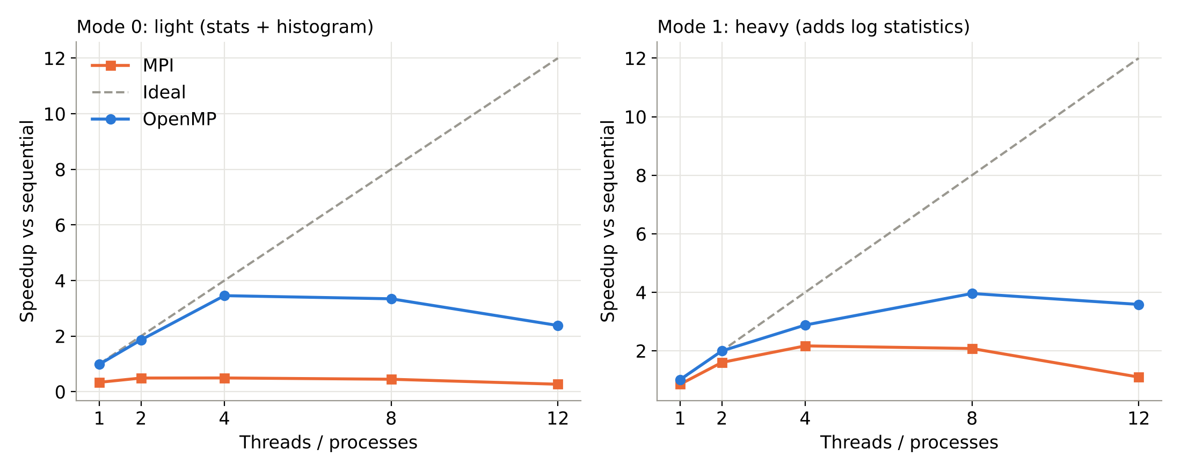
Speedup vs sequential
OpenMP peaks at 3.96x (heavy, 8 threads) and 3.45x (light, 4 threads)
MPI peaks at 2.17x (heavy, 4 procs) and is slower than sequential on the light operation
Notes:
Full dataset, mean of 5 runs. Speedup = sequential time / parallel time. MPI never exceeds 0.49x in the light mode.

Slide 5
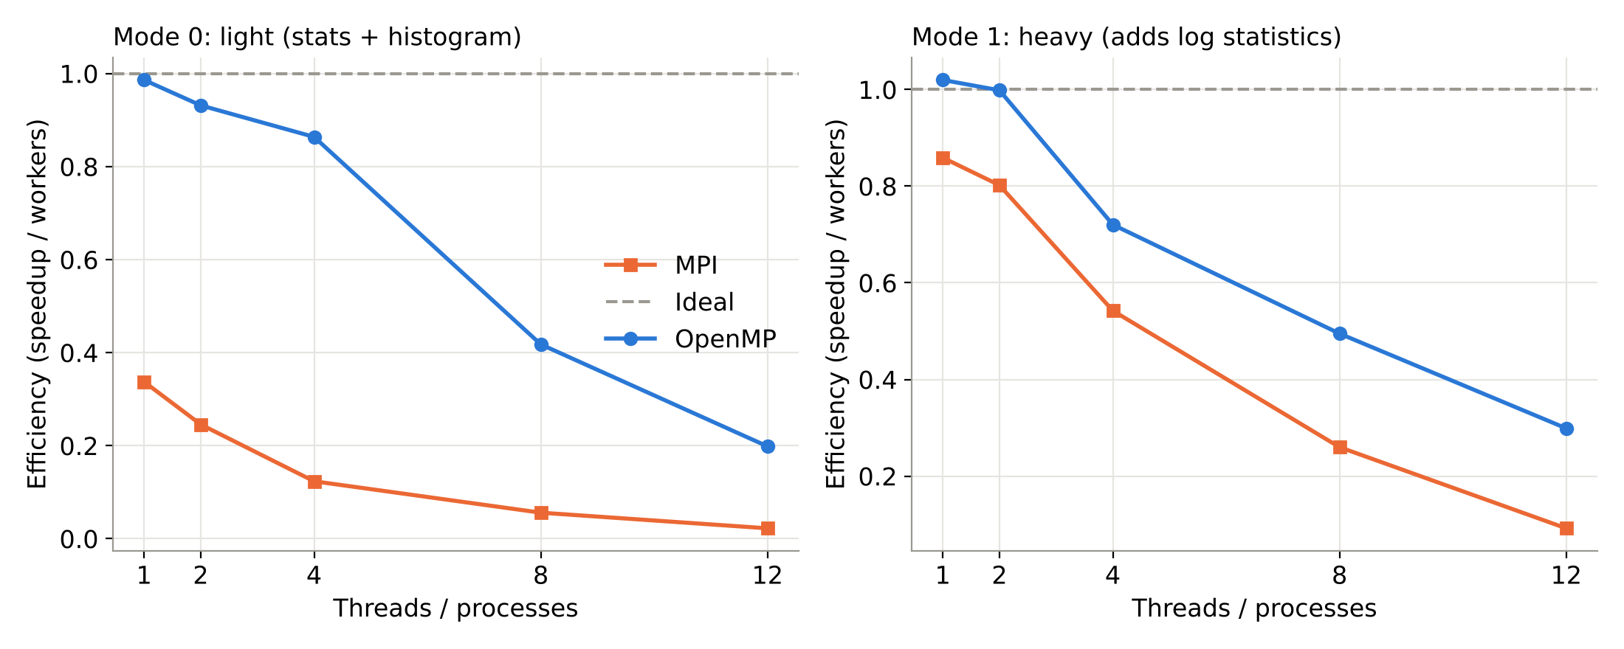
Efficiency
OpenMP heavy: 49% efficient at 8 threads; MPI: only 26%
Both fall at 12 workers: the CPU has 8 physical cores (4 performance + 4 efficiency) with 12 threads
Notes:
Efficiency = speedup / workers. At 12 workers, hyperthreads and efficiency cores add little.

Slide 6
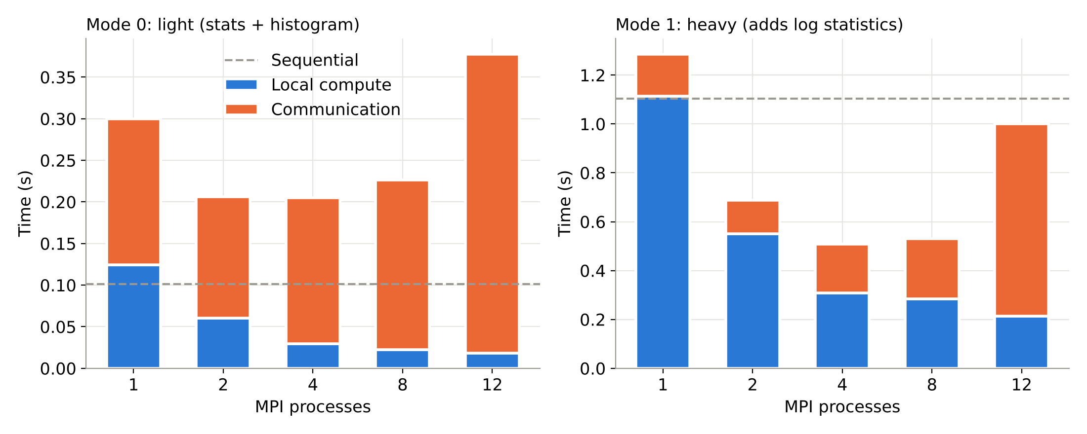
Where MPI loses time
Local compute keeps shrinking (heavy: 1.11 s to 0.21 s) but communication does not
At 8 processes, communication is 47% of MPI time (heavy) and 90% (light)
Notes:
Rank 0 must send all 378 MB regardless of process count, which acts as a serial fraction (Amdahl). At 12 processes communication rises to 0.79 s in heavy mode because processes outnumber physical cores.

Slide 7
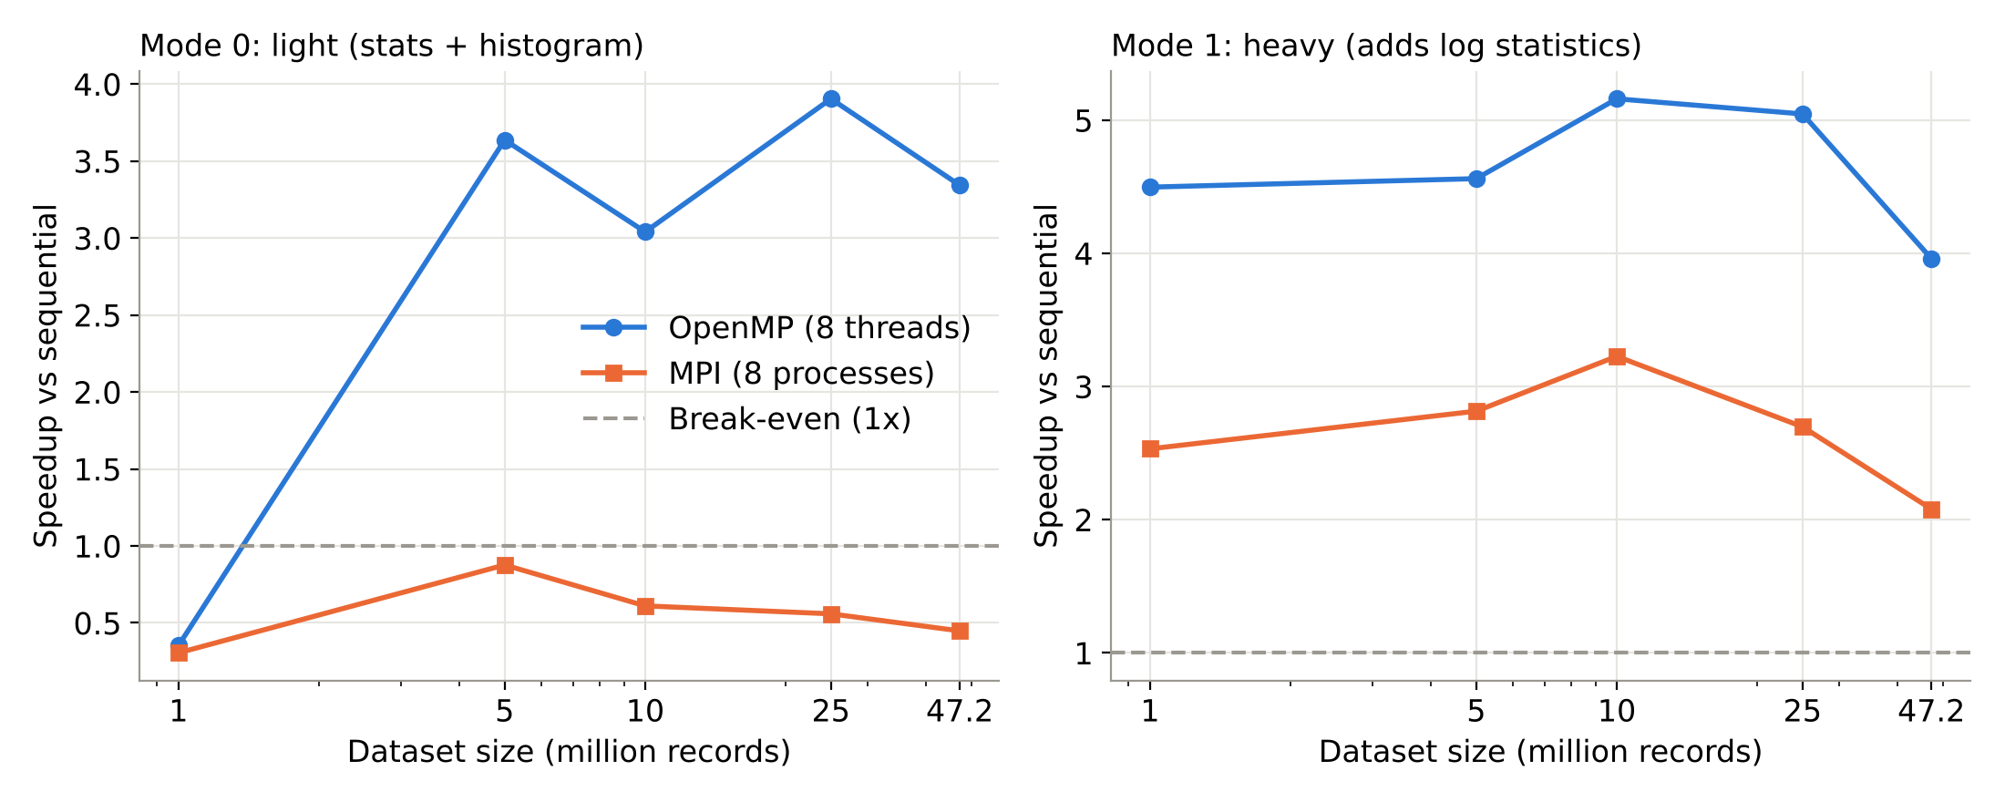
Effect of data size (8 workers)
Heavy: OpenMP 4.0x to 5.2x, MPI 2.1x to 3.2x for every size of 1 M or more
Light: OpenMP needs 5 M or more records to pay off (0.35x at 1 M); MPI never exceeds 0.88x
Notes:
Small data: thread start-up and messaging overhead dominate. Larger data: compute grows with N, but MPI scatter cost grows with N too.

Slide 8
Conclusions
OpenMP wins on one machine
MPI pays for communication
Compute per byte decides
Up to 3.96x with no data movement. Threads share memory.
Scatter of 378 MB is serial: 47% to 90% of its time at 8 processes.
Heavy work scales in both models. Light work only pays in OpenMP.
Limits and next step
These MPI runs share memory inside one machine, so real network cost is not yet included. Next: run MPI across the 4-VM cluster and compare.
Notes:
Main conclusion: parallelism pays off only when computation per byte moved is large enough. Cluster run to be added.

