Slide 1
C-Pay: An E-Wallet Application Utilizing C-Programming
Team Members
Aswin Kandel | THA081BCT004
Dikesh Manandhar | THA081BCT008
Kishan Kumar Shah | THA081BCT014
Pujag Dallakoti | THA081BCT024
Under the Supervision of:
Er. Prajwal Pakka
Department of Electronics and Computer Engineering
Institute of Engineering, Thapathali Campus
March 12, 2025

Slide 2
Presentation Outline
Introduction
Motivation
Project Objectives
Scope of Project
Project Applications
Methodology
Results & Analysis
Future Enhancements
Conclusion
References

Slide 3
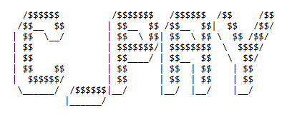
Introduction
What is C-Pay ?
A digital wallet prototype
Why choose C programming ?
Simplicity & Efficiency and Curriculum Based
Key Features
Secure User Authentication & Transaction System
Security Measures
Data Encryption & Robust Validation

Slide 4
Motivation
Global digital wallet impact
Lack of simple & lightweight solutions
Enhancing programming understanding
Real-world application of C programming
Driven by Curiosity

Slide 5
Problem Statement
Security Enhancement
Enhance protection for users’ transactional data
Logical System Design
Develop efficient mechanisms for managing account transfers
Authentication & Validation Robustness
Establish a secure and reliable user sign-in process
Interface Clarity
Design a clear and easy-to-user interface

Slide 6
Project Objectives
To develop a functional prototype by creating a working e-wallet application using C programming for basic financial transactions.
To introduce essential features by implementing core functionalities like balance inquiry, transaction history, and school fee payments to simulate real-world e-wallet operations.

Slide 7
Project Scope
Capabilities
Digital Wallet Operations: Supports basic user registration, login, and transactions
Security Implementation: Includes encryption and secure data storage
Limitations
System Compatibility: Incompatible with 16-bit operating systems
Feature Restrictions: For now, Limited to personal and educational transactions

Slide 8
Project Applications
Prototype Foundation
Serves as a basis for creating sophisticated digital payment platforms
Customization Potential
Adaptable for various commercial and organizational financial operations
Innovation Platform
Provides a framework for integrating new technologies and features into existing financial systems

Slide 9
Methodology [1] (Software Requirements)
IDEs
Visual Studio Code or others like Code::Blocks
Compiler
GCC (GNU Compiler Collection)
Debugger
GDB (GNU Debugger)

Slide 10
Methodology [2] (Hardware Requirements)
Processor
Dual-core (Intel Core i3 or equivalent)
RAM
4GB minimum
Storage
10GB free disk space
Operating System
Windows 7 or later, Linux, macOS
Display
1024x768 resolution minimum

Slide 11
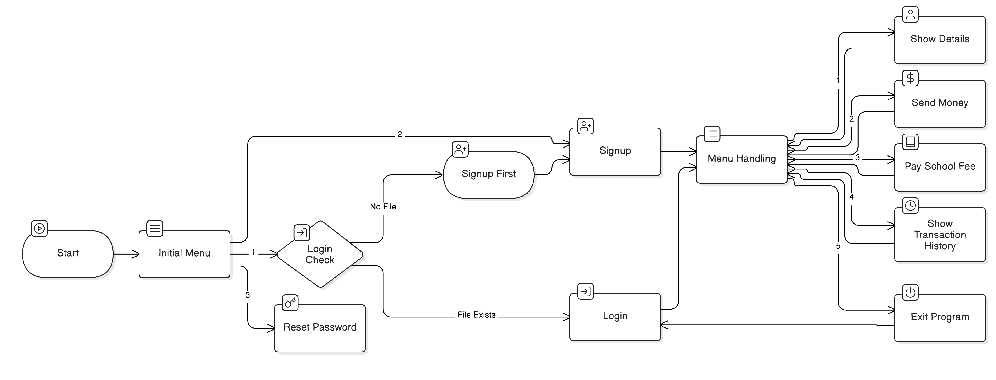
Methodology-[3] (System Block Architecture)
Fig: Overview of the Flow

Slide 12
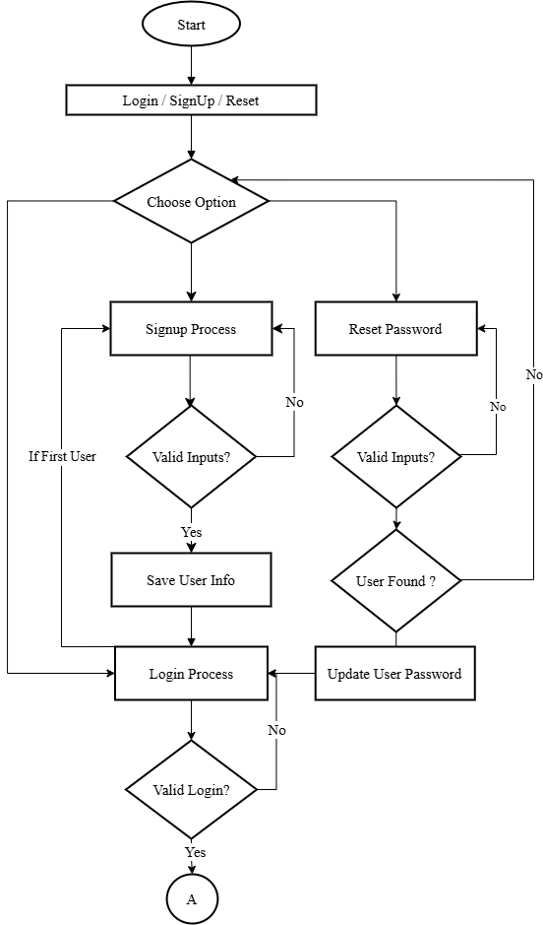
Methodology-[4] (Initial Menu Handling)

Slide 13
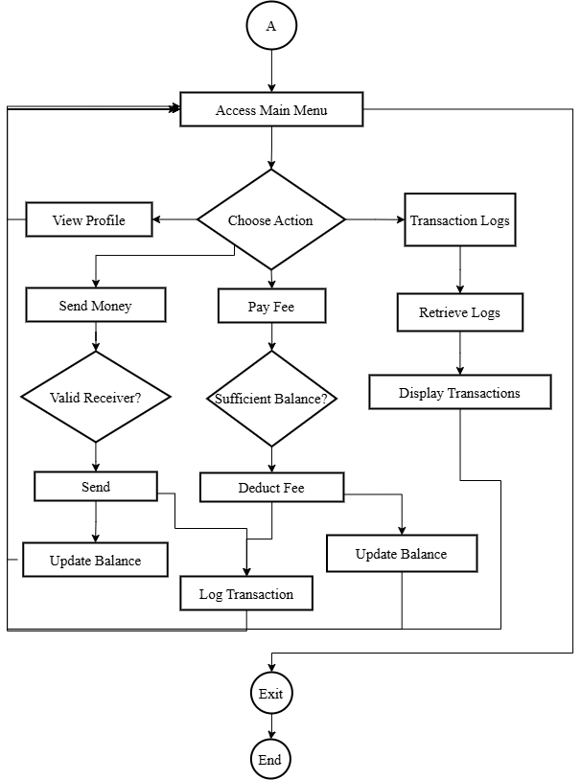
Methodology-[5] (Main Menu Handling)

Slide 14
Methodology-[6] (Working Principle contd…)
Overall Program Flow
main() Function:
Serves as entry point. Initializes UI & offers initial choices (Login, Sign Up, Reset Password)
Data Management
File Handling Functions:
load_user_data() and save_user_data(): Load user profiles & save to .dat files
encrypt() and decrypt(): Save & retrieve user passwords by simple bitwise shift
Validation Functions:
validate_email(), validate_phone(), validate_receiver(): Check for valid input formats and existing data
09/03/2025

Slide 15
Methodology-[7] (Working Principle contd…)
User Account Management
signup() Function:
Registers users by collecting & validating inputs , encrypting the password, and storing all information securely.
Calls: validate_email(), validate_phone(), encrypt(), save_user_data().
login() Function:
Authenticates users by matching input credentials against stored data.
Utilizes: decrypt(), transitions to menu_handling() on successful login.
reset_password() Function:
Allows users to reset passwords after verifying identity via multiple personal details.
Uses: validate_email(), validate_phone(), encrypt(), updates data via save_user_data().
09/03/2025

Slide 16
Methodology-[8] (Working Principle contd…)
Menu Navigation and Operations
menu_handling() Function:
Central hub for navigation : viewing details, sending money, paying fees, viewing transaction history, or exiting.
User Interactions
show_details(): Fetches and displays current user information.
send_money(): Manages money transfers, checks for valid recipient and sufficiency of funds, logs the transaction.
pay_school_fee(): Processes fee payments, verifies sufficiency of funds, and records the transaction.
show_transaction_history(): Retrieves and displays a detailed log of user's past transactions.
09/03/2025

Slide 17
Methodology-[9] (Working Principle contd…)
Transaction and Logging
log_transaction():
Called within send_money() and pay_school_fee() to record each transaction in the system, capturing details like sender, receiver, amount, and type.
Utility and Helper Functions
clear_input_buffer(), delay(), password_taker():
Facilitate user input handling and improve the user interface experience by managing input dynamics and system responses.
System Exit
exit_program():
Ends the program execution gracefully, providing a user-friendly shutdown process.
09/03/2025

Slide 18
Methodology-[10] (Working Principle contd…)
Correlations and Integrations
Each function is designed to interact seamlessly, with data validation and security being central to all user-related operations.
Transaction functions integrate closely with the logging function to ensure all financial activities are accurately recorded.
User interface functions (like those for menu handling and details display) are directly linked to data management functions, ensuring that user interactions are both intuitive and secure.
09/03/2025

Slide 19
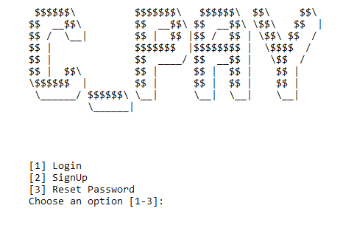
Results & Analysis-[1] (Initial Screen)
User-Friendly Interface: Clear options for easy navigation.
Visual Appeal: Engaging ASCII art and concise prompts.

Slide 20
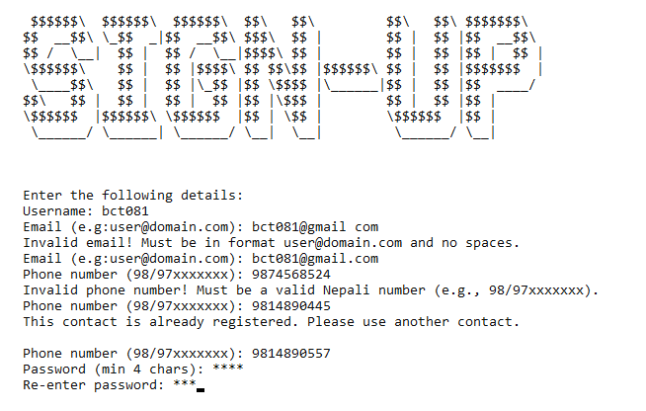
Results & Analysis-[2] (SignUp - Validation)
Comprehensive Validation: Ensures data accuracy and uniqueness.

Slide 21
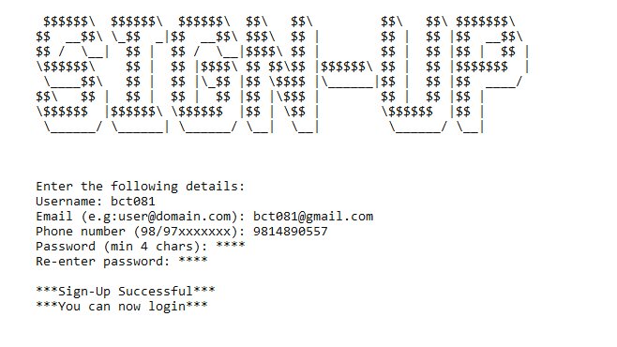
Results & Analysis-[3] (SignUp)
Successful Registration: Validates and confirms successful signup.

Slide 22
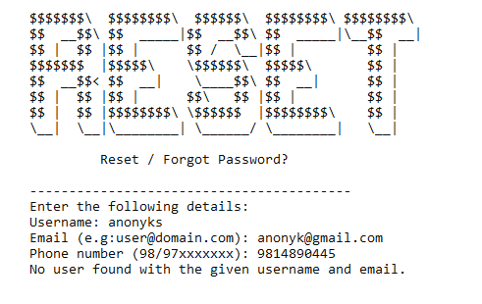
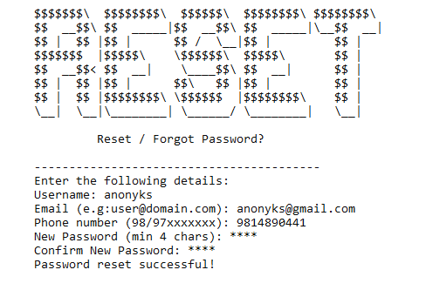
Results & Analysis-[4] (Reset Password)
Security Check: Prevents unauthorized password reset attempts
Successful Reset: Confirms password reset with matched credentials

Slide 23
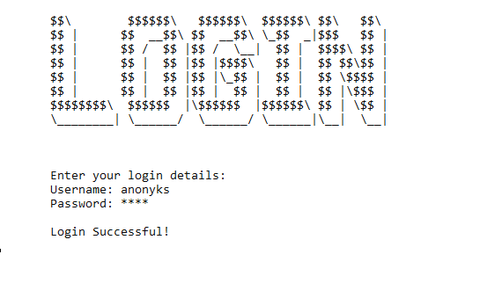
Results & Analysis-[5] (Login)
Login Validation: Successfully validates user credentials and grants access, confirming system security and reliability.

Slide 24
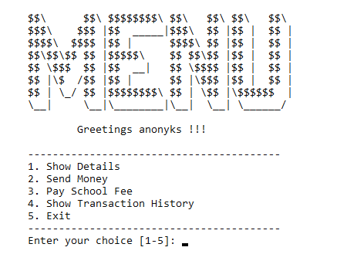
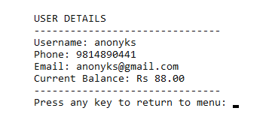
Results & Analysis-[6] (Main Menu & Show Details)
Intuitive Menu: Personalized greeting and clear navigation options.
User Details Display: Accurately shows username, info, and balance.

Slide 25
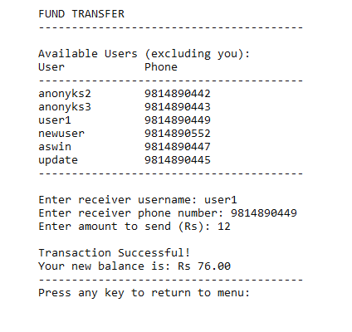
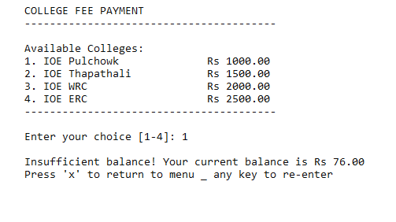
Results & Analysis-[7] (Send Money & Fee)
Balance Check: Alerts on insufficient funds effectively.
Successful Transfer: Confirms transaction and updates balance immediately.

Slide 26
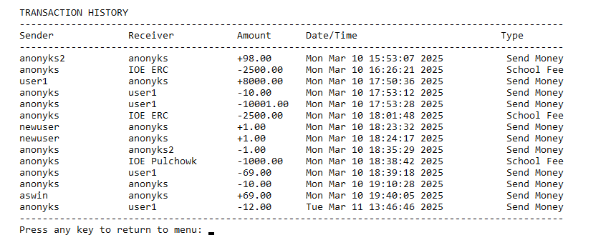
Results & Analysis-[8] (Transaction History)
Detailed Record: Displays comprehensive transaction history with sender, receiver, amount, and timestamps.

Slide 27
Future Enhancements
Graphical User Interface:
Implement a simple GUI using advance libraries
Advanced Encryption:
Upgrade current encryption methods to more robust
Memory Management Enhancements
Multi-Factor Authentication:
Enhance security features using C's cryptographic libraries.
API Integration:
Expand payment capabilities by integrating with banking APIs

Slide 28
Conclusion
Developed a Digital Wallet Using C Programming:
Created an e-wallet application, C-Pay, focused on basic financial transactions and user management, leveraging fundamental C- programming concepts.
Successfully Met Project Objectives:
Achieved the goal of integrating educational programming skills with practical application, demonstrating the feasibility and functionality of the C-Pay system in executing secure transactions and user interactions effectively.

Slide 29
References
[1] “Digital wallet,” Wikipedia [Online]
Available: https://en.wikipedia.org/wiki/Digital_wallet [Accessed: Mar. 11, 2025]
[2] A. Devil, “Programming-Basics,” GitHub [Online]
Available: https://github.com/Astrodevil/Programming-Basics [Accessed: Mar. 11, 2025]
[3] ECB, “2023 Report on Digital Wallets,” European Central Bank, Apr. 24, 2023. [Online] Available:
https://ecb.europa.eu/press/pr/date/2023/html/ecb.pr230424_1_annex~93abdb80da.en.pdf
[Accessed: Mar. 11, 2025]
[4] S. A. Al-Qubati and N. A. Al-Shaibany, “E-Wallet Security Readiness: A Survey,”
International Journal of Computer Science and Mobile Computing, vol. 13, no. 3, pp. 20-26, Mar. 2024.
[Online] Available:
https://ijcsmc.com/docs/papers/March2024/V13I3202410.pdf [Accessed: Mar. 11, 2025]
[5] "C-Authentication Program with Username & Password," Learn eTutorials. [Online]. Available:
https://learnetutorials.com/c-programming/programs/authentication-program [Accessed: Mar. 11, 2025]

Slide 30
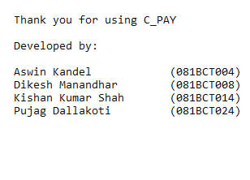
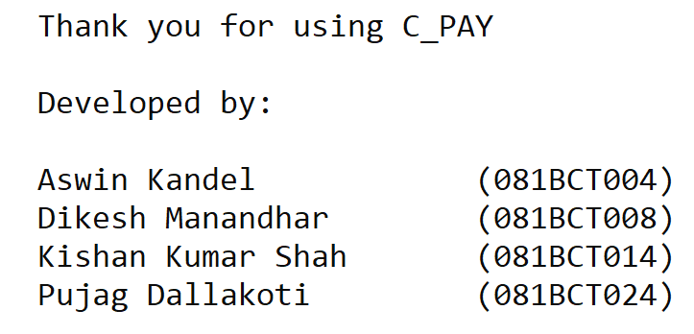
Thank You

