Slide 1
BOOK STORE MANAGEMENT SYSTEM
Presented by:
Alok Sharma (THA081BEI004)
Anvil Shakya (THA081BEI006)
Abhiyan Sharma Khawas (THA081BEI008)
Nishan Parajuli (THA081BEI023)
Department of Electronics and Computer Engineering
Thapathali Campus, IOE
March,2025

Slide 2
Background
Observed inefficient book store activity,
Need for a modern automated system ,
Helps in:
Book cataloging
Sales tracking
Record keeping and updating

Slide 3
Objectives
Automate the manual processes of book store management,
Maintain database of products
To facilitate the worker in their specified tasks,
To generate reports on book availability, sales

Slide 4
Applications
Strengthening the foundation of programming,
Developing flexible and easy to maintain application with reliability and efficiency,
Maintaining the versatility of the program.
Helping to solve a real world problem with the tools given.

Slide 5
Tools Used
Github
Visual Studio Code
Discord

Slide 6
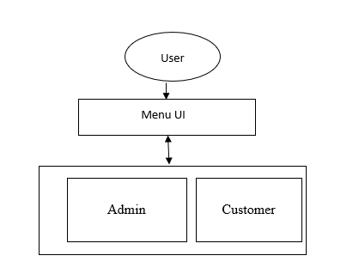
System Architecture

Slide 7
Parts of the Program

Slide 8
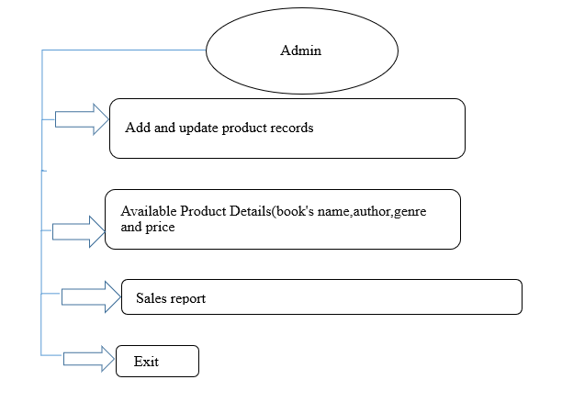

Slide 9
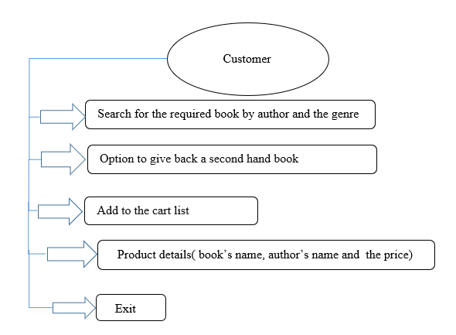

Slide 10
Text files used
Book_list.txt
Second_hand.txt
Cart.txt
sales_report.txt

Slide 11
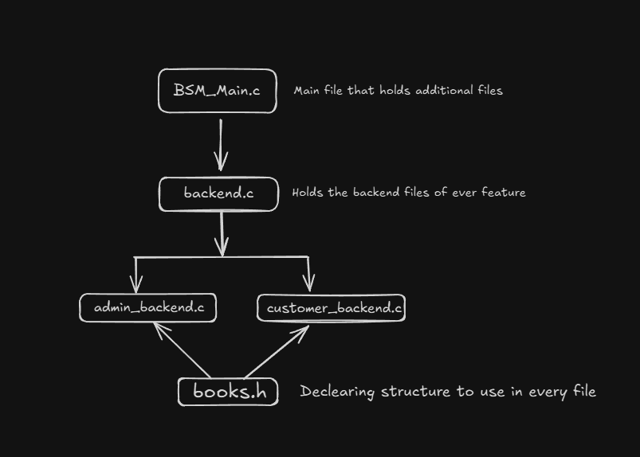
Code Structure

Slide 12
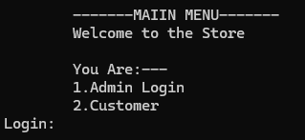
Main Page

Slide 13
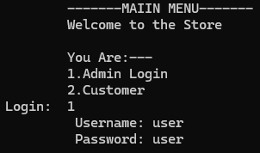
Admin login Page

Slide 14
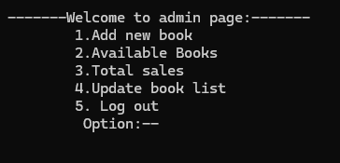
Admin Menu

Slide 15
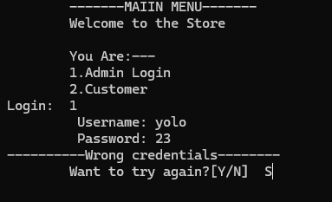
Admin Login error

Slide 16
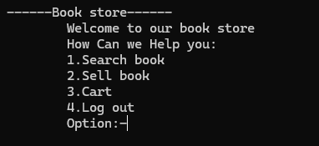
Customer Menu

Slide 17
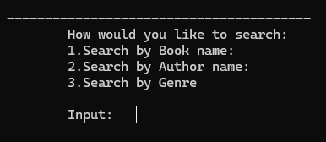
Search Menu Option

Slide 18
Limitation
No GUI accesss
Less security and integrity
Password fixing between client and developer
Possible error due to invalid inputs
Less search and filter options for customer

Slide 19
FUTURE ENHANCEMENT
Having proper security through password hashing
Adding more search and filter options for customer
Integrating online payment method (paypal, esewa) along with a GUI interface for much more easy functionality.
Allowing data to be exported to excel or database (SQL)

Slide 20
Conclusion
Creates an impactful tool for small-medium scale businesses
Simplifies the store activity incorporating C language

Slide 21

Q/A

