Slide 1
TrackHer - Period Tracking Calendar
Lecturer : Prajwal Pakka Sir
Prajwal Khanal (THA081BEI028)
Ranjhana Kumari Jha (THA081BEI034)
Shakshi Gyawali (THA081BEI037)
Shaunak Baniya (THA081BEI038)
Department of Electronics and Computer Engineering
Institute of Engineering, Thapathali Campus
March 16, 2025

Slide 2
Introduction
- A lightweight, offline period tracking app in C and GTK
- developed with the aim of tracking menstrual cycles, estimating ovulation and fertility
- Emphasizes data privacy with secure encryption
-Built With:
Language: C
Graphics Library: Raylib
March 16 1

Slide 3

Features
Menstrual Cycle Tracking: Log period dates, symptoms
Cycle Prediction: Forecast
next period & fertility
Calendar View – A visual
period tracker for easy
navigation.
March 16 2

Slide 4
Technical Stack
Programming Language: C
Graphics Library: Raylib
Database: File-based storage (or a lightweight database)
Development Tools: GCC Compiler, VS Code, Figma (for UI design)
March 16 3

Slide 5
User Interface Design
Design Process:
Figma as Inspiration – Designed a clean, user-friendly interface.
Raylib for UI Implementation – Created an interactive UI using C and Raylib.
March 16 4

Slide 6
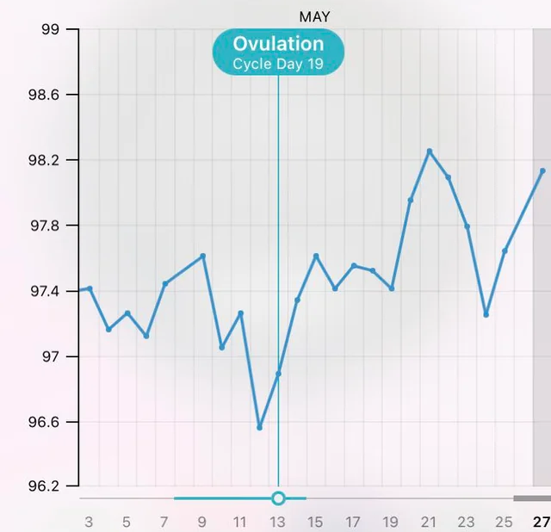
User Interface Design
March 16 5

Slide 7
Workflow
User Inputs Data: Period start date, symptoms, cycle length.
Data Processing: The system predicts the next cycle using stored data.
Calendar Display: Highlights period days, predicts future cycles.
Secure Login: Ensures privacy and personalized tracking.
March 16 6

Slide 8
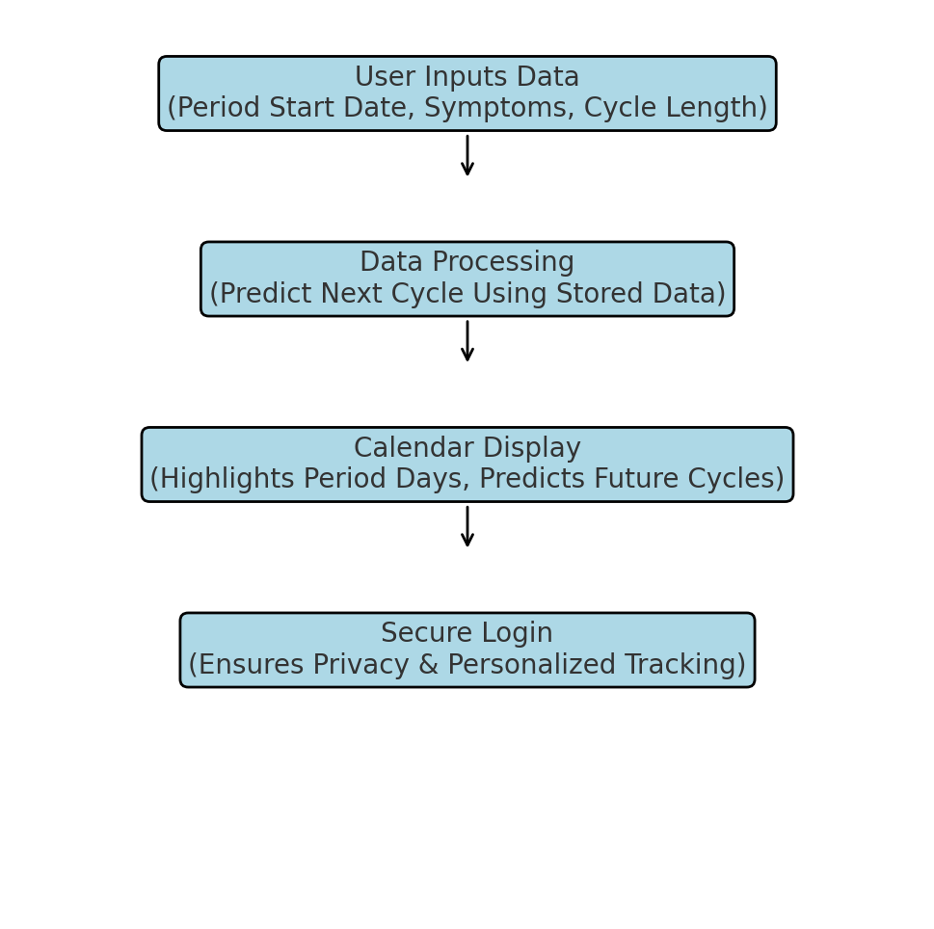
Flowchart Diagram
March 16 7

Slide 9
Data Security
Offline Mode:
No internet dependency for privacy
March 16 8

Slide 10
Challenges faces and Their Solutions
UI Implementation in C – Raylib helped us create a smooth graphical interface.
Data Storage & Retrieval – Used file handling techniques for efficient data storage.
Predicting Irregular Cycles – Basic algorithm currently; future updates will improve predictions.
March 16 9

Slide 11
Scopes for Improvement
Push Notifications – Reminders for upcoming periods.
AI-based Symptom Analysis – Smart insights based on user input.
Cloud Sync – Secure backup of period tracking data.
Custom Themes – Enhanced UI/UX.
March 16 10

Slide 12
Conclusion
TrackHer offers a secure, offline solution for menstrual health tracking, combining user-friendly design with robust data privacy measures.
Empowering you to track, understand, and embrace your cycle—because when you know your body, you can better care for it
March 16 11

Slide 13

END OF PRESENTATION

