Slide 1
Hospital Management System
Presented By:
Leah Khatiwada
Roshni Thapa
Nirjala Shrestha
Parash Neupane

Slide 2
Introduction
hospital management system, is a computer system that helps to manage information related to health care
It is aim to record each and every transactions of the hospital and preserve securely.
The data includes the names of those who received the treatment as well as the current status of doctor availability.

Slide 3
Table of contents
01
03
02
04
Objectives
Module
Language
Importance
05
Advantage
06
Conclusion

Slide 4
01
Objectives

Slide 5
A project which aims all the developing a computerized system to maintain all the information of hospital entities .
Facility of admin to login
Admin can access and modify the database content
Modules are managing doctors , patients and appointments
Find doctors if they are available or not

Slide 6
02
Language

Slide 7
High level Language – JAVA Graphical User Interface (GUI) – JAVA SWINGS Backend Database – MySQL

Slide 8
Doctors Module
Add doctor
View Records
Use to add the details of doctor
Used to view record of doctors
Edit Doctor
Fire Doctor
Used to edit the details like name specialization
To fire the doctor

Slide 9
Patients Module
ID
Patient’s Name
Disease
Id of the patient
Name of the patient
Disease of patient
Admit Date
Admit Time
Todays current date
Current time

Slide 10
04
IMPORTANCE

Slide 11
- Maintain the medical record of the patient - Time saving technology - Reduce the scope for error -Reduce the work of documentation -increases the competency of related hospital legitimately -improve the hospital quality -to secure the data related to patients and doctors

Slide 12
05
Benefits

Slide 13
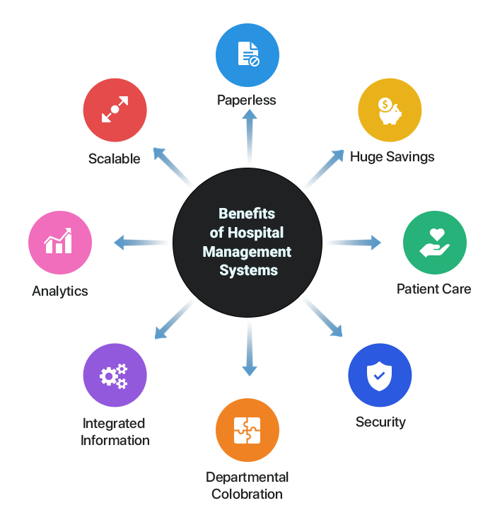

Slide 14
05
Screenshots

Slide 15
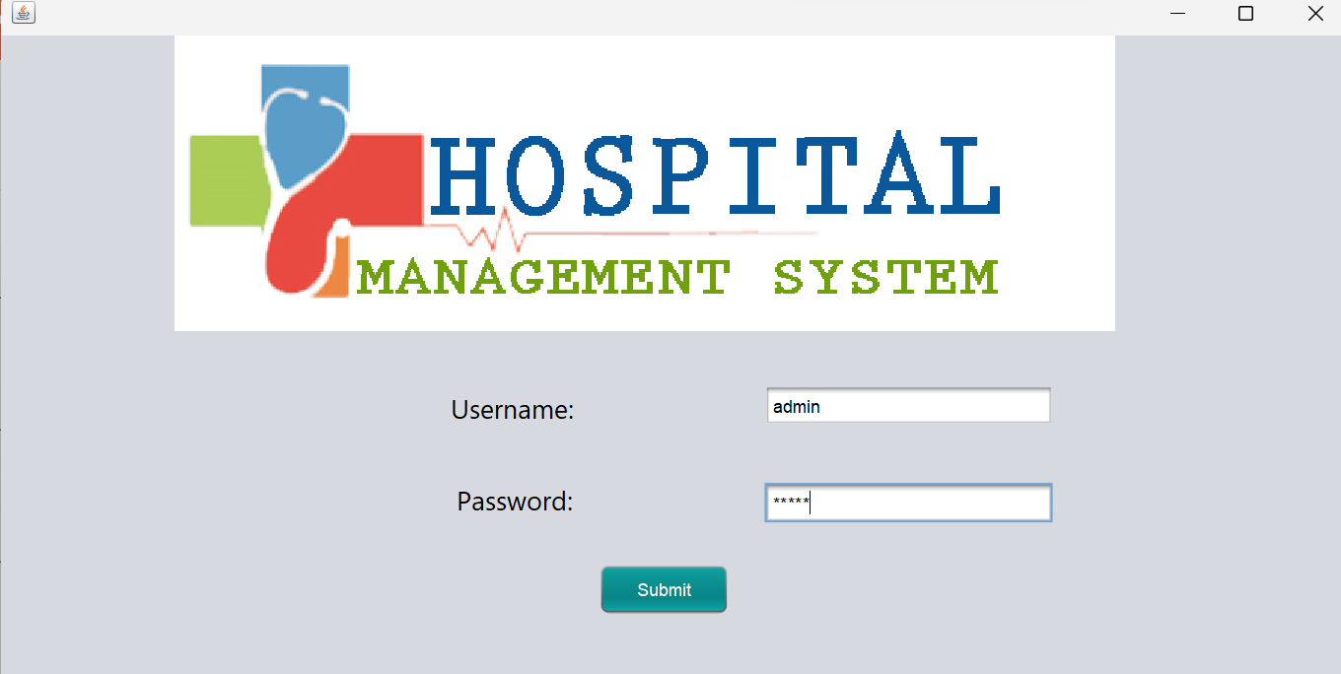
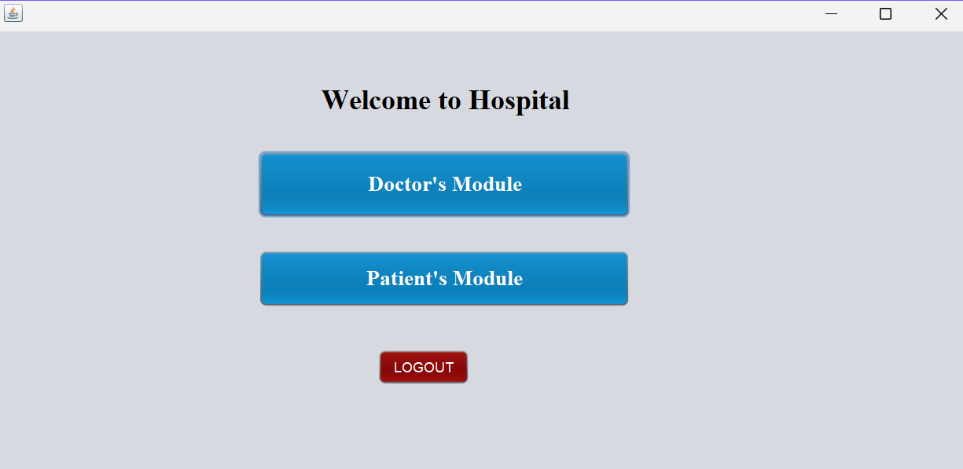

Slide 16
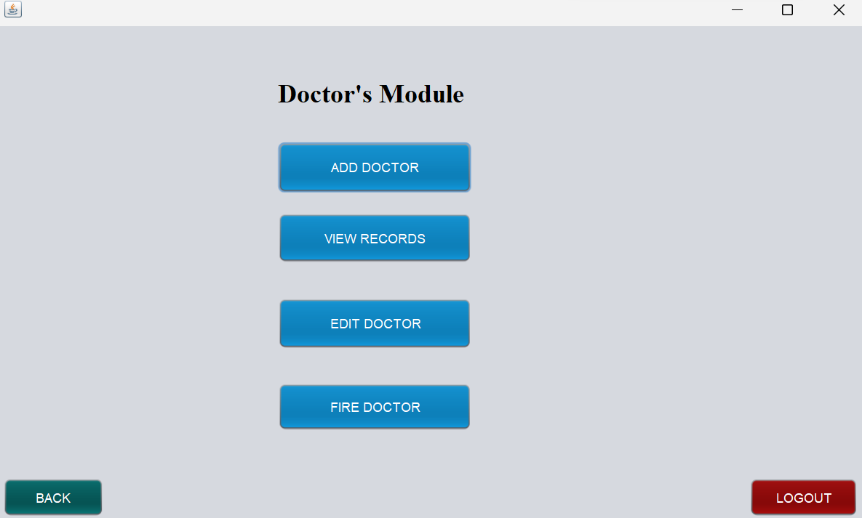
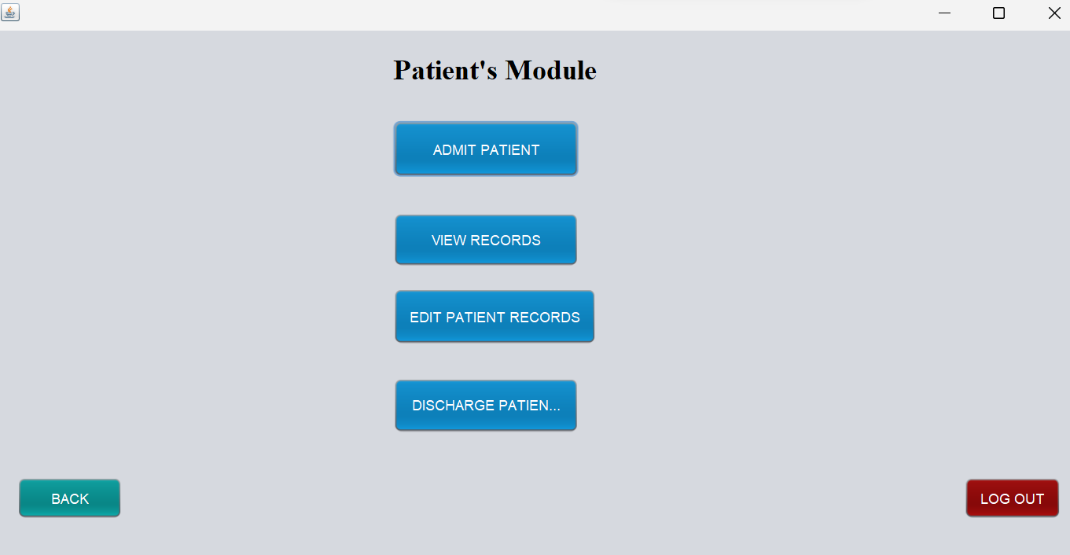

Slide 17
Conclusions
-implementation of hospital management system project helps to store all kinds of records provide coordination and user communication, implement policies , improve day to day operation.
-it is all about modernizing a hospital through use of technology

