Slide 1


Slide 2
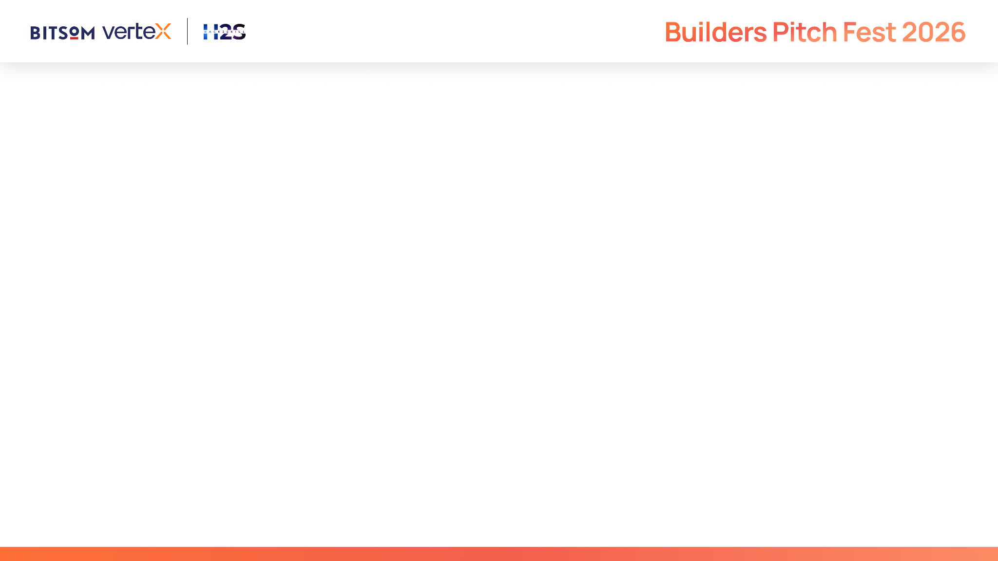
IMPORTANT
This submission deck is designed to help you present your startup in a structured and consistent manner. It enables reviewers to evaluate your solution across product, technology, AI innovation, business viability, customer validation, and enterprise readiness.
Strong submissions will demonstrate:
A clearly validated customer problem and market opportunity
Meaningful and responsible application of AI to solve the problem
Technical depth through a scalable and well-designed architecture
Product maturity supported by customer validation and measurable traction
A sustainable business model with a clear go-to-market strategy
A compelling vision for growth through the BITSoM Vertex incubation programme
Guidelines
This is not a traditional fundraising pitch deck.
Focus on demonstrating the reasoning behind your decisions rather than making marketing claims.
Wherever applicable, support your responses with evidence, metrics, customer insights, product screenshots, architecture diagrams, user journeys, and other relevant visuals.
Not every question may be applicable to every startup. Answer the questions that are most relevant to your solution and provide sufficient context to help reviewers understand your approach.

Slide 3
Startup Snapshot
What does your startup do
What milestone best represents your progress so far?

Slide 4
Problem Understanding
What problem are you solving, and who experiences it most acutely?
What evidence validates that this is a meaningful problem worth solving?

Slide 5
Customer & Market
Who is your ideal customer, and who makes the buying decision?
How large is the opportunity you are targeting?

Slide 6
Solution Overview
What is your solution, and how does it solve the identified problem?
What are the core capabilities of your product?
What measurable value does your solution deliver?

Slide 7
Technology & AI Architecture
How is your solution architecture end-to-end, including data flow and major system components?
What role does AI play within your solution, and which capabilities or workflows are powered by it?

Slide 8
Competitive Advantage
What alternatives exist today, and how does your solution compare?
If a foundation-model provider shipped this feature tomorrow, why do you still win?

Slide 9
Vision & Roadmap
What are your next major product and business milestones?
What is your long-term vision for the startup?

Slide 10
Team
Why is your team uniquely positioned to solve this problem?
What domain and technical expertise does the founding team bring?

Slide 11
Why BITSoM Vertex?
Why have you applied to the BITSoM Vertex programme?
Which challenge is currently limiting your startup's growth?

Slide 12
Supporting Material
Provide links to your:
Deployed Project Link
Project Demo Video (3–5 Minutes)
Website
GitHub Repository (if applicable)
Product Documentation
Contact Details

Slide 13


