Slide 1



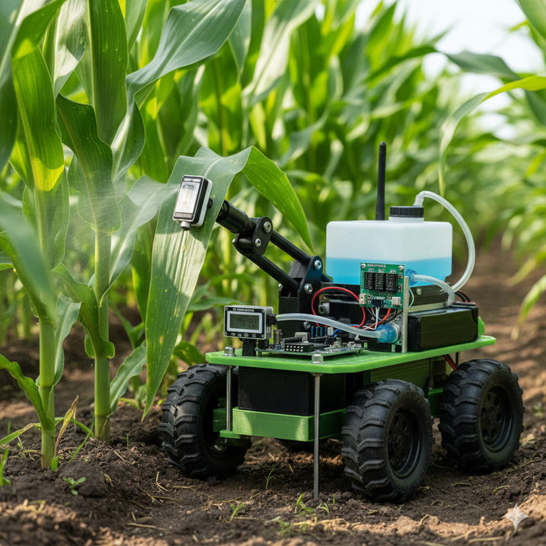


SHOCKWAVE
SQUAD
SMART INDIA HACKATHON 2025
  Problem Statement ID –
  Title: Intelligent Pesticide Sprinkling System Determined by Plant Infection Level
  Theme: AgriTech / IoT / Smart Farming
  Category: Hardware
  Team ID & Team Name

Slide 2
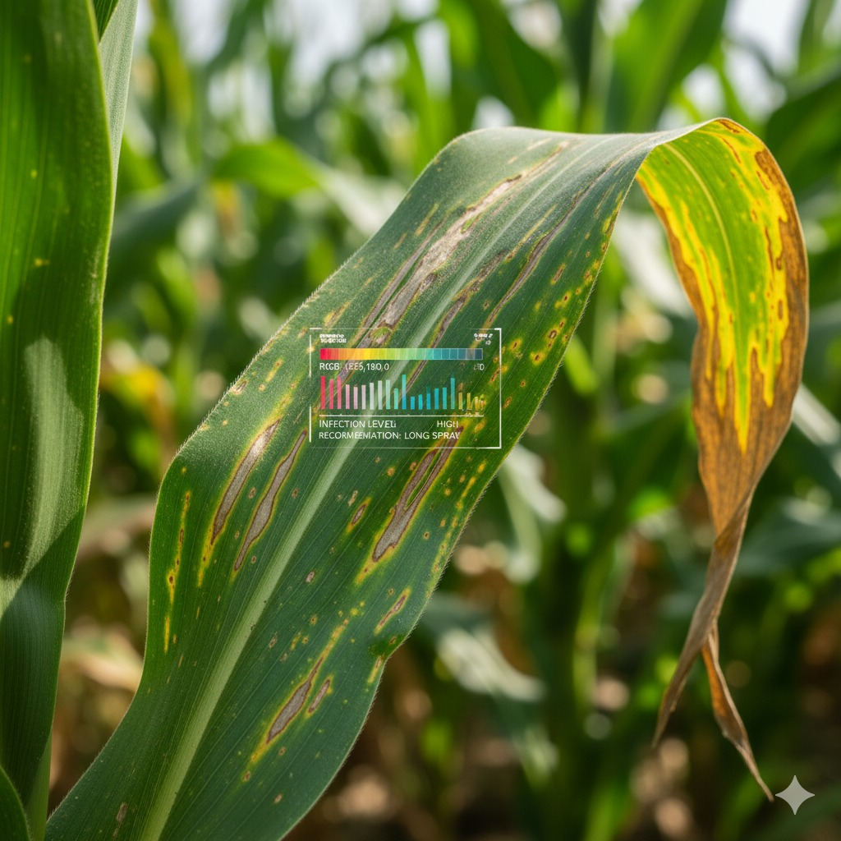
SHOCKWAVE
SQUAD
SMART INFECTION-AWARE PESTICIDE SPRINKLER
  Proposed Solution
    IoT-based system with sensors (color, humidity, soil).
    Detects infection levels in real-time using sensors.
    Activates pesticide spray only when infection risk ≥ threshold.
  How it addresses the problem
    Prevents excess pesticide use
    Reduces farmer cost & environmental damage
  Innovation & Uniqueness
    Multi-sensor approach (not just vision-based)
    Autonomous decision-making with manual override
    Low-cost, scalable, farmer-friendly
  Health Impact:
Reduces chemical exposure for farmers and ensures safer, healthier crops.
Produces safer, pesticide-controlled crops for consumers.

Slide 3
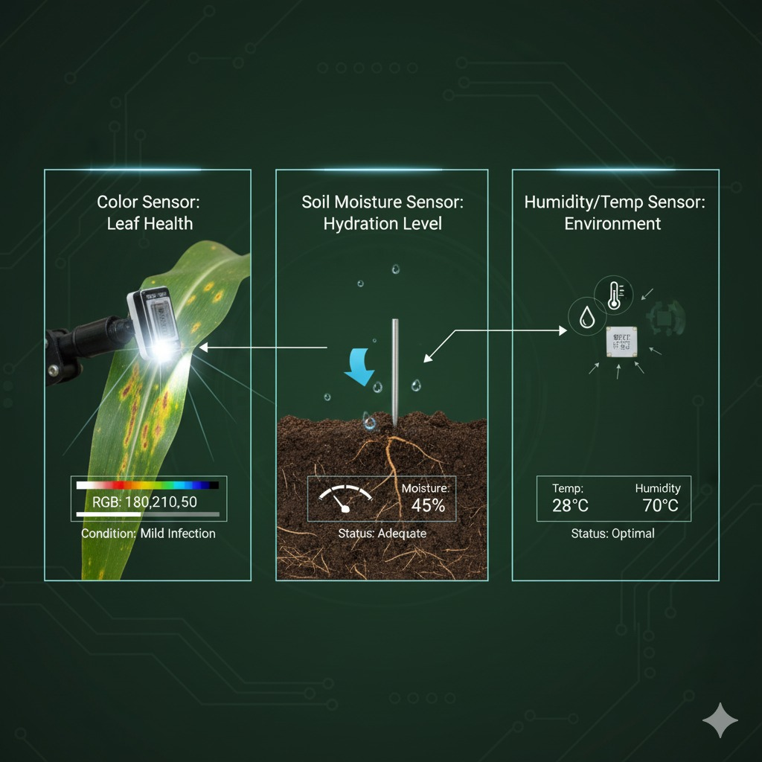
SHOCKWAVE
SQUAD
TECHNICAL APPROACH
  Technologies
  Hardware : ESP32, TCS34725 (color), DHT22 (humidity/temp), capacitive soil sensor, MOSFET-driven pump
  Communication: Wi-Fi/Bluetooth (IoT monitoring)
  Software: Embedded C/C++, threshold logic, simple ML upgrade scope

Slide 4
SHOCKWAVE
SQUAD
METHODOLOGY
Sensing Module: Color, Humidity/Temp, Soil Moisture, Leaf Wetness sensors collect real-time crop data.
Processing: ESP32 processes readings, compares with calibrated healthy crop values.
Infection Detection: Infection Index calculated using thresholds (upgradeable to ML).
Decision Logic:
  If Index ≥ Threshold → Trigger pump
  Spray for calibrated duration
  Cool-down to avoid overdose
  IoT Integration (optional): Data logging, farmer alerts, manual override.
  Prototype & Testing: Validate on crops, fine-tune thresholds, ensure rugged & scalable design.

Slide 5
SHOCKWAVE
SQUAD
FEASIBILITY & VIABILITY
  Feasibility
  Uses low-cost, readily available sensors
  Easy to assemble with existing agri-tools
  Challenges
  Calibration for different crops
  Power supply in remote farms
  Weatherproofing hardware
  Mitigation
  Provide standard calibration sheet per crop
  Solar-powered battery option
  Rugged, waterproof casing

Slide 6
SHOCKWAVE
SQUAD
IMPACT & BENEFITS
  Impact on Farmers
    Reduces chemical exposure & pesticide cost (up to 40%)
    Increases crop yield & quality
  Wider Benefits
    Environmental: Prevents soil/water contamination
    Social: Safer food, better health
    Economic: Affordable & scalable for small farmers

Slide 7
SHOCKWAVE
SQUAD
RESEARCH & REFERENCES
  Research papers on smart agriculture IoT systems
  Government agri-tech reports (ICAR, FAO, etc.)
  Open-source IoT farming projects
  Sensor datasheets & pump calibration studies

Slide 8
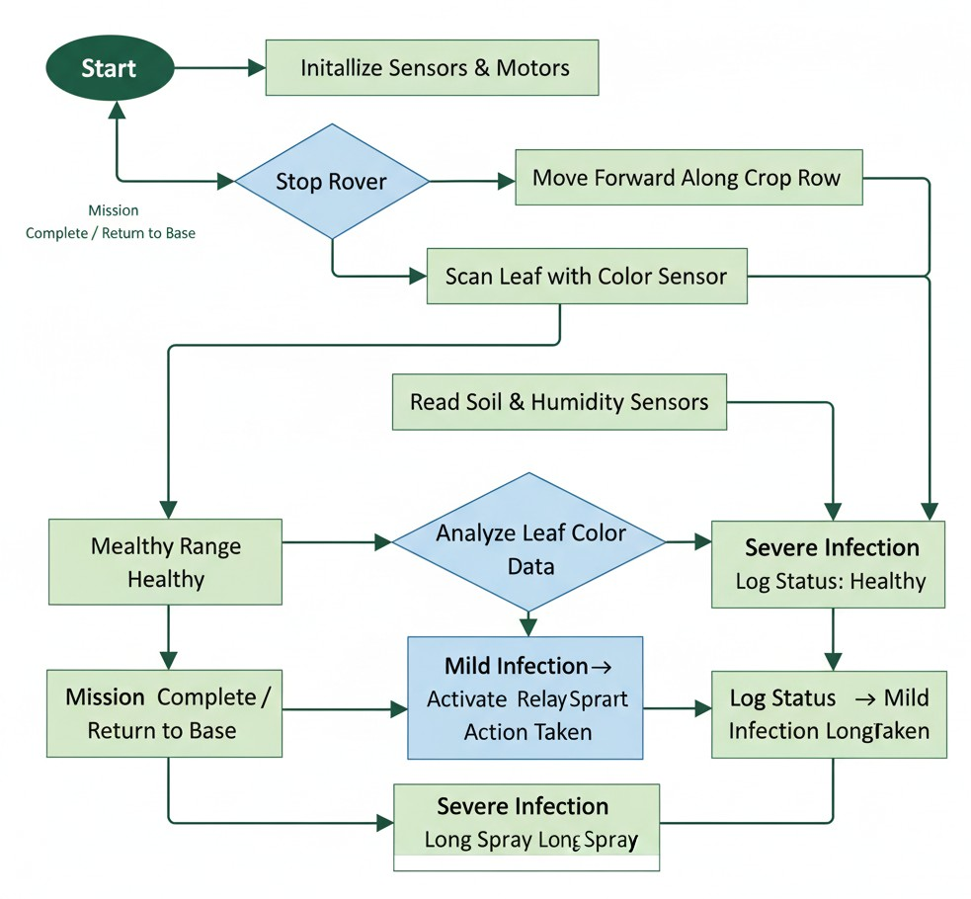
SHOCKWAVE
SQUAD

Slide 9






SHOCKWAVE
SQUAD

Slide 10
SHOCKWAVE
SQUAD
THANK YOU !

