Slide 1

NEWS PORTAL
Presented By:
ROHIT AGRAWAL
PRAJWOL THAPA
SALIN DEV NAKARMI
NABIN SHAHI
Parameshwor rokaha
Deep kumar maharjan

Slide 2
INTRODUCTION
Developed for the purpose of providing news to all viewers.
User satisfaction related news will be published.
Developed using django.

Slide 3
OBJECTIVES
Develop a dynamic website for online news portal system full of relevant information and easy to use.
Supplying with news according to user ‘s priority
Providing as possible accurate news from multiple sources.

Slide 4
LITERATURE REVIEW
Online khabar
eKantipur
Nagarik news

Slide 5
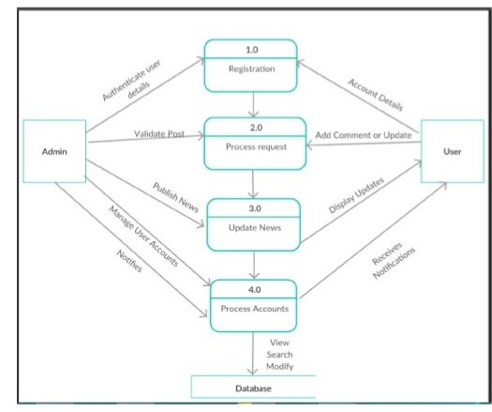
Data Flow Diagram

Slide 6
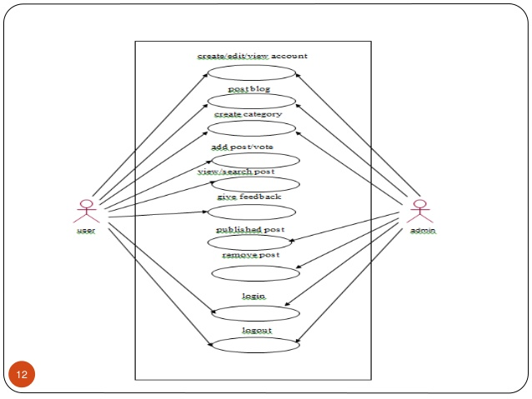
Use Case Diagram

Slide 7
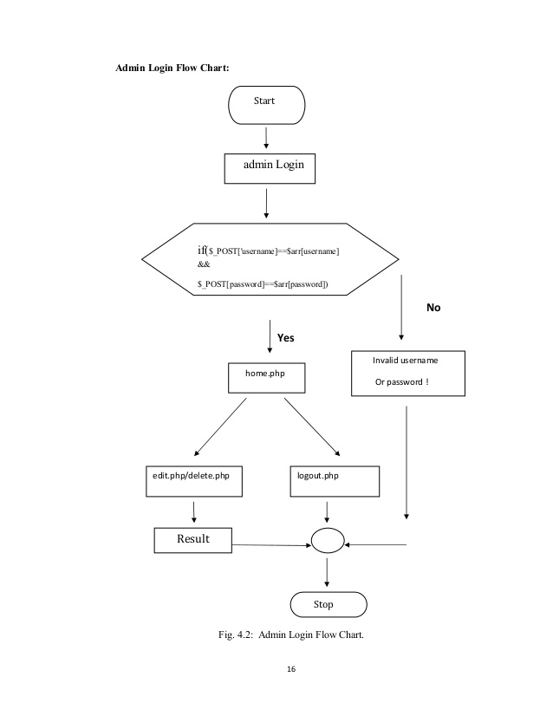
Block Diagram

Slide 8
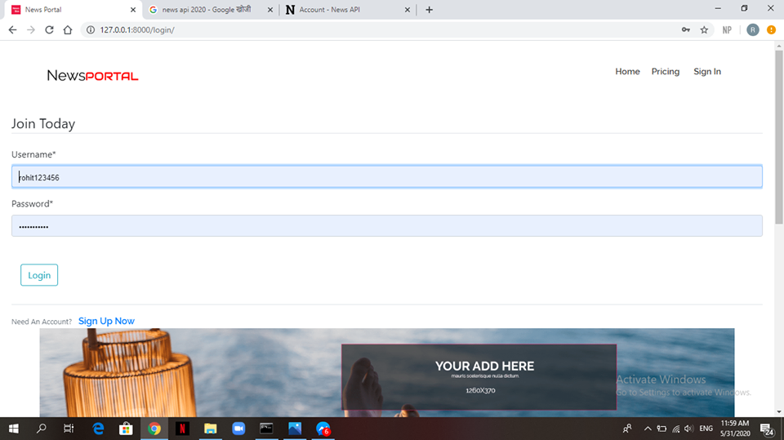
Login Interface

Slide 9
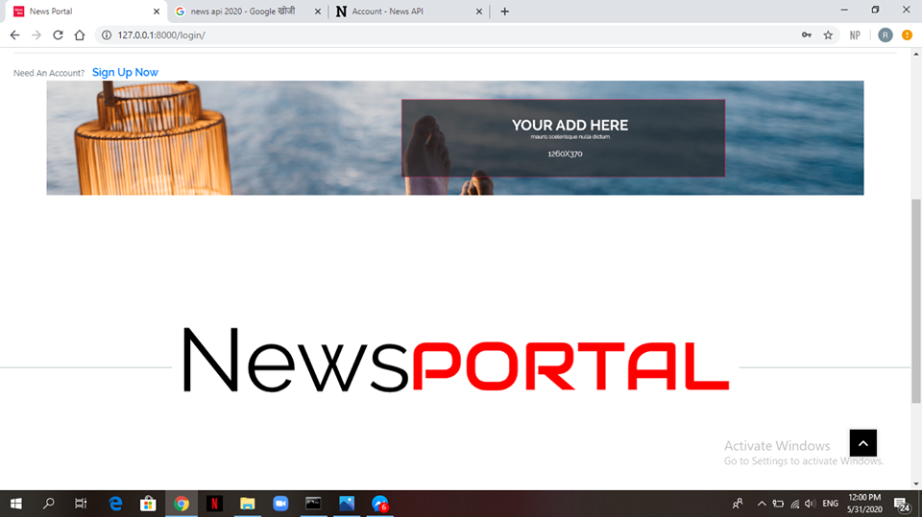
Advertisement Page

Slide 10
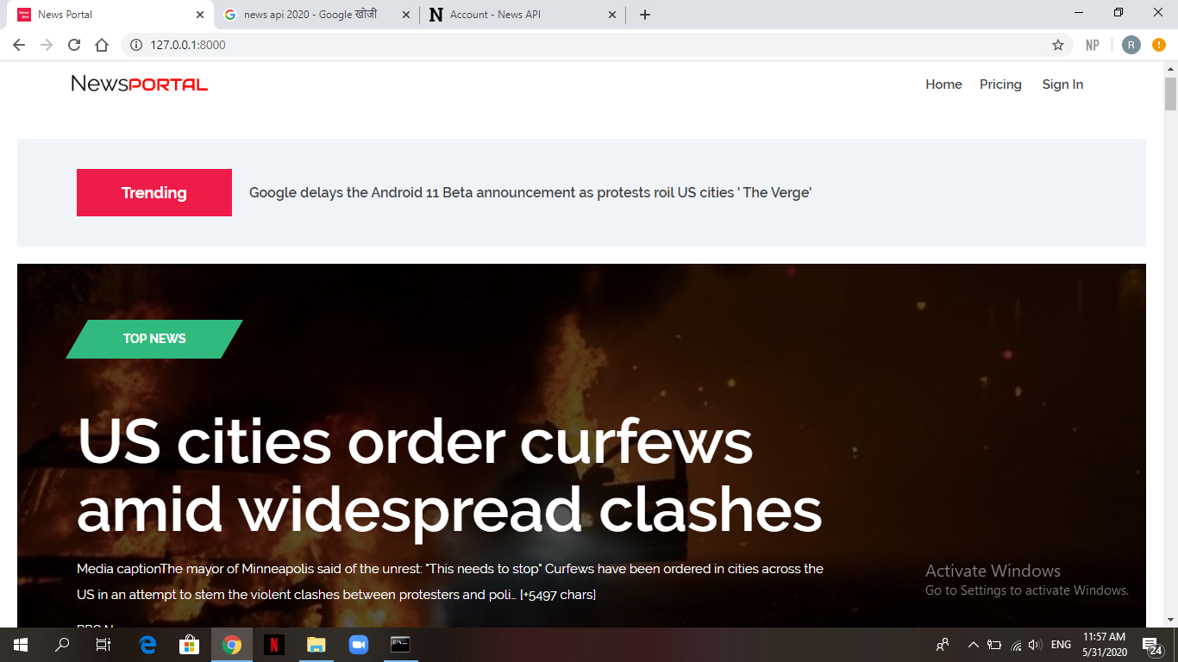
User Interface

Slide 11
REVENUE MODEL
Advertisement
Live events
Selling subscriptions
Sponsorships

Slide 12
ANY QUERIES???

Slide 13
Thank You

