Slide 1

Samsung Campaigns Analysis
Analysis Period: 2022-2024

Slide 2
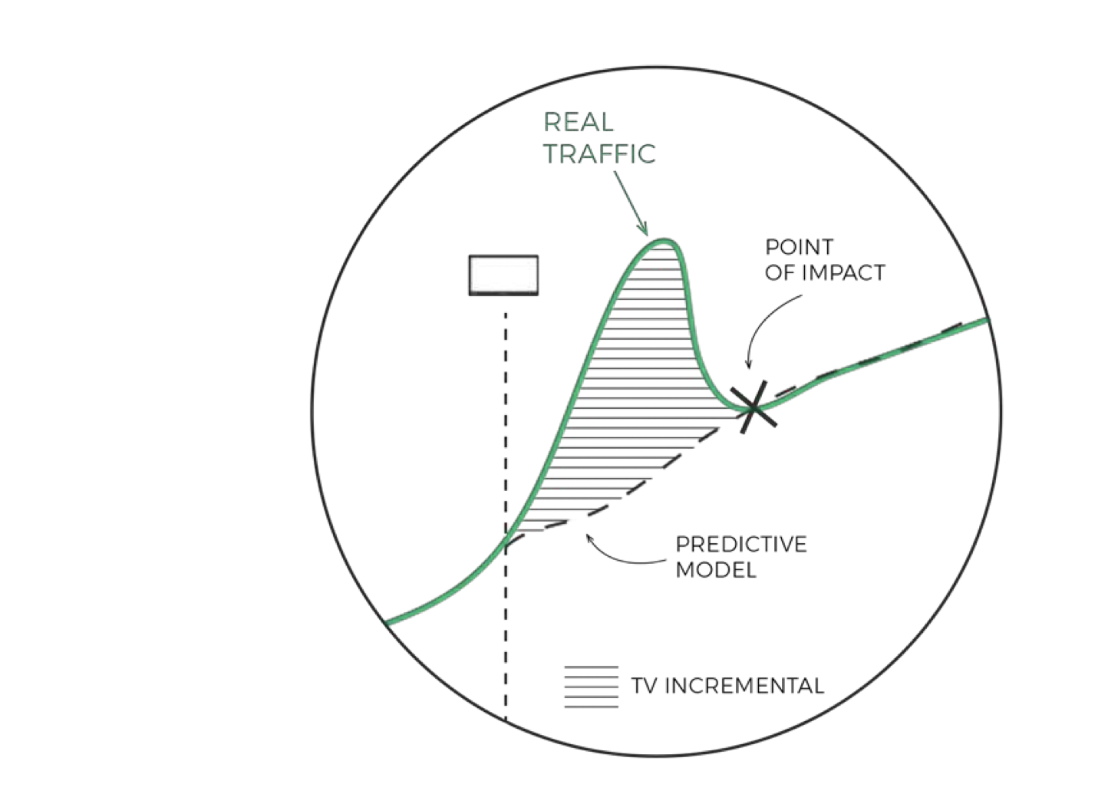
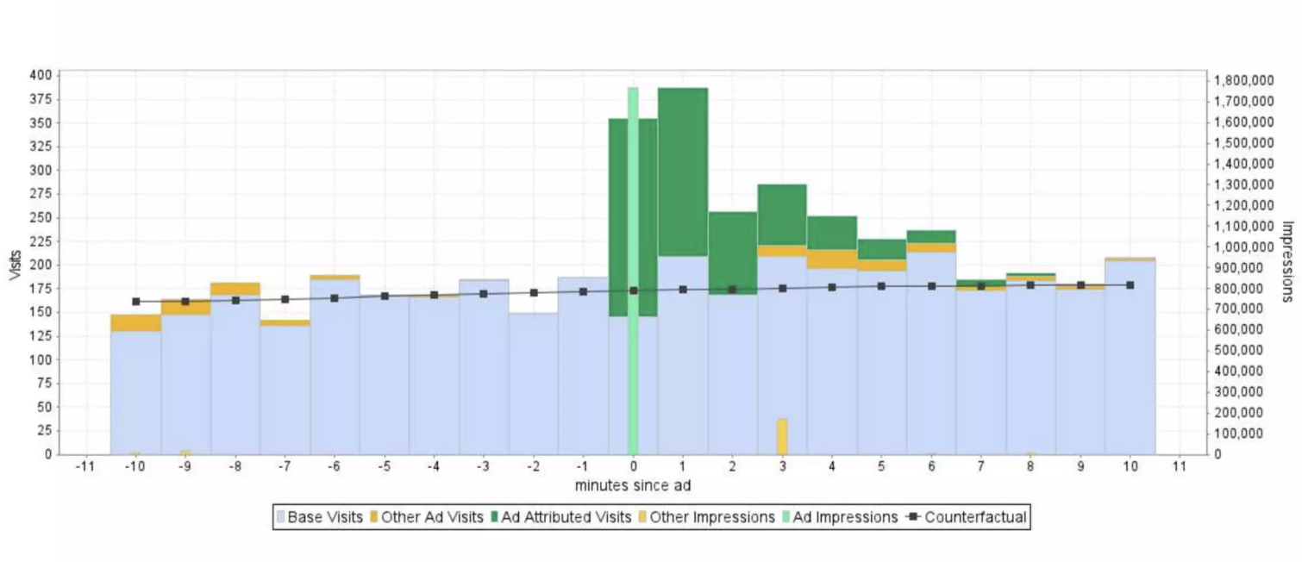
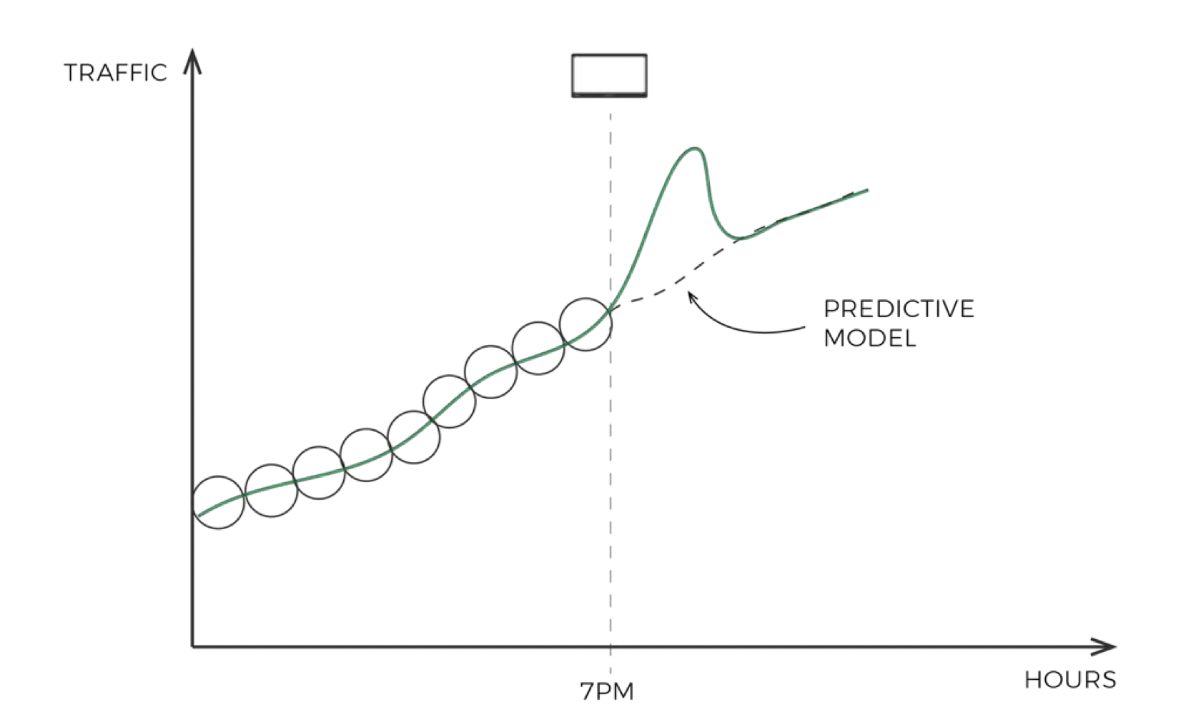
Analysis Methodology: Attribution Measurement Methodology
1
Identify Attribution window [actual data]
2
Identify Incremental impact over the dynamic baseline
3
Distribution of impact back to media
Correlation
Hours
Illustration
Illustration
A simulation is done for Hour/minutes level cohorts w.r.t Spots and correlation is measured and plotted. GSV were broken into hours level.
Bayesian algorithms (a statistical approach that makes use of prior knowledge to estimate the probability of an event ) are used to identify dynamic baselines for each cohort
Cohort level incremental impact is distributed back to each media / spot with the help of distribution and impression curves

Slide 3
Understanding Impact
#Attribution Measurement Definition
Definitions
Understanding Graphs
EFFICIENCY: Lift observed in Google search volume (GSV) per unit of cost. If this is more than 1, then returns are positive else returns are negative.
EFFECTIVENESS: Lift observed in Google search volume (GSV) per unit impressions. If this is more than 1, then returns are positive else returns are negative.
IMPACT: Incremental Google search volume
INPUT VARIABLE: Media wise Impressions, costs
OUTPUT/DRIVER VARIABLE: Google Search Volume (GSV)
SIGNIFICANCE RANGE: 90% Confidence level (p = 0.01)
Best performing media channel
2
Channels in this zone are effective but not efficient
1
Non- performing Media channels
Channels in this zone are efficient but not effective
Effectiveness
0
1
2
Efficiency
Note: Current Analysis is only considering immediate effect of media and doesn’t include any ad-stock effect leading to mid or long-term media impact

Slide 4
Considerations & Caveats
What to expect
Media Attribution & Impact: Quantifies lift contribution across media channels.
Granular Seasonality Adjustments: Hourly-level seasonality effects are already integrated into the attribution model.
Broad Seasonality Trends: Daily, weekly, and monthly seasonality are derived using standard approaches and incorporated for deeper impact analysis.
TV Performance by Channel: Assesses the effectiveness and influence of TV campaigns across networks.
Influencer GRP to cost conversion : An approx. cost of influencer is taken using 1GRP = 0.02 Million views
Forecasting-Based Estimations: A portion of the analysis relies on forecasting, which introduces a margin of error in final results

Slide 5
~15% long term lift in Google trends for Samsung
Samsung Lift Analysis
Take-away | Why it matters
1. Every heavy burst of paid video (TV + YouTube) pushed Google-search interest sharply above baseline. | We see three distinct activations – Aug ’22 (+41 % peak-to-pre), Aug ’23 (+22 %) and Jul ’24 (+51 %).
2. The floor keeps rising –“baseline” trend is ~15 % higher today than before the first burst. | Even after the spikes subside, Samsung is retaining part of the gain. Paid video is building durable brand equity, not just creating momentary noise.
3. 2024 delivered the biggest single-week lift despite a smaller overall GRP flight. | A more concentrated schedule, refreshed creative and the YouTube influencer drop combined for the best spike-to-GRP ratio so far.
4. YouTube injections (orange bars) amplify the TV spikes and lengthen the tail. | In all three bursts the GRP bars end first, but search interest decays more slowly – the long-tail effect coincides with the influencer live dates.
5. Momentum now sustains even in “dark” weeks – twice the level at the very start of 2022. | The compounding effect means each new burst starts from a higher baseline, so future media can work harder.
Lift ->
41%
22%
51%
Lifts are calculated w.r.t pre-period
Growing trend line
Three tightly-timed video bursts have more than approx. doubled Samsung’s organic search momentum, with each successive wave starting higher and lifting faster – evidence that TV and Youtube is stacking, not resetting

Slide 6

Now let’s look at channel wise performance for each year and then consolidated insights …

Slide 7
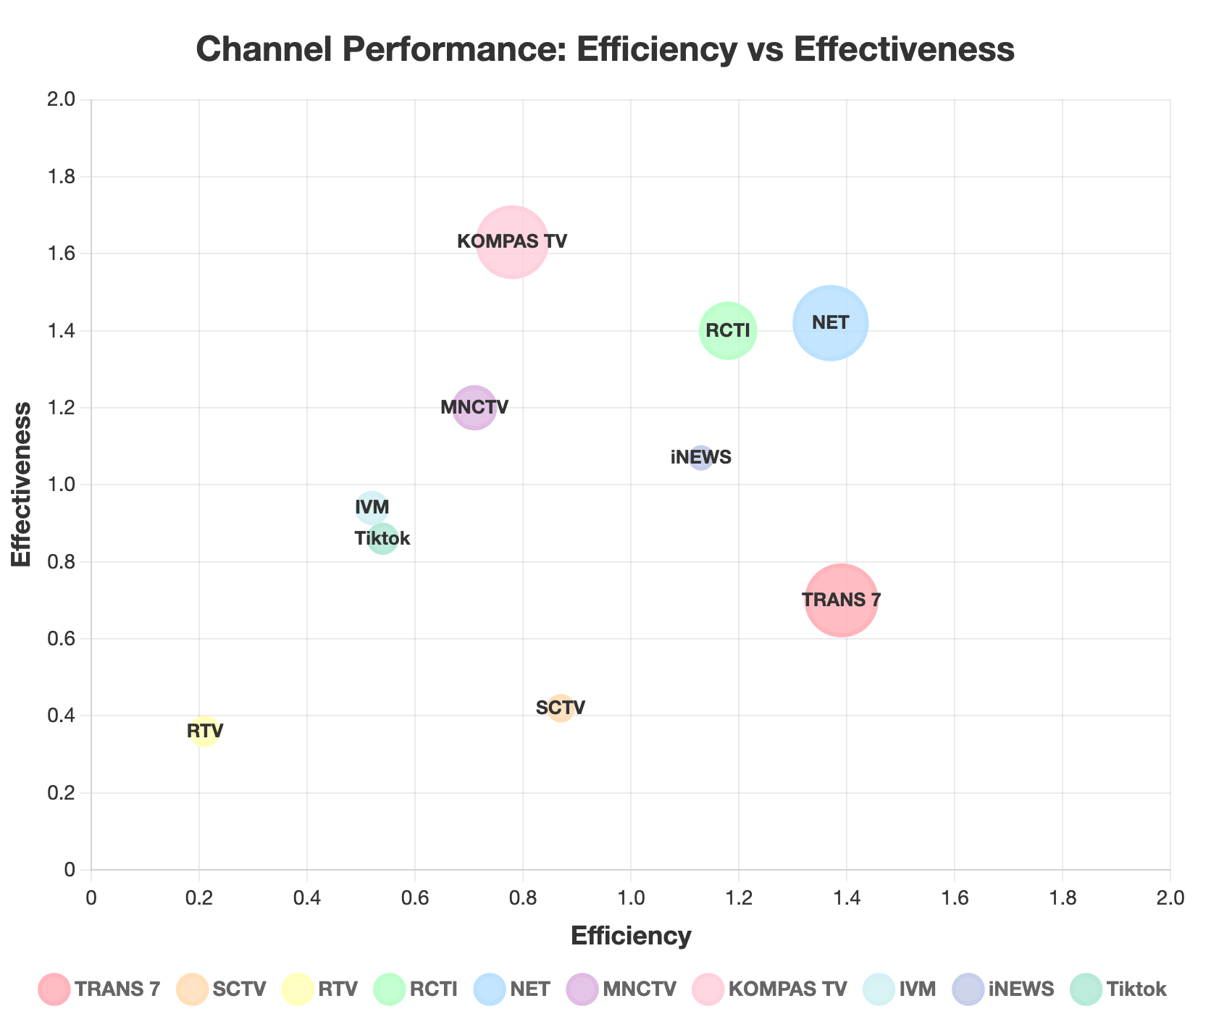
2022: TRANS 7 and NET sit firmly in the high-efficiency / high-effectiveness quadrant; RTV trails
Channel | % Spend | %Impact | %Impressions
TRANS 7 | 16.04% | 22.30% | 31.85%
SCTV | 5.58% | 4.85% | 11.56%
RTV | 6.19% | 1.30% | 3.61%
RCTI | 12.43% | 14.67% | 10.48%
NET | 16.55% | 22.67% | 15.97%
MNCTV | 9.44% | 6.70% | 5.59%
KOMPAS TV | 15.98% | 12.46% | 7.65%
IVM | 6.90% | 3.59% | 3.82%
iNEWS | 4.87% | 5.50% | 5.14%
Tiktok | 6.40% | 3.46% | 4.02%
Key take aways
NET and RCTI stand out in the “green zone” – both efficient ( >1 ) and highly effective ( >1 ).
TRANS 7 delivers the biggest share of GRPs (32 %) yet lags on per-unit impact: effectiveness just 0.70×.
KOMPAS TV over-indexes on effectiveness (1.63×) but is cost-heavy (spend 19 % > GRP 9 %).
YouTube remains a low-cost reach extender – only 1.4 % of spend for 10 % of GRP but limited lift

Slide 8
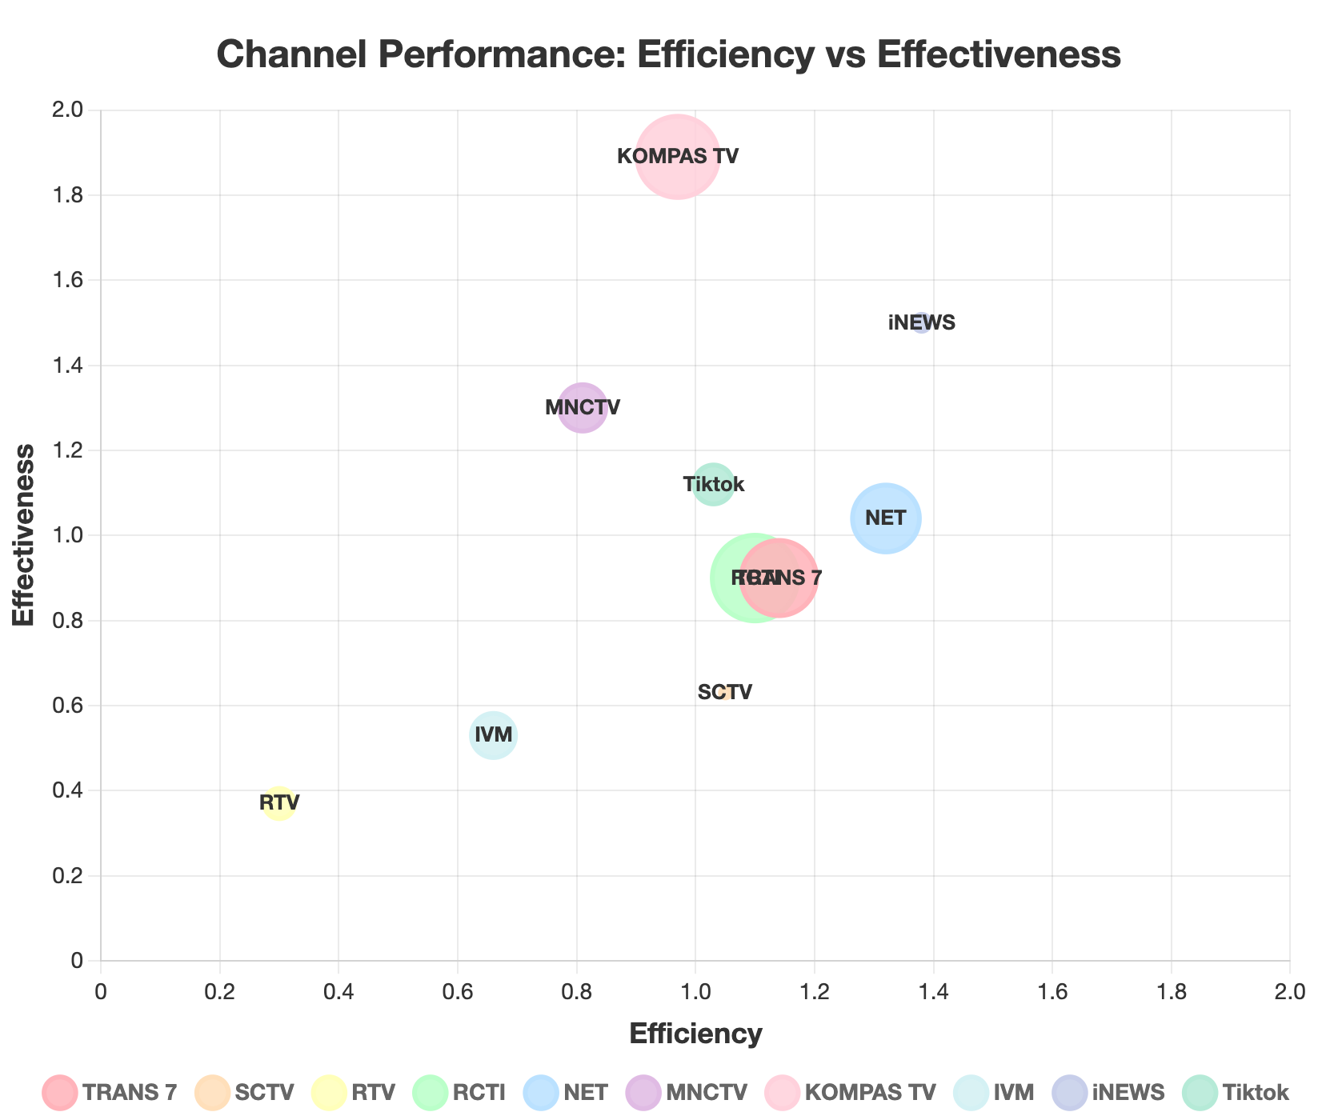
2023: TRANS 7 sustains leadership, YouTube improves efficiency, KOMPAS TV edges up in effectiveness
Channel | % Spend | %Impact | %Impressions
TRANS 7 | 15.66% | 17.85% | 19.84%
SCTV | 2.06% | 2.16% | 3.43%
RTV | 6.29% | 1.89% | 5.10%
RCTI | 17.84% | 19.62% | 21.80%
NET | 13.92% | 18.37% | 17.67%
MNCTV | 9.65% | 7.82% | 6.01%
KOMPAS TV | 16.91% | 16.40% | 8.68%
IVM | 9.18% | 6.06% | 11.43%
iNEWS | 3.51% | 4.84% | 3.23%
Tiktok | 8.10% | 8.34% | 7.45%
Key take aways
All major TV networks cluster around efficiency ≈ 1; only KOMPAS TV & MNCTV break into effectiveness > 1.3.
TRANS 7 still the single biggest driver of impact (21 %), but spend > impact → efficiency just 1.14.
YouTube doubles its share of spend vs 2022 ( 3.1 % ) but remains sub-critical on effectiveness (0.45×).
RTV is the least effective medium (0.37×) despite higher spend share (6.3 %)

Slide 9
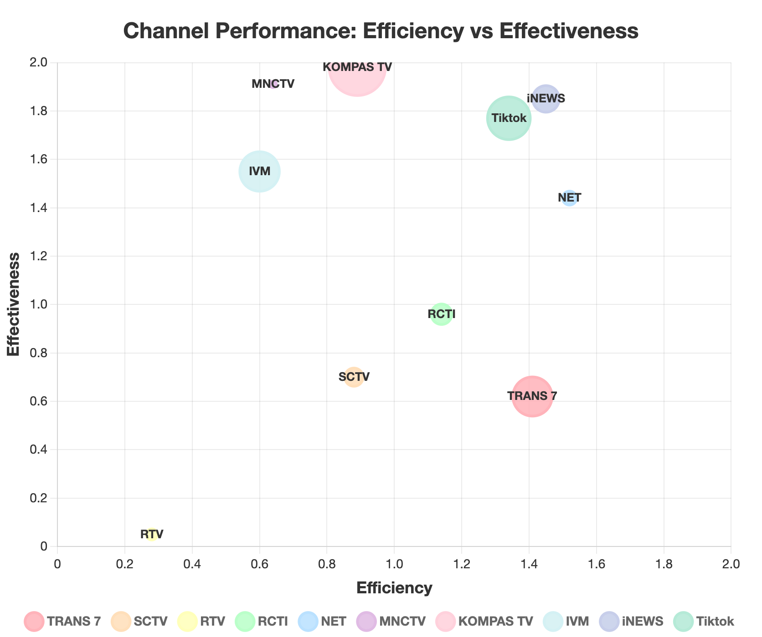
2024: KOMPAS TV commands impact share, while TRANS 7 delivers the most balanced performance
Channel | % Spend | %Impact | %Impressions
TRANS 7 | 14.30% | 20.16% | 32.52%
SCTV | 6.62% | 5.83% | 8.32%
RTV | 4.02% | 1.13% | 22.51%
RCTI | 7.45% | 8.49% | 8.85%
NET | 5.06% | 7.69% | 5.34%
MNCTV | 2.32% | 1.48% | 0.78%
KOMPAS TV | 20.52% | 18.26% | 9.22%
IVM | 14.42% | 8.65% | 5.58%
iNEWS | 9.69% | 14.05% | 7.59%
Tiktok | 15.60% | 20.90% | 11.81%
Key take aways
EKOMPAS TV dominates the green quadrant – strongest effectiveness (3.37×) and respectable efficiency (1. 07×).
YouTube leaps to 11.8 % GRP / 20.9 % impact; efficiency back above parity (1.34×).
RTV continues to be a drag: 21 % GRP yet minimal impact (1.14 %), yielding very low efficiency (0.28).
TRANS 7 largest GRP share again (32.8 %), but effectiveness only 0.62×

Slide 10
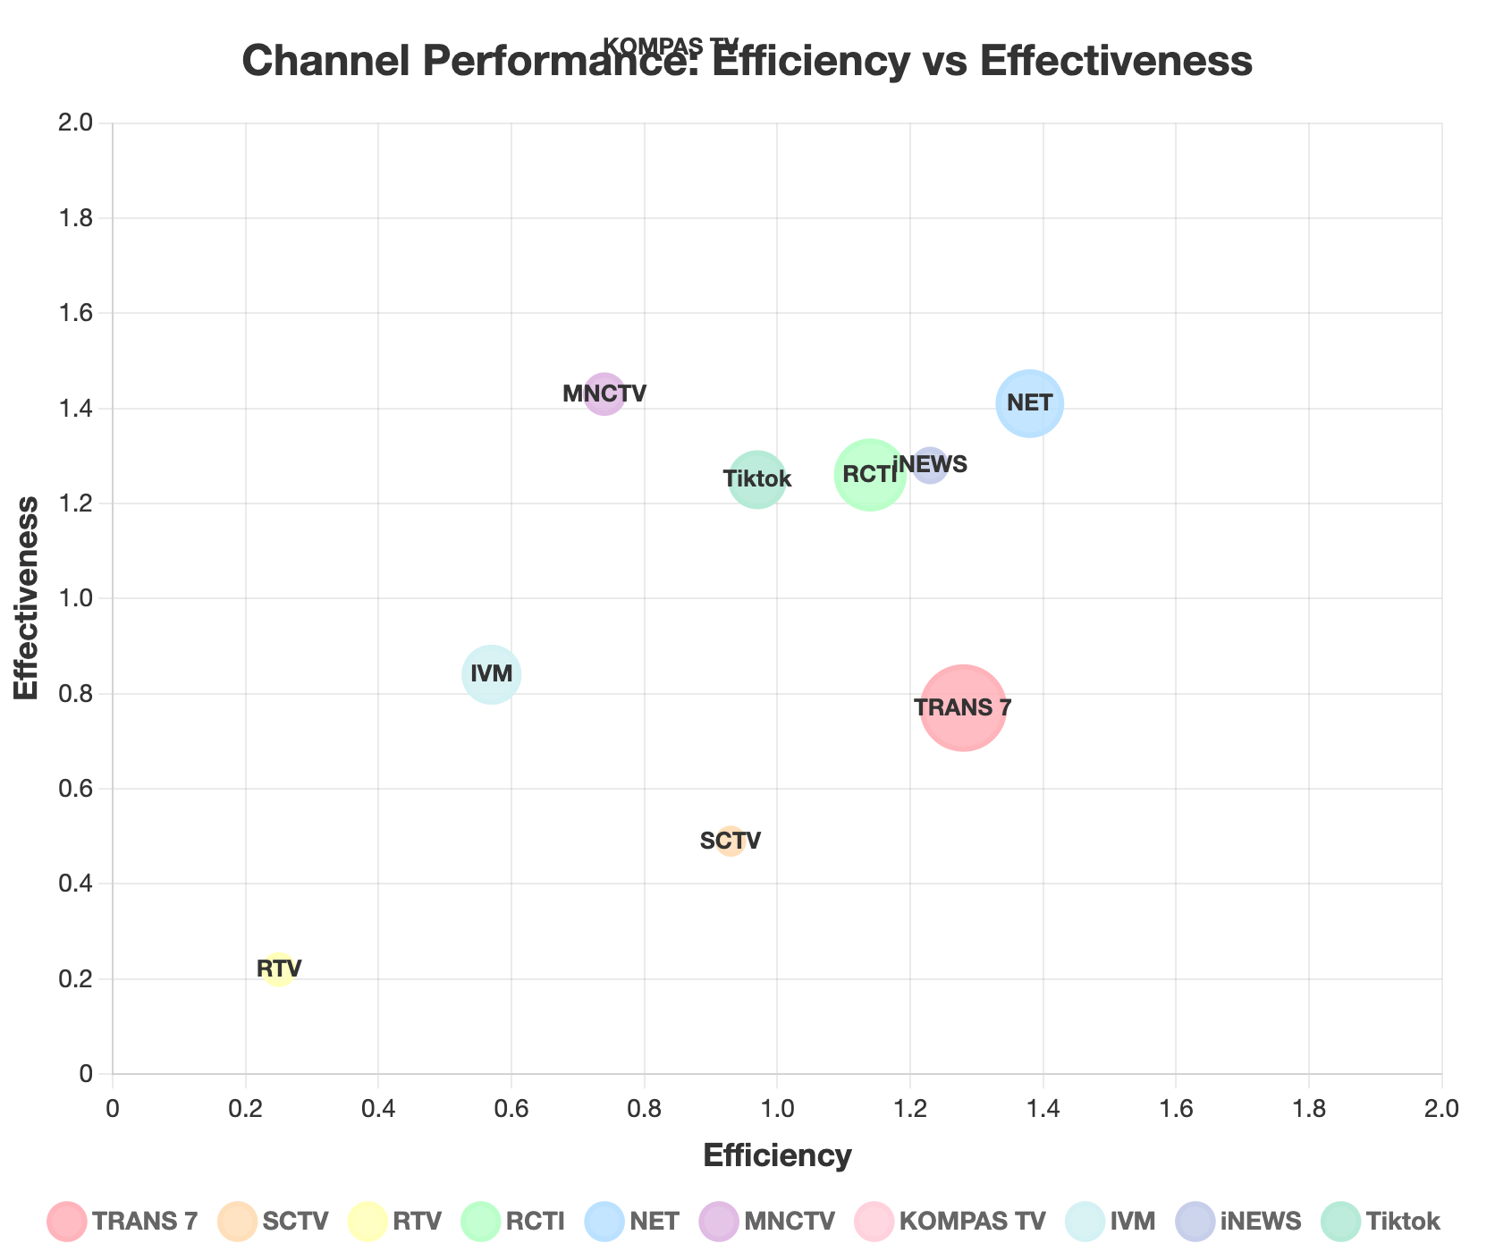
3-Year view: TRANS 7 consistently anchors the efficiency–effectiveness sweet spot across campaigns
Channel | % Spend | %Impact | %Impressions
TRANS 7 | 15.33% | 19.63% | 25.49%
SCTV | 4.75% | 4.42% | 9.02%
RTV | 5.50% | 1.38% | 6.25%
RCTI | 12.57% | 14.33% | 11.38%
NET | 11.84% | 16.34% | 11.59%
MNCTV | 7.14% | 5.28% | 3.69%
KOMPAS TV | 17.80% | 14.95% | 6.92%
IVM | 10.17% | 5.80% | 6.90%
iNEWS | 6.02% | 7.41% | 5.79%
Tiktok | 10.03% | 9.73% | 7.79%
Key take aways
KOMPAS TV and NET are the best all-round performers (both > 1 on efficiency & effectiveness).
TRANS 7 remains indispensable for scale ( ~27 % GRP, 21 % impact) but is cost-heavier than peers.
YouTube, while cost-efficient (spend 4 % vs GRP 9.6 %), still under-delivers on search lift (4.5 %).
RTV and SCTV are consistent under-performers – low effectiveness (< 0.4×) despite meaningful budgets

Slide 11
Thank you

