Slide 1
Structural Design Pattern
Adaptor Design Pattern
Bridge Design pattern
Composite
Decorator
Facade
Flyweight
Proxy

Slide 2
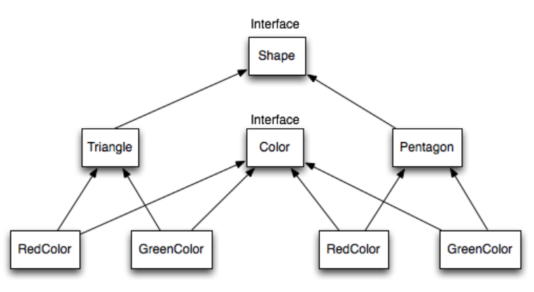
Bridge Design Pattern
When we have interface hierarchies in both interfaces as well as implementations, then bridge design pattern is used to decouple the interfaces from implementation and hiding the implementation details from the client programs.
According to Gang Of Four (Gof) bridge design pattern is:
“Decouple an abstraction from its implementation so that the two can vary independently”
It follows the notion to prefer Composition over Inheritance
Problem:
The two interfaces color and Shape are so interconnected that is very difficult to make any changes in any interface.
https://www.journaldev.com/1491/bridge-design-pattern-java

Slide 3
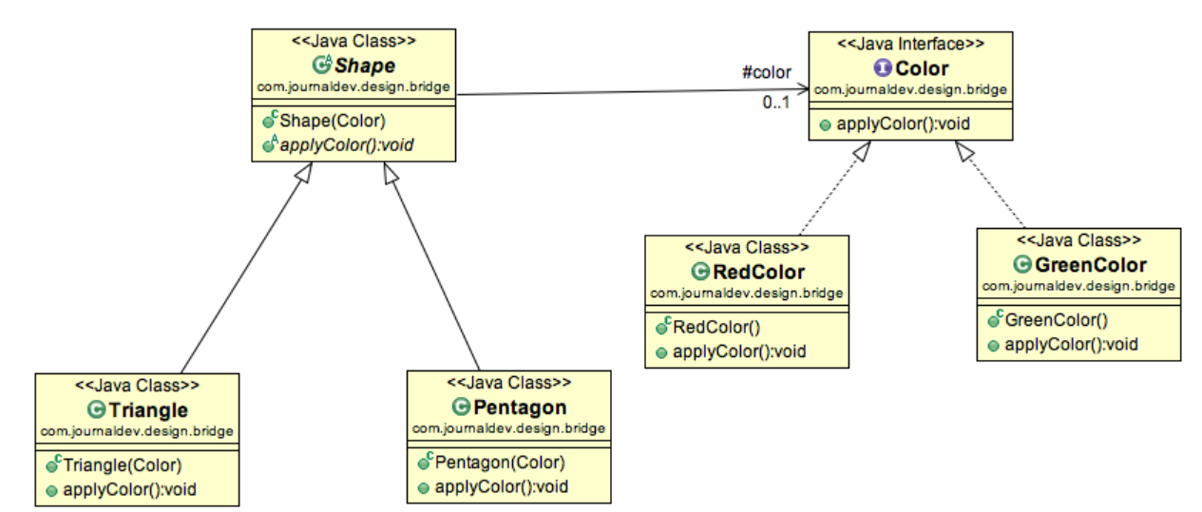
Bridge Pattern Continues
Notice the bridge between Shape abstract class and Color interface.
Bridge design pattern can be used when both abstraction and implementation can have different hierarchies independently and we want to hide the implementation from the client application.

Slide 4
Bridge Pattern Continues
Sample java code of the above explanation.
public abstract class Shape {
//Composition - implementor
protected Color color;
//constructor with implementor as input argument
public Shape(Color c){
this.color=c;
}
abstract public void applyColor();
}
public interface Color {
public void applyColor();
}
public class RedColor implements Color{
public void applyColor(){
System.out.println("red.");
}
}
public class GreenColor implements Color{
public void applyColor(){
System.out.println(“Green.");
}
}
public class Triangle extends Shape{
public Triangle(Color c) {
super(c);
}
@Override
public void applyColor() {
System.out.print("Triangle filled with color ");
color.applyColor();
}
}
public class Pentagon extends Shape{
public Pentagon(Color c) {
super(c);
}
@Override
public void applyColor() {
System.out.print("Pentagon filled with color ");
color.applyColor();
}
}
BridgeTestProgram
public class BridgePatternTest {
public static void main(String[] args) {
Shape tri = new Triangle(new RedColor());
tri.applyColor();
Shape pent = new Pentagon(new GreenColor());
pent.applyColor();
}
}

