Slide 1
Creational Design Pattern
Factory Method Design Pattern
Abstract factory Design pattern
Builder Design Pattern
Singleton Design Pattern
Prototype Design Pattern

Slide 2
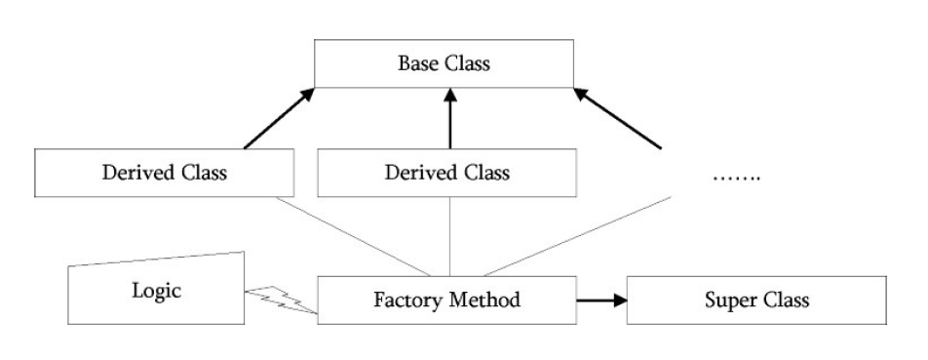
Factory Method Design Pattern
Factory Method is just a fancy method that instantiate objects.
Like Factory, the job of the factory method is to create or produce objects

Slide 3
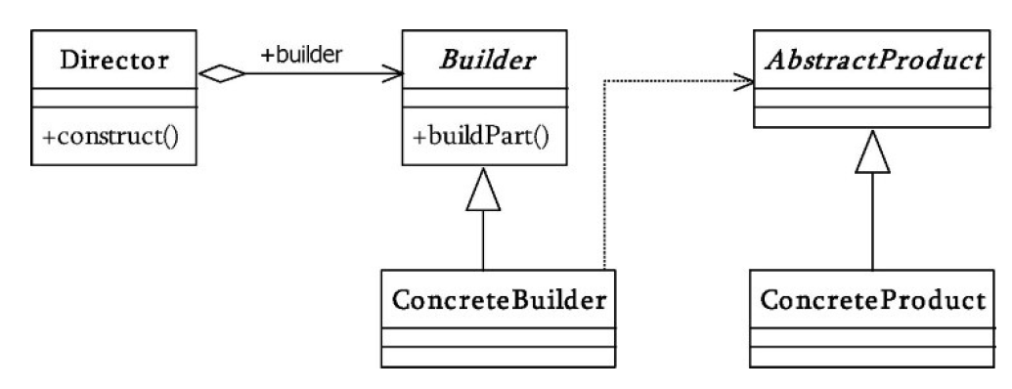
Builder Design Pattern
There are three major issues with Factory and Abstract Factory design patterns when the Object contains a lot of attributes.
Too Many arguments to pass from client program to the Factory class that can be error prone because most of the time, the type of arguments are same and from client side its hard to maintain the order of the argument.
Some of the parameters might be optional but in Factory Pattern, we are forced to send all the parameters and optional parameters need to send as NULL.
If the object is heavy and its creation is complex, then all that complexity will be part of Factory classes that is confusing.
Used to construct a complex object step by step and the final step will return the object.
The process of constructing an object should be generic so that it can be used to create different representations of the same object.
UML Diagram

Slide 4
Builder Design Pattern Continues…
Steps to implement builder design pattern in java.
First of all you need to create a static nested class and then copy all the arguments from the outer class to builder class. We should follow the naming convention and is the class name is Computer, the builder class should be named as Computer builder.
Java builder class should have a public constructor and all the required attributes as parameter.
Java Builder class should have methods to set the optional parameters and it should return the same Builder object after setting the optional attribute.
The final step is to provide a build() method in the builder class that will return the Object needed by client program. For this we need to have a private constructor in the Class with Builder class as argument.
public class Computer {
//required parameters
private String HDD;
private String RAM;
//optional parameters
private boolean isGraphicsCardEnabled;
private boolean isBluetoothEnabled;
public String getHDD() {
return HDD;
}
public String getRAM() {
return RAM;
}
public boolean isGraphicsCardEnabled() {
return isGraphicsCardEnabled;
}
public boolean isBluetoothEnabled() {
return isBluetoothEnabled;
}
private Computer(ComputerBuilder builder) {
this.HDD=builder.HDD;
this.RAM=builder.RAM;
this.isGraphicsCardEnabled=builder.isGraphicsCardEnabled;
this.isBluetoothEnabled=builder.isBluetoothEnabled;
}
//Builder Class
public static class ComputerBuilder{
// required parameters
private String HDD;
private String RAM;
// optional parameters
private boolean isGraphicsCardEnabled;
private boolean isBluetoothEnabled;
public ComputerBuilder(String hdd, String ram){
this.HDD=hdd;
this.RAM=ram;
}
public ComputerBuilder setGraphicsCardEnabled(boolean isGraphicsCardEnabled) {
this.isGraphicsCardEnabled = isGraphicsCardEnabled;
return this
}
public ComputerBuilder setBluetoothEnabled(boolean isBluetoothEnabled) {
this.isBluetoothEnabled = isBluetoothEnabled;
return this;
public Computer build(){
return new Computer(this);
}
}
}

Slide 5
Builder Design Pattern Continues…
Notice that Computer class has only getter methods and no public constructor. So the only way to get a Computer object is through the ComputerBuilder class.
Builder Design Pattern Example in JDK
java.lang.StringBuilder#append() (unsynchronized)
java.lang.StringBuffer#append() (synchronized)
import com.journaldev.design.builder.Computer;
public class TestBuilderPattern {
public static void main(String[] args) {
//Using builder to get the object in a single line of code and
//without any inconsistent state or arguments management issues
Computer comp = new Computer.ComputerBuilder("500 GB", "2 GB").setBluetoothEnabled(true).setGraphicsCardEnabled(true).build();
}
}
Test Program

Slide 6
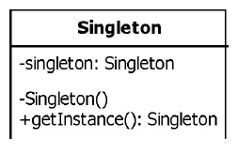
Singleton Design Pattern
Singleton design pattern is used when we require only instance of the class throughout the application.
The singleton class is instantiated at the time of first access and the same instance is used thereafter till the application quits.
We should allow global point of access to that single instance.
Singleton employs a technique known as lazy instantiation to create the singleton. As a result, the singleton instance is not created until the getInstance() method is called for the first time. This technique ensures that singleton instances are created only when needed.
public class Singleton{
private static Singleton instance;
private Singleton(){}
public static Singleton getInstance(){
if(instance == null){
instance == new Singleton();
}
return instance;
}
}
UML Diagram
Singleton Implementation

Slide 7
Singleton Design Pattern Continues…
In multithreaded scenario there is possibilities of allowing to create multiple instances if we don’t synchronization.
If we synchronize the getInstance() method, the above singleton method is thread safe.
public class Singleton{
private static Singleton instance;
private Singleton(){}
public synchronized static Singleton getInstance(){
if(instance == null){
instance == new Singleton();
}
return instance;
}
}
The problem with this solution is, it may be expensive.
Each access to the Singleton requires acquisition of a lock, but in reality, we need a lock only when initializing instance.
That should occur only the first time instance is called. If instance is called n times during the course of a program run, we need the lock only for the first call. To solve this problem, instead of synchronizing the entire method, the below code only synchronizes the critical code.
Method synchronized
public class Singleton{
private static Singleton instance;
private Singleton(){}
public static Singleton getInstance(){
if(instance == null){
synchronized (Singleton.class){
instance == new Singleton();
}
}
return instance;
}
}
Block synchronized

Slide 8
Singleton Design Pattern Continues…
Double-Checked Locking:
However the above code is not thread safe .
Consider the following scenario: Thread 1 enters the synchronized block, and, before it can assign the singleton member variable, the thread is preempted. Subsequently, another thread can enter the if block. The second thread will wait for the first thread to finish, but we will still wind up with two distinct singleton instances
To solve this problem, we go for double checked locking.
public class Singleton{
private static Singleton instance;
private Singleton(){}
public static Singleton getInstance(){
if(instance == null){
synchronized (Singleton.class){
if(instance == null){
instance == new Singleton();
}
}
}
return instance;
}
}
UML Diagram
Singleton Implementation

Slide 9
Singleton Design Pattern Continues…
All the above code example of Single is a Lazy initialization code example where the object is getting initiated at the time of 1st time creation of object.
The singleton class can also be created by using early initialization process where the singleton object is getting created at the time of loading the class. This will solve the problem of multi threading also as it is thread safe.
public class Singleton{
private static Singleton instance = new Singleton;
private Singleton(){}
public static Singleton getInstance(){
return instance;
}
}
public class Singleton{
private static Singleton instance;
private Singleton(){}
public static Singleton getInstance(){
if(instance == null){
synchronized (Singleton.class){
if(instance == null){
instance == new Singleton();
}
}
}
return instance;
}
}
Early Initialization Singleton Implementation
Lazy Initialization Singleton Implementation

