Slide 1
Creational Design Pattern
Factory Method Design Pattern
Abstract factory Design pattern
Builder Design Pattern
Singleton Design Pattern
Prototype Design Pattern

Slide 2
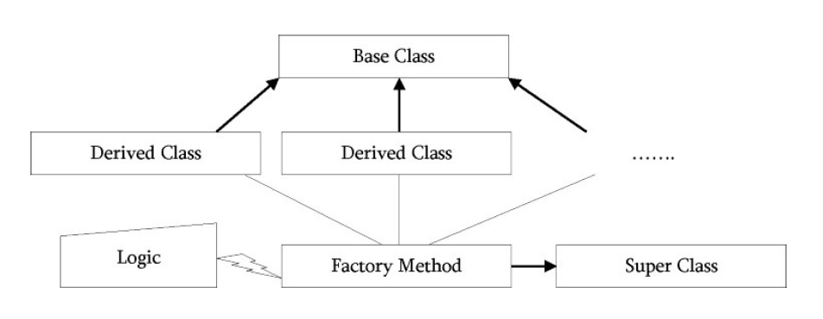
Factory Method Design Pattern
Factory Method is just a fancy method that instantiate objects.
Like Factory, the job of the factory method is to create or produce objects

Slide 3
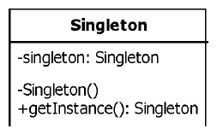
Singleton Design Pattern
Singleton design pattern is used when we require only instance of the class throughout the application.
The singleton class is instantiated at the time of first access and the same instance is used thereafter till the application quits.
We should allow global point of access to that single instance.
Singleton employs a technique known as lazy instantiation to create the singleton. As a result, the singleton instance is not created until the getInstance() method is called for the first time. This technique ensures that singleton instances are created only when needed.
public class Singleton{
private static Singleton instance;
private Singleton(){}
public static Singleton getInstance(){
if(instance == null){
instance == new Singleton();
}
return instance;
}
}
UML Diagram
Singleton Implementation

Slide 4
Singleton Design Pattern Continues…
In multithreaded scenario there is possibilities of allowing to create multiple instances if we don’t synchronization.
If we synchronize the getInstance() method, the above singleton method is thread safe.
public class Singleton{
private static Singleton instance;
private Singleton(){}
public synchronized static Singleton getInstance(){
if(instance == null){
instance == new Singleton();
}
return instance;
}
}
The problem with this solution is, it may be expensive.
Each access to the Singleton requires acquisition of a lock, but in reality, we need a lock only when initializing instance.
That should occur only the first time instance is called. If instance is called n times during the course of a program run, we need the lock only for the first call. To solve this problem, instead of synchronizing the entire method, the below code only synchronizes the critical code.
Method synchronized
public class Singleton{
private static Singleton instance;
private Singleton(){}
public static Singleton getInstance(){
if(instance == null){
synchronized (Singleton.class){
instance == new Singleton();
}
}
return instance;
}
}
Block synchronized

Slide 5
Singleton Design Pattern Continues…
Double-Checked Locking:
However the above code is not thread safe .
Consider the following scenario: Thread 1 enters the synchronized block, and, before it can assign the singleton member variable, the thread is preempted. Subsequently, another thread can enter the if block. The second thread will wait for the first thread to finish, but we will still wind up with two distinct singleton instances
To solve this problem, we go for double checked locking.
public class Singleton{
private static Singleton instance;
private Singleton(){}
public static Singleton getInstance(){
if(instance == null){
synchronized (Singleton.class){
if(instance == null){
instance == new Singleton();
}
}
}
return instance;
}
}
UML Diagram
Singleton Implementation

Slide 6
Singleton Design Pattern Continues…
All the above code example of Single is a Lazy initialization code example where the object is getting initiated at the time of 1st time creation of object.
The singleton class can also be created by using early initialization process where the singleton object is getting created at the time of loading the class. This will solve the problem of multi threading also as it is thread safe.
public class Singleton{
private static Singleton instance = new Singleton;
private Singleton(){}
public static Singleton getInstance(){
return instance;
}
}
public class Singleton{
private static Singleton instance;
private Singleton(){}
public static Singleton getInstance(){
if(instance == null){
synchronized (Singleton.class){
if(instance == null){
instance == new Singleton();
}
}
}
return instance;
}
}
Early Initialization Singleton Implementation
Lazy Initialization Singleton Implementation

