Slide 1
Creational Design Pattern
Factory Method Design Pattern
Abstract factory Design pattern
Builder Design Pattern
Singleton Design Pattern
Prototype Design Pattern

Slide 2
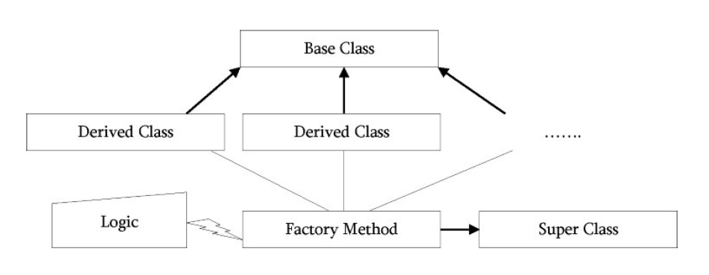
Factory Method Design Pattern
Factory Method is just a fancy method that instantiate objects.
Like Factory, the job of the factory method is to create or produce objects

