Slide 1
SalesData
File created on: 7/17/2023 11:24:12 AM

Slide 2
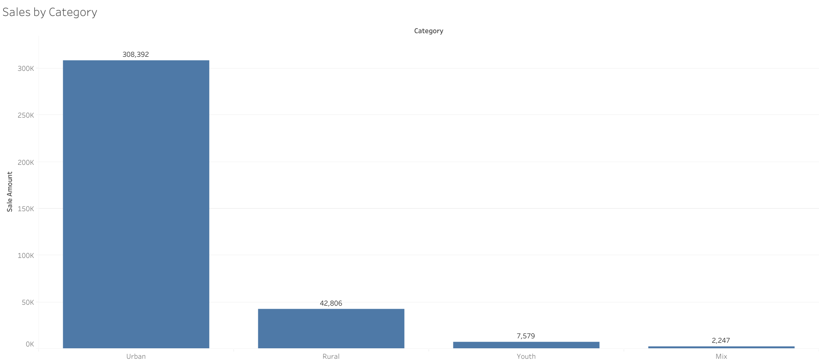

Slide 3
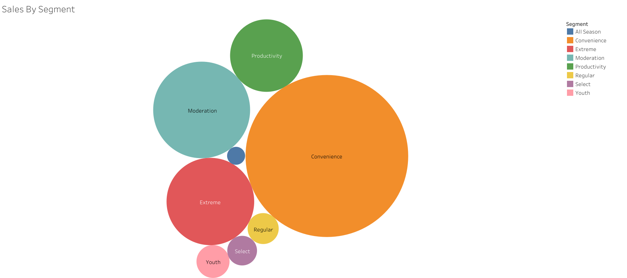

Slide 4
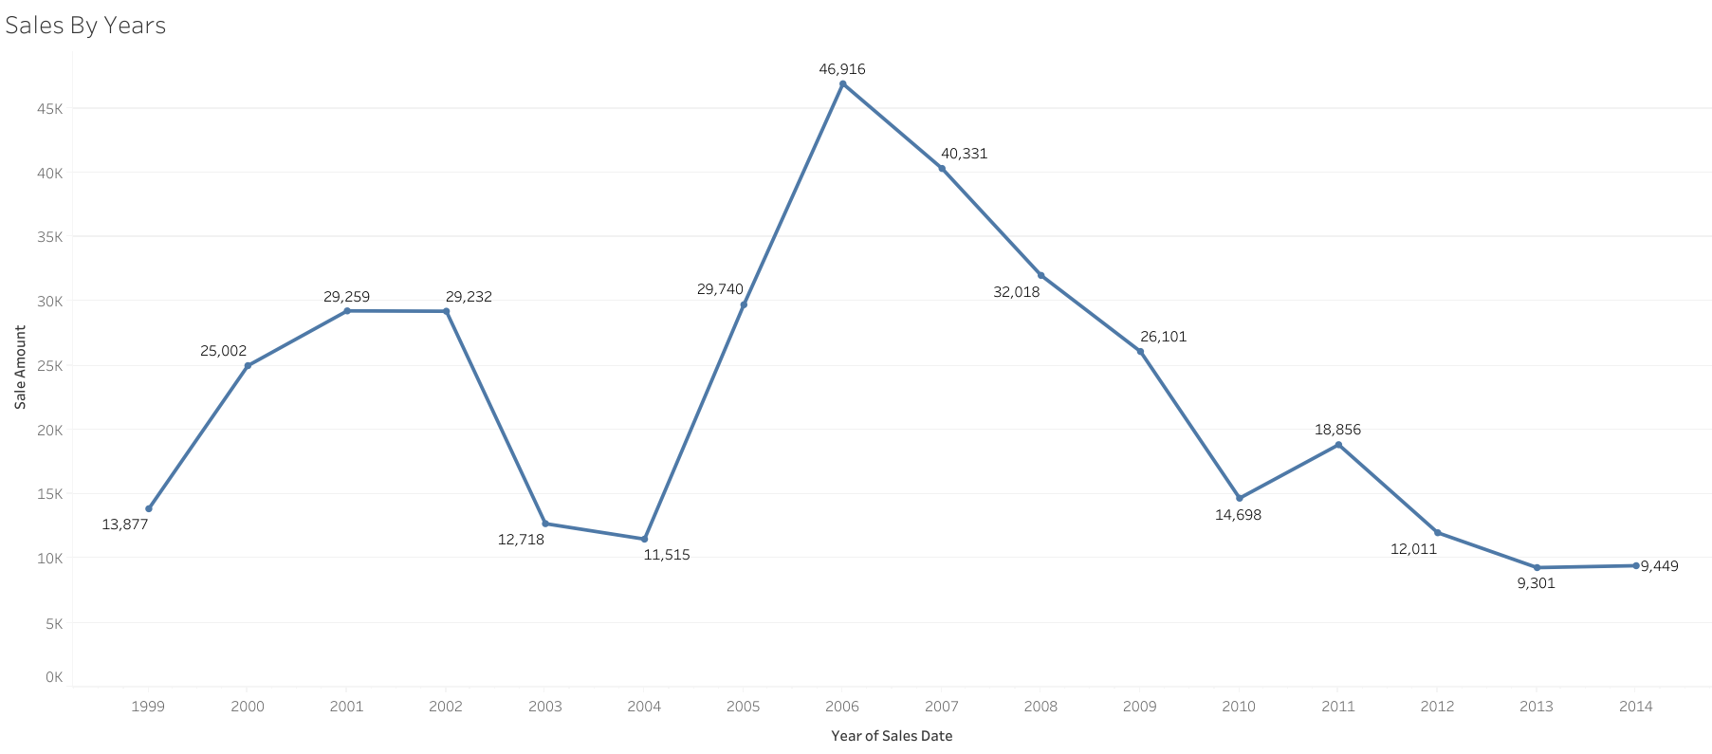

Slide 5
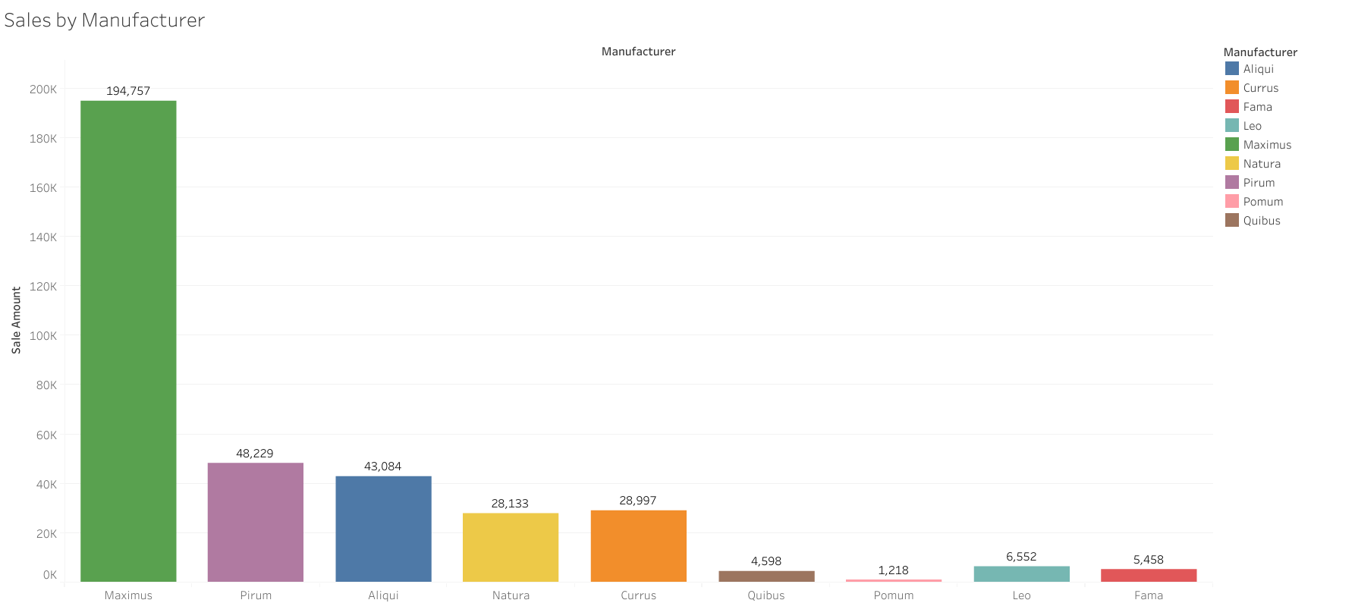

Slide 6
