Slide 1

Netflix Data Analysis Project
An end-to-end data analysis project exploring Netflix's content library through Python, SQL, and Power BI visualization.

Slide 2



Project Overview
Dataset
Analysis Goals
Skills Demonstrated
8,807 records with 12 columns including titles, types, countries, ratings, and genres
Content distribution, growth trends, top countries and genres, business insights
Python, SQL, data cleaning, visualization, and end-to-end analytics

Slide 3

Data Cleaning & Preparation
Python Libraries Used
Pandas for data manipulation
NumPy for numerical operations
Matplotlib and Seaborn for visualization
Cleaning Steps
Filled missing values in country and director fields
Converted date_added to datetime format
Removed duplicates and split genres

Slide 4
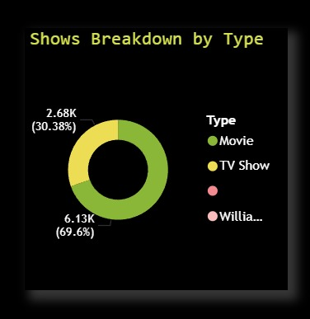
Exploratory Data Analysis
6,190
2,676
2,800
Movies
TV Shows
United States
Dominate the platform compared to TV shows
Significant but smaller portion of content
Top content-producing country

Slide 5
SQL Business Insights
1
Content Distribution
Count movies vs TV shows and analyze type distribution across the platform
2
Top Countries
Identify top 5 countries with highest content production and regional trends
3
Popular Ratings
Find most common ratings like TV-MA and PG to understand content maturity
4
Genre Performance
Determine which genres have highest number of titles and viewer appeal
5
Recent Additions
Track top 10 most recent content additions for freshness metrics
6
Year-wise Growth
Analyze content growth trends over time with year-over-year comparisons

Slide 6
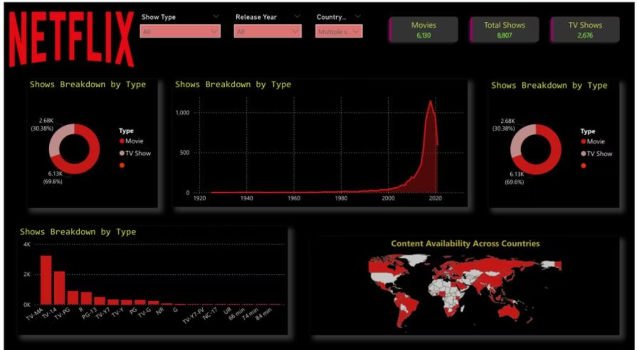
Power BI Dashboard
Dashboard Highlights
Interactive content distribution charts
Country-wise production maps
Genre popularity rankings
Year-wise growth trends
KPI metrics for quick insights
Helps stakeholders make data-driven decisions quickly.

Slide 7
Key Insights
Movies Dominate
US Leads Production
Movies (6,190) significantly outnumber TV shows (2,676) on the platform
United States produces 2,800+ titles, followed by India with 1,000+
Rapid Growth Post-2015
Drama & International Popular
Content production increased dramatically after 2015, peaking in 2020
Dramas (~17K) and International Movies (~19K) are most popular genres

Slide 8




Business Recommendations
Content Strategy
Global Expansion
Focus on popular genres like drama and international content to attract more viewers and increase engagement
Invest more in countries where performance is strong and explore emerging markets for content production
User Engagement
Content Planning
Improve recommendation systems using content-based filtering to give users better personalized suggestions
Increase content production based on current trends, audience preferences, and seasonal patterns

Slide 9

Tools & Technologies
Python
Pandas, NumPy, Matplotlib, Seaborn for data analysis and visualization
SQL
MySQL for advanced business queries and data extraction
Power BI
Interactive dashboard creation and business intelligence reporting
GitHub
Project hosting, version control, and collaboration

Slide 10

Key Learnings & Future Improvements
Key Learnings
Future Improvements
Data cleaning and preprocessing techniques
Writing efficient SQL queries
Data visualization and storytelling
Building end-to-end analytics projects
Build advanced recommendation system with ML
Deploy dashboard online for real-time access
Use machine learning for content prediction
Automate data pipeline with scheduling

