Slide 1
Getting started with Angular
Prakash Tripathi
Twitter: @Prakash_MANIT | http://www.techyprakash.com

Slide 2
Javascript
JavaScript is a high-level, dynamic and interpreted programming language.
JavaScript was originally developed in May 1995 by Brendan Eich.
Standardized version named ECMAScript in June 1997
The current supported ECMAScript for most browsers in 6.

Slide 3
jQuery
Allows for DOM Manipulation
Does not provide structure to your code
Does not allow for two way binding

Slide 4
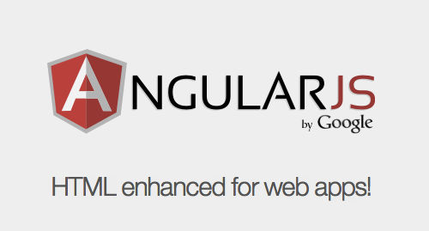
What is ANGULARJS or Angular 1.x?
Open source Front end framework release
On Oct 2010.
Adjusts and adapts traditional HTML in order to present dynamic content through the two way data biding which allows instantaneous synchronization of views and models.
AngularJS is a Javascript MVC framework created by Google to build properly architecture and maintainable web applications.

Slide 5
What is ANGULARJS? (Conti..)
It’s not a JavaScript library (As they say). There are no functions which we can directly call and use.
It is not a DOM manipulation library like jQuery. But it uses subset of jQuery for DOM manipulation (called jqLite).
For MVC/MVVM design pattern

Slide 6
Philosophy
“ANGULARJS is what HTML could have been if it had been designed for web application development.”
“ANGULARJS is built around the philosophy that declarative code is better than imperative code while building UIs and wiring different components of web application together.”

Slide 7
Why ANGULARJS?
Defines numerous ways to organize web application at client side.
Enhances HTML by attaching directives, custom tags, attributes, expressions, templates within HTML.
Encourage TDD
Encourage MVC/MVVM design pattern and Separation of concern.
Code Reuse
Good for Single Page Apps (SPA)

Slide 8
Why ANGULARJS? (Conti..)
Lightweight ( < 36KB compressed and minified)
Free

Slide 9
Hello Javascript
<p id="greeting1"></p>
<script>
var isIE = document.attachEvent;
var addListener = isIE
? function(e, t, fn) {
e.attachEvent('on' + t, fn);}
: function(e, t, fn) {
e.addEventListener(t, fn, false);};
addListener(document, 'load', function(){
var greeting = document.getElementById('greeting1');
if (isIE) {
greeting.innerText = 'Hello World!';
} else {
greeting.textContent = 'Hello World!';
}
});
</script>

Slide 10
Hello JQuery
<p id="greeting2"></p>
<script>
$(function(){
$('#greeting2').text('Hello World!');
});
</script>

Slide 11
Hello AngularJS
<p ng:init="greeting = 'Hello World!'">{{greeting}}</p>

Slide 12
Key Features of ANGULARJS
Declarative HTML approach
Easy Data Binding : Two way Data Binding
Reusable Components
MVC/MVVM and Dependency Injection Pattern
End to end Integration Testing / Unit Testing
Routing, Templating
Modules and Services
Expressions and Filters
Directives, Form Validation
$scope, $http, $routeProvider…

Slide 13
MVC : Model View Controller
View :
Renders the Model data
Send User actions/events to controller
UI
View
Controller
Model
3. Implement the Business Logic on response data and Bind it to View
1. Event or User Action or View Load
Model:
Business Logic
Notify view changes
Application Functionality
Data in general
Controller:
Define Application Behavior
Maps user actions to Model
Select view for response
2. Maps to particular Model after fetching the data

Slide 14

MVVM: Model View ViewModel
View
ViewModel
Model
UI
User actions, commands
Data binding
Notifications
Presentation Logic
Business Logic and Data
Data Access
Update ViewModel about change

Slide 15
Angular 2
Released on Sep 2016.
Using TypeScript
Angular is a complete rewrite from the same team that built AngularJS.
Many modern browsers support it (Even IE11/Edge/Crome)

Slide 16
Angular JS vs Angular 2
Angular does not have a concept of "scope" or controllers, instead it uses a hierarchy of components as its main architectural concept.
Angular has a different expression syntax, focusing on "[ ]" for property binding, and "( )" for event binding.
Mobile development – desktop development is much easier when mobile performance issues are handled first
Modularity – much core functionality has moved to modules, producing a lighter, faster core.
Modern browsers only – reducing the need for browser compatibility workarounds

Slide 17
Angular JS vs Angular 2 (Conti..)
Angular recommends the use of Microsoft's TypeScript language, which supports features including Class-based Object Oriented Programming
Improved dependency injection – bindings make it possible for dependencies to be named
Dynamic loading
Asynchronous template compilation
Simpler Routing
Replacing controllers and $scope with components and directives – a component is a directive with a template
Reactive programming support using RxJS

Slide 18
Angular 4, why not 3?
Released on Mar-2017
Skipping 3 to avoid a confusion due to the misalignment of the router package's version which was already distributed as v3.3.0
Angular 4 is backward compatible with Angular 2.
Smaller and Faster: With Angular 4, programs will consume less space and run quicker than previous versions.
View Engine: They have made adjustments under to hood to decrease the size of the generated code
Improved *ngIf and *ngFor: Now you can utilize an if/else design syntax, and assign local variables like if to unroll an observable.

Slide 19
Typescript
TypeScript is a typed superset of JavaScript that compiles/transpiles to plain JavaScript
Released on Oct-2012.
TypeScript is a superset of ECMAScript 6 (ES6), and is backwards compatible with ECMAScript 5 (i.e.: JavaScript). Angular also includes the benefits of ES6 that includes Lambdas, Iterators, For/Of loops, Python-style generators, Reflection
Additional functionalities: Modules, classes, interfaces, “arrow” syntaks, namespaces, enumerated types
Weakly or dynamically typed (:any)
Strongly typed (:string, :number, :Class)

Slide 20
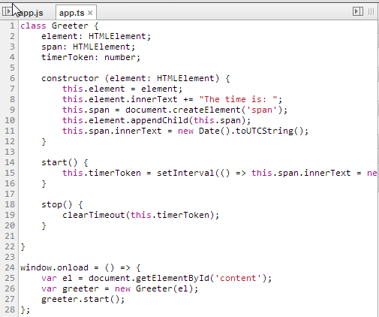
Typescript (code snippet)

Slide 21
Dependency injection
The way we give an instance of the object to some other part of the angular application
Instances of services are given through the constructors

Slide 22
About Me
Senior Consultant/ Tech Lead at Deloitte Consulting Hyderabad
Microsoft MVP – 2016/2017 (Visual Studio and Development Technologies)
C# Corner MVP – 2016/2017
Certified Scrum Master
Blogs/Articles: http://www.techyprakash.com

Slide 23
Thanks for attending the session. You may reach out to my twitter handle @Prakash_MANIT for any additional query.

