Slide 1
Getting started with .NET Core 2.0
Prakash Tripathi
@Prakash_MANIT

Slide 2
Agenda
Why .NET Core?
Versions, Pre-requites
.NET Core Overview
Architecture, .NET Standard
Components, Compilation Process
.NET Core Vs .NET Framework
Comparison
Tools, Command Line tools
Demo 1- Command Line tools
Migration from .NET Framework to Core
What's new in .NET Core 2.0?
Open Source Pitch
.NET Foundation, Open source tools
Demo 2 - Core projects
.NET Core roadmap

Slide 3
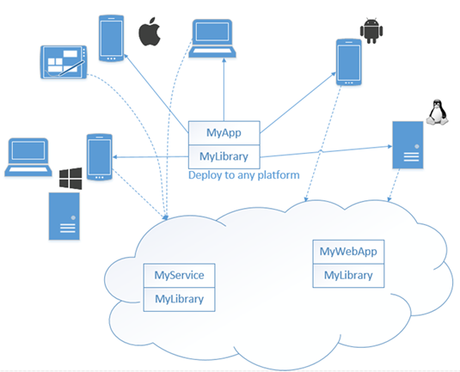
Why .NET Core? Please look at below image and tell us what message you are sensing…

Slide 4
Why .NET Core? (Conti…) Below are some of the prevailing necessity behind .NET Core
Ask from community for Cross-platform development framework.
Need for a highly modular framework.
Need for high performance and scalable systems.
Need for pure Open-Source framework with direct support from community.
Need for framework with frequent updates.

Slide 5
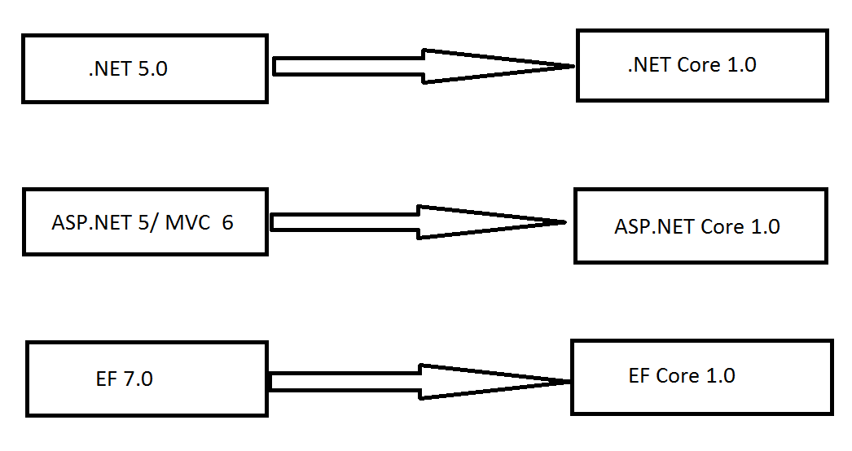
.NET Core Versioning Below image depicts the version changes took place for .NET Core

Slide 6
Pre-requisite for .NET Core Below are the prerequisite for running .NET Core.
>= Windows 7 SP1 and Windows Server 2008 R2 SP1
>= Visual Studio 2015 Update 3 for .NET Core 1.0/1.1, additional installation of core is required.
>= Visual Studio 2017 for .NET Core 1.0/1.1 and 2.0 (Need >= VS 2017 15.3)
Visual Studio 2017 is recommended by Microsoft to work on .NET Core.
Visual Studio 2017 community edition is freely available to download for learning purpose.

Slide 7
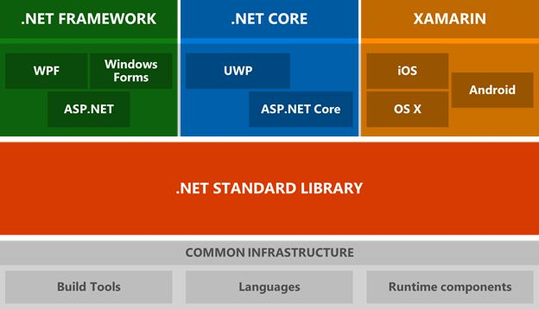
.NET Architecture diagram Below is the latest .NET architecture with three supported runtimes

Slide 8
.NET Standard Library
The .NET Standard is a formal specification of .NET APIs that are intended to be available on all .NET runtimes.
The .NET Standard enables the following key scenarios:
Defines uniform set of BCL APIs for all .NET platforms to implement, independent of workload.
Enables developers to produce portable libraries that are usable across .NET runtimes, using this same set of APIs.
Reduces the conditional compilation of shared source due to .NET APIs, only for OS APIs.

Slide 9
.NET Core Overview
.NET Core is a cross-platform, modular and open source platform for developing general purpose applications. Currently it supports Console Apps, Libraries, Web applications/services, Windows 10 UWP and Xamarin forms.
.NET Core refers to several technologies including .NET Core, ASP.NET Core and Entity Framework Core. These products are actively developed by the .NET team and in collaboration with a community of open source developers
The following characteristics define .NET Core:
Cross-platform: Runs on Windows, mac-OS and Linux; The supported Operating Systems list can be found at github.
Modular: .NET Core is completely modularized. Each component is distributed via NuGet, Also assembly can be updated independently and do not rely on major framework releases.

Slide 10
.NET Core Overview (Conti...)
Open source: The .NET Core platform is open source, using MIT and Apache 2 licenses. Documentation is licensed under CC-BY. .NET Core is a .NET Foundation project.
Compatible: .NET Core is compatible with .NET Framework, Xamarin and Mono, via the .NET Standard Library. It supports full side by side execution to make it easy to adopt new .NET Core versions without affecting other apps
Command-line tools: All product scenarios can be exercised at the command-line. For example, dotnet new , dotnet build, dotnet restore, dotnet run etc.
Supported by Microsoft: .NET Core is supported by Microsoft, per .NET Core Support. (Same confidence as Google supported Angular☺)

Slide 11
.NET Core Components
The .NET Core platform is made of several components, which includes the managed compilers, the runtime, the base class libraries, and application models such as Console apps, ASP.NET MVC & API apps.
.NET Core is composed of the following parts:
.NET runtime (CoreCLR), which provides a type system, assembly loading, a garbage collector, native interop and other basic services. The .NET Core runtime includes the same GC and JIT (RyuJIT), but doesn’t include features like Application Domains or Code Access Security.
Framework libraries (CoreLibrary), factored base library (removal of dependencies) to provide primitive data types, app composition types and fundamental utilities.
SDK tools and compilers (CoreSDK) that enable the base developer experience for ex. CLI tools and 'dotnet' app host, which is used to launch .NET Core apps

Slide 12
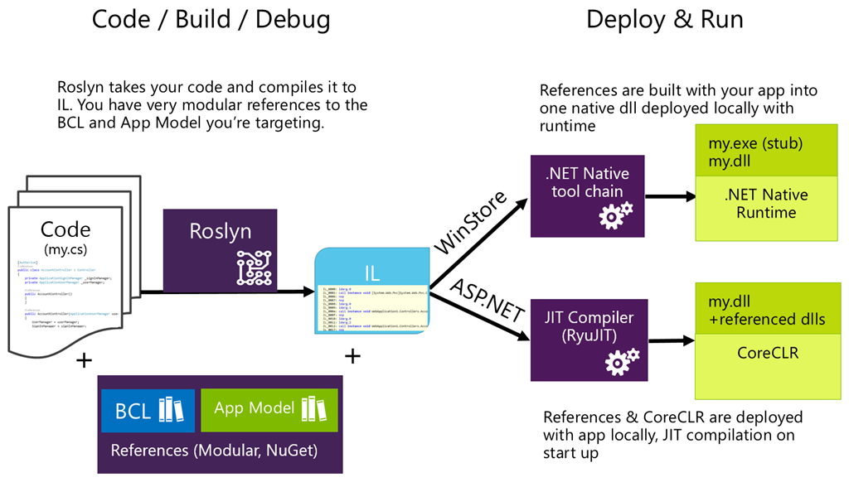
.NET Core Compilation Process No .exe in Console App☺, it’s all DLL and No GAC as it’s Windows Specific.

Slide 13
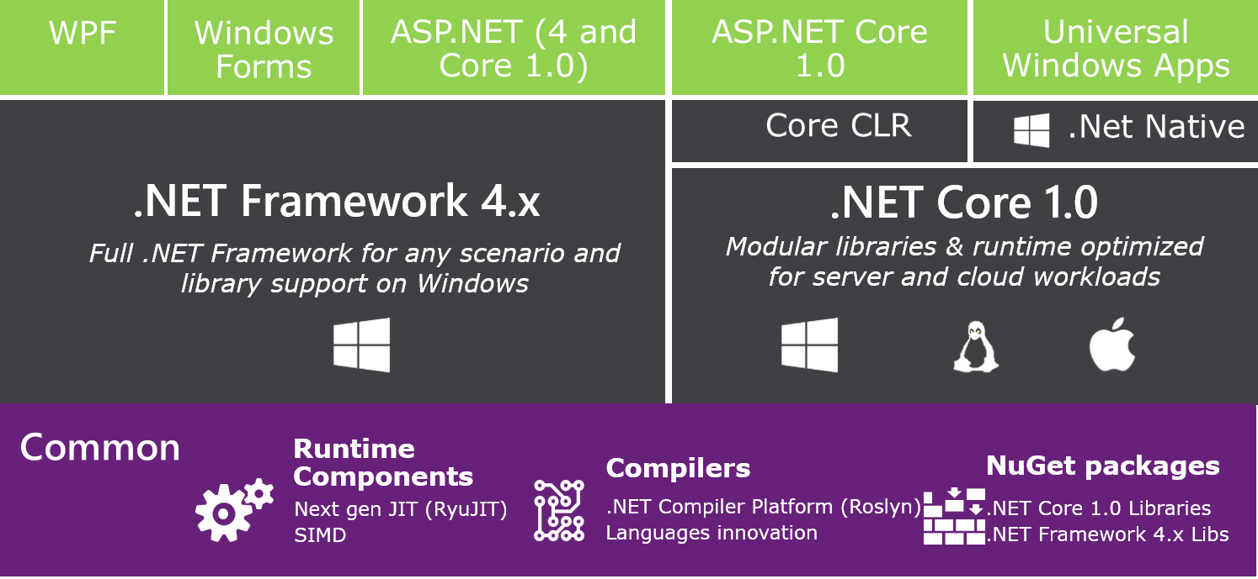
.NET Core vs .NET Framework Below image depicts the high level comparison of .NET Fx and Core

Slide 14
.NET Core Vs.NET Framework (Conti...)
The .NET platform was first announced by Microsoft in 2000 and then evolved from there. The .NET Framework has been the primary .NET product produced by Microsoft during that 15+ year span.
The major differences between .NET Core and the .NET Framework:
Criteria | .NET Core | .NET Framework
App-models/ Work loads | It supports Console, Library, Web apps and Web API across platforms | It supports all work loads including Win forms, WPF, WCF but only in Windows machines.
API | It has fewer API (implemented by .NET Standard) although list is growing in each versions | It has rich set of API for windows platforms
Open Source | .NET Core is fully open source | only a read-only subset of the .NET Framework is open source.

Slide 15
Development and Debugging tools Choice of tool specific to platforms: Visual Studio on Windows Visual Studio For MAC Visual Studio Code on Mac, Linux, or Windows Unit Tesing Frameworks: MS Test (VisualStudio.TestTools.UnitTesting) X-Unit

Slide 16
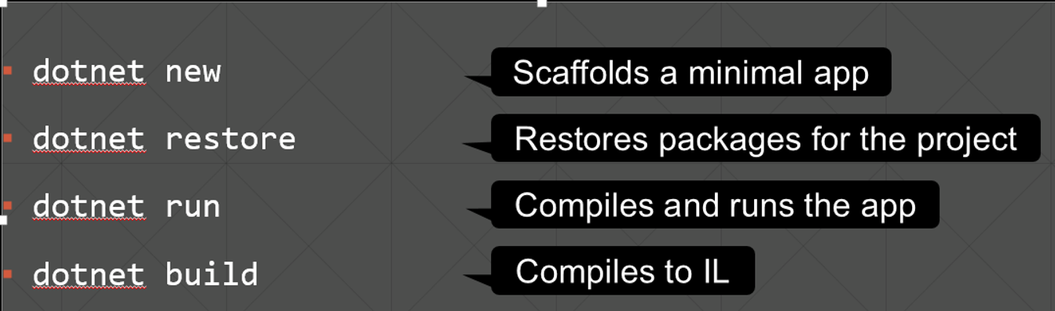
.NET Command Line Interface (CLI) Command CLI commands has been introduced to make project creations faster.

Slide 17
Demo1 – Command Line Tools

Slide 18
Migration from .NET Framework Apps to Core Following are some of the considerations when planning a migration from existing .NET framework to .NET core.
Cannot:
WPF, WinForms, unless UWP
ASP.NET Web Forms
Anything Windows-specific: registry, ACLs, perf counters
Should (absolutely):
General purpose libraries
Should (With some re-write):
ASP.NET MVC
Console apps

Slide 19
What's new in .NET Core 2.0?
.NET Standard 2.0 Expanded APIs & the Ability to Reference Full Framework Libraries:
.NET Standard broadens the set of APIs available to include a lot of the missing features. It now supports 32,000+ APIs. It is now much easier to port your code to a .NET Standard library without major code changes.
For example popular logging libraries like log4net is available now
Expanded OS Support:
Linux is now treated as a single operation system instead of different distribution. This also holds true for Windows and macOS. For example, there are no individual runtimes any longer for win8 and win10.
Live Unit Testing Support:
Live Unit Testing (LUT) is a new feature we introduced in Visual Studio 2017 enterprise edition and with 15.3 it now supports .NET Core. Users who are passionate with Test Driven Development (TDD) will certainly love this new addition. To invoke, Test->Live Unit Testing->Start

Slide 20
What's new in .NET Core 2.0? (Conti..)
ASP.NET Core Razor Pages Are New
ASP.NET now supports razor syntax based pages, called Razor Pages. You can now essentially crate a razor view without a controller.
Visual Basic for .NET Core Is Here!
Currently it is limited to making class libraries and console application. As per roadmap, support in other areas coming soon.

Slide 21
Open Source Pitch

Slide 22
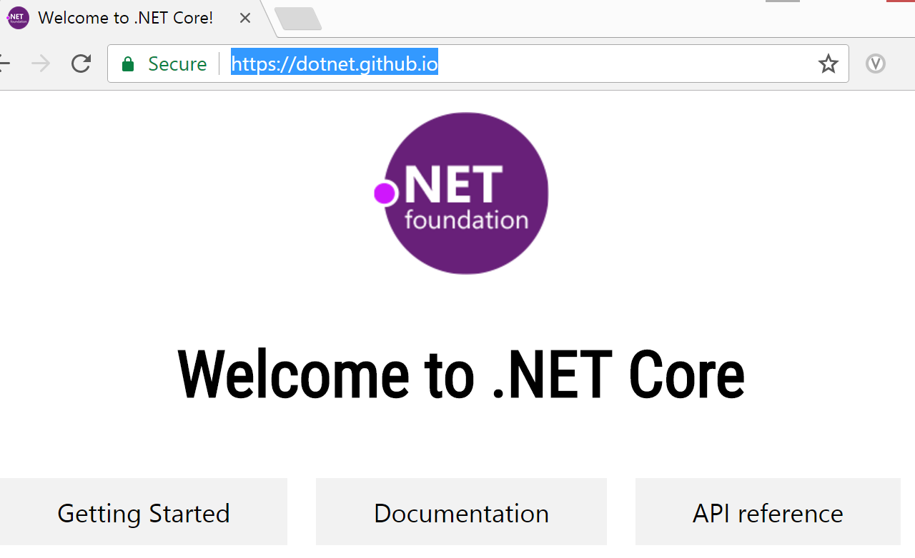
.NET Foundation Below is the GitHub site of .NET Foundation that is developing/maintaining .NET Core.

Slide 23
.NET Foundation (Conti…) The .NET Foundation includes representatives from, among others, Microsoft, GitHub, and Xamarin. Projects under the stewardship of the .NET Foundation currently include the .NET Compiler Platform ("Roslyn") as well as the ASP.NET family of projects, .NET Core, Xamarin Forms along with popular .NET open source frameworks like xUnit and Reactive Extensions. They’re actively engaged in supporting open source projects in the .NET ecosystem https://dotnetfoundation.org/projects

Slide 24
Support for Open Source tools Visual Studio Code: Free, Open source and Cross platform Development IDE. Can be downloaded from https://code.visualstudio.com/ Support for npm, bower, gulp, grunt, etc
npm
bower
grunt
gulp
npm is the default package manager for the JavaScript runtime environment Node.js.
Bower is a package management system for client-side programming.
Grunt is a JavaScript Task Runner.
Gulp is a JavaScript automation tool.

Slide 25
Demo2 – Core Projects

Slide 26
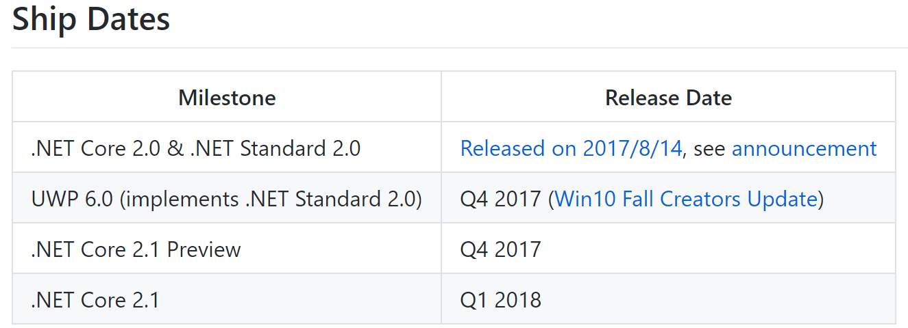
.NET Core Road map Below is the current road map for .NET Core. The latest data is available at GitHub site https://github.com/dotnet/core/blob/master/roadmap.md

Slide 27
QnA

Slide 28
About Me
Senior Consultant/ Tech Lead at Deloitte Consulting Hyderabad
Microsoft MVP – 2016 & 2017 (Visual Studio and Development Technologies)
C# Corner MVP – 2016 & 2017
CSM® | ITIL®
Blogs/Articles: http://www.techyprakash.com/

Slide 29
Thanks for attending the session. You may reach out to my twitter handle @Prakash_MANIT for any additional query.

