Slide 1
SPEEDUP TEST DRIVEN DEVELOPMENT USING VS-2015
Prakash Tripathi

Slide 2
Agenda
Test Driven Development (TDD) What/Why?
How to work with Test Driven Development?
Demo
Speedup TDD using IntelliTest in Visual Studio 2015.
Demo
QnA

Slide 3
Test Driven Development (TDD) What/Why?

Slide 4
What is Test Driven Development?
Development or programming practice that adds reliability to the application behavior.
Mindset and approach towards software development that enforces writing Unit Tests before/along with coding the functionality.
Enforces Interface based design to support loose coupling and modularity.
Enforces a check that “Does our code do what we intended?”

Slide 5
Why TDD Important?
Many projects fail because they lack a good testing methodology.
Helps Developers by enforcing better design and sense of confidence in terms of quality by regularly checking and looking the test cases execution success. It also helps to avoid break in another dependent area due to any recent change.
Helps Testers by saving their time from logging obvious issues and re-validation so that they can focus on complex test scenarios.
Helps Project Managers in optimizing the overall budget by having reduced test cycles and less issues at UAT and Production ☺.
Helps Client by better overall experience and reduced maintenance cost later.
Helps Company in getting repeat business as a result of client satisfaction.
Appears natural practice but in reality it isn’t that common ☺.

Slide 6
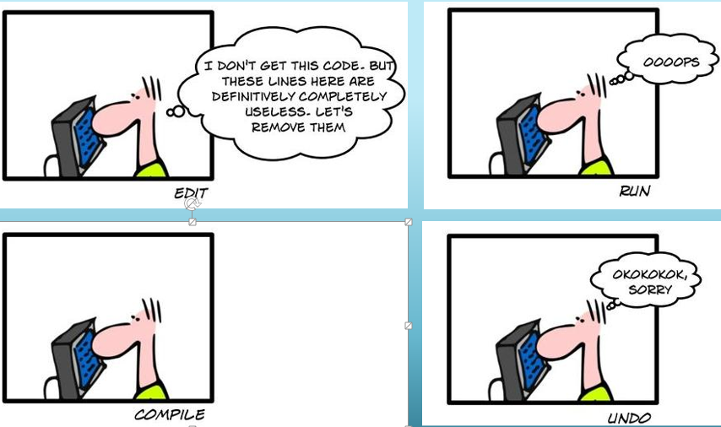
Why TDD Important? Real-World Scenario.

Slide 7
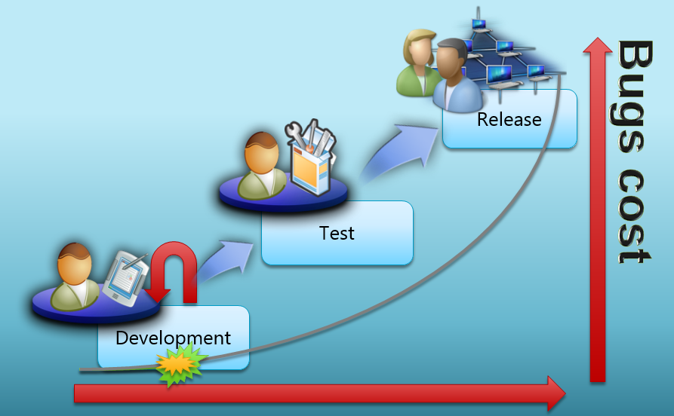
Why TDD Important? Cost.

Slide 8
Why we don’t use TDD every time?
Not including unit test cases efforts in estimation.
No experience of TDD in Development Team.
Tight deadlines ☹.
“Make it work” overrides the quality aspect.
No Enforcement of Test case creation from Lead/Manager.
Client is not asking about test code coverage etc.
Any other?

Slide 9
Unit Test Frameworks
MS Test (Microsoft.VisualStudio.TestTools.UnitTesting)
Nunit (Can be downloaded from NuGet)
Xunit (Can be downloaded from NuGet)
……

Slide 10
How to work with Test Driven Development?

Slide 11
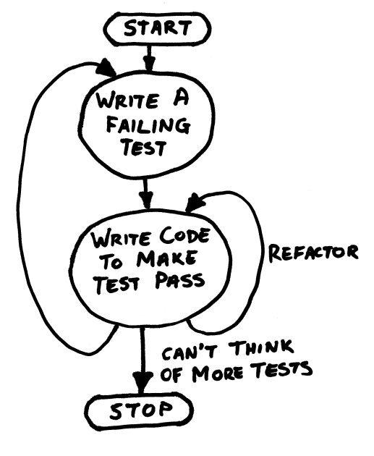
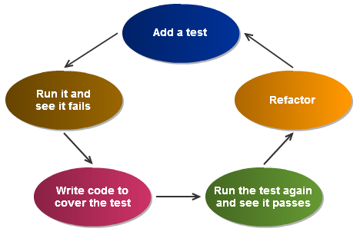
Lifecycle of TDD

Slide 12
How does TDD work?
Have a requirement for example write a function to handle withdraw in the saving bank account.
Think about what could be a reasonable test cases to verify the requirement. Consider Positive, Negative and Exception Scenarios. Also consider boundary conditions, incorrect data types etc.
Write the unit test before coding the functionality. Of course, the test will fail, and that’s fine initially. Although some people prefer vise-versa.
This is a process of continuous improvement in the duration of development, so once you identify possible improvements, refactor the code and add more test cases to increase code coverage.
Enable “Running Unit Test after successful build in Visual Studio”.

Slide 13
What are Unit Tests?
Coded to test specific aspects of a functionality.
Created to test Positive, Negative and Exception scenarios.
Independent with other tests in terms of scenario and execution order.
Automated.
Can be opened from Test Explorer (Test -> Windows -> Test Explorer)

Slide 14
Typical structure of Unit Test (Arrange-> Invoke -> Assert)
Arrange: Set up all perquisite needed for testing (create any objects, allocate any needed resources etc.).
Invoke: Call the method to be tested with required parameters.
Assert: Verify that the tested method returns the expected output.
In some cases, Arrange may not be required.

Slide 15
What is Code Refactoring?
Change in internal structure of the code without changing it’s core functionality or external behavior.
Apply better pattern and constructs.
Removes duplicate code.
Simple Example: xy+ xz= x(y+z).
Same result as previous code but simplified for code readibilty and maintainbility.
Dev Tools like Resharper helps in code refactoring.

Slide 16
Code Coverage
Measurement of the unit test cases created for any code block.
Shows coverage in percent against Solution/Project/Class/Method.
Test—> Analyze Code Coverage –> Selected Tests/ All Tests
Enable the “Show Code Coverage Coloring” option in the “Code Coverage Results” dialog window to see what code touched/ covered by tests. It shows coloring for each of them.
covered ( light blue),
partially covered ( light orange)
not covered (light red)

Slide 17
Mocking What/Why?
Mocking is a method to mimic the dependent objects.
Mocking provides easy way to mimic the external objects like Database, Web Services etc.
There are several mocking frameworks available for example Moq, TypeMock etc.

Slide 18
Demo

Slide 19
Speedup TDD using IntelliTest in Visual Studio 2015.

Slide 20
IntelliTest
An intelligent assistant for software development, helping dev teams find bugs early and reduce test maintenance costs.
Based on previous Microsoft Research work called “Pex.”
Engine uses white-box code analyses and constraint solving to synthesize precise test input values to exercise all code paths.
Helps in ever-shortening release cycles in software development.

Slide 21
IntelliTest – Menu options
Run IntelliTest:
This option will let you run the automatic test case first then you can select the appropriate once to save.
Create IntelliTest
This saves all the generated test cases into the files and then you can run later.

Slide 22
Demo

Slide 23
QnA

Slide 24
Thanks for attending the session. You may reach out to my twitter handle @Prakash_MANIT for any additional query.

