Slide 1
PHASE 3 PROGRESS · SEMESTER 3
Domain-Adaptive Zero-Shot Anomaly Detection Using Vision-Language Models
Adapting a video anomaly detector to a new camera with one sentence the system writes itself — no training, no labels, every model frozen.
Prakash Kumar Sarangi
M.Tech Computer Science and Engineering
Supervisors: Dr. Pranesh Das · Dr. Raju Hazari
National Institute of Technology Calicut
October 2026
Notes:
Title. Introduce yourself and the one-line premise: adapting an anomaly detector to a new camera with one sentence the system writes itself, with nothing retrained.

Slide 2
THE PROBLEM
A detector is tied to the place it learned
Standard approach. Show the system weeks of ordinary footage from one camera until it learns what normal looks like there.
The cost. Move it anywhere else and it fails — a new site means new footage collection and a full retraining cycle.
SHOPPING MALL
FACTORY FLOOR
A forklift moving through the aisles is
an immediate alarm.
The identical forklift is completely
routine.
Same footage. Opposite answers. The picture did not change — the rule did.
1
Notes:
Open with the example, not the definition. Mall versus factory - the same forklift, opposite answers. Then the cost: every new customer means new footage and a retraining cycle. That cost is what we are removing.

Slide 3
RESEARCH GAP · 1 OF 2
The literature solves the adjacent problem
Domain adaptation distinguishes between kinds of difference between places. [11–15, 20]
Type of shift | What moves | Example
Covariate shift | Appearance | A stop sign in fog versus sunshine. Still a stop sign.
Concept shift | The rule itself | A bicycle on a road versus on a footpath. Identical image, opposite label.
WHAT THE SURVEYS SAY
“Concept shift is usually not a common problem in popular object classification… this review mainly focuses on covariate shift.” — Liu et al., 2022 [14]. Singhal et al. [15] list stable p(y|x) as the first condition under which domain adaptation is justified.
Fair for object recognition — a cat is a cat everywhere. But anomaly detection is built on concept shift.
2
Notes:
This is the slide that shows you read the six surveys. Read the Liu quote aloud - the field scopes concept shift OUT by explicit decision. Make clear you are not criticising them: for object recognition it is the right call.

Slide 4
RESEARCH GAP · 2 OF 2
Why that matters for anomaly detection
In anomaly detection, “normal” is defined by the deployment context — not by the object. That is the definition of the task.
Input | Domain A | Domain B
A person running | Park — normal | Bank vault — anomalous
A person lying down | Beach — normal | Factory aisle — anomalous
A vehicle | Road — normal | Walkway — anomalous
THE GAP WE TARGET
Methods that align appearance cannot help here — the appearance is already identical. Two domains can share p(x) exactly while the labelling function differs. A 2026 position paper [1] argues the same premise independently; what is missing is a test of whether supplied context does any work.
3
Notes:
Land the consequence. In anomaly detection normality IS the deployment context. Mention the 2026 position paper yourself - an independent group reached the same premise, which answers 'did you invent this problem?'

Slide 5
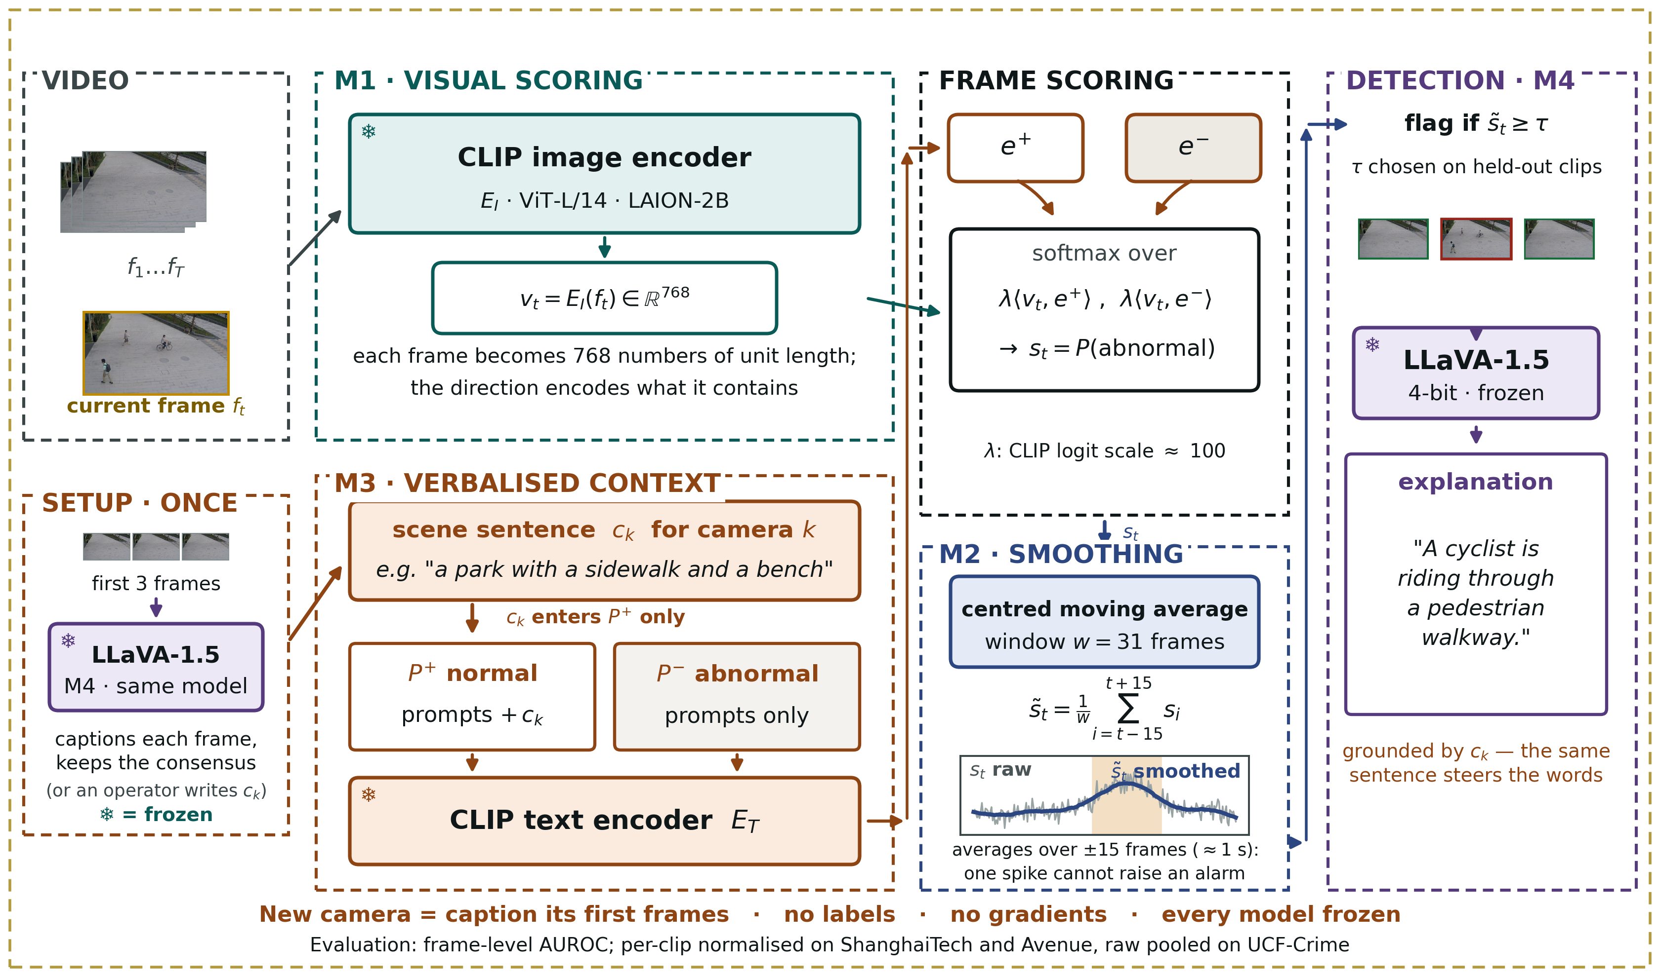
PROPOSED FRAMEWORK
DA-ZVAD: one sentence per camera, written by the system
EVERY MODEL FROZEN
M1 Frozen CLIP [4] scores each frame: normal vs abnormal text.
M2 Moving average over time — no parameters.
M3 One scene sentence per camera, in the normal prompts only.
M4 Frozen LLaVA [24] writes each camera's sentence, and explains events.
NEW CAMERA
Caption its first frames. No labels, no gradients.
4
Notes:
Walk the four modules left to right in about thirty seconds. Point at the SETUP box: LLaVA captions a new camera's first frames and that caption is the camera's sentence - no human needed. Then stop on M3, the only place the domain enters, and its one rule: the sentence goes into the normal prompts only.

Slide 6
METHOD · DESIGN RATIONALE
Why freezing everything is the point
The risk. If the system learned even a little from the new site, and performance improved, we could not say what caused it — the sentence, or the learning.
Our design. No parameter anywhere is allowed to change. Exactly one thing in the system can vary: the text.
The consequence. Any measured difference is attributable to the sentence. There is no other candidate.
IDENTIFIABILITY
This is what makes the adaptation claim testable rather than asserted. You cannot run our central experiment on the competing systems — their text is learned on training data [9], or entangled in an LLM prior [3], or paired with trained detection heads [10].
It also means the claim can be falsified — which is the next slide.
5
Notes:
The strongest methodological point in the deck. Say it slowly. And note that the competing systems CANNOT run our experiment - their text is learned on training data (VERA), or entangled in an LLM prior (LAVAD), or paired with trained detection heads (OVVAD).

Slide 7
EVALUATION DESIGN
A protocol that can prove us wrong
Run the identical pipeline four times. Change only the sentence.
Condition | Sentence supplied | Purpose
none | M3 disabled | Lower reference
generic | “a generic scene” | Controls for merely having context
matched | Correct description of the scene | The proposed operating condition
mismatched | Description of the wrong domain | FALSIFYING CONTROL
PREDICTED SIGNATURE, FIXED BEFORE MEASUREMENT
matched ≥ generic ≥ none, with mismatched measurably WORSE. If a deliberately wrong description costs nothing, the method ignores its context and our claim is refuted.
6
Notes:
Emphasise that the interpretation was fixed BEFORE any measurement, and that the mismatched condition is designed to refute us. A panel will respect a test you could have failed - and later in the deck, one you partly did.

Slide 8
EXPERIMENTS · SETUP
What we ran
Video | ShanghaiTech [21] (12 views) · CUHK Avenue [26] (1 view) · UCF-Crime [27] (~290 scenes)
Image | MVTec AD [7] — detection baseline only
Scale | 418 test videos · 97,752 sampled frames · frame-level ground truth
Models | CLIP ViT-L/14 [4, 22] (LAION-2B) and LLaVA-1.5-7B [24] 4-bit — all frozen
Hardware | NVIDIA A40, college GPU server · PyTorch 2.3.1 / CUDA 12.1
Runs | 5 full runs, cached-embedding analyses, LLaVA captioning, UCF-Crime pre-registered run
EVERY RUN RECORDS ITS OWN CONDITIONS
Each run writes a manifest: the exact code commit, whether the working tree was clean, host, GPU, driver and library versions, full configuration, and per-dataset frame and label counts. Committed alongside the results — every figure in this deck is traceable to the state that produced it.
7
Notes:
Keep this brief - it is the credibility slide. If anyone doubts the work is yours, offer to open a manifest. Three video benchmarks now, UCF-Crime added in Phase 3; MVTec is only the image baseline.

Slide 9
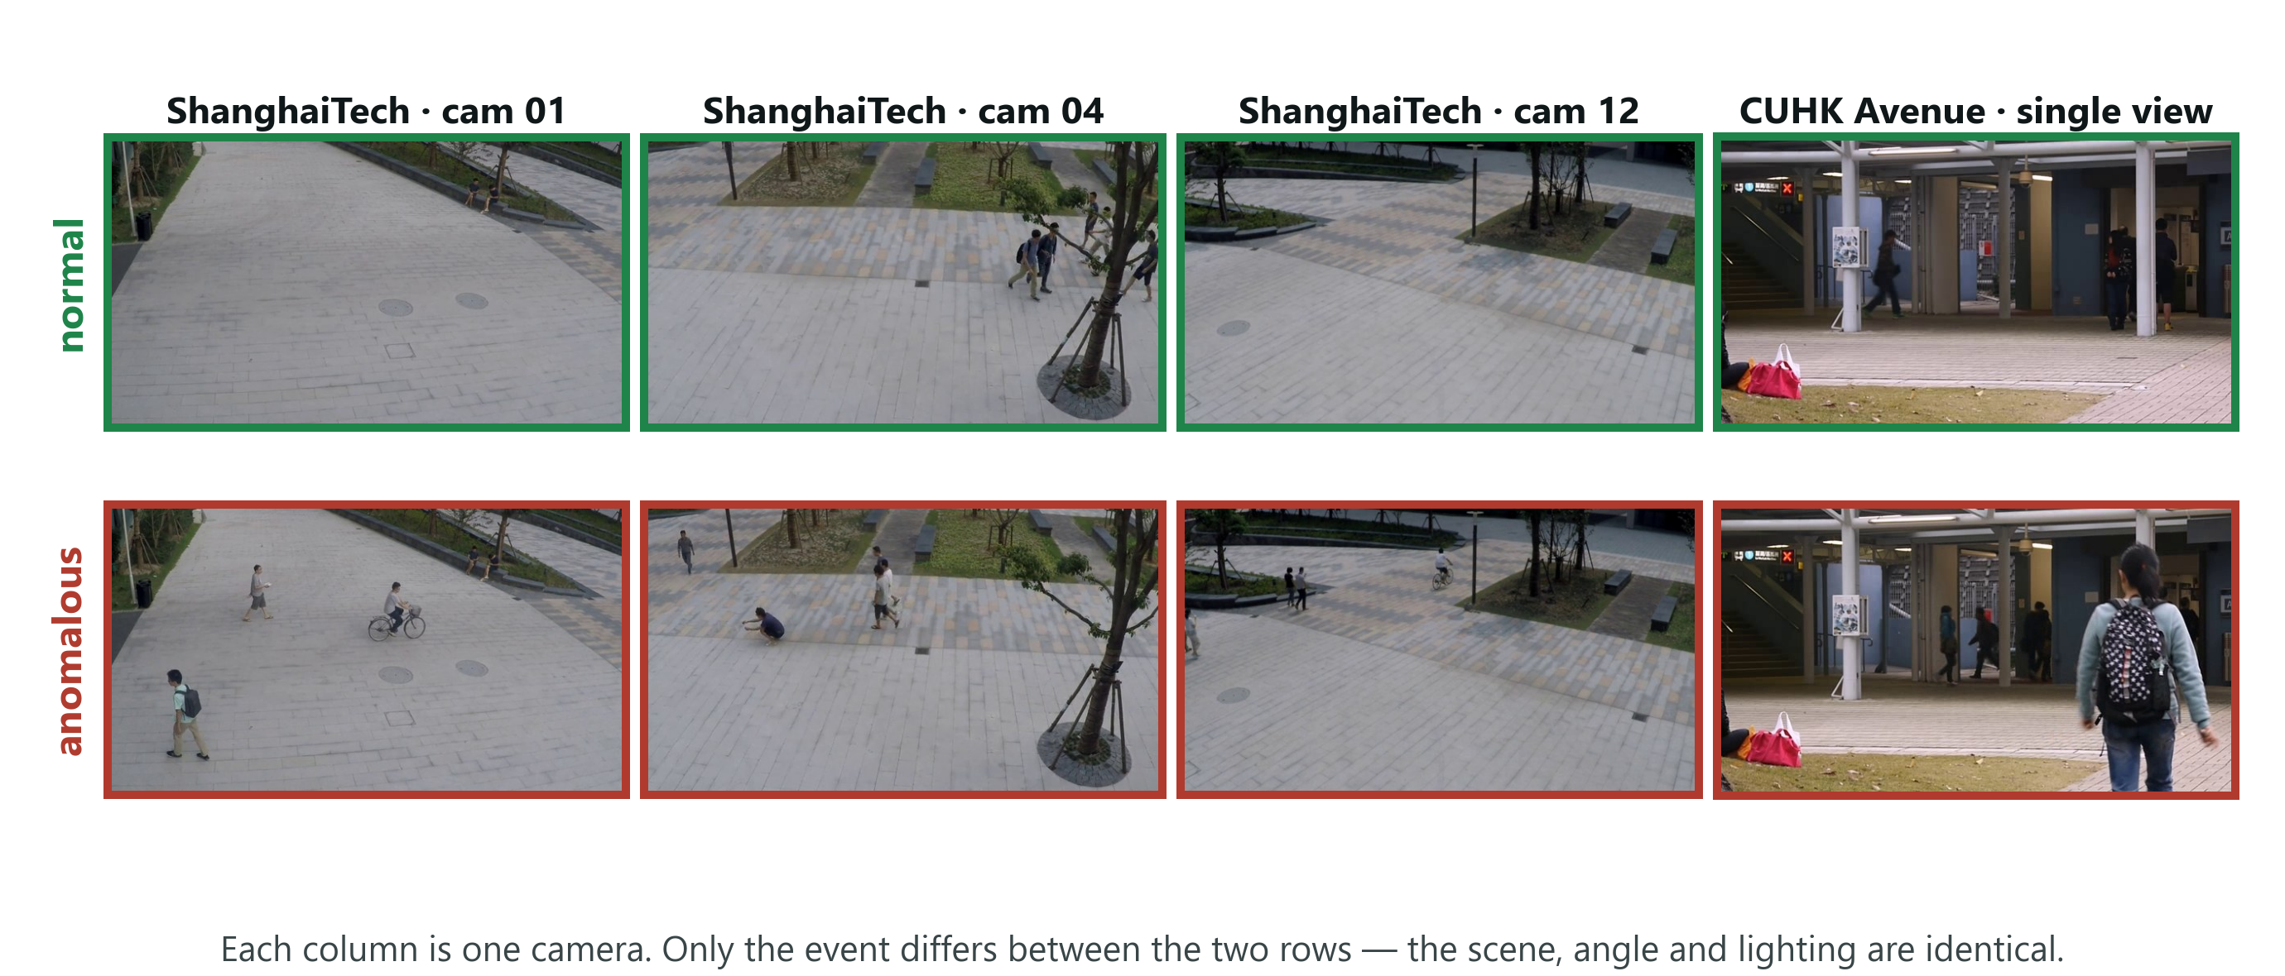
EXPERIMENTS · THE DATA
What the two campus benchmarks look like
HOW TO READ IT
Each column is one fixed camera: the scene stays constant and only the event changes — an empty walkway and the same walkway with a cyclist look alike and are labelled opposite. UCF-Crime, added in Phase 3, is the opposite case: almost every one of its 290 videos is a different place.
8
Notes:
Thirty seconds, no more. Point down one column and say the scene never changes - only the event does. Then one line on UCF-Crime: there, almost every video is a different place, which is why each gets its own sentence.

Slide 10
EXPERIMENTS · WHAT HAPPENED
The first result was a failure
0.49
Fifty minutes of GPU time produced a detector performing exactly as well as a coin flip.
frame-level AUROC — 0.50 is random guessing
And the central experiment came out backwards:
Condition | Predicted | Observed
matched (correct description) | Best | WORST — 0.666
mismatched (wrong description) | Worst | Among the best — 0.695
This is the point at which the idea looks broken.
9
Notes:
Do not rush past this and do not apologise for it. The first run was chance, and the key experiment came out backwards. Then pause. The next two slides are what makes this presentation worth listening to.

Slide 11
EXPERIMENTS · DIAGNOSIS
Diagnosis 1 — we were measuring it wrong
12 camera views. CLIP sits at a different baseline score under each one — different lighting, different angle.
Our error. We pooled every frame from all 12 cameras into one ranking.
The analogy. Ranking students from different schools by raw marks when the schools grade differently. The comparison destroys the ordering.
The published protocol for this benchmark [21] normalises each clip first. We were not doing it.
0.49
0.71
→
Identical scores. Uses no labels.
We report both figures in the paper.
as reported
correctly pooled
10
Notes:
The schools analogy works on everyone - use it. Stress twice that the fix uses no labels and is the benchmark's own published protocol, and that both figures appear in the paper.

Slide 12
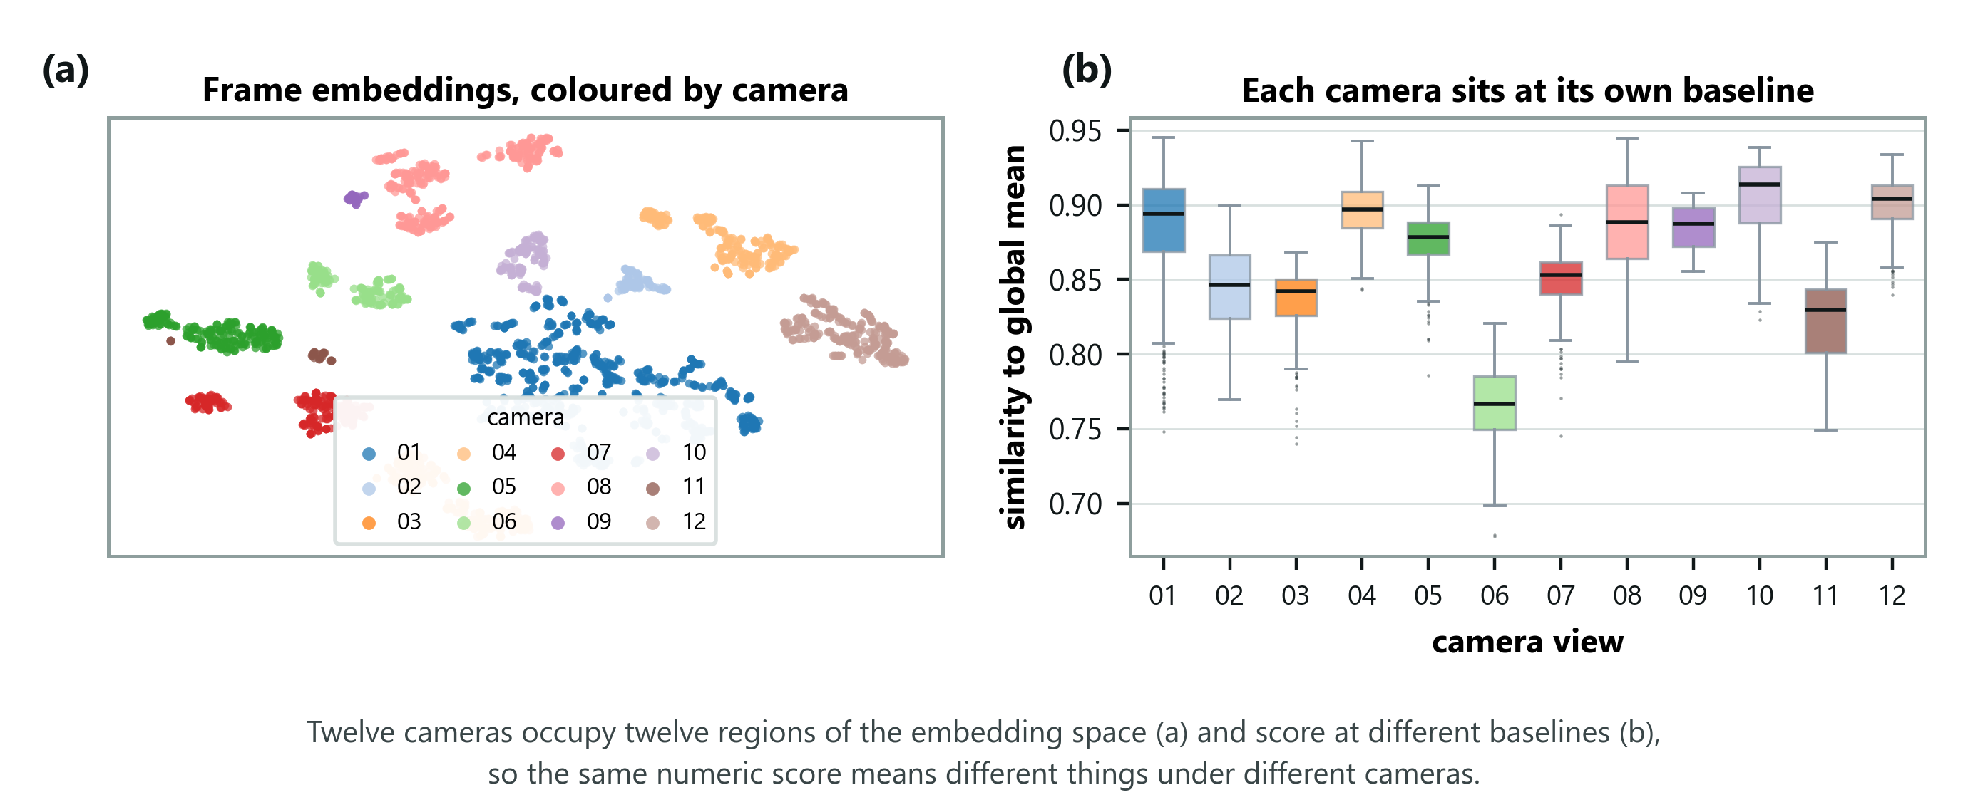
EXPERIMENTS · DIAGNOSIS
The evidence for that diagnosis
HOW TO READ IT
Left: every frame projected to two dimensions and coloured by camera — the views sit in separate regions. Right: how similar each view is to the average frame, differing by more than 0.13 between views. Neither panel uses labels, so this is not hindsight.
11
Notes:
This is the proof that the diagnosis was not invented after the fact. Say clearly that neither panel uses labels. The cameras are separate regions of the space and sit at different similarity levels, which is exactly why pooling raw scores destroyed the ordering.

Slide 13
EXPERIMENTS · THE FINDING
Diagnosis 2 — the description cancelled itself out
We were appending the scene sentence to BOTH prompt sets:
NORMAL PROMPT
ABNORMAL PROMPT
“a campus walkway with pedestrians,
everything is normal”
“a campus walkway with pedestrians,
but something is wrong”
Shared words. Each prompt set is averaged into one summary vector. Shared text enters both — so the two summaries move toward each other.
The method depends on them being different. We were erasing the very contrast the decision rests on.
Which explains the inversion. An accurate description matches every frame strongly, so it absorbs the most contrast. A wrong one matches nothing, so it does no damage.
THE FIX
Attach the description to the normal prompts only — the scene defines what normal looks like here; an anomaly is a departure from it.
12
Notes:
The most interesting slide. Point at the two prompts and let them see the shared words. Then the punchline: the more accurate the description, the more damage it does. That is why the result inverted.

Slide 14
RESULTS · CENTRAL EXPERIMENT
After the fix: the predicted signature
ShanghaiTech, all 107 clips, per-clip normalised. Every model frozen; only the sentence and its injection point vary.
Injection point | none | generic | matched | mismatched | gap
Both prompt sets | 0.707 | 0.670 | 0.666 | 0.695 | −0.029
Normal set only | 0.707 | 0.691 | 0.734 | 0.628 | +0.105
The “none” column is identical in both rows — confirming nothing but the injection point changed.
0.734
0.628
correct description
wrong description — a 10-point penalty
Nothing else was permitted to change, so the text caused it — slide 17 says how.
13
Notes:
The headline. Point at the none column being identical in both rows - that is the control, and it proves only the injection point changed. Then point at 0.628 and say a wrong sentence costs ten points on the benchmark metric. Do not say 'the text redefines normal' - slide 17 explains why.

Slide 15
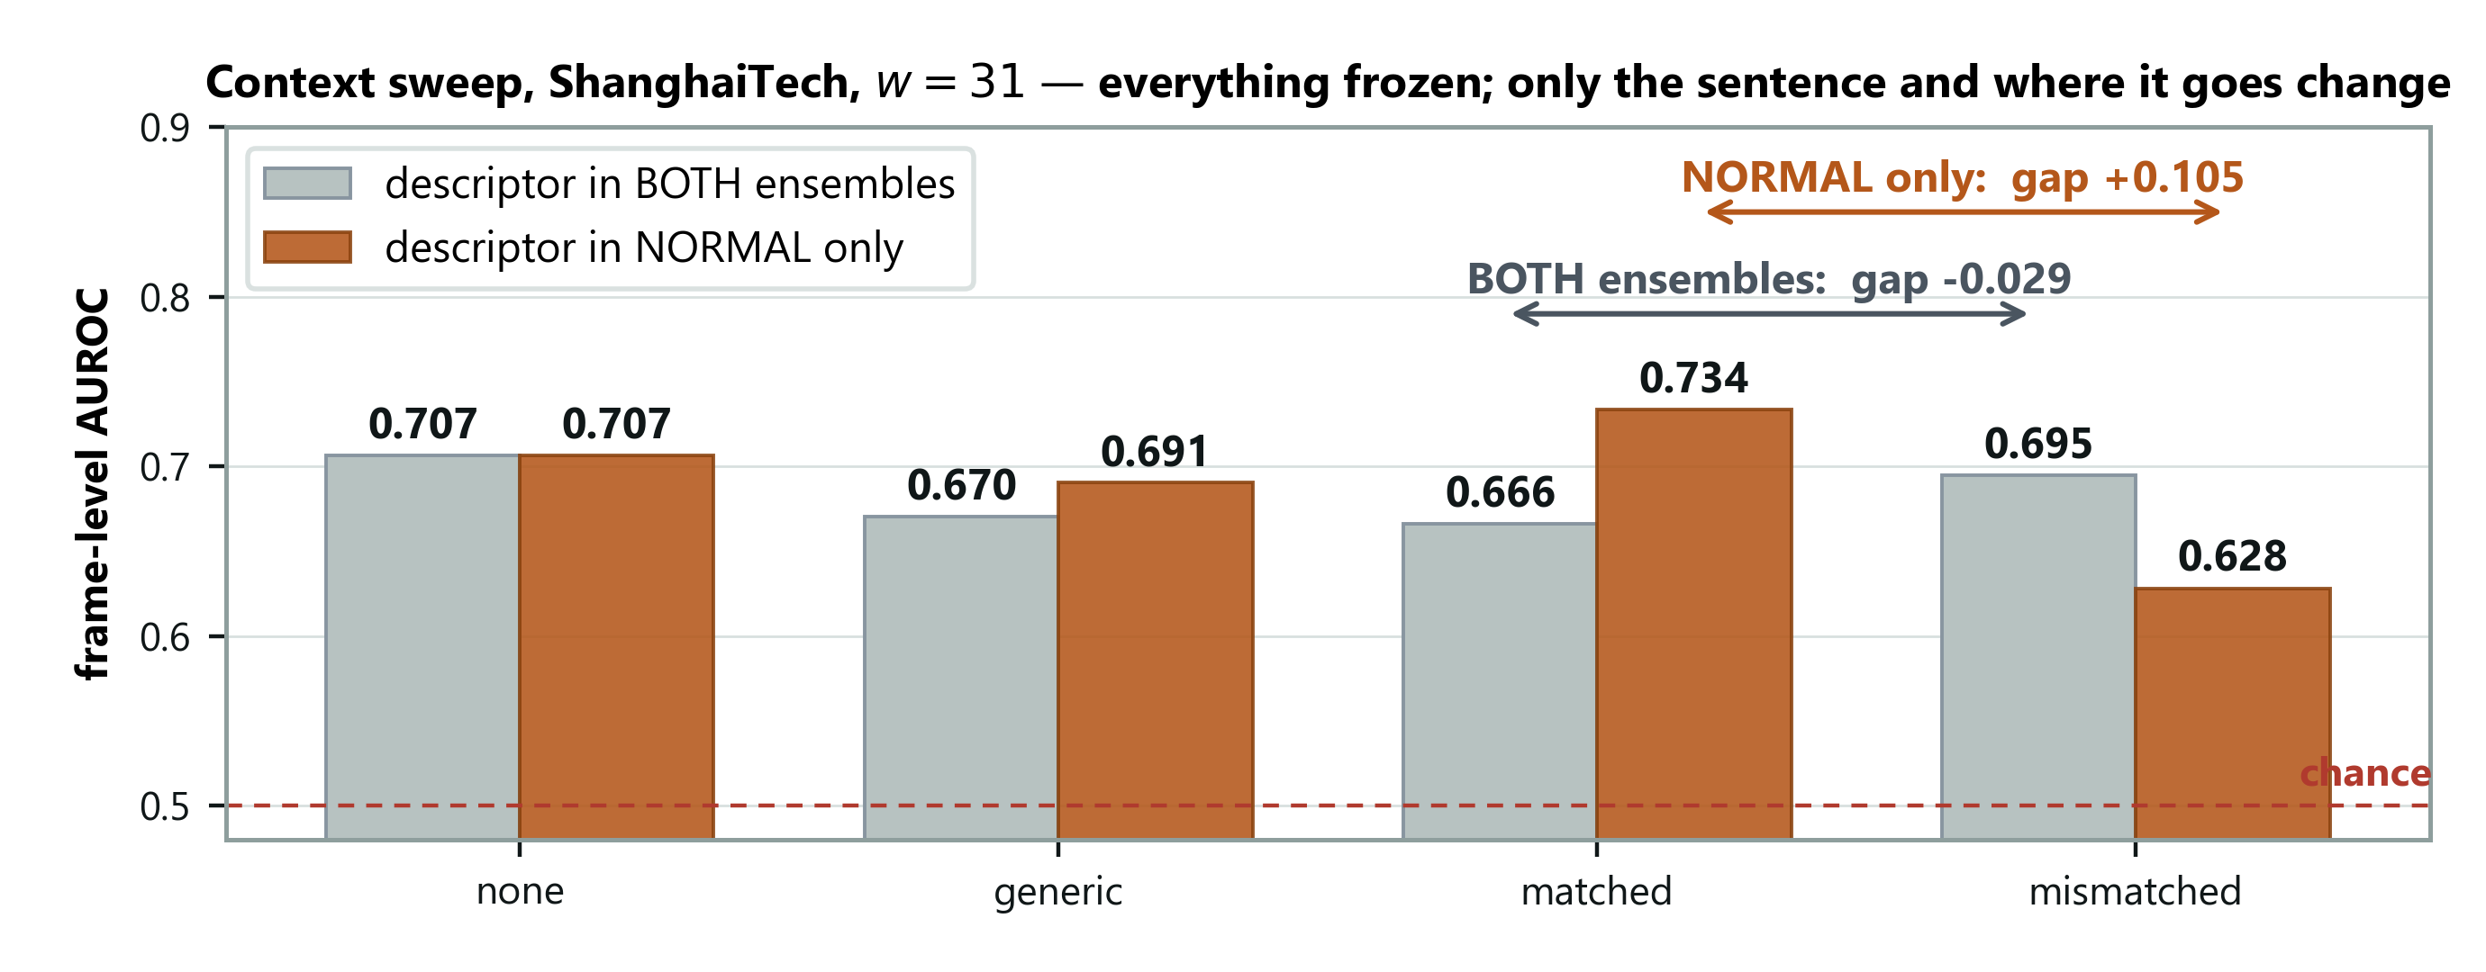
RESULTS · CENTRAL EXPERIMENT
The same experiment, drawn
HOW TO READ IT
The number the experiment exists to produce is the arrow: the distance between the matched and mismatched bars. Grey bars put the sentence in both prompt sets and that distance is negative. Orange bars put it in the normal set only and it becomes +0.105.
14
Notes:
The picture of the previous table. Trace the two arrows with a finger. The grey arrow points the wrong way and the orange one points the right way, and the only thing separating them is where the sentence was attached.

Slide 16
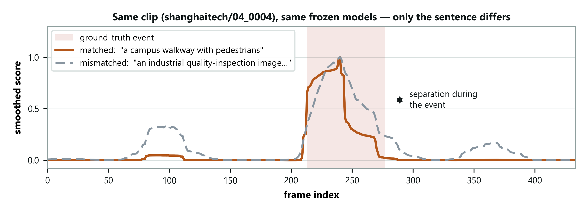
RESULTS · WHAT THE GAP LOOKS LIKE
One clip, two sentences
HOW TO READ IT
Same frozen models, same frames, same smoothing — the only difference is whether the sentence describes a campus walkway or an industrial site. The curves track each other outside the event and separate inside it. Nothing else was free to vary, so the text caused the separation.
15
Notes:
The most persuasive slide in the deck for a sceptical panel, because there is no aggregation to argue with - two runs over identical frames with identical frozen weights. Say that the curves coincide outside the event on purpose: that is the control.

Slide 17
RESULTS · INTERPRETATION
Stating the claim precisely
THE WEAKER HALF
THE CLAIM WE MAKE
A correct description beats none by +0.027.
Positive at every window, but inside the ±0.036 split-to-split spread.
A WRONG description lowers the benchmark score by 0.105.
Nothing else could have caused it.
WHAT A SECOND METRIC SHOWED (PHASE 3)
Judged only by which frames rank highest INSIDE each video, the gap is +0.006. The sentence mostly shifts each video's overall score level — telling cameras apart — and the pooled metric rewards that. It barely re-ranks frames within a video. A full audit is the next experiment.
A secondary finding, not present in the literature: WHERE the description is injected dominates WHAT it says — to the point of reversing the direction of the effect.
16
Notes:
Be scrupulous. The +0.027 sits inside the spread, so we report direction only. Then the Phase 3 check, said plainly: judged only inside each video, the gap is +0.006. The sentence mostly shifts each video's score level - it tells cameras apart - rather than re-ranking frames. We found this ourselves and the audit is the next experiment. Saying it first is what protects you.

Slide 18
RESULTS · COMPONENT ABLATION
Which components earn their place
Scoring signal | Held-out AUROC | Full test set
Scene-centre normality only | 0.585 ± 0.025 | 0.585
Semantic + scene-centre | 0.645 ± 0.034 | 0.640
Kinematic — motion only | 0.685 ± 0.015 | 0.686
Semantic + kinematic | 0.711 ± 0.034 | 0.706
Semantic — language only | 0.718 ± 0.036 | 0.707
Held-out figures are means over five clip-level partitions, with the spread across them.
The language pathway alone is best. Adding a motion signal costs 0.001 on the full set; adding scene-centre normality costs 0.067.
This was not the expected answer. ShanghaiTech's anomalies look kinematic — a bicycle at cycling speed — so appearance and motion should be complementary. Measured here, they are not.
17
Notes:
Volunteer the surprise: we expected motion to help and it does not. The pooled embedding already registers enough of it. Reporting the prediction that failed is stronger than reporting only the ones that held.

Slide 19
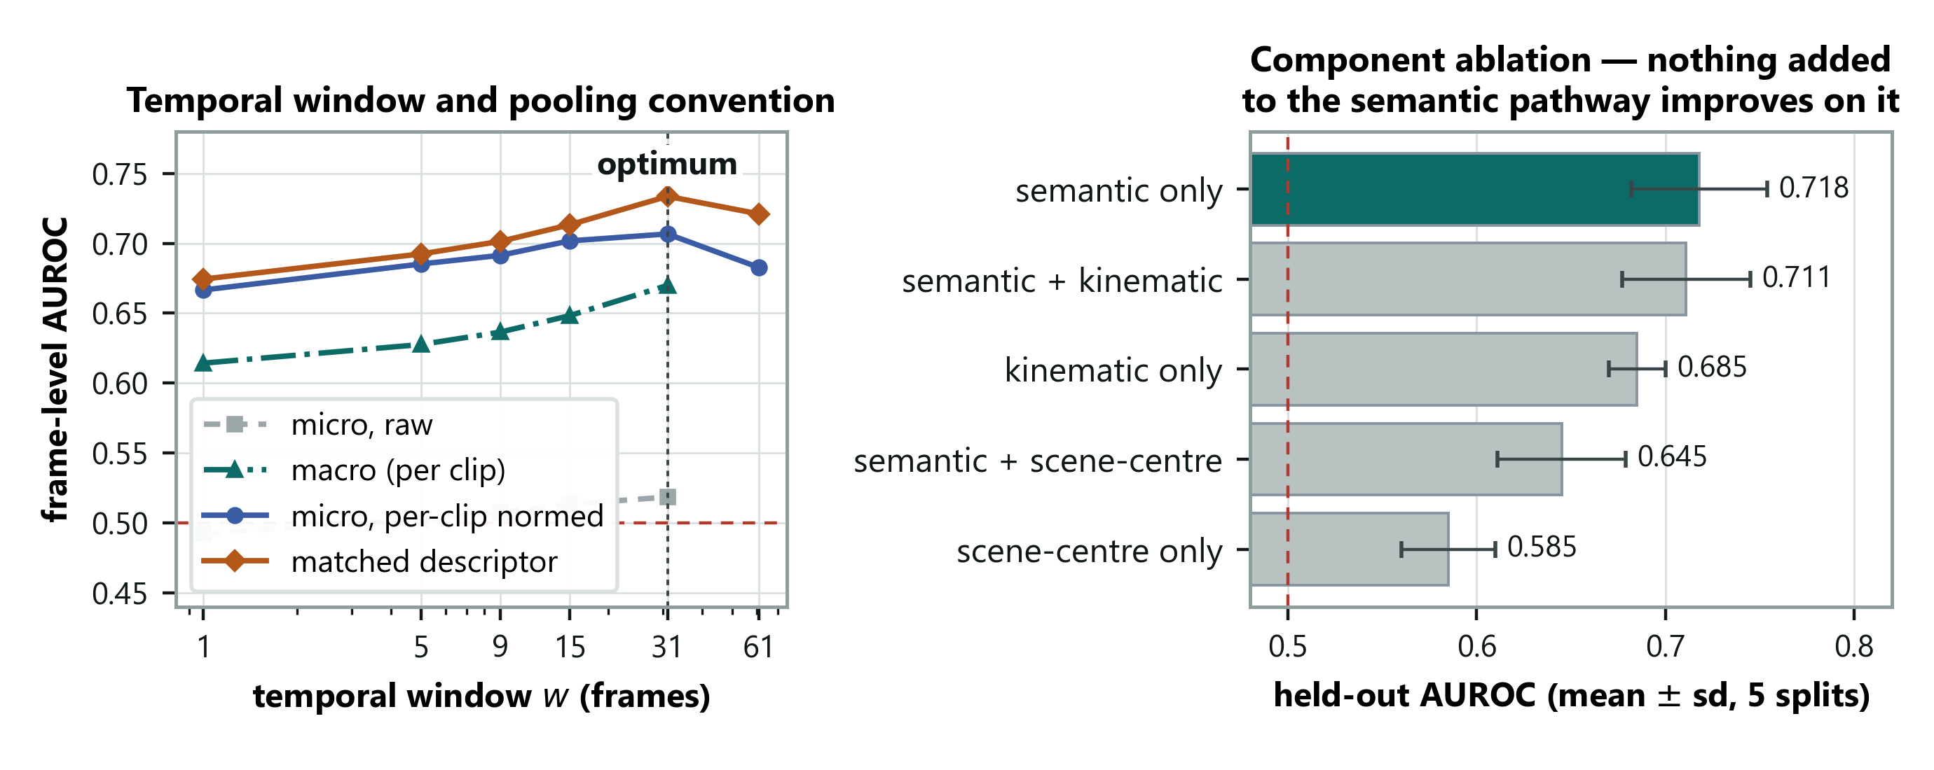
RESULTS · ABLATION
Window length, and what each component adds
HOW TO READ IT
Left: smoothing helps up to w=31 and then hurts, so the window has a real optimum rather than the metric rewarding more blur; the grey curve is the wrong pooling and never leaves chance. Right: the error bars overlap, so the honest claim is that nothing added beats language alone — not that language alone wins.
18
Notes:
Volunteer the weakness before anyone asks. The error bars overlap, so the top three are statistically tied. The claim is that nothing we added beat plain language, which is a negative result about our own elaborations, not a win over the alternatives.

Slide 20
RESULTS · CROSS-DOMAIN
A second domain — the replication test
Identical frozen configuration applied to CUHK Avenue. Nothing retuned. Only the scene sentence changed.
Dataset | none | generic | matched | mismatched | gap
ShanghaiTech (12 views) | 0.707 | 0.691 | 0.734 | 0.628 | +0.105
CUHK Avenue (1 view) | 0.706 | 0.729 | 0.677 | 0.657 | +0.020
DETECTION TRANSFERS
ADAPTATION DOES NOT
0.706 vs 0.707 with no descriptor.
The detector works equally well.
Gap 5× smaller, and the correct
description scores BELOW none.
OUR EXPLANATION — STATED AS A CONJECTURE
ShanghaiTech has 12 camera views; Avenue has one, so a scene description has nothing to tell apart. Tested next inside single ShanghaiTech views, and later on UCF-Crime's ~290 scenes.
19
Notes:
The most important slide in the deck. Detection transfers almost exactly; the adaptation does not. Give the honest reading - on Avenue a placeholder beats an accurate description, so that benefit cannot be domain adaptation. Then give the conjecture AND the experiment that would settle it - the next slide, and UCF-Crime later in the deck.

Slide 21
RESULTS · THE CONTROL
We tested that explanation, and it held
ShanghaiTech is twelve single-view datasets stacked together. If the descriptor works by telling the model WHICH scene it is in, then confining the sweep to one camera view should reproduce Avenue's flat result.
Evaluation | Scenes | Clips | Gap
CUHK Avenue (single view) | 1 | 21 | +0.020
ShanghaiTech, within a single view (mean) | 1 each | 5–34 each | +0.033
ShanghaiTech, pooled across views | 12 | 107 | +0.105
UCF-Crime, own sentence per video (Phase 3) | ~290 | 290 | +0.096
THE PREDICTION COULD HAVE FAILED
A within-view gap near +0.105 would have refuted it; it came back at a third. But ~290 scenes gave no bigger gap than 12: it needs scenes, it does not keep growing.
What the sentence mainly supplies is WHICH scene you are in — not what counts as normal within it. Three of nine views show a negative gap, so inside one scene the effect is not reliable.
20
Notes:
This is the slide that shows a full cycle: we saw something odd, formed an explanation, designed a test that could have killed it, ran it, and it held. Say out loud that a gap near +0.105 here would have refuted us. Then give the caveat yourself - three of nine views are negative, so within one scene the effect is not reliable. The last row is Phase 3: ~290 scenes gave no bigger gap than 12, so the claim is 'needs scenes', not 'grows with scenes'.

Slide 22
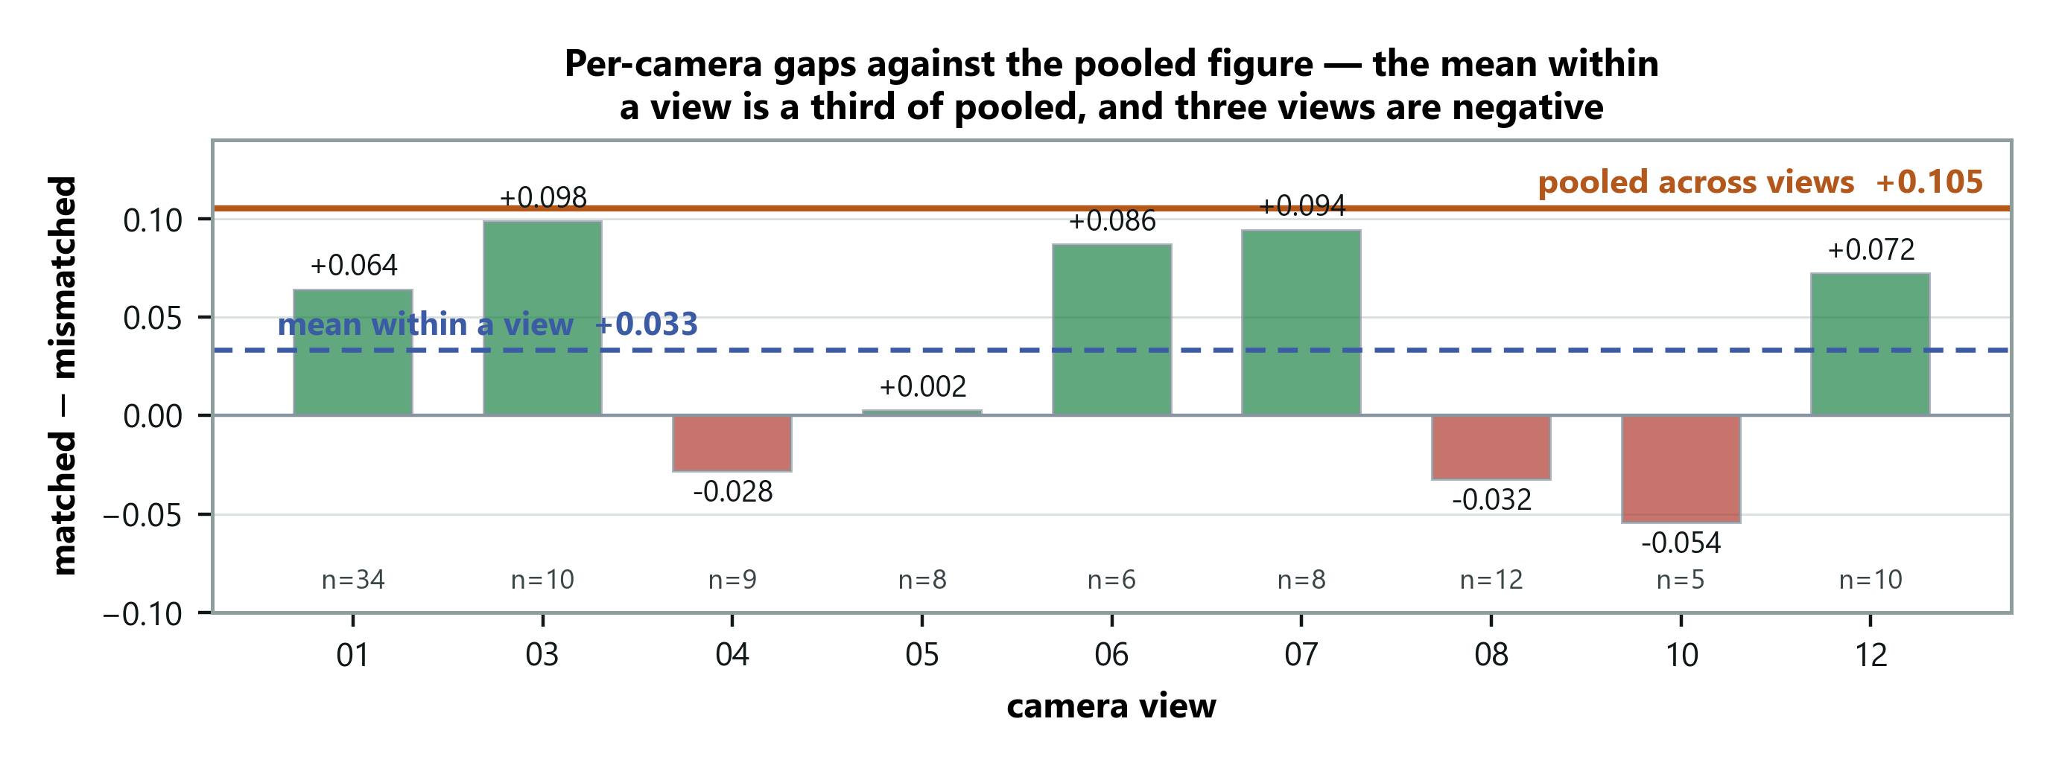
RESULTS · THE CONTROL
Every camera view, one at a time
HOW TO READ IT
The orange line is the pooled result; each bar is one view on its own. Most fall well short of it and three are negative — but views 03 and 07 nearly reach it, so this is a shift in the average, not a clean collapse. The bars rest on between five and thirty-four clips each.
21
Notes:
Show the spread yourself. Three views are negative and two nearly reach the pooled figure, so the result is a shift in the mean rather than a collapse everywhere. Saying this before the panel spots it is the difference between a caveat and a hole.

Slide 23
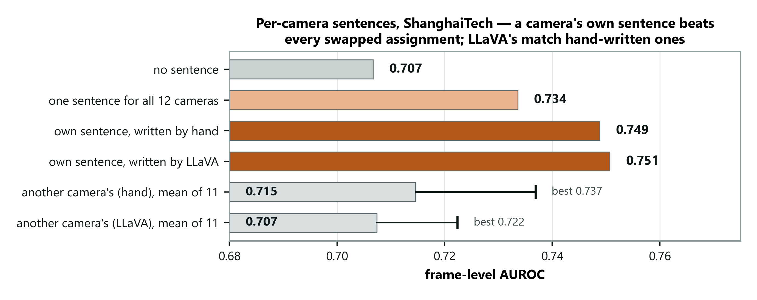
PHASE 3 · RESULT 6
A sentence per camera — written by the system
HOW TO READ IT
Each camera gets its own sentence instead of one for all twelve. Written by hand: 0.749. Written by LLaVA from the camera's first three frames, with no human and no labels: 0.751. Give each camera ANOTHER camera's sentence and it drops — even the best of 11 swaps (0.737) loses. The sentence works by matching its camera.
22
Notes:
Phase 3 starts here. Say what changed: each camera gets its own sentence, and LLaVA writes it from the first three frames - no human, no labels. Point at the swapped bars: even the best swap loses, so the sentence works by matching its camera. Do not claim LLaVA beats a human; 0.751 against 0.749 is noise.

Slide 24
PHASE 3 · RESULT 7
UCF-Crime: predictions written down first
290 real CCTV videos [27] from ~290 different places, 140 with a crime. Four predictions were committed to git before any score was computed.
0.824
Registered prediction | Measured | Outcome
P1 gap grows beyond ShanghaiTech's +0.105 | +0.096 | Refuted
P2 own sentence beats borrowed ones | +0.110 | Holds
P3 own sentence beats one shared sentence | +0.011 | Holds (small)
P4 correct beats wrong-domain description | +0.086 | Holds
AUROC, no training — LAVAD 0.803, AnyAnomaly 0.807
WHAT IT SHOWS
Another video's sentence scores BELOW no sentence (0.713 vs 0.756): the wrong scene misleads. P1 failed, so the claim is narrowed from 'the benefit scales with scene diversity' to 'the benefit needs it'.
23
Notes:
The strongest slide for credibility. The predictions were committed to git before any score existed. Say P1 failed before anyone asks, and that the claim was narrowed because of it. On LAVAD: 'comparable or better'. LAVAD samples every 16th frame too, but other papers' numbers can differ by small protocol details. AnyAnomaly gets 0.807 here - below us, unlike on the campus benchmarks.

Slide 25
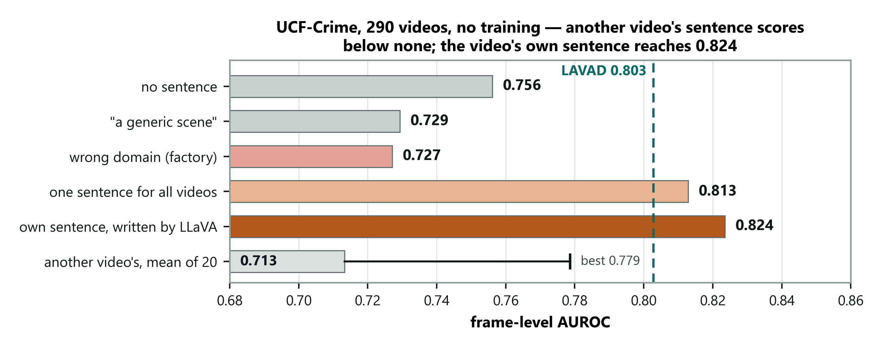
PHASE 3 · RESULT 7
UCF-Crime, drawn
HOW TO READ IT
The video's own LLaVA sentence reaches 0.824; borrowed sentences average 0.713, below having none. The dashed line is LAVAD's 0.803 (AnyAnomaly: 0.807). Both are other papers' numbers, so read it as comparable, not as a margin.
24
Notes:
Point at the borrowed-sentence bar first: worse than no sentence at all. That is the clearest evidence that the sentence tells the model where it is. Then the dashed LAVAD line, with the protocol caveat.

Slide 26
RESULTS · NEGATIVE FINDINGS
Six things that did not work
Modification | Outcome
Quadrant scoring, to catch small objects | No improvement in any configuration
Prompts naming bicycles and vehicles | Much worse alone — 0.486
Clip's own average as the normality reference | 0.585, and it degrades the language signal
Adding a motion signal | Costs 0.001 — not complementary
Local temporal deviation before projection | Better scorer, but narrows the context gap
Per-prompt max pooling | 0.678 against 0.707
WHY THESE ARE IN THE DECK
The claim is that the minimal configuration is the right one. That is only credible alongside the alternatives that were tried. A clean table of successes is the artefact that is easy to fabricate; six diagnosed failures are not.
25
Notes:
Say why you are showing failures: the claim is that the minimal configuration is right, and that is only credible next to what was tried. If the panel suspects generated work, this slide is your best answer.

Slide 27
ASSESSMENT
Where this sits against the literature
Training-free method (no target data) | Avenue | ShT | UCF
Zero-shot CLIP [4] | 62.3 | 60.9 | 53.2‡
Zero-shot ImageBind [36] | 64.5 | 61.3 | 53.7‡
LLaVA-1.5 [24] | 67.4 | 59.6 | 72.8‡
Video-ChatGPT [37] | 76.9 | 69.1 | —
LAVAD [3] — captioner + LLM + refiner | — | — | 80.3‡
DA-ZVAD (ours) — one frozen encoder + a sentence | 67.7 | 73.4 | 82.4
AnyAnomaly [2] — 3 LVLM queries per segment | 87.3 | 79.7 | 80.7
‡ from LAVAD [3], Table 1. All other figures from AnyAnomaly [2], Tables 5–6. Ours: Avenue/ShT one shared sentence; UCF one sentence per video.
AnyAnomaly asks “is the thing I named happening?” We ask “is anything happening that doesn’t belong here?” Theirs needs a list of what could go wrong — at evaluation it is handed the benchmark’s own anomaly classes. Ours needs a description of the ordinary.
WHERE WE LEAD
First of six training-free methods on UCF-Crime; behind AnyAnomaly on the campus benchmarks.
26
Notes:
Anchor on the trained baseline: 73.4 matches the benchmark's own 2018 baseline using none of its training data. Then the reframe - AnyAnomaly is handed the class list, we are not. Then the UCF column: first of six training-free methods, above LAVAD and AnyAnomaly - say 'comparable or better', since these are other papers' numbers. The ‡ rows come from LAVAD's paper, the rest from AnyAnomaly's.

Slide 28
ASSESSMENT
Limitations we are stating ourselves
The mechanism is bounded. It works on ShanghaiTech and UCF-Crime and nearly vanishes on single-camera Avenue. A pre-registered prediction that it grows with scene diversity was refuted.
Resolution ceiling. Whole-frame embeddings at 224×224 cannot resolve small objects. Quadrant scoring did not close it; patch-level scoring is untested.
What the sentence actually does is not settled. Inside each video it barely re-ranks frames (+0.006); most of the 0.105 is per-video score shifts that the pooled metric rewards. An audit is the next experiment.
The metrics are scale-sensitive. Softmax plus per-clip normalisation changes pooled figures without changing rankings; on UCF-Crime the effect shrinks under per-video normalisation.
Configuration selection. No validation split exists for these benchmarks, so we split clips and report the half never used to select.
No explanations yet. M4 now writes the camera sentences, but has not yet explained flagged events.
27
Notes:
Deliver these confidently rather than apologetically. Dwell on the first two: we found ourselves that the pooled metric rewards score shifts, and that applies to every CLIP-based zero-shot VAD paper, not only ours.

Slide 29
NEXT
What comes next
Priority | Work | Why it matters
1 | Measurement audit: within-video ranking and raw scores, all benchmarks | Decides what the sentence really does: re-ranks frames or calibrates cameras
2 | XD-Violence (pre-registered) and UCF-Crime on every frame | LAVAD's second benchmark; makes the comparison airtight
3 | NWPU Campus — scene-dependent anomalies | The only benchmark where the same event flips label by scene: a direct concept-shift test
4 | Patch-level scoring; M4 explanations | Higher figure on small anomalies; completes the framework for the thesis
DONE SINCE PHASE 2
Within-view control with a confidence interval; prototype direction measured; per-camera sentences written by the system (0.751); UCF-Crime under pre-registered predictions (0.824); every citation checked against its source.
28
Notes:
The audit comes first because it decides how the result is described. Then XD-Violence, LAVAD's other benchmark. NWPU Campus is the one dataset where the same event is normal in one scene and abnormal in another - the direct test of concept shift. Point at the box at the bottom for what is done.

Slide 30
PHASE 3
Summary
1
The gap
Domain adaptation research targets covariate shift by explicit scoping [14, 15]. Anomaly detection is dominated by concept shift.
2
The method
Every model frozen; adaptation carried by one sentence per camera, which the system writes itself from a few frames.
3
The result
0.751 on ShanghaiTech and 0.824 on UCF-Crime with no training. A wrong sentence costs 0.105 — mostly by shifting scores between videos.
4
The finding
Where the description is injected dominates what it says, to the point of reversing the effect. Not in the literature.
5
The boundary
It needs several scenes: flat on single-camera Avenue, strong on ShanghaiTech and UCF-Crime — but it does not keep growing with more scenes, as a pre-registered test showed.
All results reproducible from committed code and run manifests.
29
Notes:
Close on the boundary, not the number. Say plainly that one registered prediction failed and the claim was narrowed, and that the within-video check is being audited. Then hand over.

Slide 31
1 OF 3
References
[1] K. Wilkinghoff, N. Madan, J. M. Valverde, K. Nasrollahi, R. T. Ionescu, R. Wisniewski, T. B. Moeslund, W. Wang, Z.-H. Tan, Out of context: Reliability in multimodal anomaly detection requires contextual inference, arXiv preprint arXiv:2604.13252 (2026).
[2] S. Ahn, Y. Jo, K. Lee, S. Kwon, I. Hong, S. Park, AnyAnomaly: Zero-shot customizable video anomaly detection with LVLM, in: Proceedings of the IEEE/CVF Winter Conference on Applications of Computer Vision (WACV), 2026, pp. 3026–3035.
[3] L. Zanella, W. Menapace, M. Mancini, Y. Wang, E. Ricci, Harnessing large language models for training-free video anomaly detection, in: Proceedings of the IEEE/CVF Conference on Computer Vision and Pattern Recognition (CVPR), 2024, pp. 18527–18536.
[4] A. Radford, J. W. Kim, C. Hallacy, A. Ramesh, G. Goh, S. Agarwal, G. Sastry, A. Askell, P. Mishkin, J. Clark, G. Krueger, I. Sutskever, Learning transferable visual models from natural language supervision, in: Proceedings of the International Conference on Machine Learning (ICML), 2021, pp. 8748–8763.
[5] J. Jeong, Y. Zou, T. Kim, D. Zhang, A. Ravichandran, O. Dabeer, WinCLIP: Zero-/few-shot anomaly classification and segmentation, in: Proceedings of the IEEE/CVF Conference on Computer Vision and Pattern Recognition (CVPR), 2023, pp. 19606–19616.
[6] Q. Zhou, G. Pang, Y. Tian, S. He, J. Chen, AnomalyCLIP: Object-agnostic prompt learning for zero-shot anomaly detection, in: Proceedings of the International Conference on Learning Representations (ICLR), 2024.
[7] P. Bergmann, M. Fauser, D. Sattlegger, C. Steger, MVTec AD — A comprehensive real-world dataset for unsupervised anomaly detection, in: Proceedings of the IEEE/CVF Conference on Computer Vision and Pattern Recognition (CVPR), 2019, pp. 9592–9600.
[8] K. Roth, L. Pemula, J. Zepeda, B. Schölkopf, T. Brox, P. Gehler, Towards total recall in industrial anomaly detection, in: Proceedings of the IEEE/CVF Conference on Computer Vision and Pattern Recognition (CVPR), 2022, pp. 14318–14328.
[9] M. Ye, W. Liu, P. He, VERA: Explainable video anomaly detection via verbalized learning of vision-language models, in: Proceedings of the IEEE/CVF Conference on Computer Vision and Pattern Recognition (CVPR), 2025, pp. 8679–8688.
[10] P. Wu, X. Zhou, G. Pang, Y. Sun, J. Liu, P. Wang, Y. Zhang, Open-vocabulary video anomaly detection, in: Proceedings of the IEEE/CVF Conference on Computer Vision and Pattern Recognition (CVPR), 2024, pp. 18297–18307.
[11] V. M. Patel, R. Gopalan, R. Li, R. Chellappa, Visual domain adaptation: A survey of recent advances, IEEE Signal Processing Magazine 32 (2015) 53–69.
[12] M. Wang, W. Deng, Deep visual domain adaptation: A survey, Neurocomputing 312 (2018) 135–153.
[13] G. Wilson, D. J. Cook, A survey of unsupervised deep domain adaptation, ACM Computing Surveys 51 (2020) 1–46.
30
Notes:
Do not read these out. They are here because they are the evidence base for the gap: the six surveys are what let us say the field scopes concept shift out. Be ready to say which one contains the quote - it is Liu et al. 2022.

Slide 32
2 OF 3
References
[14] X. Liu, C. Yoo, F. Xing, H. Oh, G. El Fakhri, J.-W. Kang, J. Woo, Deep unsupervised domain adaptation: A review of recent advances and perspectives, APSIPA Transactions on Signal and Information Processing 11 (2022). ArXiv:2208.07422.
[15] P. Singhal, R. Walambe, S. Ramanna, K. Kotecha, Domain adaptation: Challenges, methods, datasets, and applications, IEEE Access 11 (2023) 6973–7020.
[16] L. Fan, F. Liu, C. Chen, Domain adaptation of large language models for geotechnical applications, Solid Earth Sciences (2026). Art. no. 100285.
[17] D. Guo, Y. Fu, S. Li, Ada-VAD: Domain adaptable video anomaly detection, in: Proceedings of the SIAM International Conference on Data Mining (SDM), 2024, pp. 634–642.
[18] Y. Lu, F. Yu, M. K. K. Reddy, Y. Wang, Few-shot scene-adaptive anomaly detection, in: Proceedings of the European Conference on Computer Vision (ECCV), 2020, pp. 125–141.
[19] A. Aich, K.-C. Peng, A. K. Roy-Chowdhury, Cross-domain video anomaly detection without target domain adaptation, in: Proceedings of the IEEE/CVF Winter Conference on Applications of Computer Vision (WACV), 2023, pp. 2578–2590.
[20] W. M. Kouw, M. Loog, An introduction to domain adaptation and transfer learning, arXiv preprint arXiv:1812.11806 (2018).
[21] W. Liu, W. Luo, D. Lian, S. Gao, Future frame prediction for anomaly detection — A new baseline, in: Proceedings of the IEEE/CVF Conference on Computer Vision and Pattern Recognition (CVPR), 2018, pp. 6536–6545.
[22] A. Dosovitskiy, L. Beyer, A. Kolesnikov, D. Weissenborn, X. Zhai, T. Unterthiner, M. Dehghani, M. Minderer, G. Heigold, S. Gelly, J. Uszkoreit, N. Houlsby, An image is worth 16x16 words: Transformers for image recognition at scale, in: Proceedings of the International Conference on Learning Representations (ICLR), 2021.
[23] A. Vaswani, N. Shazeer, N. Parmar, J. Uszkoreit, L. Jones, A. N. Gomez, L. Kaiser, I. Polosukhin, Attention is all you need, in: Advances in Neural Information Processing Systems (NeurIPS), 2017, pp. 5998–6008.
[24] H. Liu, C. Li, Q. Wu, Y. J. Lee, Visual instruction tuning, in: Advances in Neural Information Processing Systems (NeurIPS), 2023, pp. 34892–34916.
[25] T. Dettmers, A. Pagnoni, A. Holtzman, L. Zettlemoyer, QLoRA: Efficient finetuning of quantized LLMs, in: Advances in Neural Information Processing Systems (NeurIPS), 2023, pp. 10088–10115.
[26] C. Lu, J. Shi, J. Jia, Abnormal event detection at 150 FPS in MATLAB, in: Proceedings of the IEEE International Conference on Computer Vision (ICCV), 2013, pp. 2720–2727.
31
Notes:
Also not read aloud. If asked how the work is positioned, this slide is the answer: the frozen models are all off-the-shelf, the benchmarks and metrics are the standard ones, and every method we compare against is here.

Slide 33
3 OF 3
References
[27] W. Sultani, C. Chen, M. Shah, Real-world anomaly detection in surveillance videos, in: Proceedings of the IEEE/CVF Conference on Computer Vision and Pattern Recognition (CVPR), 2018, pp. 6479–6488.
[28] T. Fawcett, An introduction to ROC analysis, Pattern Recognition Letters 27 (2006) 861–874.
[29] A. P. Bradley, The use of the area under the ROC curve in the evaluation of machine learning algorithms, Pattern Recognition 30 (1997) 1145–1159.
[30] J. Davis, M. Goadrich, The relationship between precision-recall and ROC curves, in: Proceedings of the International Conference on Machine Learning (ICML), 2006, pp. 233–240.
[31] B. Schölkopf, J. C. Platt, J. Shawe-Taylor, A. J. Smola, R. C. Williamson, Estimating the support of a high-dimensional distribution, Neural Computation 13 (2001) 1443–1471.
[32] H. Lv, C. Chen, Z. Cui, C. Xu, Y. Li, J. Yang, Learning normal dynamics in videos with meta prototype network, in: Proceedings of the IEEE/CVF Conference on Computer Vision and Pattern Recognition (CVPR), 2021, pp. 15425–15434.
[33] C. Yan, S. Zhang, Y. Liu, G. Pang, W. Wang, Feature prediction diffusion model for video anomaly detection, in: Proceedings of the IEEE/CVF International Conference on Computer Vision (ICCV), 2023, pp. 5527–5537.
[34] H. Zhou, J. Cai, Y. Ye, Y. Feng, C. Gao, J. Yu, Z. Song, W. Yang, Video anomaly detection with motion and appearance guided patch diffusion model, arXiv preprint arXiv:2412.09026 (2024).
[35] J. Micorek, H. Possegger, D. Narnhofer, H. Bischof, M. Kampel, MULDE: Multiscale log-density estimation via denoising score matching for video anomaly detection, in: Proceedings of the IEEE/CVF Conference on Computer Vision and Pattern Recognition (CVPR), 2024, pp. 18868–18877.
[36] R. Girdhar, A. El-Nouby, Z. Liu, M. Singh, K. V. Alwala, A. Joulin, I. Misra, ImageBind: One embedding space to bind them all, in: Proceedings of the IEEE/CVF Conference on Computer Vision and Pattern Recognition (CVPR), 2023, pp. 15180–15190.
[37] M. Maaz, H. Rasheed, S. Khan, F. Khan, Video-ChatGPT: Towards detailed video understanding via large vision and language models, in: Proceedings of the 62nd Annual Meeting of the Association for Computational Linguistics (ACL), 2024, pp. 12585–12602.
32
Notes:
The third reference slide exists because the comparative analysis added seven entries. If asked which of these you actually read rather than cited from a table: the six DA surveys, AnyAnomaly, LAVAD and WinCLIP. The one-class figures are as tabulated by AnyAnomaly, and the slide says so.

