Slide 1
PHASE 3 AND 4 REVIEW · SEMESTER 3
Domain-Adaptive Zero-Shot Anomaly Detection Using Vision-Language Models
From a sentence per camera to one fixed text prior for every camera — no training, no labels, every model frozen, verified by a sealed test.
Prakash Kumar Sarangi
M.Tech Computer Science and Engineering
Supervisors: Dr. Pranesh Das · Dr. Raju Hazari
National Institute of Technology Calicut
November 2026
Notes:
Title. Introduce yourself and the one-line premise: adapting an anomaly detector to a new camera with one sentence the system writes itself, with nothing retrained.

Slide 2
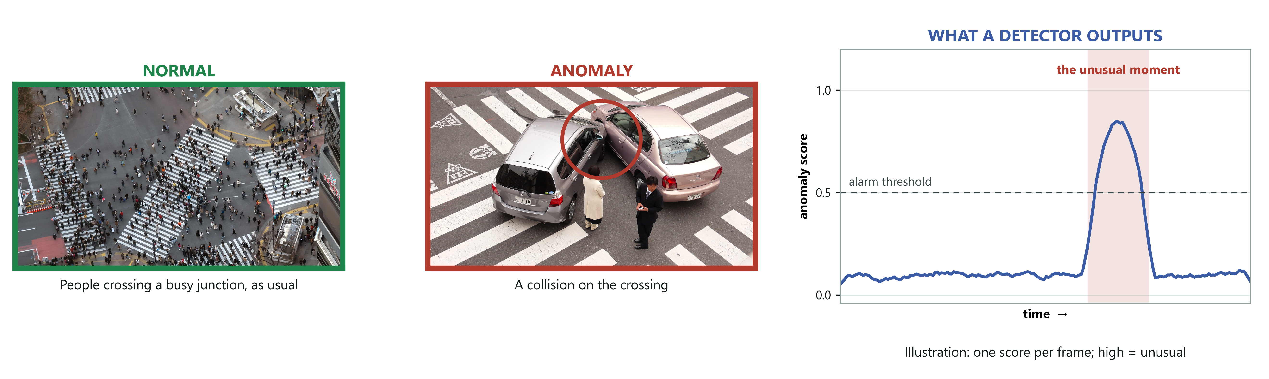
INTRODUCTION
What is video anomaly detection?
WHAT
HOW
WHY IT IS HARD
Find moments in video that do not fit what usually happens at that place — a collision, a fight, a fall.
Score every frame. When the score crosses a threshold, flag that moment for a human to check.
Anomalies are rare and varied, so no one can collect examples of them all. Systems learn “normal” instead.
Photos: “Scramble from above, SHIBUYA SKY” by Sei F; “Japanese car accident” by Shuets Udono — both CC BY-SA 2.0, via Wikimedia Commons, cropped. Right panel: illustration.
1
Notes:
Keep it simple - this slide is for anyone on the panel who is not in this field. Left: a busy crossing, hundreds of people, all normal. Middle: a collision on a crossing - that is an anomaly. Right: what a detector produces, a score for every frame that rises at the unusual moment and crosses the alarm line; it is an illustration. Then the three boxes, one line each. These photos are not from our data - our data starts on page 9.

Slide 3
THE PROBLEM
A detector is tied to the place it learned
Standard approach. Show the system weeks of ordinary footage from one camera until it learns what normal looks like there.
The cost. Move it anywhere else and it fails — a new site means new footage collection and a full retraining cycle.
SHOPPING MALL
FACTORY FLOOR
A forklift moving through the aisles is
an immediate alarm.
The identical forklift is completely
routine.
Same footage. Opposite answers. The picture did not change — the rule did.
2
Notes:
Open with the example, not the definition. Mall versus factory - the same forklift, opposite answers. Then the cost: every new customer means new footage and a retraining cycle. That cost is what we are removing.

Slide 4
RESEARCH GAP · 1 OF 2
The literature solves the adjacent problem
Domain adaptation distinguishes between kinds of difference between places. [11–15, 20]
Type of shift | What moves | Example
Covariate shift | Appearance | A stop sign in fog versus sunshine. Still a stop sign.
Concept shift | The rule itself | A bicycle on a road versus on a footpath. Identical image, opposite label.
WHAT THE SURVEYS SAY
“Concept shift is usually not a common problem in popular object classification… this review mainly focuses on covariate shift.” — Liu et al., 2022 [14]. Singhal et al. [15] list stable p(y|x) as the first condition under which domain adaptation is justified.
Fair for object recognition — a cat is a cat everywhere. But anomaly detection is built on concept shift.
3
Notes:
This is the slide that shows you read the six surveys. Read the Liu quote aloud - the field scopes concept shift OUT by explicit decision. Make clear you are not criticising them: for object recognition it is the right call.

Slide 5
RESEARCH GAP · 2 OF 2
Why that matters for anomaly detection
In anomaly detection, “normal” is defined by the deployment context — not by the object. That is the definition of the task.
Input | Domain A | Domain B
A person running | Park — normal | Bank vault — anomalous
A person lying down | Beach — normal | Factory aisle — anomalous
A vehicle | Road — normal | Walkway — anomalous
THE GAP WE TARGET
Methods that align appearance cannot help here — the appearance is already identical. Two domains can share p(x) exactly while the labelling function differs. A 2026 position paper [1] argues the same premise independently; what is missing is a test of whether supplied context does any work.
4
Notes:
Land the consequence. In anomaly detection normality IS the deployment context. Mention the 2026 position paper yourself - an independent group reached the same premise, which answers 'did you invent this problem?'

Slide 6
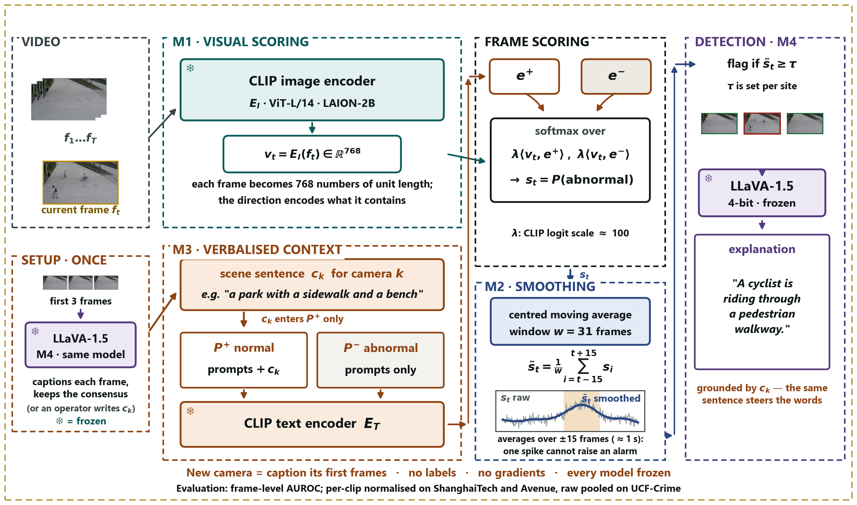
PROPOSED FRAMEWORK
DA-ZVAD: one sentence per camera, written by the system
EVERY MODEL FROZEN
M1 Frozen CLIP [4] scores each frame: normal vs abnormal text.
M2 Moving average over time — no parameters.
M3 One scene sentence per camera, in the normal prompts only.
M4 Frozen LLaVA [24] writes each camera's sentence, and explains events.
NEW CAMERA
Caption its first frames. No labels, no gradients.
5
Notes:
Walk the four modules left to right in about thirty seconds. Point at the SETUP box: LLaVA captions a new camera's first frames and that caption is the camera's sentence - no human needed. Then stop on M3, the only place the domain enters, and its one rule: the sentence goes into the normal prompts only.

Slide 7
METHOD · DESIGN RATIONALE
Why freezing everything is the point
The risk. If the system learned even a little from the new site, and performance improved, we could not say what caused it — the sentence, or the learning.
Our design. No parameter anywhere is allowed to change. Exactly one thing in the system can vary: the text.
The consequence. Any measured difference is attributable to the sentence. There is no other candidate.
IDENTIFIABILITY
This is what makes the adaptation claim testable rather than asserted. You cannot run our central experiment on the competing systems — their text is learned on training data [9], or entangled in an LLM prior [3], or paired with trained detection heads [10].
It also means the claim can be falsified — which is the next slide.
6
Notes:
The strongest methodological point in the deck. Say it slowly. And note that the competing systems CANNOT run our experiment - their text is learned on training data (VERA), or entangled in an LLM prior (LAVAD), or paired with trained detection heads (OVVAD).

Slide 8
EVALUATION DESIGN
A protocol that can prove us wrong
Run the identical pipeline four times. Change only the sentence.
Condition | Sentence supplied | Purpose
none | M3 disabled | Lower reference
generic | “a generic scene” | Controls for merely having context
matched | Correct description of the scene | The proposed operating condition
mismatched | Description of the wrong domain | FALSIFYING CONTROL
PREDICTED SIGNATURE, FIXED BEFORE MEASUREMENT
matched ≥ generic ≥ none, with mismatched measurably WORSE. If a deliberately wrong description costs nothing, the method ignores its context and our claim is refuted.
7
Notes:
Emphasise that the interpretation was fixed BEFORE any measurement, and that the mismatched condition is designed to refute us. A panel will respect a test you could have failed - and later in the deck, one you partly did.

Slide 9
EXPERIMENTS · SETUP
What we ran
Video | ShanghaiTech [21] (12 views) · CUHK Avenue [26] (1 view) · UCF-Crime [27] (~290 scenes)
Image | MVTec AD [7] — detection baseline only
Scale | 418 test videos · 97,752 sampled frames · frame-level ground truth
Models | CLIP ViT-L/14 [4, 22] (LAION-2B) and LLaVA-1.5-7B [24] 4-bit — all frozen
Hardware | NVIDIA A40, college GPU server · PyTorch 2.3.1 / CUDA 12.1
Runs | 5 full runs, cached-embedding analyses, LLaVA captioning, UCF-Crime pre-registered run
EVERY RUN RECORDS ITS OWN CONDITIONS
Each run writes a manifest: the exact code commit, whether the working tree was clean, host, GPU, driver and library versions, full configuration, and per-dataset frame and label counts. Committed alongside the results — every figure in this deck is traceable to the state that produced it.
8
Notes:
Keep this brief - it is the credibility slide. If anyone doubts the work is yours, offer to open a manifest. Three video benchmarks now, UCF-Crime added in Phase 3; MVTec is only the image baseline.

Slide 10
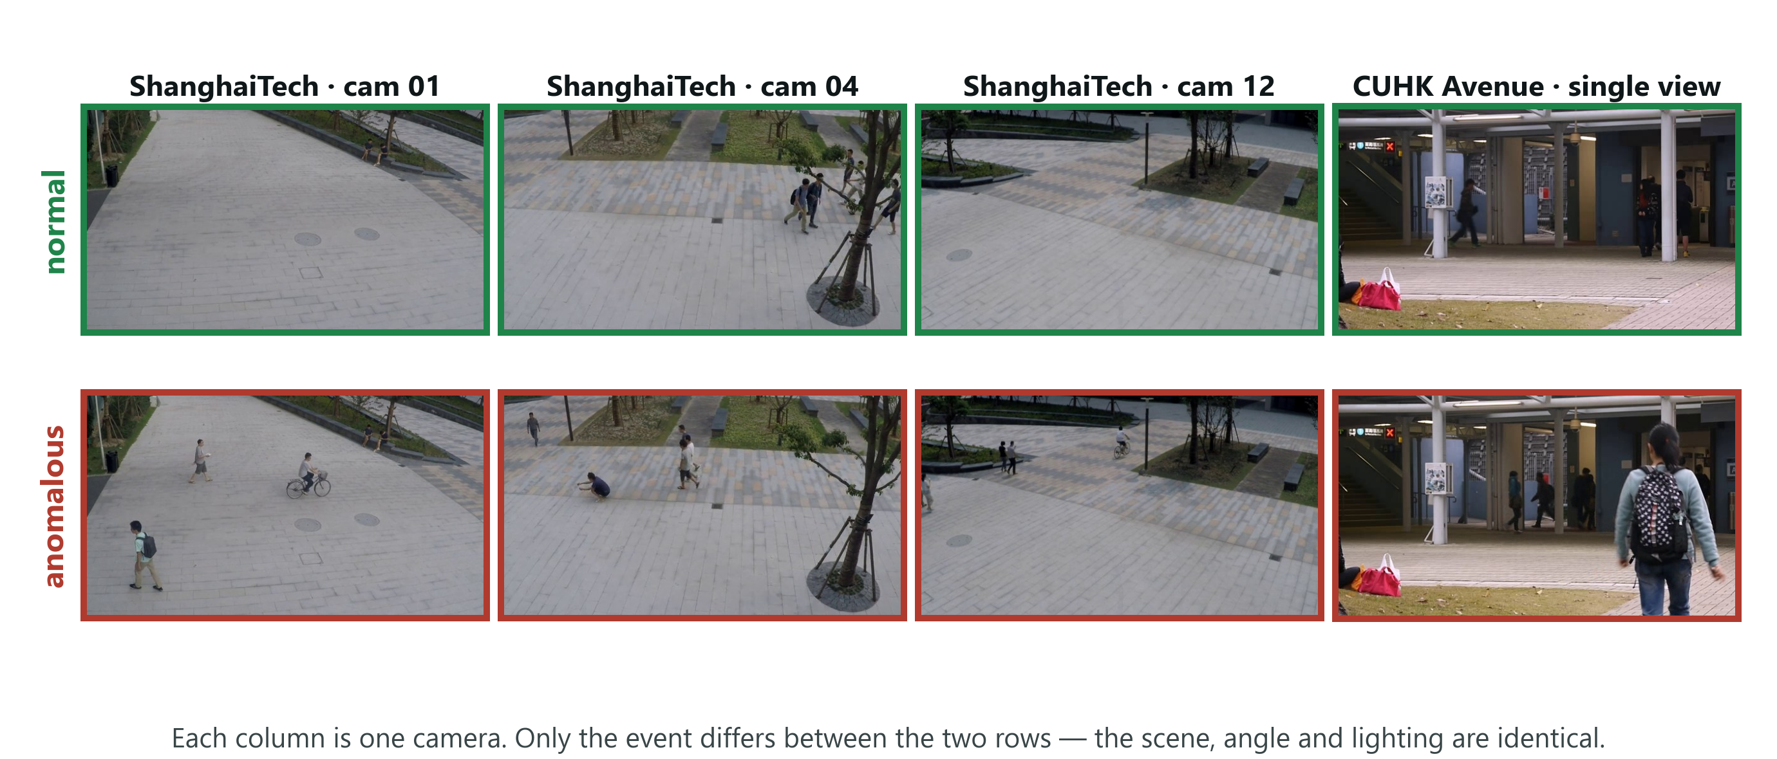
EXPERIMENTS · THE DATA
What the two campus benchmarks look like
HOW TO READ IT
Each column is one fixed camera: the scene stays constant and only the event changes — an empty walkway and the same walkway with a cyclist look alike and are labelled opposite. UCF-Crime, added in Phase 3, is the opposite case: almost every one of its 290 videos is a different place.
9
Notes:
Thirty seconds, no more. Point down one column and say the scene never changes - only the event does. Then one line on UCF-Crime: there, almost every video is a different place, which is why each gets its own sentence.

Slide 11
EXPERIMENTS · WHAT HAPPENED
The first result was a failure
0.49
Fifty minutes of GPU time produced a detector performing exactly as well as a coin flip.
frame-level AUROC — 0.50 is random guessing
And the central experiment came out backwards:
Condition | Predicted | Observed
matched (correct description) | Best | WORST — 0.666
mismatched (wrong description) | Worst | Among the best — 0.695
This is the point at which the idea looks broken.
10
Notes:
Do not rush past this and do not apologise for it. The first run was chance, and the key experiment came out backwards. Then pause. The next two slides are what makes this presentation worth listening to.

Slide 12
EXPERIMENTS · DIAGNOSIS
Diagnosis 1 — we were measuring it wrong
12 camera views. CLIP sits at a different baseline score under each one — different lighting, different angle.
Our error. We pooled every frame from all 12 cameras into one ranking.
The analogy. Ranking students from different schools by raw marks when the schools grade differently. The comparison destroys the ordering.
The published protocol for this benchmark [21] normalises each clip first. We were not doing it.
0.49
0.67
Identical scores, no smoothing. Uses no labels.
With smoothing (w=31): 0.52 → 0.71.
Both figures are in the paper.
→
as reported
correctly pooled
11
Notes:
The schools analogy works on everyone - use it. Stress twice that the fix uses no labels and is the benchmark's own published protocol, and that both figures appear in the paper.

Slide 13
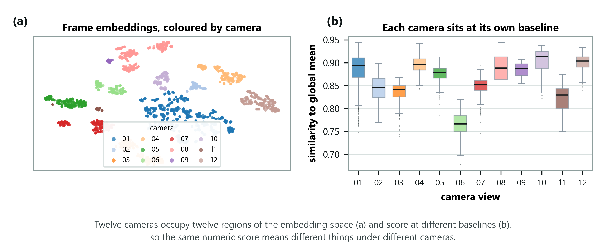
EXPERIMENTS · DIAGNOSIS
The evidence for that diagnosis
HOW TO READ IT
Left: every frame projected to two dimensions and coloured by camera — the views sit in separate regions. Right: how similar each view is to the average frame, differing by more than 0.13 between views. Neither panel uses labels, so this is not hindsight.
12
Notes:
This is the proof that the diagnosis was not invented after the fact. Say clearly that neither panel uses labels. The cameras are separate regions of the space and sit at different similarity levels, which is exactly why pooling raw scores destroyed the ordering.

Slide 14
EXPERIMENTS · THE FINDING
Diagnosis 2 — the description cancelled itself out
We were appending the scene sentence to BOTH prompt sets:
NORMAL PROMPT
ABNORMAL PROMPT
“a university campus walkway with
pedestrians, everything is normal”
“a university campus walkway with pedestrians,
but something abnormal is happening”
Shared words. Each prompt set is averaged into one summary vector. Shared text enters both — so the two summaries move toward each other.
The method depends on them being different. We were erasing the very contrast the decision rests on.
Which explains the inversion. An accurate description matches every frame strongly, so it absorbs the most contrast. A wrong one matches nothing, so it does no damage.
THE FIX
Attach the description to the normal prompts only — the scene defines what normal looks like here; an anomaly is a departure from it.
13
Notes:
The most interesting slide. Point at the two prompts and let them see the shared words. Then the punchline: the more accurate the description, the more damage it does. That is why the result inverted.

Slide 15
RESULTS · CENTRAL EXPERIMENT
After the fix: the predicted signature
ShanghaiTech, all 107 clips, per-clip normalised. Every model frozen; only the sentence and its injection point vary.
Injection point | none | generic | matched | mismatched | gap
Both prompt sets | 0.707 | 0.670 | 0.666 | 0.695 | −0.029
Normal set only | 0.707 | 0.691 | 0.734 | 0.628 | +0.105
The “none” column is identical in both rows — confirming nothing but the injection point changed.
0.734
0.628
correct description
wrong description — a 10-point penalty
Nothing else was permitted to change, so the text caused it — page 17 says how.
14
Notes:
The headline. Point at the none column being identical in both rows - that is the control, and it proves only the injection point changed. Then point at 0.628 and say a wrong sentence costs ten points on the benchmark metric. Do not say 'the text redefines normal' - page 17 explains why.

Slide 16
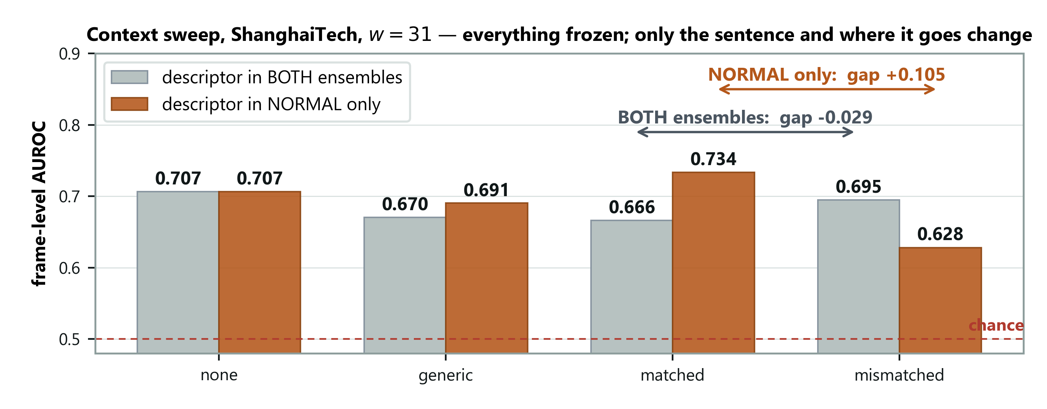
RESULTS · CENTRAL EXPERIMENT
The same experiment, drawn
HOW TO READ IT
The number the experiment exists to produce is the arrow: the distance between the matched and mismatched bars. Grey bars put the sentence in both prompt sets and that distance is negative. Orange bars put it in the normal set only and it becomes +0.105.
15
Notes:
The picture of the previous table. Trace the two arrows with a finger. The grey arrow points the wrong way and the orange one points the right way, and the only thing separating them is where the sentence was attached.

Slide 17
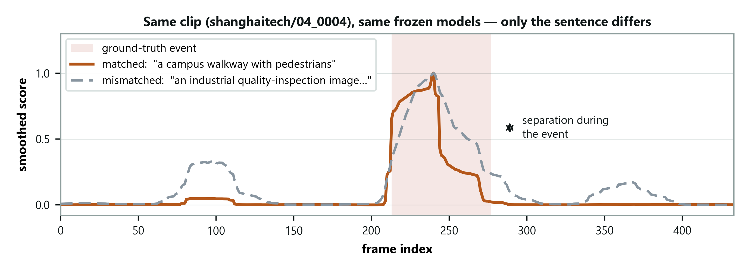
RESULTS · WHAT THE GAP LOOKS LIKE
One clip, two sentences
HOW TO READ IT
Same frozen models, same frames, same smoothing — the only difference is whether the sentence describes a campus walkway or an industrial site. The curves track each other outside the event and separate inside it. Nothing else was free to vary, so the text caused the separation.
16
Notes:
The most persuasive slide in the deck for a sceptical panel, because there is no aggregation to argue with - two runs over identical frames with identical frozen weights. Say that the curves coincide outside the event on purpose: that is the control.

Slide 18
RESULTS · INTERPRETATION
Stating the claim precisely
THE WEAKER HALF
THE CLAIM WE MAKE
A correct description beats none by +0.027.
Positive at every window, but inside the ±0.036 split-to-split spread.
A WRONG description lowers the benchmark score by 0.105.
Nothing else could have caused it.
WHAT THE MEASUREMENT AUDIT SHOWED (PHASE 3)
With the decision rule fixed before running it: 82% of this 0.105 is a shift in each video's overall score level, which puts cameras on one scale. Frames inside a video are barely re-ranked (+0.006). Every published number was reproduced first (52 checks).
A secondary finding, not present in the literature: WHERE the description is injected dominates WHAT it says — to the point of reversing the direction of the effect.
17
Notes:
Be scrupulous. The +0.027 sits inside the spread, so we report direction only. Then the Phase 3 check, said plainly: judged only inside each video, the gap is +0.006. The sentence mostly shifts each video's score level - it tells cameras apart - rather than re-ranking frames. We found this ourselves and then measured it with a rule fixed in advance: 82 to 87 percent is calibration. Saying it first is what protects you.

Slide 19
RESULTS · COMPONENT ABLATION
Which components earn their place
Scoring signal | Held-out AUROC | Full test set
Scene-centre normality only | 0.585 ± 0.025 | 0.585
Semantic + scene-centre | 0.645 ± 0.034 | 0.640
Kinematic — motion only | 0.685 ± 0.015 | 0.686
Semantic + kinematic | 0.711 ± 0.034 | 0.706
Semantic — language only | 0.718 ± 0.036 | 0.707
Held-out figures are means over five clip-level partitions, with the spread across them.
The language pathway alone is best. Adding a motion signal costs 0.001 on the full set; adding scene-centre normality costs 0.067.
This was not the expected answer. ShanghaiTech's anomalies look kinematic — a bicycle at cycling speed — so appearance and motion should be complementary. Measured here, they are not.
18
Notes:
Volunteer the surprise: we expected motion to help and it does not. The pooled embedding already registers enough of it. Reporting the prediction that failed is stronger than reporting only the ones that held.

Slide 20
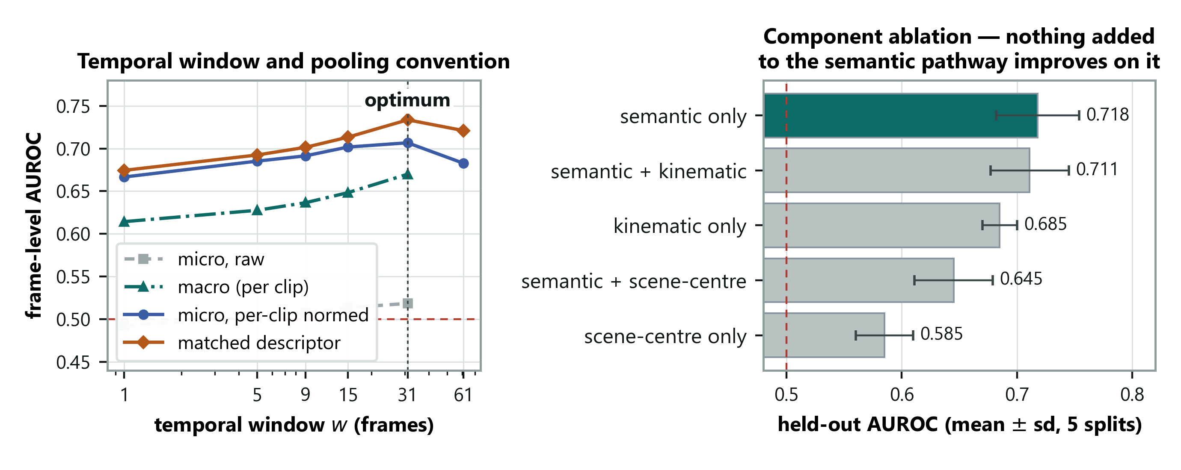
RESULTS · ABLATION
Window length, and what each component adds
HOW TO READ IT
Left: smoothing helps up to w=31 and then hurts, so the window has a real optimum rather than the metric rewarding more blur; the grey curve is the wrong pooling and never leaves chance. Right: the error bars overlap, so the honest claim is that nothing added beats language alone — not that language alone wins.
19
Notes:
Volunteer the weakness before anyone asks. The error bars overlap, so the top three are statistically tied. The claim is that nothing we added beat plain language, which is a negative result about our own elaborations, not a win over the alternatives.

Slide 21
RESULTS · CROSS-DOMAIN
A second domain — the replication test
Identical frozen configuration applied to CUHK Avenue. Nothing retuned. Only the scene sentence changed.
Dataset | none | generic | matched | mismatched | gap
ShanghaiTech (12 views) | 0.707 | 0.691 | 0.734 | 0.628 | +0.105
CUHK Avenue (1 view) | 0.706 | 0.729 | 0.677 | 0.657 | +0.020
DETECTION TRANSFERS
ADAPTATION DOES NOT
0.706 vs 0.707 with no descriptor.
The detector works equally well.
Gap 5× smaller, and the correct
description scores BELOW none.
OUR EXPLANATION — STATED AS A CONJECTURE
ShanghaiTech has 12 camera views; Avenue has one, so a scene description has nothing to tell apart. Tested next inside single ShanghaiTech views, and later on UCF-Crime's ~290 scenes.
20
Notes:
The most important slide in the deck. Detection transfers almost exactly; the adaptation does not. Give the honest reading - on Avenue a placeholder beats an accurate description, so that benefit cannot be domain adaptation. Then give the conjecture AND the experiment that would settle it - the next slide, and UCF-Crime later in the deck.

Slide 22
RESULTS · THE CONTROL
We tested that explanation, and it held
ShanghaiTech is twelve single-view datasets stacked together. If the descriptor works by telling the model WHICH scene it is in, then confining the sweep to one camera view should reproduce Avenue's flat result.
Evaluation | Scenes | Clips | Gap
CUHK Avenue (single view) | 1 | 21 | +0.020
ShanghaiTech, within a single view (mean) | 1 each | 5–34 each | +0.033
ShanghaiTech, pooled across views | 12 | 107 | +0.105
UCF-Crime, own sentence per video (raw, w=5) | ~290 | 290 | +0.096
THE PREDICTION COULD HAVE FAILED
A within-view gap near +0.105 would have refuted it; it came back at a third. But ~290 scenes gave no bigger gap than 12: it needs scenes, it does not keep growing.
What the sentence mainly supplies is WHICH scene you are in — not what counts as normal within it. Three of nine views show a negative gap, so inside one scene the effect is not reliable.
21
Notes:
This is the slide that shows a full cycle: we saw something odd, formed an explanation, designed a test that could have killed it, ran it, and it held. Say out loud that a gap near +0.105 here would have refuted us. Then give the caveat yourself - three of nine views are negative, so within one scene the effect is not reliable. The last row is Phase 3: ~290 scenes gave no bigger gap than 12, so the claim is 'needs scenes', not 'grows with scenes'.

Slide 23
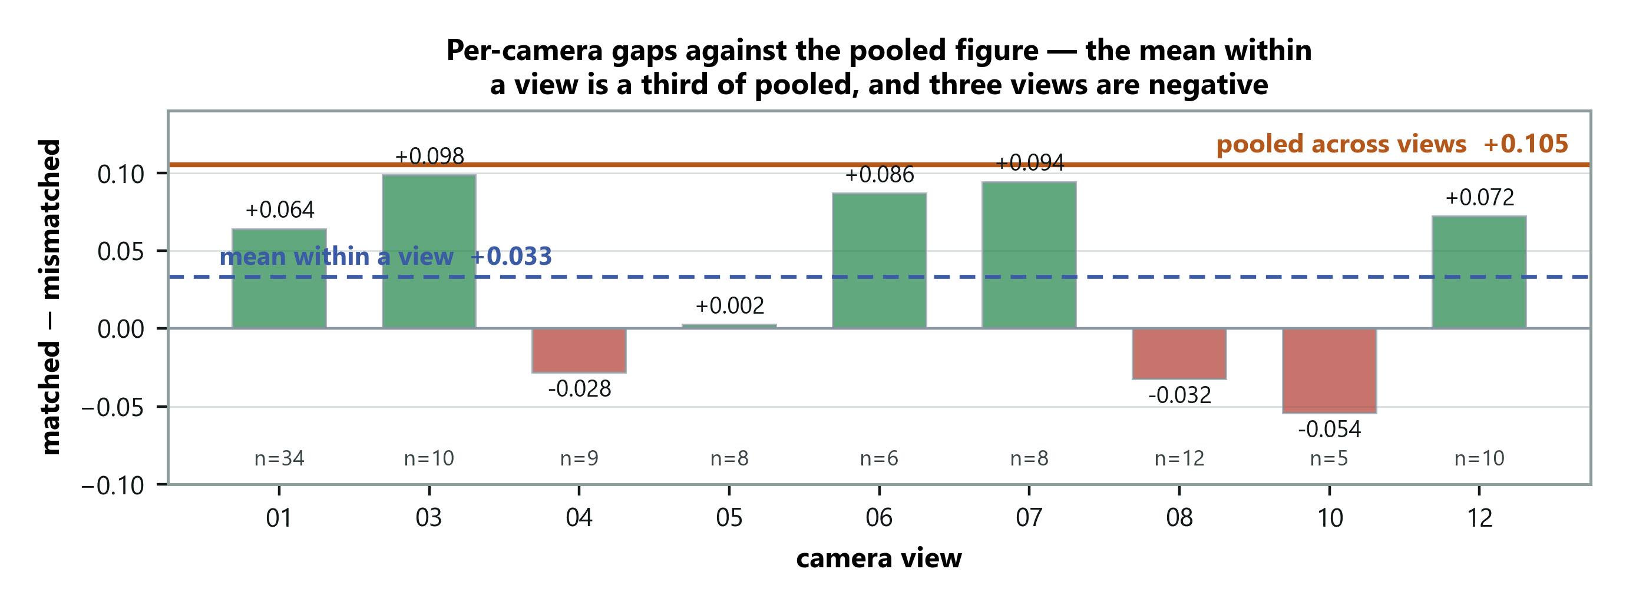
RESULTS · THE CONTROL
Every camera view, one at a time
HOW TO READ IT
The orange line is the pooled result; each bar is one view on its own. Most fall well short of it and three are negative — but views 03 and 07 nearly reach it, so this is a shift in the average, not a clean collapse. The bars rest on between five and thirty-four clips each.
22
Notes:
Show the spread yourself. Three views are negative and two nearly reach the pooled figure, so the result is a shift in the mean rather than a collapse everywhere. Saying this before the panel spots it is the difference between a caveat and a hole.

Slide 24
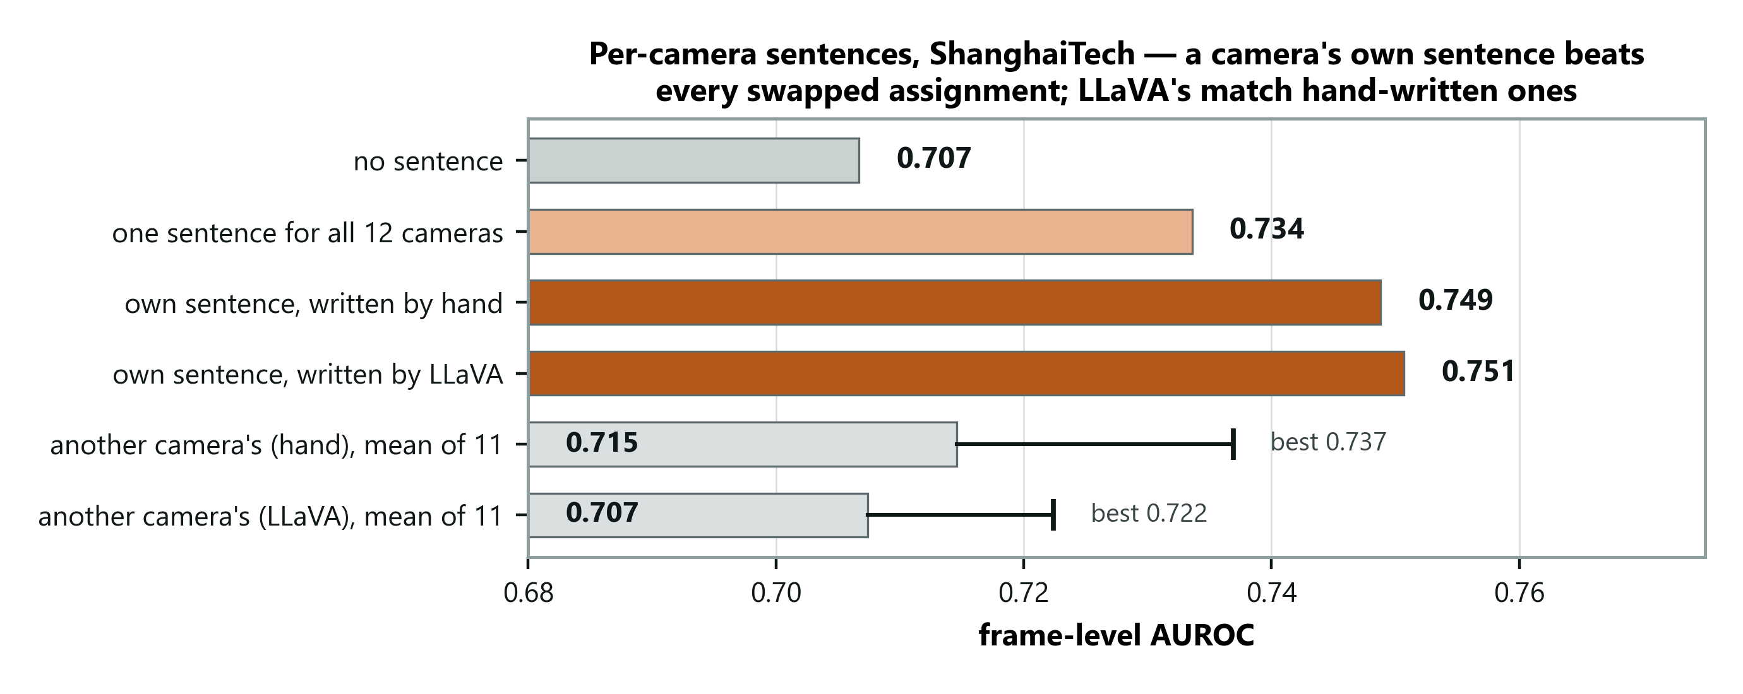
PHASE 3 · RESULT 6
A sentence per camera — written by the system
HOW TO READ IT
Each camera gets its own sentence instead of one for all twelve. Written by hand: 0.749. Written by LLaVA from the camera's first three frames, with no human and no labels: 0.751. Give each camera ANOTHER camera's sentence and it drops — even the best of 11 swaps (0.737) loses. The sentence works by matching its camera.
23
Notes:
Phase 3 starts here. Say what changed: each camera gets its own sentence, and LLaVA writes it from the first three frames - no human, no labels. Point at the swapped bars: even the best swap loses, so the sentence works by matching its camera. Do not claim LLaVA beats a human; 0.751 against 0.749 is noise.

Slide 25
PHASE 3 · RESULT 7
UCF-Crime: predictions written down first
290 real CCTV videos [27] from ~290 different places, 140 with a crime. Four predictions were committed to git before any score was computed.
0.824
Registered prediction | Measured | Outcome
P1 gap grows beyond ShanghaiTech's +0.105 | +0.096 | Refuted
P2 own sentence beats borrowed ones | +0.110 | Holds
P3 own sentence beats one shared sentence | +0.011 | Holds (small)
P4 correct beats wrong-domain description | +0.086 | Holds
AUROC, no training · 95% CI 0.756–0.877 · comparable to LAVAD 0.803, AnyAnomaly 0.807
WHAT IT SHOWS
Another video's sentence scores BELOW no sentence (0.713 vs 0.756): the wrong scene misleads. P1 failed, so the claim is narrowed from 'the benefit scales with scene diversity' to 'the benefit needs it'.
24
Notes:
The strongest slide for credibility. The predictions were committed to git before any score existed. Say P1 failed before anyone asks, and that the claim was narrowed because of it. On LAVAD: 'comparable or better'. LAVAD samples every 16th frame too, but other papers' numbers can differ by small protocol details. AnyAnomaly gets 0.807 here - below us, unlike on the campus benchmarks.

Slide 26
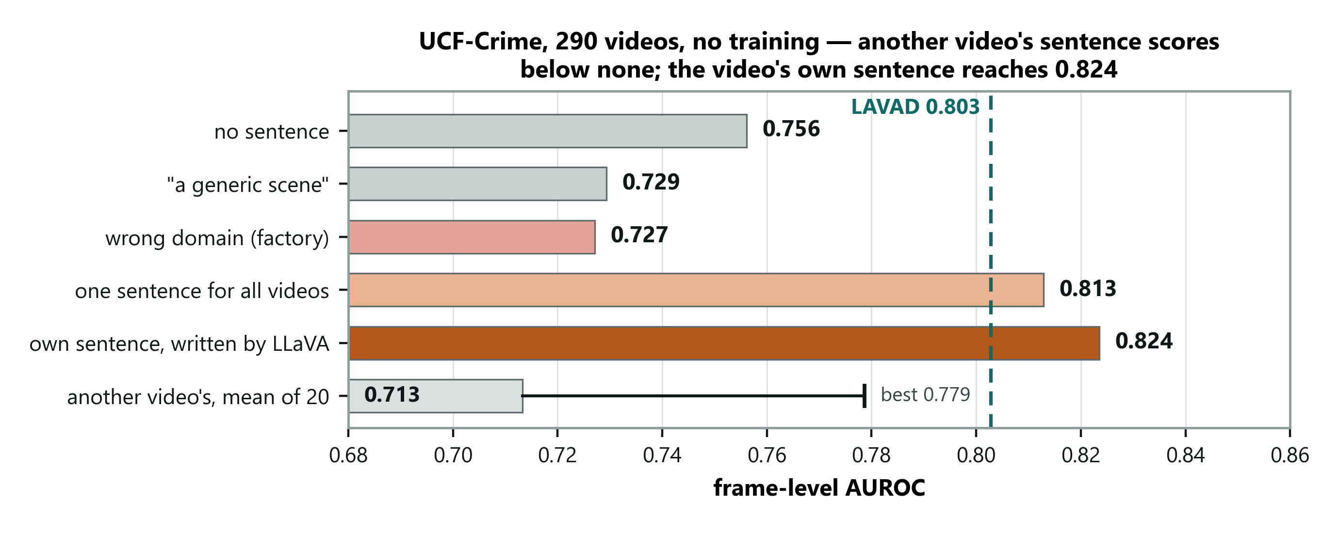
PHASE 3 · RESULT 7
UCF-Crime, drawn
HOW TO READ IT
The video's own LLaVA sentence reaches 0.824; borrowed sentences average 0.713, below having none. The dashed line is LAVAD's 0.803 (AnyAnomaly: 0.807). Both sit inside our 95% interval (0.756–0.877), so read it as comparable, not as a margin.
25
Notes:
Point at the borrowed-sentence bar first: worse than no sentence at all. That is the clearest evidence that the sentence tells the model where it is. Then the dashed LAVAD line, with the protocol caveat.

Slide 27
RESULTS · NEGATIVE FINDINGS
Six things that did not work
Modification | Outcome
Quadrant scoring, to catch small objects | No improvement in any configuration
Prompts naming bicycles and vehicles | Much worse alone — 0.486
Clip's own average as the normality reference | 0.585, and it degrades the language signal
Adding a motion signal | Costs 0.001 — not complementary
Local temporal deviation before projection | Better scorer, but narrows the context gap
Per-prompt max pooling | 0.678 against 0.707
WHY THESE ARE IN THE DECK
The claim is that the minimal configuration is the right one. That is only credible alongside the alternatives that were tried. A clean table of successes is the artefact that is easy to fabricate; six diagnosed failures are not.
26
Notes:
Say why you are showing failures: the claim is that the minimal configuration is right, and that is only credible next to what was tried. If the panel suspects generated work, this slide is your best answer.

Slide 28
ASSESSMENT
Where this sits against the literature
Training-free method (no target data) | Avenue | ShT | UCF
Zero-shot CLIP [4] | 62.3 | 60.9 | 53.2‡
Zero-shot ImageBind [36] | 64.5 | 61.3 | 53.7‡
LLaVA-1.5 [24] | 67.4 | 59.6 | 72.8‡
Video-ChatGPT [37] | 76.9 | 69.1 | —
LAVAD [3] — captioner + LLM + refiner | — | — | 80.3‡
DA-ZVAD (ours) — one frozen encoder + a sentence | 67.7 | 73.4 | 82.4
AnyAnomaly [2] — 3 LVLM queries per segment | 87.3 | 79.7 | 80.7
‡ from LAVAD [3], Table 1. All other figures from AnyAnomaly [2], Tables 5–6. Ours: Avenue/ShT one shared sentence; UCF one sentence per video.
AnyAnomaly asks “is the thing I named happening?” We ask “is anything happening that doesn’t belong here?” Theirs needs a list of what could go wrong — at evaluation it is handed the benchmark’s own anomaly classes. Ours needs a description of the ordinary.
WHERE WE STAND
Comparable to LAVAD and AnyAnomaly on UCF-Crime (inside our 95% interval); behind AnyAnomaly on campus.
27
Notes:
Anchor on the trained baseline: 73.4 matches the benchmark's own 2018 baseline using none of its training data. Then the reframe - AnyAnomaly is handed the class list, we are not. Then the UCF column: the highest figure, but inside our own bootstrap interval - say 'comparable to LAVAD and AnyAnomaly', never 'better'. The ‡ rows come from LAVAD's paper, the rest from AnyAnomaly's.

Slide 29
ASSESSMENT
Limitations we are stating ourselves
The mechanism is bounded. It works on ShanghaiTech and UCF-Crime and nearly vanishes on single-camera Avenue. A pre-registered prediction that it grows with scene diversity was refuted.
Resolution ceiling. Whole-frame embeddings at 224×224 cannot resolve small objects. Quadrant scoring did not close it; patch-level scoring is untested.
The sentence mainly calibrates. A pre-specified audit: 82–87% of the headline gains are per-video score shifts that put cameras on one scale; frames inside a video are barely re-ranked (at most +0.024).
The metrics are scale-sensitive. Softmax plus per-clip normalisation changes pooled figures without changing rankings; on UCF-Crime the effect shrinks under per-video normalisation.
Configuration selection. No validation split exists for these benchmarks, so we split clips and report the half never used to select.
No explanations yet. M4 now writes the camera sentences, but has not yet explained flagged events.
28
Notes:
Deliver these confidently rather than apologetically. Dwell on the first two after the first: we measured that the pooled metric rewards score shifts, and that applies to every CLIP-based zero-shot VAD paper, not only ours.

Slide 30
NEXT
What comes next
Priority | Work | Why it matters
1 | XD-Violence (pre-registered) and UCF-Crime on every frame | LAVAD's second benchmark; tests the calibration reading on new data
2 | NWPU Campus — scene-dependent anomalies (pre-registered) | The only benchmark where the same event flips label by scene: the method's boundary
3 | Patch-level scoring; M4 explanations | Higher figure on small anomalies; completes the framework for the thesis
DONE SINCE PHASE 2
Per-camera sentences written by the system (0.751); UCF-Crime under pre-registered predictions (0.824, 95% CI 0.756–0.877); a measurement audit of how the sentence helps (mostly calibration); every citation checked against its source.
29
Notes:
XD-Violence comes first: LAVAD's other benchmark, already pre-registered, with a prediction that tests the calibration reading. NWPU Campus is the one dataset where the same event is normal in one scene and abnormal in another - the direct test of concept shift. Point at the box at the bottom for what is done.

Slide 31
PHASE 3
Summary
1
The gap
DA research scopes out concept shift [14, 15]; anomaly detection is dominated by it.
2
The method
Every model frozen; adaptation carried by one sentence per camera, which the system writes itself from a few frames.
3
The result
0.751 ShanghaiTech, 0.824 UCF-Crime (comparable to LAVAD, AnyAnomaly), no training; mostly calibration.
4
The finding
Where the description is injected dominates what it says, to the point of reversing the effect. Not in the literature.
5
The boundary
Needs several scenes: flat on Avenue (one camera), strong on ShanghaiTech and UCF-Crime, not growing beyond.
All results reproducible from committed code and run manifests.
30
Notes:
Close on the boundary, not the number. Say plainly that one registered prediction failed and the claim was narrowed, and that the audit showed the sentence mostly puts cameras on one scale. Then hand over.

Slide 32
PHASE 4 · NOVEMBER 2026
What happened after Phase 3
PHASE 2
PHASE 3
PHASE 4a
PHASE 4b
One sentence for the scene
A sentence per camera, written by the system
Two new benchmarks — the sentence breaks
Describe normal calmly, list concrete actions
ShanghaiTech 0.734
ShanghaiTech 0.751 · UCF-Crime 0.824
XD-Violence 0.624 → 0.417
XD-Violence 0.722 · frozen
THE POINT OF THIS SECTION
Every step was decided by a rule written before the result existed, and the failures are reported. No model was trained at any point.
31
Notes:
This section is what I did after the last review. Read the timeline left to right. Phase 2 showed one shared sentence helps on campus video. Phase 3 had the system write a sentence per camera, and UCF-Crime reached 0.824. In Phase 4 I added two benchmarks, and on XD-Violence the sentence broke. The rest of this section is how I fixed that, without any training, and what the new model scores.

Slide 33
PHASE 4 · WHAT BROKE
Two new benchmarks — and the sentence broke
0.624
Benchmark | What it contains | Measure
XD-Violence [38] | 800 test videos: films, sports, games, news, CCTV; 6 violence classes | AP
NWPU Campus [39] | 242 test videos, 43 campus scenes, scene-dependent anomalies | AUROC
XD-Violence AP — no sentence
0.417
NWPU CAMPUS
The sentence neither helped nor hurt there: 0.659 without, 0.667 with — within noise.
XD-Violence AP — with the LLaVA sentence
32
Notes:
Two new benchmarks. XD-Violence: films, sports, games, news and CCTV, scored by average precision, its official measure. NWPU Campus: 43 campus scenes, some anomalies depend on the scene. With no sentence XD scores 0.624; with the LLaVA sentence it falls to 0.417. That is the failure this section answers.

Slide 34
PHASE 4 · DIAGNOSIS
Why it broke: the sentence described the violence as normal
How the sentence is made. LLaVA captions the first 3 sampled frames of each video.
What went wrong. In 127 of 500 violent XD videos, the violence had already begun in those frames.
The effect. The normal-side sentence named the event, so the detector treated it as normal.
The check. Dropping the sentence on those 127 videos recovers 66% of the loss (0.417 → 0.554).
LESSON
Whatever replaces the sentence must not depend on what a camera's first frames happen to show.
33
Notes:
The cause is simple. LLaVA writes the sentence from a video's first three frames. In 127 of the 500 violent XD videos, the violence had already started in those frames, so the sentence called the fight normal. Dropping the sentence on just those videos recovers two thirds of the loss. The lesson: the fix must not depend on what the first frames happen to show.

Slide 35
PHASE 4 · WHAT THE LITERATURE TAUGHT US
Fifteen new papers — and a mistake in our own design
NOVA [40]. The normal side must never contain look-alike actions.
Our mistake. Our ‘near-miss’ list added look-alikes (‘hugging’ beside fighting) — the opposite. Disclosed.
ASK-Hint [41]. Concrete actions (‘punching’) work better than labels (‘fighting’).
Encoders. The strongest recent methods use PE-Core [42], a newer frozen encoder.
WHAT THIS CHANGED
Phase 4 tests these ideas one at a time — and corrects the near-miss design instead of hiding it.
34
Notes:
I read fifteen recent papers. The key lesson came from NOVA: the normal side must never contain actions that look like anomalies. Our earlier near-miss list did exactly the opposite - it added hugging as normal next to fighting. I disclosed that. ASK-Hint showed concrete actions beat abstract labels. And the strongest methods use a newer encoder, PE-Core.

Slide 36
PHASE 4 · METHOD
How Phase 4 was run: one idea at a time, rules first
1 Write the rule
2 Commit to Git
3 Reproduce
4 Rule decides
and predictions
before any score
old scores exactly
keep or drop
THE KEEP RULE, ACROSS THE FOUR BENCHMARKS
Higher on more than half of them · significantly better on at least two (95% interval above zero) · significantly worse on none.
Significance: 1,000 paired re-draws of the test videos.
35
Notes:
Before each idea I wrote down the rule and my predictions and committed them to Git, so the date proves the order. Every run first had to reproduce the old scores exactly. Then the rule decided, not me. An idea is kept only if it is better on more than half the datasets, significantly better on at least two, and significantly worse on none. Significance is a paired bootstrap over videos.

Slide 37
PHASE 4 · WHAT WE KEPT
Ingredient 1 — a stronger frozen encoder (PE-Core)
No text changes | ShanghaiTech | UCF-Crime | XD (AP) | NWPU
CLIP ViT-L/14 (Phases 1–3) | 0.707 | 0.756 | 0.624 | 0.659
PE-Core [42] | 0.666 | 0.847 | 0.494 | 0.617
READING IT
Better on UCF-Crime only; significantly worse on XD-Violence. The encoder alone is not the fix — the gains came from the text.
36
Notes:
First ingredient: PE-Core replaces CLIP ViT-L. Same job, newer model. But be clear: on its own it is better only on UCF-Crime and clearly worse on XD. So the encoder alone is not the improvement; the gains came from the text, which the next two slides show.

Slide 38
PHASE 4 · WHAT WE KEPT
Ingredient 2 — describe normal calmly (C)
Quiet places | Calm people
an empty walkway | a person standing still
an empty street | a person sitting quietly
an empty room | two people talking calmly
a quiet open area with nobody around | a person walking slowly
Effect on PE-Core | Change
ShanghaiTech | +0.091 *
XD-Violence (AP) | +0.141 *
NWPU Campus | +0.051 *
UCF-Crime | −0.030
NOT LUCK
* significant (95% interval above zero). A second set of eight different calm phrases also passed the rule. Rule from NOVA [40]: no look-alike actions on the normal side.
37
Notes:
Second ingredient, the main idea. Eight fixed phrases added to the normal side: four quiet places, four calm people. Calm normality keeps the two sides far apart, so action moves clearly toward abnormal. On PE-Core: plus 9 on ShanghaiTech, 14 on XD, 5 on NWPU, all significant; UCF minus 3, within noise. A second, completely different wording also passed, so it is not one lucky set of words.

Slide 39
PHASE 4 · WHAT WE KEPT
Ingredient 3 — a frozen bank of 48 concrete actions (B)
12 types × 4 phrases each
fighting | weapon | theft
vandalism | road accident | fire or explosion
riot or arrest | abuse | falling
vehicle among pedestrians | sudden running | trespass
Effect on top of C | Change
XD-Violence (AP) | +0.088 *
UCF-Crime | +0.039 *
ShanghaiTech | +0.026
NWPU Campus | −0.030
HOW IT WAS MADE
Examples: ‘two people punching each other’, ‘a cyclist riding through a crowd of pedestrians’. Written once by an LLM before scoring, then frozen — the same list for every dataset. Concrete actions follow ASK-Hint [41]. * significant.
38
Notes:
Third ingredient: the abnormal side becomes 48 concrete actions, twelve types of four. Written once by an LLM before it was scored, then frozen, and the same list for every dataset. On top of the calm phrases it adds about 9 points on XD and 4 on UCF, both significant; ShanghaiTech and NWPU move within noise. Be open that the LLM knew these datasets' anomaly types - that is why the sealed test matters.

Slide 40
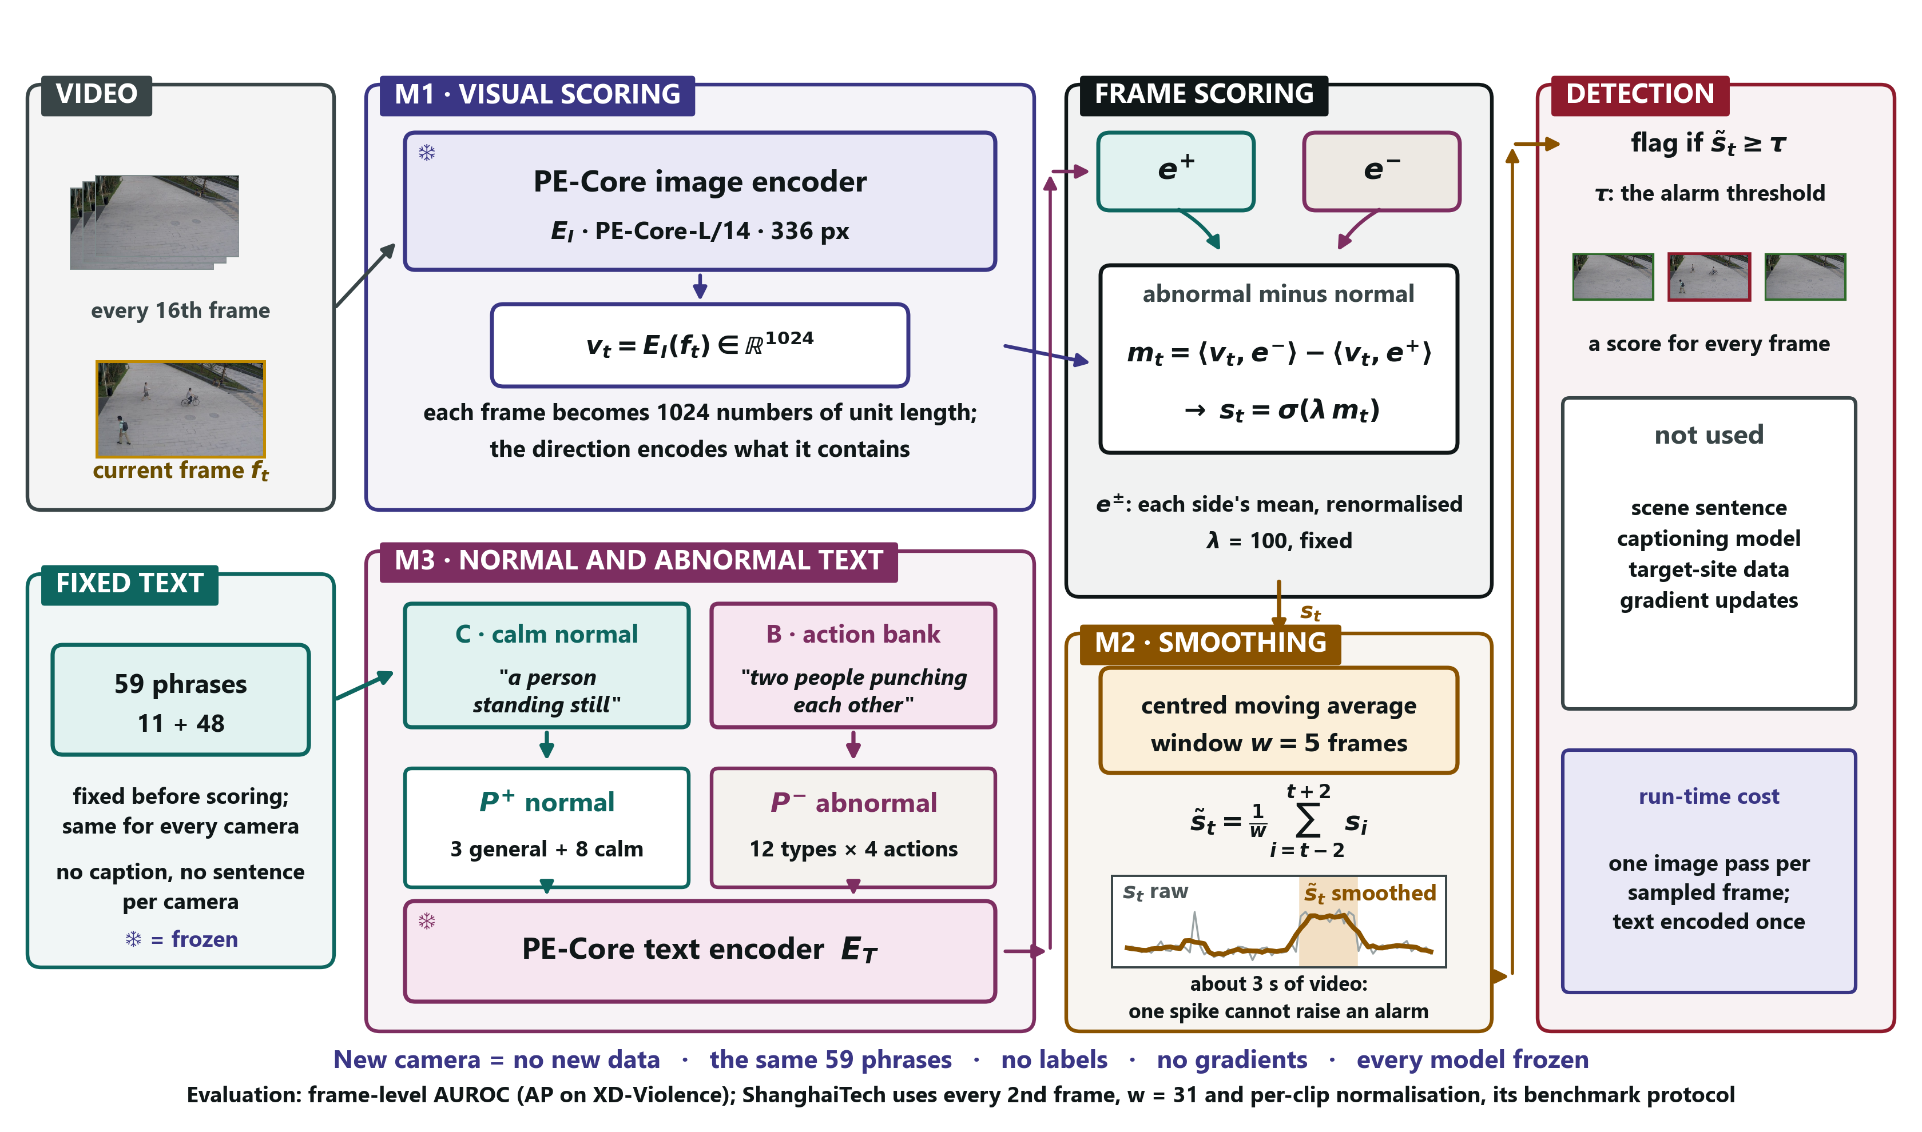
PHASE 4 · PROPOSED FRAMEWORK
The new framework: no sentence, 59 fixed phrases
WHAT CHANGED
M1 PE-Core replaces CLIP
M3 calm normal + action bank, not a sentence
Same scoring and smoothing
Gone LLaVA and the sentence
39
Notes:
This is the new architecture. Compare it with the Phase 3 one: M1 is PE-Core instead of CLIP; M3 no longer holds a sentence per camera - it holds the calm normal phrases and the action bank, 59 phrases fixed in advance. Scoring and smoothing are unchanged. LLaVA is gone. A new camera needs no new data.

Slide 41
PHASE 4 · RESULTS
Progress on every benchmark
Stage | ShanghaiTech | UCF-Crime | XD (AP) | NWPU
Phase 1–2 · CLIP, no sentence | 0.707 | 0.756 | 0.624 | 0.659
Phase 2 · one shared sentence | 0.734 | 0.813 | 0.582 | 0.648
Phase 3 · sentence per camera / video (LLaVA) | 0.751 | 0.824 | 0.417 | 0.667
Phase 4 · PE-Core + calm phrases | 0.757 | 0.817 | 0.635 | 0.669
Phase 4 · PE-Core + calm phrases + action bank (frozen) | 0.783 | 0.856 | 0.722 | 0.639
AGAINST THE PHASE 3 MODEL, SAME VIDEOS
No worse on any benchmark, significantly better on XD-Violence (+0.305) — and no captioning model.
40
Notes:
This is the progress slide. Each row is a stage of the project, on the same test videos. The shared sentence of Phase 2, the per-camera and per-video sentences of Phase 3, then Phase 4. The final row is the frozen model. XD went from 0.417 to 0.722; UCF from 0.824 to 0.856; ShanghaiTech from 0.751 to 0.783. NWPU is the honest exception: 0.639, about three points below the calm phrases alone, within noise.

Slide 42
PHASE 4 · RESULTS
Progress, drawn
41
Notes:
The same numbers as bars. Look at XD: the Phase 3 bar collapses and the Phase 4 bars recover and pass where we started. On the other three, each stage is level or higher, except the small NWPU dip at the end.

Slide 43
PHASE 4 · NEGATIVE FINDINGS
What we tried and dropped
Idea | Why it was dropped
‘Normal scene:’ / ‘Anomalous scene:’ labels | Three significant gains, but significantly worse on NWPU
Both encoders together | Only XD improved, at double the cost
Scoring by anomaly type (NOVA) | XD rose to 0.769, but ShanghaiTech fell 0.082
Different templates per side (Flashback) | Significantly worse on NWPU
Phrases chosen by scene | No gain; scene recognition itself worked (11 of 12 cameras)
Memory of the camera's own past | Significantly worse on ShanghaiTech and XD
EVERY FAILURE IS REPORTED
All six had rules written before scoring; none is hidden.
42
Notes:
Briefly, what did not survive the rule. Labels gained on three datasets but hurt NWPU. Two encoders only helped XD at double the cost. NOVA's scoring by type raised XD to 0.769 but cost 8 points on ShanghaiTech. Flashback's templates hurt NWPU. Choosing phrases by scene recognised scenes well but added nothing. Camera memory hurt ShanghaiTech and XD. All of these had rules written first.

Slide 44
PHASE 4 · ASSESSMENT
Against published methods
Method | UCF-Crime | XD (AP) | ShanghaiTech | NWPU
NOVA [40] | 89.86 | 84.82 | — | —
ASK-Hint [41] | 89.83 | — | — | —
Flashback-PE [43] | 87.29 | 75.13 | — | —
DA-ZVAD, final (ours) | 85.6 | 72.2 | 78.3 | 63.9
Frozen VLM [44] | 85.32 | 68.98 | — | —
AnyAnomaly [2] | 80.7 | — | 79.7 | —
LAVAD [3] | 80.3 | 62.01 | — | —
VERA [9] — uses training data | — | 70.54 | — | —
FPDM / MULDE [34, 36] — trained | 74.7 / 78.5 | — | 78.6 / 81.3 | —
Cao et al. [39] — trained, scene-conditioned | — | — | — | 68.2
VERA as quoted by Flashback; others from each paper's own tables. Point estimates — gaps of 1–2 points are within our uncertainty.
43
Notes:
Here is where the frozen model stands, using only figures I checked in each paper's PDF. On UCF-Crime and XD we are behind only the top few methods. On ShanghaiTech we are level with trained methods like FPDM. On NWPU we sit inside the range of trained methods. Our intervals are several points wide, so I do not claim to beat any one method - and these numbers are exploratory until the sealed test.

Slide 45
PHASE 4 · ASSESSMENT
Why the strongest methods score higher
Method | What gives it the edge | What it costs
NOVA | 20 normal + 20 abnormal phrases per anomaly class, guidance for each dataset | Tailored to crime datasets; tested on UCF and XD only
Flashback | Memory of 1 million generated captions; a video encoder | GPT-4o, 76 hours, $181 to build
ASK-Hint | A large video-language model asked about each video | Heavy; prompt count chosen on its own results
Frozen VLM | A large model asked a question about every frame | Heavy at run time
Ours | One frozen encoder, 59 fixed phrases | The same setup for crime and campus
44
Notes:
Why can't we match NOVA or Flashback? Look at what they use. NOVA writes twenty normal and twenty abnormal phrases for every anomaly class, with guidance for each dataset, and only tests on crime datasets. Flashback builds a memory of a million generated captions - 76 hours, 181 dollars - and uses a video encoder. ASK-Hint runs a large video-language model and chose its prompt count from its own results table. We use one frozen encoder and 59 fixed phrases, the same for crime and campus cameras.

Slide 46
PHASE 4 · ASSESSMENT
Why we did not reach their numbers
One frame at a time. Running looks like walking in a single frame.
The whole frame at once. A small bicycle in a crowd barely changes the frame's vector.
Tailoring has a price. NOVA-style scoring raised our XD to 0.769 but cost 0.082 on ShanghaiTech.
What could close part of the gap | What it fixes | Status
Patch-level scoring | Small objects (ShanghaiTech, NWPU) | Planned; needs new encoding
A frozen video encoder | Anomalies defined by motion | Future work
Heavy video-language model or training | Everything | Breaks the training-free goal
OUR GOAL
Stay light and training-free, and work on any camera.
45
Notes:
Three reasons we are below them. One frame at a time: running looks like walking in a single frame. The whole frame at once: a small bicycle in a crowd barely changes the frame's vector. And tailoring has a price: when I tried NOVA's scoring, XD rose to 0.769 but ShanghaiTech fell 8 points. Matching them would need a heavy model, training, or tailoring per dataset - each breaks our goal. The table is what could close part of the gap without breaking it.

Slide 47
PHASE 4 · SEALED TEST
The sealed test: 0.747 on unseen UBnormal
0.747
Condition | Micro AUROC | 95% interval | Macro
Final: PE-Core + calm + bank | 0.747 | [0.704, 0.789] | 0.906
PE-Core + calm phrases | 0.687 | [0.634, 0.741] | 0.896
Plain PE-Core | 0.651 | [0.599, 0.708] | 0.858
Plain CLIP ViT-L/14 | 0.586 | [0.522, 0.644] | 0.813
UBnormal micro AUROC, final model — scored once on 29 unseen scenes
+0.096
over plain PE-Core; 95% interval +0.051 to +0.142
THREE PREDICTIONS, COMMITTED BEFORE ANY UBNORMAL DATA EXISTED
U1 Interval above 0.5 (chance): holds, [0.704, 0.789]
U2 Final model beats plain PE-Core: holds, +0.096
U3 Score between 0.60 and 0.75: holds, by 0.003
46
Notes:
This is the test the whole Phase 4 method was built for. On the sixth of November I froze the model, and only then downloaded UBnormal: 29 rendered scenes the model had never seen. It was scored once. The final model reaches 0.747 micro AUROC, where 0.5 is chance. Plain PE-Core with the old prompts scores 0.651, so the calm phrases and the bank add 0.096, with an interval of 0.051 to 0.142, clearly above zero. Plain CLIP, our earlier encoder, scores 0.586. All three predictions I wrote down before any data existed held. The third only just: I predicted at most 0.75 and got 0.747, which shows the range was cautious, not tuned.

Slide 48
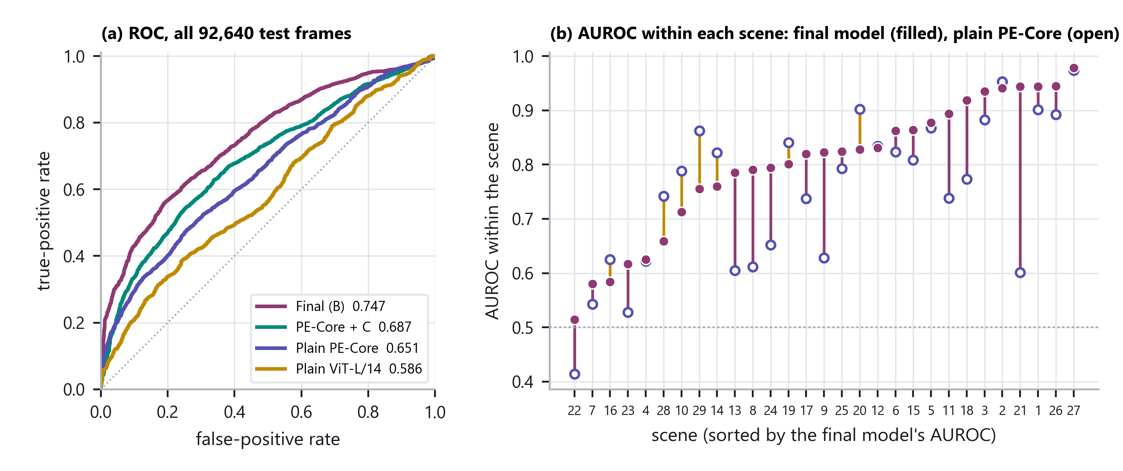
PHASE 4 · SEALED TEST
The sealed test, drawn
HOW TO READ IT
Left: the final model (purple) lies above the other three along the whole ROC curve, not at one point. Right (post hoc): one dot per scene — better than plain PE-Core in 20 of 29, median 0.788 → 0.823, never below chance (lowest 0.514).
47
Notes:
Left: the ROC curves of the four models over all 92,640 test frames. The final model lies above the others along the whole curve, so the gain is not one lucky threshold. Right: one dot per scene. The final model ranks frames better than plain PE-Core in 20 of the 29 scenes, the median rises from 0.788 to 0.823, and it never falls below chance. Say clearly that the right panel was not pre-registered: it describes the result, it does not test anything.

Slide 49
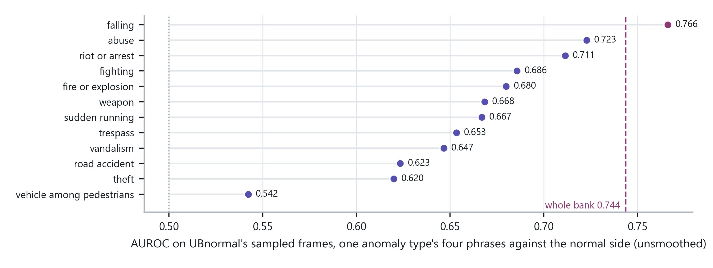
PHASE 4 · SEALED TEST
Which phrases carried the score
HOW TO READ IT · POST HOC
Each type used alone: all 12 beat chance. Falling is strongest (0.766), close to UBnormal's “having a seizure” and “laying down”; vehicle among pedestrians is weakest (0.542). The whole bank (0.744) is near its best type.
48
Notes:
Here each of the bank's twelve types is used alone against the normal side. All twelve beat chance. Falling is the strongest, which makes sense because UBnormal contains people having a seizure and lying down. Vehicle among pedestrians is the weakest, even though UBnormal has jaywalking: our phrases describe cyclists among people, not a person crossing a road. The whole bank is close to its best type, so its strength is breadth. This analysis is post hoc.

Slide 50
PHASE 4 · SEALED TEST
UBnormal against published methods
Method | Uses from UBnormal | Micro | Macro
Georgescu et al. [46] | normal training videos | 59.3 | 84.9
Georgescu et al. + anomalies [46] | training videos and anomalies | 61.3 | 85.6
Bertasius et al., fine-tuned [46] | supervised fine-tuning | 68.5 | 80.3
FPDM [33] (as in [45]) | normal training videos | 62.7 | —
OVVAD [10] | training videos | 62.94 | —
STG-NF (as in [45]) | normal training videos | 71.8 | —
AnomalyRuler [45] | a few normal frames and GPT-4 | 71.9 | —
DA-ZVAD v2, final (ours) | nothing | 74.7 | 90.6
ABOVE, NOT BETTER
74.7 is above every published micro figure, but STG-NF (71.8) and AnomalyRuler (71.9) lie inside our interval of 70.4–78.9. Every method listed trained on UBnormal; ours saw none of it.
49
Notes:
These are published UBnormal results, all checked in the source papers. Every one of these methods uses UBnormal's own training data; ours used nothing of UBnormal. Our 74.7 is above every published micro figure and our macro 90.6 is above every macro figure. But STG-NF and AnomalyRuler, at 71.8 and 71.9, are inside our interval, so I say 'above', not 'better'.

Slide 51
PHASE 4 · WHAT THE TEST SHOWS
What the sealed test shows — and what it does not
Carried over. Calm phrases and bank both helped on 29 unseen scenes, with the signs seen in development.
Wording fixed first. Allowed: “detects anomalies on unseen data, without training”; vs plain CLIP only “no worse”.
Not fully independent. UBnormal's paper, listing its anomaly types, was read before the bank was written.
One synthetic test. UBnormal is computer-generated; real footage from new sites is still untested.
SCORED ONCE · NO RERUN
Before the run, the seven frozen files matched their hashes, the development scores reproduced exactly and all 211 test videos were present. Then a single run over all 92,640 test frames.
50
Notes:
What does the result mean? The text prior carried over to unseen scenes. The wording was fixed before the test, and I keep to it: against plain CLIP the rule only lets me say 'no worse', even though the gap is 0.161, because one benchmark cannot satisfy a rule that needs two. Two disclosures: I read the UBnormal paper, which lists its anomaly types, on the third of November, before the bank was written on the fifth; no video or label was seen. And UBnormal is computer-generated, so real footage from new sites is still the open test.

Slide 52
PHASE 4
Summary
1
What broke
A sentence written from first frames called the violence normal on XD (0.417).
2
What fixed it
Calm normal phrases and a frozen bank of 48 concrete actions, on PE-Core.
3
The progress
XD 0.417 → 0.722 · UCF 0.824 → 0.856 · ShanghaiTech 0.751 → 0.783 — no training.
4
The method
One idea at a time, rules written first, six failures reported.
5
The sealed test
UBnormal 0.747, +0.096 over plain PE-Core; all three predictions held.
51
Notes:
Close on progress and honesty together. The sentence broke on XD for a reason we found. Describing normal calmly and listing concrete actions fixed it, without training and without a captioning model. The model was frozen, then scored once on unseen UBnormal: 0.747, and every prediction held.

Slide 53
1 OF 4
References
[1] K. Wilkinghoff, N. Madan, J. M. Valverde, K. Nasrollahi, R. T. Ionescu, R. Wisniewski, T. B. Moeslund, W. Wang, Z.-H. Tan, Out of context: Reliability in multimodal anomaly detection requires contextual inference, arXiv preprint arXiv:2604.13252 (2026).
[2] S. Ahn, Y. Jo, K. Lee, S. Kwon, I. Hong, S. Park, AnyAnomaly: Zero-shot customizable video anomaly detection with LVLM, in: Proceedings of the IEEE/CVF Winter Conference on Applications of Computer Vision (WACV), 2026, pp. 3026–3035.
[3] L. Zanella, W. Menapace, M. Mancini, Y. Wang, E. Ricci, Harnessing large language models for training-free video anomaly detection, in: Proceedings of the IEEE/CVF Conference on Computer Vision and Pattern Recognition (CVPR), 2024, pp. 18527–18536.
[4] A. Radford, J. W. Kim, C. Hallacy, A. Ramesh, G. Goh, S. Agarwal, G. Sastry, A. Askell, P. Mishkin, J. Clark, G. Krueger, I. Sutskever, Learning transferable visual models from natural language supervision, in: Proceedings of the International Conference on Machine Learning (ICML), 2021, pp. 8748–8763.
[5] J. Jeong, Y. Zou, T. Kim, D. Zhang, A. Ravichandran, O. Dabeer, WinCLIP: Zero-/few-shot anomaly classification and segmentation, in: Proceedings of the IEEE/CVF Conference on Computer Vision and Pattern Recognition (CVPR), 2023, pp. 19606–19616.
[6] Q. Zhou, G. Pang, Y. Tian, S. He, J. Chen, AnomalyCLIP: Object-agnostic prompt learning for zero-shot anomaly detection, in: Proceedings of the International Conference on Learning Representations (ICLR), 2024.
[7] P. Bergmann, M. Fauser, D. Sattlegger, C. Steger, MVTec AD — A comprehensive real-world dataset for unsupervised anomaly detection, in: Proceedings of the IEEE/CVF Conference on Computer Vision and Pattern Recognition (CVPR), 2019, pp. 9592–9600.
[8] K. Roth, L. Pemula, J. Zepeda, B. Schölkopf, T. Brox, P. Gehler, Towards total recall in industrial anomaly detection, in: Proceedings of the IEEE/CVF Conference on Computer Vision and Pattern Recognition (CVPR), 2022, pp. 14318–14328.
[9] M. Ye, W. Liu, P. He, VERA: Explainable video anomaly detection via verbalized learning of vision-language models, in: Proceedings of the IEEE/CVF Conference on Computer Vision and Pattern Recognition (CVPR), 2025, pp. 8679–8688.
[10] P. Wu, X. Zhou, G. Pang, Y. Sun, J. Liu, P. Wang, Y. Zhang, Open-vocabulary video anomaly detection, in: Proceedings of the IEEE/CVF Conference on Computer Vision and Pattern Recognition (CVPR), 2024, pp. 18297–18307.
[11] V. M. Patel, R. Gopalan, R. Li, R. Chellappa, Visual domain adaptation: A survey of recent advances, IEEE Signal Processing Magazine 32 (2015) 53–69.
[12] M. Wang, W. Deng, Deep visual domain adaptation: A survey, Neurocomputing 312 (2018) 135–153.
[13] G. Wilson, D. J. Cook, A survey of unsupervised deep domain adaptation, ACM Computing Surveys 51 (2020) 1–46.
52
Notes:
Do not read these out. They are here because they are the evidence base for the gap: the six surveys are what let us say the field scopes concept shift out. Be ready to say which one contains the quote - it is Liu et al. 2022.

Slide 54
2 OF 4
References
[14] X. Liu, C. Yoo, F. Xing, H. Oh, G. El Fakhri, J.-W. Kang, J. Woo, Deep unsupervised domain adaptation: A review of recent advances and perspectives, APSIPA Transactions on Signal and Information Processing 11 (2022). ArXiv:2208.07422.
[15] P. Singhal, R. Walambe, S. Ramanna, K. Kotecha, Domain adaptation: Challenges, methods, datasets, and applications, IEEE Access 11 (2023) 6973–7020.
[16] L. Fan, F. Liu, C. Chen, Domain adaptation of large language models for geotechnical applications, Solid Earth Sciences (2026). Art. no. 100285.
[17] D. Guo, Y. Fu, S. Li, Ada-VAD: Domain adaptable video anomaly detection, in: Proceedings of the SIAM International Conference on Data Mining (SDM), 2024, pp. 634–642.
[18] Y. Lu, F. Yu, M. K. K. Reddy, Y. Wang, Few-shot scene-adaptive anomaly detection, in: Proceedings of the European Conference on Computer Vision (ECCV), 2020, pp. 125–141.
[19] A. Aich, K.-C. Peng, A. K. Roy-Chowdhury, Cross-domain video anomaly detection without target domain adaptation, in: Proceedings of the IEEE/CVF Winter Conference on Applications of Computer Vision (WACV), 2023, pp. 2578–2590.
[20] W. M. Kouw, M. Loog, An introduction to domain adaptation and transfer learning, arXiv preprint arXiv:1812.11806 (2018).
[21] W. Liu, W. Luo, D. Lian, S. Gao, Future frame prediction for anomaly detection — A new baseline, in: Proceedings of the IEEE/CVF Conference on Computer Vision and Pattern Recognition (CVPR), 2018, pp. 6536–6545.
[22] A. Dosovitskiy, L. Beyer, A. Kolesnikov, D. Weissenborn, X. Zhai, T. Unterthiner, M. Dehghani, M. Minderer, G. Heigold, S. Gelly, J. Uszkoreit, N. Houlsby, An image is worth 16x16 words: Transformers for image recognition at scale, in: Proceedings of the International Conference on Learning Representations (ICLR), 2021.
[23] A. Vaswani, N. Shazeer, N. Parmar, J. Uszkoreit, L. Jones, A. N. Gomez, L. Kaiser, I. Polosukhin, Attention is all you need, in: Advances in Neural Information Processing Systems (NeurIPS), 2017, pp. 5998–6008.
[24] H. Liu, C. Li, Q. Wu, Y. J. Lee, Visual instruction tuning, in: Advances in Neural Information Processing Systems (NeurIPS), 2023, pp. 34892–34916.
[25] T. Dettmers, A. Pagnoni, A. Holtzman, L. Zettlemoyer, QLoRA: Efficient finetuning of quantized LLMs, in: Advances in Neural Information Processing Systems (NeurIPS), 2023, pp. 10088–10115.
[26] C. Lu, J. Shi, J. Jia, Abnormal event detection at 150 FPS in MATLAB, in: Proceedings of the IEEE International Conference on Computer Vision (ICCV), 2013, pp. 2720–2727.
53
Notes:
Also not read aloud. If asked how the work is positioned, this slide is the answer: the frozen models are all off-the-shelf, the benchmarks and metrics are the standard ones, and every method we compare against is here.

Slide 55
3 OF 4
References
[27] W. Sultani, C. Chen, M. Shah, Real-world anomaly detection in surveillance videos, in: Proceedings of the IEEE/CVF Conference on Computer Vision and Pattern Recognition (CVPR), 2018, pp. 6479–6488.
[28] T. Fawcett, An introduction to ROC analysis, Pattern Recognition Letters 27 (2006) 861–874.
[29] A. P. Bradley, The use of the area under the ROC curve in the evaluation of machine learning algorithms, Pattern Recognition 30 (1997) 1145–1159.
[30] J. Davis, M. Goadrich, The relationship between precision-recall and ROC curves, in: Proceedings of the International Conference on Machine Learning (ICML), 2006, pp. 233–240.
[31] B. Schölkopf, J. C. Platt, J. Shawe-Taylor, A. J. Smola, R. C. Williamson, Estimating the support of a high-dimensional distribution, Neural Computation 13 (2001) 1443–1471.
[32] H. Lv, C. Chen, Z. Cui, C. Xu, Y. Li, J. Yang, Learning normal dynamics in videos with meta prototype network, in: Proceedings of the IEEE/CVF Conference on Computer Vision and Pattern Recognition (CVPR), 2021, pp. 15425–15434.
[33] C. Yan, S. Zhang, Y. Liu, G. Pang, W. Wang, Feature prediction diffusion model for video anomaly detection, in: Proceedings of the IEEE/CVF International Conference on Computer Vision (ICCV), 2023, pp. 5527–5537.
[34] H. Zhou, J. Cai, Y. Ye, Y. Feng, C. Gao, J. Yu, Z. Song, W. Yang, Video anomaly detection with motion and appearance guided patch diffusion model, arXiv preprint arXiv:2412.09026 (2024).
[35] J. Micorek, H. Possegger, D. Narnhofer, H. Bischof, M. Kampel, MULDE: Multiscale log-density estimation via denoising score matching for video anomaly detection, in: Proceedings of the IEEE/CVF Conference on Computer Vision and Pattern Recognition (CVPR), 2024, pp. 18868–18877.
[36] R. Girdhar, A. El-Nouby, Z. Liu, M. Singh, K. V. Alwala, A. Joulin, I. Misra, ImageBind: One embedding space to bind them all, in: Proceedings of the IEEE/CVF Conference on Computer Vision and Pattern Recognition (CVPR), 2023, pp. 15180–15190.
[37] M. Maaz, H. Rasheed, S. Khan, F. Khan, Video-ChatGPT: Towards detailed video understanding via large vision and language models, in: Proceedings of the 62nd Annual Meeting of the Association for Computational Linguistics (ACL), 2024, pp. 12585–12602.
54
Notes:
The third reference slide exists because the comparative analysis added seven entries. If asked which of these you actually read rather than cited from a table: the six DA surveys, AnyAnomaly, LAVAD and WinCLIP. The one-class figures are as tabulated by AnyAnomaly, and the slide says so.

Slide 56
4 OF 4
References
[38] P. Wu, J. Liu, Y. Shi, Y. Sun, F. Shao, Z. Wu, Z. Yang, Not only look, but also listen: Learning multimodal violence detection under weak supervision, in: Proceedings of the European Conference on Computer Vision (ECCV), 2020.
[39] C. Cao, Y. Lu, P. Wang, Y. Zhang, A new comprehensive benchmark for semi-supervised video anomaly detection and anticipation, in: Proceedings of the IEEE/CVF Conference on Computer Vision and Pattern Recognition (CVPR), 2023.
[40] W.-C. Yin, Y.-C. Kao, C.-K. Lin, Y.-C. Tseng, NOVA: Normal-side modeling for training-free zero-shot video anomaly detection, arXiv preprint arXiv:2609.06360 (2026).
[41] S. Zou, X. Tian, L. Wesemann, F. Waschkowski, Z. Yang, J. Zhang, Unlocking vision-language models for video anomaly detection via fine-grained prompting, in: Proceedings of the IEEE/CVF Winter Conference on Applications of Computer Vision (WACV), 2026.
[42] D. Bolya, P.-Y. Huang, P. Sun, J. H. Cho, A. Madotto, C. Wei, T. Ma, J. Zhi, J. Rajasegaran, H. Rasheed, J. Wang, M. Monteiro, H. Xu, S. Dong, N. Ravi, D. Li, P. Dollár, C. Feichtenhofer, Perception Encoder: The best visual embeddings are not at the output of the network, in: Advances in Neural Information Processing Systems (NeurIPS), 2025.
[43] H. Lee, H. Kim, I.-J. Kim, Y. Choi, Flashback: Memory-driven zero-shot, real-time video anomaly detection, arXiv preprint arXiv:2505.15205 (2025).
[44] I. Song, J. Lee, A VLM answer is not an anomaly score: Rank compression across image and video anomaly detection, arXiv preprint arXiv:2608.21244 (2026).
[45] Y. Yang, K. Lee, B. Dariush, Y. Cao, S.-Y. Lo, Follow the rules: Reasoning for video anomaly detection with large language models, arXiv preprint arXiv:2407.10299 (2024).
[46] A. Acsintoae, A. Florescu, M.-I. Georgescu, T. Mare, P. Sumedrea, R. T. Ionescu, F. S. Khan, M. Shah, UBnormal: New benchmark for supervised open-set video anomaly detection, in: Proceedings of the IEEE/CVF Conference on Computer Vision and Pattern Recognition (CVPR), 2022.
55

