Slide 1


END-SEMESTER PRESENTATION · MAY 2026
Zero-Shot Multimodal Anomaly Detection
Using Vision-Language Models | From Static Images to Video
Prakash Kumar Sarangi · M251250CS · Department of CSE
National Institute of Technology Calicut
Guide: Prof. Dr. Pranesh Das

Slide 2

PROBLEM STATEMENT
OUR APPROACH
Problem Statement & Our Approach
Why does zero-shot anomaly detection matter — and how does CLIP address it?
⚠️ The Challenge
✨ Our Approach: CLIP Zero-Shot
Traditional AD requires training data per category
Outputs only scores — never explains what is wrong
Use CLIP's joint vision-language embedding space
Score = cosine similarity (damaged vs good text prompts)
No temporal awareness for video streams
No method is zero-shot + explainable + temporal simultaneously
No training data needed — zero-shot by design
Extensible to video via temporal adapters
At a glance: the left side highlights the limitations of conventional anomaly detection, while the right side shows how CLIP provides a zero-shot, explainable, and scalable path forward.
Image Input
CLIP ViT-L/14
Prompt Ensemble
Anomaly Score
Each stage contributes to a lightweight inference pipeline that can extend from static images to video.

Slide 3


LITERATURE REVIEW
PRIMARY BASELINES
Literature: PatchCore & WinCLIP
Foundational image anomaly detection methods — our primary baselines
PatchCore · CVPR 2022
Patch-level features stored in a memory bank; anomaly = max distance from normal patches
99.1% AUROC on MVTec AD — best supervised upper bound
Requires training data per category; no explanations
WinCLIP · CVPR 2023
First CLIP-based zero-shot AD with Compositional Prompt Ensembles
91.8% AUROC zero-shot via multi-scale sliding window localisation
Hand-crafted prompts; no explanations of detected defects
Our baseline: 88.5% zero-shot AUROC using prompt ensembles, no sliding window — kept simple for video extensibility.

Slide 4

ADVANCED VLMS
RESEARCH GAP
AnomalyCLIP, AnomalyGPT & MMAD
Advanced VLM approaches — and why a research gap persists
AnomalyCLIP · ICLR 2024
AnomalyGPT · AAAI 2024
MMAD · ICLR 2025
Learnable object-agnostic prompts
~94% AUROC on MVTec AD
Better cross-domain generalisation
Requires fine-tuning — not zero-shot
No video or temporal capability
First MLLM for industrial AD
94.1% AUROC with 1-shot
Natural language explanations of defects
Requires fine-tuning — not zero-shot
No temporal support
Benchmark: 7 AD subtasks
Tests GPT-4o, Claude, LLaVA
Even GPT-4o: moderate accuracy only
Prompt design is critical for AD
MLLMs alone are insufficient
Research gap validated: No existing method is simultaneously zero-shot, explainable, and temporally aware.

Slide 5
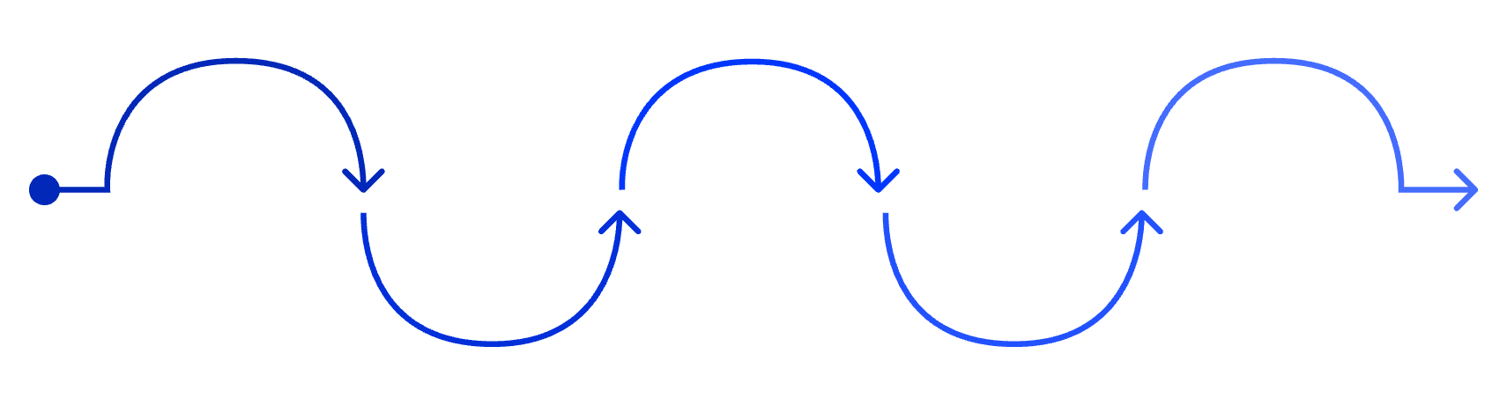

VIDEO AD
Pivot to Video AD
Why we extended from image anomaly detection to video anomaly detection
Why extend to video?
Image Inspection
Sequential Frames
Temporal Context
Video Anomaly Detection
Motion Cues
Image AD: static, controlled environments
Video AD: dynamic scenes with temporal context
Professor's guidance: "Look into domain adaptability beyond static images"
Static image anomaly analysis
Stack nearby frames for context
Model temporal dependencies across time
Capture optical flow and dynamics
Dynamic scene understanding and alerts

Slide 6
OPEN-VOCABULARY
VIDEO AD
SURVEY
OVVAD & VAD Survey: Shaping Our Direction
CVPR 2024 + ACM 2025: zero-shot framework + survey evidence.
OVVAD Architecture
Why the Survey Matters
Frozen CLIP: fixed ViT-B/16 features
Temporal adapter: learns frame sequence cues
Text injection: normal/anomaly descriptions
Anomaly synthesis: boosts robustness
400+ methods: broad VAD map
Key gaps: weak generalization, weak time modeling, label-heavy
Open-vocab VAD: handles unseen anomalies via language
Why DA-ZVAD: supports zero-shot, language-aware direction
86.40% AUC on UCF-Crime

Slide 7


CVPR 2024
CVPR 2025
LAVAD & VERA — Training-Free Video AD
Two CVPR papers that complete our architectural puzzle
LAVAD
VERA
Caption-then-reason pipeline
Verbalized domain prompting
Frames → BLIP-2 Captions → LLM Scoring
LLM reasons about temporal events across frames
Dynamically adjusts normality baseline
Outperforms all unsupervised VAD methods
"A dimly lit warehouse with conveyor belts"
Cross-modal refinement reduces caption noise
Zero training required; domain-adaptive via text alone
Explainable outputs; cross-domain robust
Limitations: Noisy/hallucinated captions; high LLM inference cost
Running person: Normal in an arena, anomalous in a warehouse — domain context matters.

Slide 8


BENCHMARK
DA-ZVAD
Comparative Analysis
No existing method satisfies all five desiderata — DA-ZVAD targets this gap.
What matters most: zero-shot, training-free, explainable, temporal, and domain-adaptive performance.
Method
Venue
Zero-Shot
Training-Free
Explainable
Temporal
Domain-Adaptive
PatchCore
CVPR '22
✗
✗
✗
✗
✗
WinCLIP
CVPR '23
✓
✓
✗
✗
✗
AnomalyCLIP
ICLR '24
✓
✗
✗
✗
✗
AnomalyGPT
AAAI '24
✗
✗
✓
✗
✗
OVVAD
CVPR '24
✓
✗
✗
✓
Partial
LAVAD
CVPR '24
✓
✓
Partial
✓
✗
VERA
CVPR '25
✓
✓
✓
✓
✓
DA-ZVAD (Ours)
Proposed
✓
✓
✓
✓
✓
Key insight: DA-ZVAD is the only proposed method satisfying all five desiderata simultaneously — zero-shot, training-free, explainable, temporal, and domain-adaptive.

Slide 9

CLIP BASELINE
MVTEC AD
CLIP Baseline — Results on MVTec AD
15 categories · 1,725 test images · Zero training data
88.5%
90.7%
135.8s
Mean AUROC
F1 Score
Inference Time
Zero-shot, no training
Strong detection precision
On T4 GPU, full dataset
Gap vs WinCLIP (91.8%): attributed to omission of multi-scale sliding window — a deliberate trade-off for video extensibility.
Category Breakdown
Textures — 99.5% mean
Objects — 83.1% mean
Carpet 99.2% · Grid 99.7% · Leather 100% · Tile 98.7% · Wood 100%
Bottle 85.6% · Cable 79.5% · Capsule 80.9% · Transistor 72.7% · Zipper 80.3%
Global appearance captured well by CLIP
Localised defects need stronger spatial reasoning

Slide 10
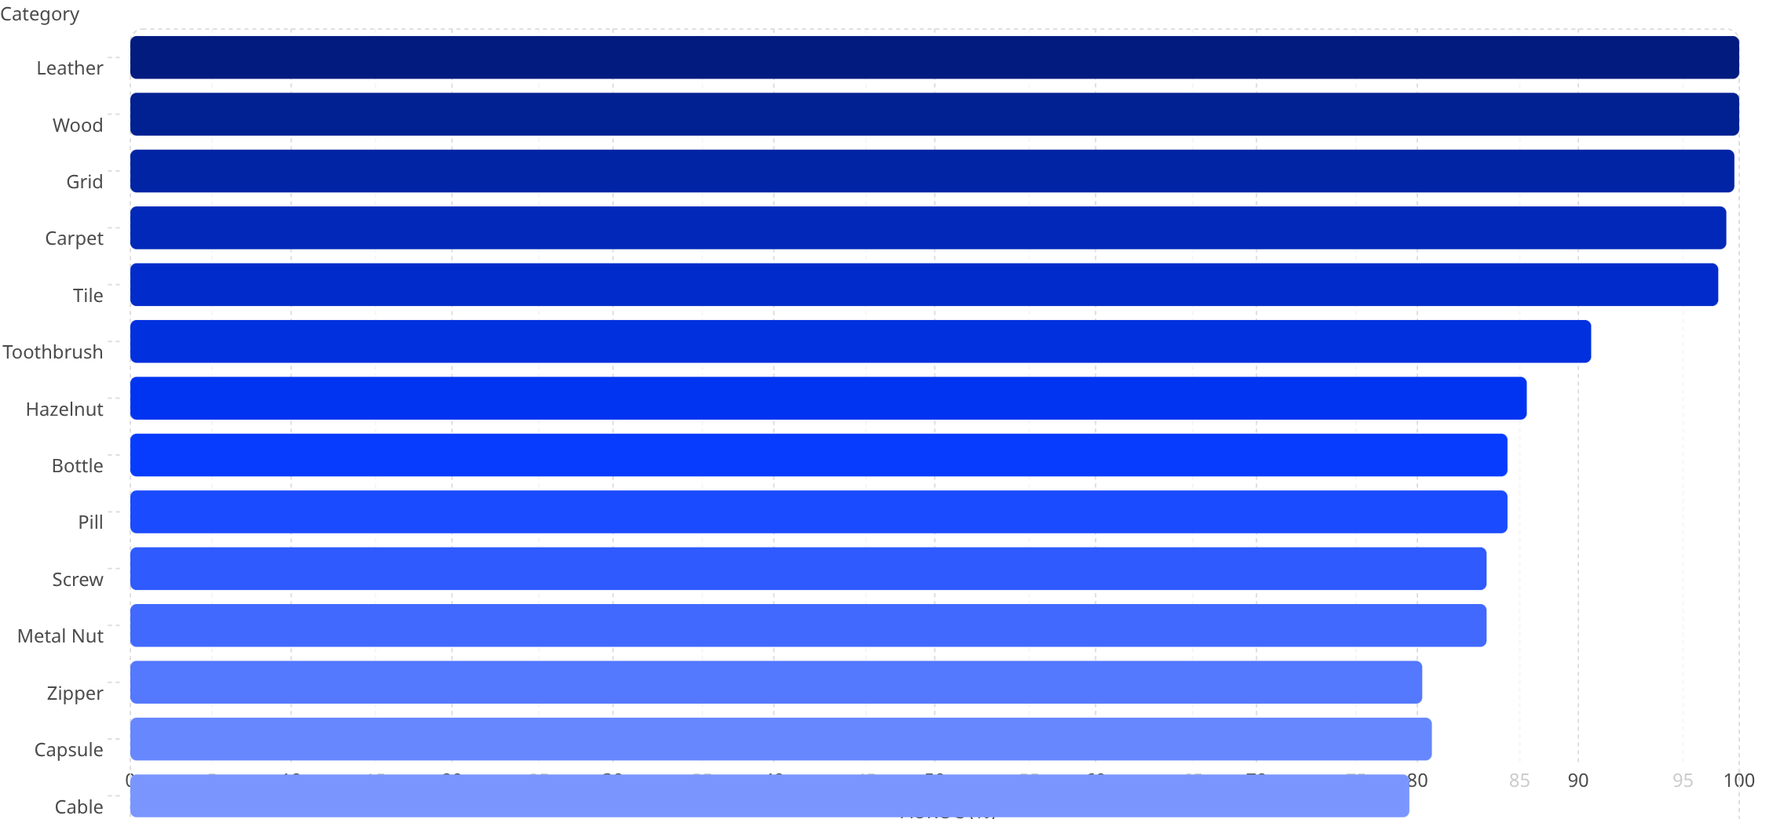

PERFORMANCE BREAKDOWN
AUROC by Category
Visual performance breakdown across all 15 MVTec AD categories — textures consistently outperform objects.
100
100
99.7
99.2
98.7
90.8
86.8
85.6
85.6
84.3
84.3
80.3
80.9
79.5
72.7
Key pattern: texture categories are nearly perfect, while object categories are more sensitive to localized and structural defects.
Textures lead
Objects lag
Next phase
Leather, wood, grid, carpet, and tile cluster at the top.
Transistor, cable, capsule, and zipper show the toughest cases.
Improve spatial reasoning for fine-grained defect localization.
Texture categories (leather, wood, grid) achieve near-perfect scores. Object categories with localised or structural defects — transistor, cable, capsule — highlight the need for spatial reasoning enhancements in the next phase.

Slide 11

VIDEO EXTENSION
PER-FRAME CLIP SCORING
Video Extension — Per-Frame CLIP Scoring
Simulating conveyor belt quality inspection with pseudo-video frames
0.307
0.894
0.587
Normal Score
Anomalous Score
Score Gap
Experimental Setup
MVTec bottle images sequenced as pseudo-video frames
30 frames: Normal ×10 → Anomalous ×10 → Normal ×10
Each frame scored independently by CLIP
Simulates real-time conveyor belt inspection
Frame Sequence — Score Pattern
Normal
Normal
Score ≈ 0.307 — baseline frames
Score ≈ 0.307 — returned baseline
Anomalous
Score ≈ 0.894 — high deviation
Clean separation validates CLIP for video: A 0.587 score gap between normal and anomalous frames confirms CLIP's discriminative power as a foundation for the DA-ZVAD video pipeline.

