Slide 1
Webinar-2
RAG

Slide 2
Table of Contents
What is RAG?
RAG Architecture
RAG Use Cases
RAG Advantages
RAG drawbacks/challenges

Slide 3
What is RAG?
Natural language processing (NLP) technique that combines generative AI models with traditional information retrieval systems.
RAG models can process and consolidate knowledge to create human-like responses, instructions, or explanations.
RAG can be used to improve the quality of generative AI responses, provide answers to questions that aren't in the intent list, and access fresher information.
RAG is appropriate for use cases such as chatbots, email, text messaging, and other conversational applications.

Slide 4
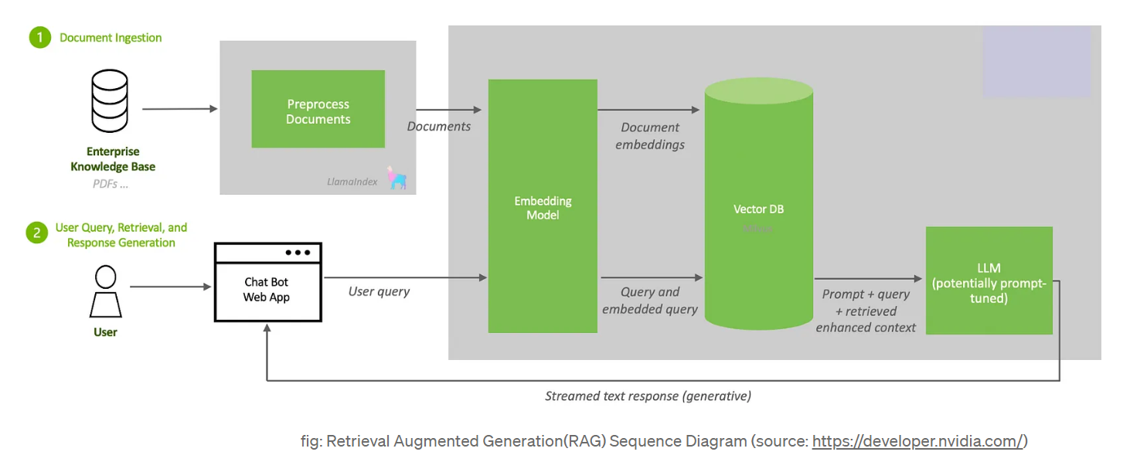
Basic RAG Architecture

Slide 5
RAG Use Cases
Question Answering:
Provides precise, contextually relevant answers by leveraging extensive data retrieval and generation capabilities.
Knowledge Management:
Facilitates retrieval of specific information and generates comprehensive summaries or reports.
Customer Support:
Delivers accurate, context-specific responses to queries, enhancing chatbot performance.

Slide 6
RAG Use Cases Cont ….
E-commerce:
Generates detailed product descriptions and enhances customer interaction with accurate recommendations.
Healthcare:
Provides up-to-date medical information and detailed treatment plans, improving patient interaction.
Legal and Compliance:
Summarizes legal documents and generates compliance reports by analyzing relevant regulations.

Slide 7
RAG - Advantages
Improved Accuracy:
Ensures outputs are accurate and grounded in factual data by retrieving relevant information before generating responses, thereby reducing hallucinations.
Enhanced Contextual Understanding:
Produces contextually aware and comprehensive answers by combining retrieved data with generative capabilities.
Scalability:
Efficiently processes vast amounts of information and quickly retrieves relevant data, making it suitable for applications requiring extensive knowledge bases.

Slide 8
RAG - Advantages Cont ….
Enhanced User Experience:
Facilitates natural language interactions and provides personalized responses based on user preferences and history.
Cost-Effective:
Optimizes computational resources and efficiently utilizes existing knowledge bases, reducing the need for extensive training data and computation.
Reduced Training Data Requirements:
Relies on pre-existing knowledge bases, reducing the need for extensive training data for the generative model to perform well.

Slide 9
RAG - Drawbacks
Complexity:
Integrating and tuning retrieval and generation models increases system and operational complexity.
Hallucinations:
LLM model can hallucinate while generating response from retrieved chunks.
Latency:
Increased response times and challenges in achieving real-time performance due to the dual retrieval and generation steps.

Slide 10
RAG - Drawbacks Cont ….
Dependence on Data Quality:
Garbage In, Garbage Out. The accuracy of generated responses depends on the quality of retrieved data, with biases potentially being amplified.
Evaluation Challenges:
Assessing performance and user satisfaction is complex, requiring evaluation of both retrieval and generation quality.
Potential for Information Overload:
Lost in the middle. Excessive information can overwhelm the generative component, making relevance filtering challenging.

Slide 11
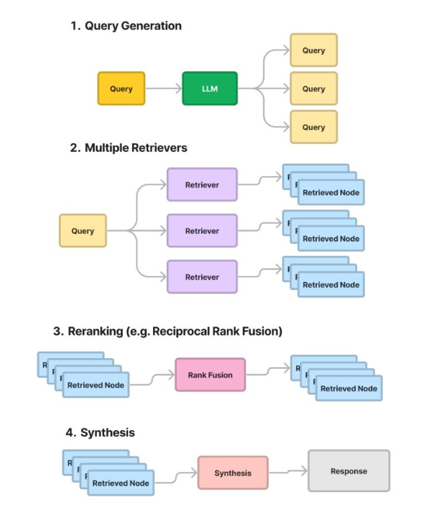
Fusion
RAG

Slide 12
Thank You

