Slide 1
CSE 561 Paper Review

Slide 2
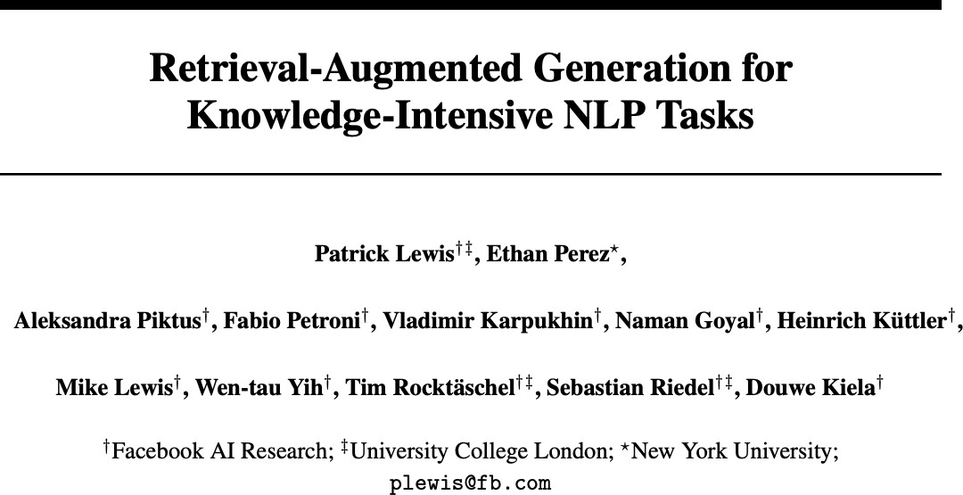
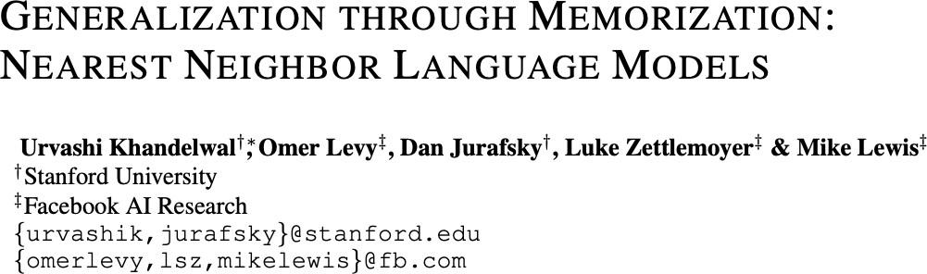

Slide 3
Overview
RAG
Methods
Results
Conclusion
Overview
Retrieval Augmented Generation (RAG)
Model Setup
Results
Performance comparison

Slide 4
Overview
RAG
Methods
Results
Conclusion
Retrieval Augmented Generation (RAG)
Retrieval-augmented generation (RAG) is a technique for enhancing the accuracy and reliability of generative AI models with facts fetched from external sources
Pre-trained Retriever
Pre-trained Seq2seq model
Query Encoder
Input Data
+
Generator
Fine-tune
Output Data
Document Index

Slide 5
Overview
RAG
Methods
Results
Conclusion
Importance
Updated world knowledge
Providing insights into their predictions
Hallucinations

Slide 6
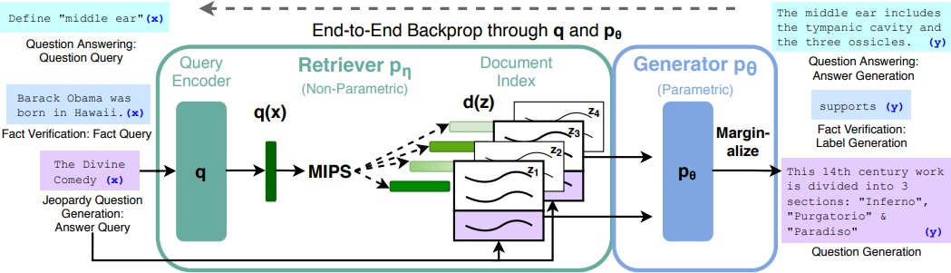
Results
Overview
RAG
RAG Architecture
Conclusion
For query x, Maximum Inner Product Search (MIPS) is used to find the top-K documents z_{i}.
For final prediction y, z is treated as a latent variable and marginalized over seq2seq predictions given different documents
Input data
Retriever Model Architecture
Generator Model Architecture
Output Data
RAG implementations showed better performance in all tested tasks .

Slide 7

Overview
RAG
RAG Architecture
Results
Conclusion
Models
RAG
2 variations
RAG-Token
Retrieved passages are represented as token-level embeddings
RAG-Sequence
Retrieved passages are treated as sequences of text
Instead of concatenating the passages with the input data, token-level representations of the passages are directly integrated into the input embeddings
Each retrieved passage is concatenated with the input data or prompt to form a longer sequence
This combined sequence is then fed into the generator model (e.g., BART) for generating the final output
The generator model (BART) then operates on these modified input embeddings, considering the additional information from the retrieved passages during generation.

Slide 8
Overview
RAG
RAG Architecture
Results
Conclusion
Experimental Results
Tasks:
Open-domain Question Answering
Abstractive Question Answering
Jeopardy Question Generation
Fact Verification

Slide 9
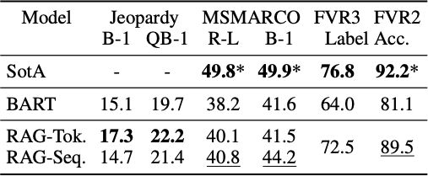
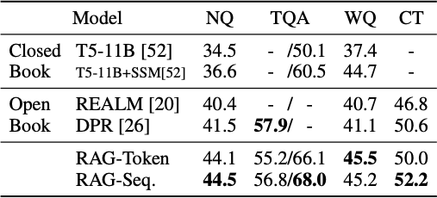
Overview
RAG
RAG Architecture
Results
Conclusion
Experimental Results
Task: Open-domain Question Answering
Table 2: Generation and classification Test Scores.
Table 1: Open-Domain QA Test Scores.
RAG implementations showed better performance showing improved performance on all except one open-domain question
answering task.
9

Slide 10
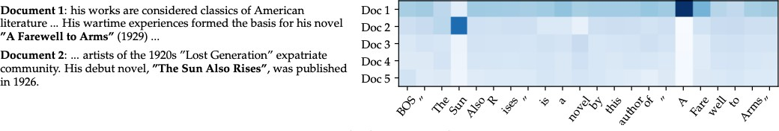
Overview
RAG
RAG Architecture
Results
Conclusion
Experimental Results
Task: Fact Verification
Figure 2: RAG-Token document posterior p(zi|x, yi, yi) for each generated token for input “Hemingway" for Jeopardy generation with 5 retrieved documents.
10

Slide 11
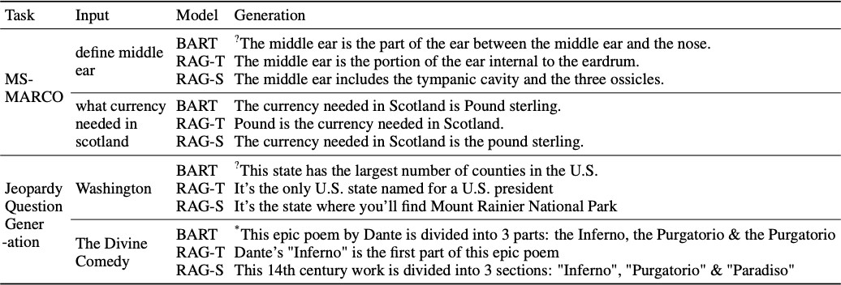
Overview
RAG
RAG Architecture
Results
Conclusion
Experimental Results
Task: Fact Verification
Table 3: Table 3: Examples from generation tasks. RAG models generate more specific and factually accurate responses. ‘?’ indicates factually incorrect responses, * indicates partially correct responses.
11

Slide 12
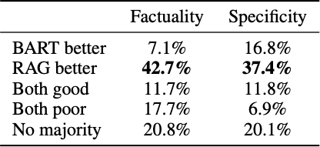
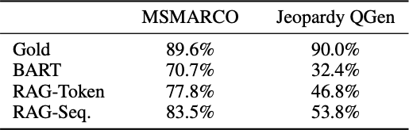
Overview
RAG
RAG Architecture
Results
Conclusion
Experimental Results
Task: Jeopardy Question Generation
Task: Generation Diversity
Table 4: Human assessments for the Jeopardy Question Generation Task
Table 5: Ratio of distinct to total tri-grams for generation tasks

Slide 13
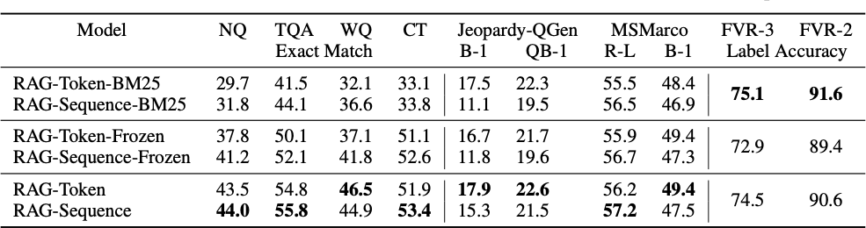
Overview
RAG
RAG Architecture
Results
Conclusion
Experimental Results
Task: Retrieval Ablations
Table 6: Ablations on the dev set. As FEVER is a classification task, both RAG models are equivalent.

Slide 14
Overview
RAG
RAG Architecture
Results
Conclusion
Experimental Results
Task: Index hot-swapping
Built an index using the DrQA Wikipedia dump from December 2016 and compare outputs from RAG using this index to the newer index from our main results (December 2018).
RAG answers 70% correctly using the 2016 index for 2016 world leaders and 68% using the 2018 index for 2018 world leaders.
This shows that RAG’s world knowledge can be updated by simply replacing its non-parametric memory.

Slide 15
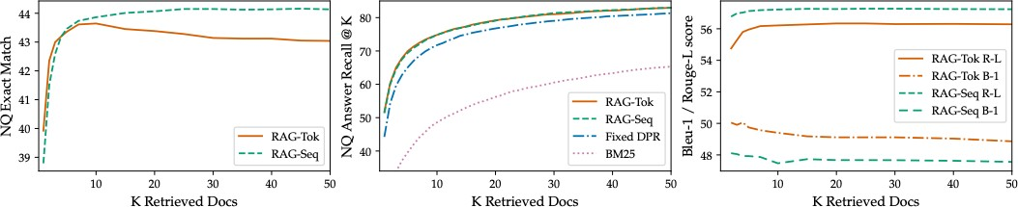
Overview
RAG
RAG Architecture
Results
Conclusion
Effect of Retrieving more documents
Retrieving more documents can lead to improved relevance of the retrieved passages. The model shows diminishing returns when it comes to the number of documents retrieved after retrieving a certain number of documents.

Slide 16
Overview
RAG
RAG Architecture
Results
Conclusion
Conclusion
Hybrid generation models with access to parametric and non- parametric memory.
Obtains state of the art results on open-domain QA
Improved generation compared to parametric BART, with RAG more factual and specific

Slide 17
Overview
kNN-LM
Methods
Results
Conclusion
Overview
kNN-LM
Model Setup
Experimental Results
Performance comparison

Slide 18
Overview
kNN-LM
Methods
Results
Conclusion
kNN-LM
An approach that extends a pre-trained LM by linearly interpolating its next word distribution with a k-nearest neighbors (kNN) model
The nearest neighbors are computed according to distance in the pre-trained embedding space and can be drawn from any text collection, including the original LM training data.
This approach allows rare patterns to be memorized explicitly, rather than implicitly in model parameters.
It also improves performance when the same training data is used for learning the prefix representations and the kNN model, strongly suggesting that the prediction problem is more challenging than previously appreciated.

Slide 19
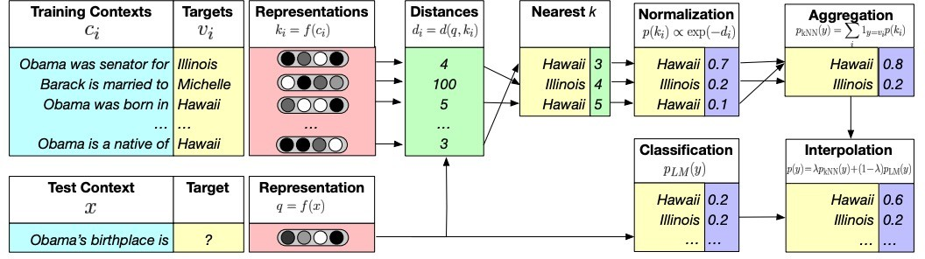
Overview
kNN-LM
kNN-LM Architecture
Results
Conclusion
Model Architecture
Computing distribution over targets
Datastore Construction
Inference
Interpolation
Figure 1. Illustration of kNN-LM
19

Slide 20
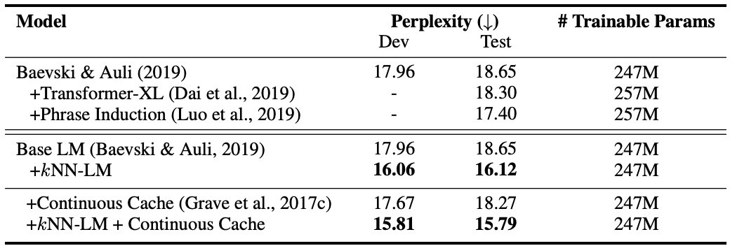
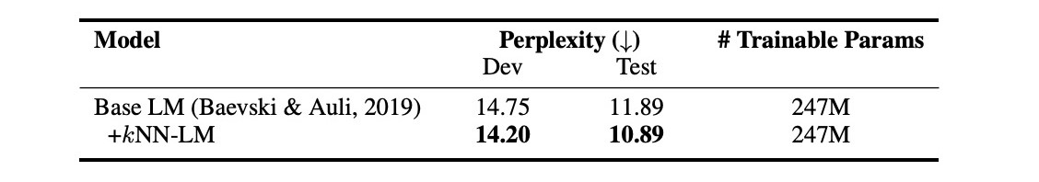
Overview
kNN-LM
kNN-LM Architecture
Results
Conclusion
Experimental Results
Table 2. Performance on BOOKS
Table 1. Performance on WIKITEXT-103
The kNN-LM model shows improvement compare to the baselines with lower perplexity scores
20

Slide 21
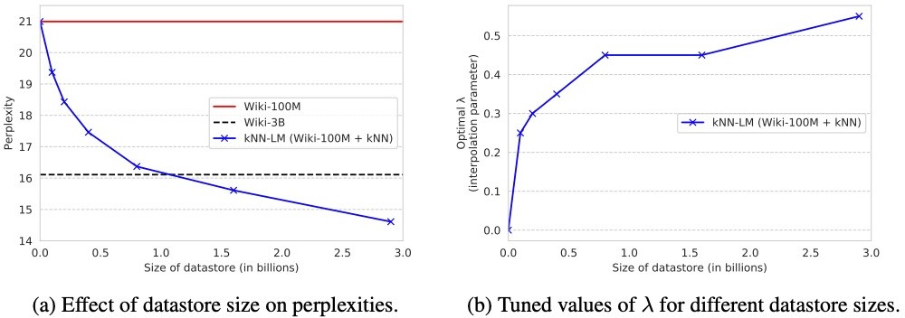
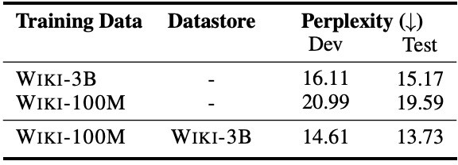
Overview
kNN-LM
kNN-LM Architecture
Results
Conclusion
Experimental Results
Task : Training Data as the datastore
Table 3. Experimental results on WIKI-3B
Figure 2. Varying size on the datastore
As the size of the datastore increases, a higher weight on the retrieved training examples (controlled by λ) becomes more
beneficial in improving model performance
21

Slide 22
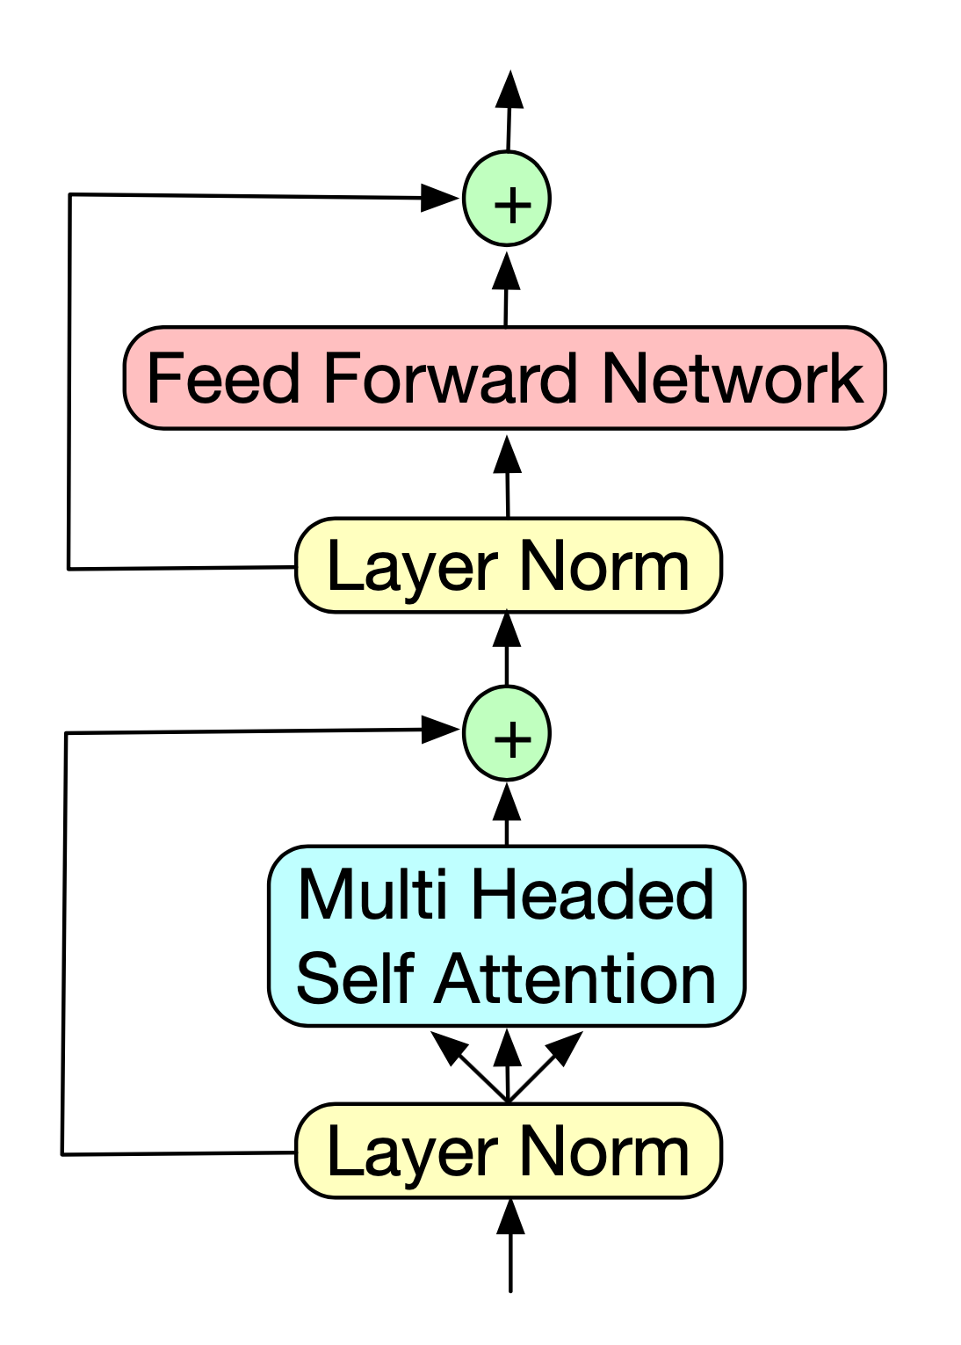
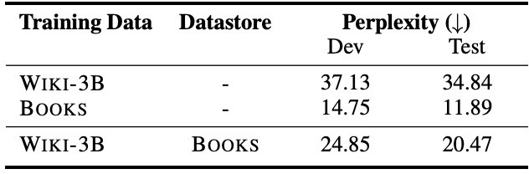
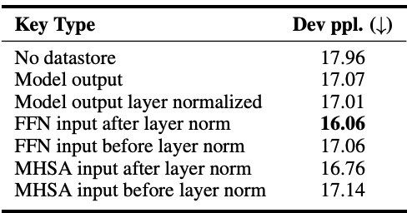
Overview
kNN-LM
kNN-LM Architecture
Results
Conclusion
Experimental Results
Task : Additional Data without training
Figure 3. Transformer layer of the LM
Table 4. Performance on in-domain BOOKS data
Table 5. WIKITEXT-103 validation results using different states from the final layer of the LM as the representation function for keys and queries

Slide 23
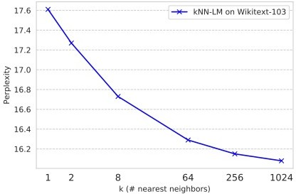
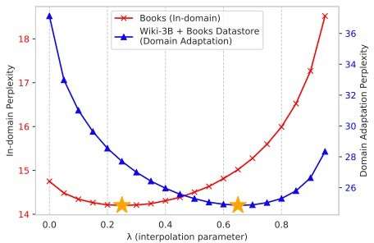
Overview
kNN-LM
kNN-LM Architecture
Results
Conclusion
Experimental Results
Task: Tuning Nearest neighbor search
Figure 4. Effect of the number of nearest neighbors returned per word on WIKITEXT- 103 (validation set).
Figure 4. Effect of interpolation parameter λ on in-domain (left y-axis) and out-of-domain (right y-axis) validation set performances.

Slide 24
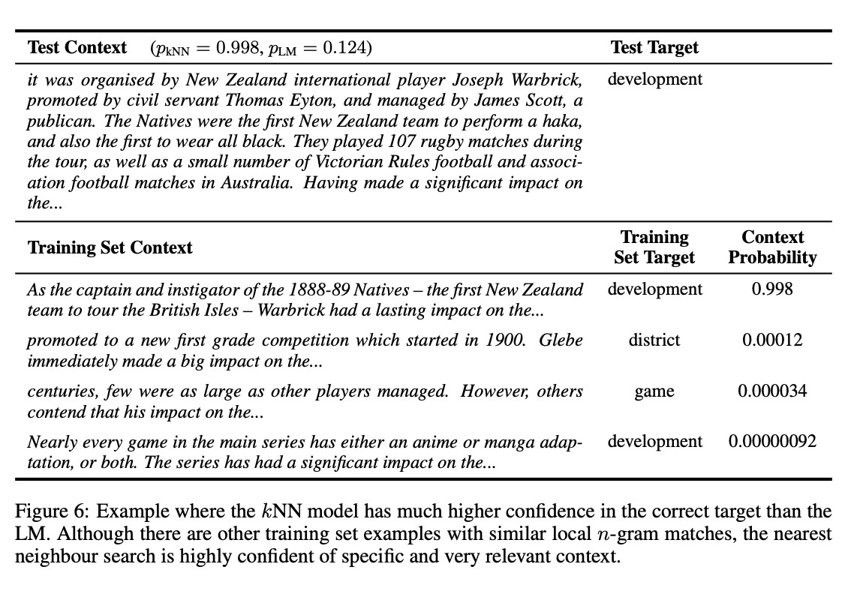
Overview
kNN-LM
kNN-LM Architecture
Results
Conclusion
Experimental Results
Figure 6. Example where the kNN model has much higher confidence in the correct target than the LM.
24

Slide 25
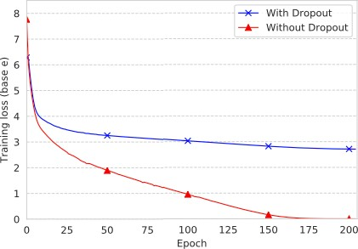
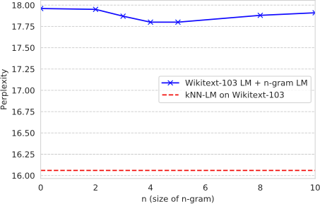
Overview
kNN-LM
kNN-LM Architecture
Results
Conclusion
Experimental Results
Figure 8. Training curves for the Transformer LM with
Figure 7. Interpolating the Transformer LM with n- gram LMs on WIKITEXT-103 (validation set) .
and without dropout.
25

Slide 26
Overview
kNN-LM
kNN-LM Architecture
Results
Conclusion
Conclusion
kNN-LM outperform standard language models by directly quering training examples at test time
Learning similarity functions between contexts may be an easier problem than predicting the next word from some given context.

Slide 27
Questions?

