Slide 1

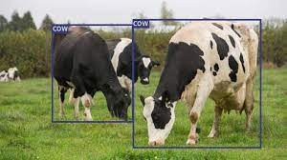
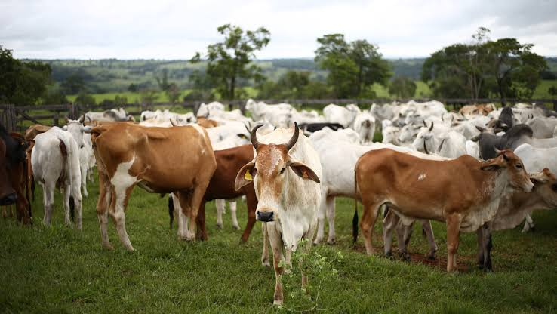
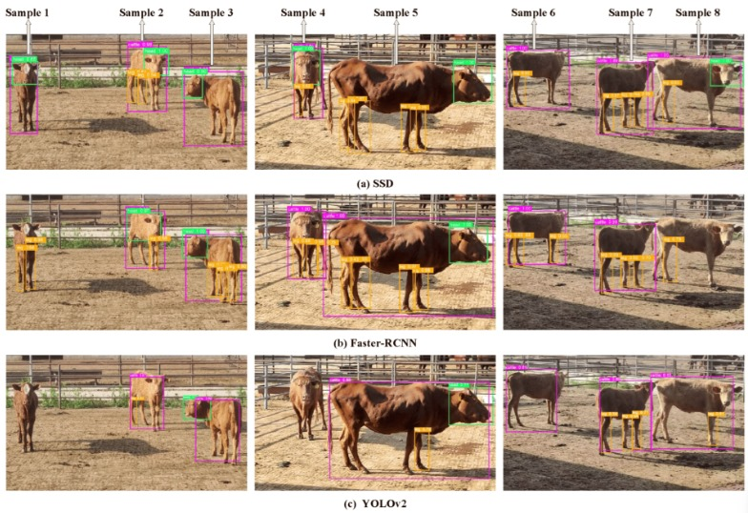
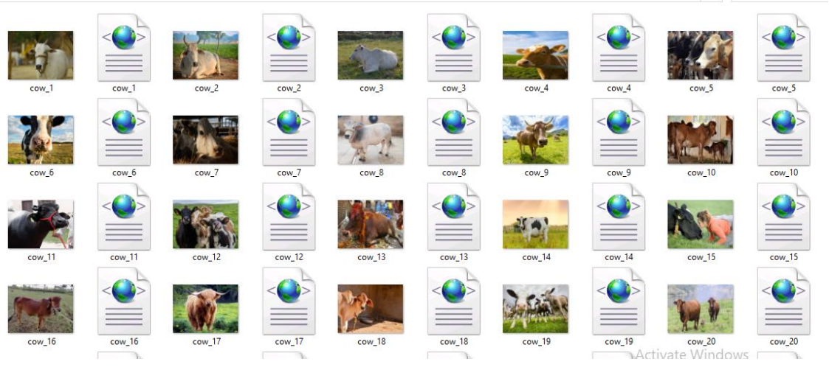
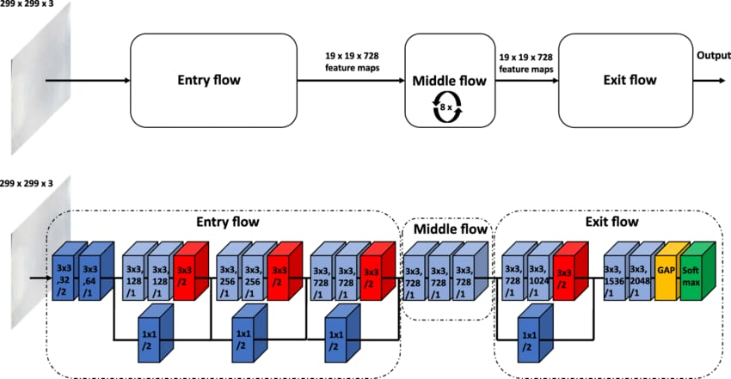
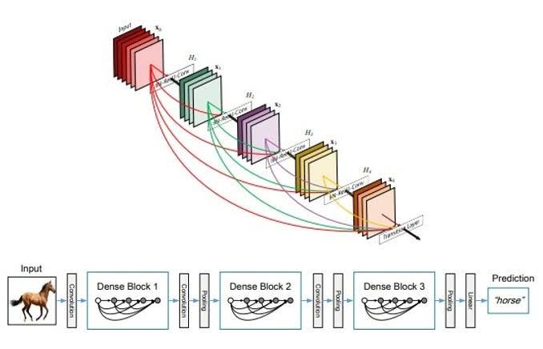

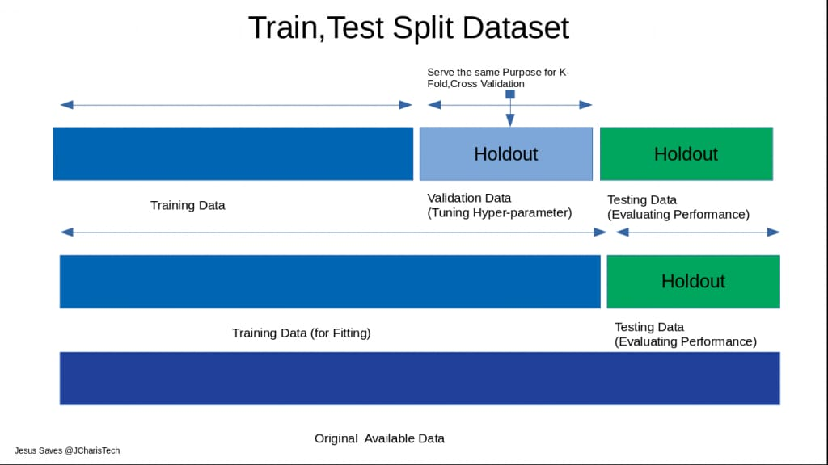
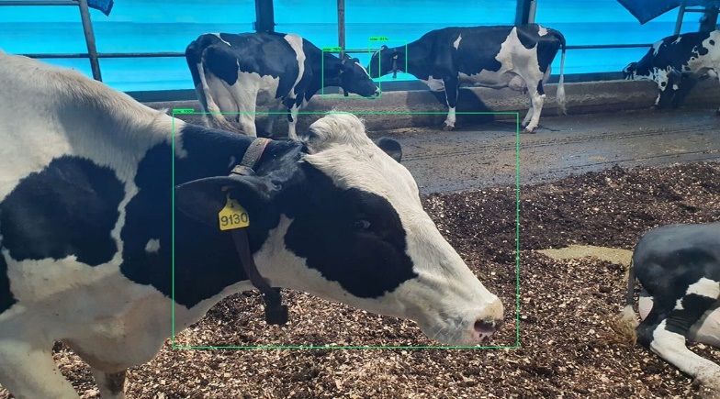
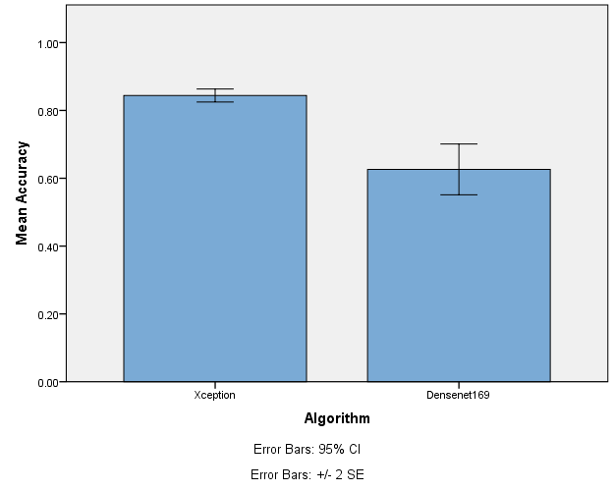
Name: P. Hemaprakash Register Number: 192012046
Guided by Dr. Dinokumar Kongkham
Ms. Poorani.S
Guided by Dr. Mary Valantina. G
Efficient detection animal intrusion in agriculture fields using novel Xception model compared over Densent169 with improved accuracy
THE PROJECT'S GOAL IS TO DEVELOP A SYSTEM THAT CAN ACCURATELY DETECT INSTANCES OF ANIMALS INVADING AGRICULTURAL AREAS. THIS INDICATES THE CONTEXT OF THE DETECTION, INDICATING THAT IT IS INTENDED FOR USE IN AGRICULTURAL SITUATIONS.
XCEPTION IS A CONVOLUTIONAL NEURAL NETWORK (CNN) NOTED FOR ITS ABILITY TO PERFORM IMAGE CATEGORIZATION TASKS EFFICIENTLY. THE PROJECT SEEKS TO USE A NOVEL VERSION OF THE XCEPTION MODEL, WITH A UNIQUE OR CUSTOMIZED IMPLEMENTATION.
DENSENET169 IS ANOTHER CNN ARCHITECTURE THAT THE TEAM INTENDS TO TEST AGAINST THE XCEPTION MODEL. THIS ENTAILS DOING A COMPARISON ANALYSIS TO ASSESS THE PERFORMANCE OF THE TWO MODELS.
THIS PROJECT ENTAILS DEVELOPING AN EFFICIENT METHOD FOR DETECTING ANIMAL ENCROACHMENT IN FARM AREAS. THIS WILL BE ACCOMPLISHED BY CONSTRUCTING A FRESH XCEPTION MODEL AND COMPARING ITS PERFORMANCE TO DENSENET169, WITH THE GOAL OF INCREASING ACCURACY.
INTRODUCTION
Animal Detection In Field's
MATERIALS AND METHODS
Colab & IBM
Input data
Software Tools
Comparison of the accuracies of both algorithms
Preprocessing
Model building
END
Comparison in graphical model using SPSS software
Output
Split, Train and test
Classification
RESULTS
Independent Samples Test
 |  | Levene's Test for Equality of Variances |  | t-test for Equality of Means
 |  | F | Sig. | t | df | Sig. (2-tailed) | Mean Difference | Std. Error Difference | 95% Confidence Interval of the Difference
 |  |  |  |  |  |  |  |  | Lower | Upper
Accuracy | Equal variances assumed | 12.052 | .003 | 5.636 | 18 | .000 | .21800 | .03868 | .13674 | .29926
 | Equal variances not assumed |  |  | 5.636 | 10.190 | .000 | .21800 | .03868 | .13203 | .30397
 | ALGO | N | MEAN | Std.Deviation | Std.ERROR. Mean
ACCURAY | XCEPTION | 10 | 0.844 | 0.02779 | 0.00879
 | DENSENET169 | 10 | .7013 | 0.02590 | 0.00819
Xception and Densent169
Statistical Analysis of Xception and Densent169
The Xception model outperformed Densenet169, with 84.44% accuracy versus 62.60%. This shows that Xception is superior at detecting animal encroachment in agricultural settings. The experiment involved training and evaluating both models on a variety of datasets, with Xception outperforming them in terms of feature extraction. These findings highlight the necessity of selecting the right deep learning architecture for each assignment.
DISCUSSION AND CONCLUSION
A statistical analysis using the Independent Samples T-test with a 95% confidence level and a standard deviation of +/-1 reveals a significance value of p=0.001 (independent sample T - test p<0.05) is obtained and shows that there is a statistical significant difference between the group 1 and group 2.
Therefore, there is an improvement in the performance level, and the values of the outcomes are
Xception - 84.44%
Densent169 - 62.60%
The findings highlight the significance of choosing appropriate model architectures for various objectives. Xception's excellent performance shows that it is well-suited for the difficult task of recognizing complex patterns associated with animal encroachment.
Xception offers a more effective solution for detecting animal intrusion in agriculture fields compared to Densenet169. These results have practical implications for improving crop protection and resource management strategies in agricultural settings.
BIBLIOGRAPHY
Barati et al., 2020
M Barati, F Javanmardi, S Jazayeri, M Jabbari, J Rahmani, F Barati, H Nickho, S H Davoodi, N Roshanravan, A M Khaneghah
Bhandari et al., 2020
D Bhandari, S Rafiq, Y Gat, P Gat, R Waghmare, V Kumar
Callmann et al., 2020
C E Callmann, M P Thompson, N C Gianneschi Poly(peptide): Synthesis, structure, and function of peptide-polymer amphiphiles and protein-like polymers
Automatically identifying, counting, and describing wild animals in camera-trap images with deep learning. In November (2017). arXiv:1703.05830v5.

