Slide 1

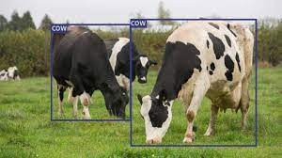
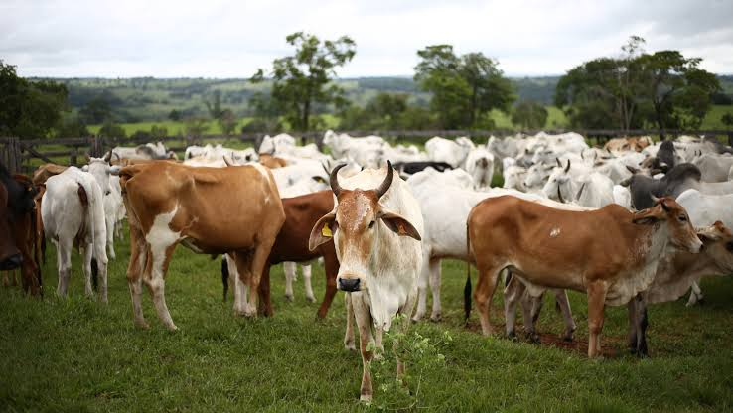
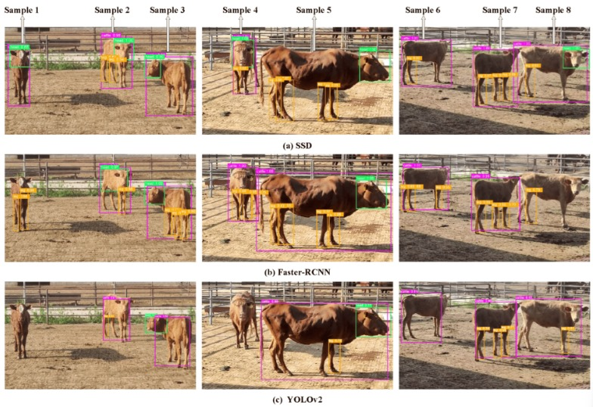
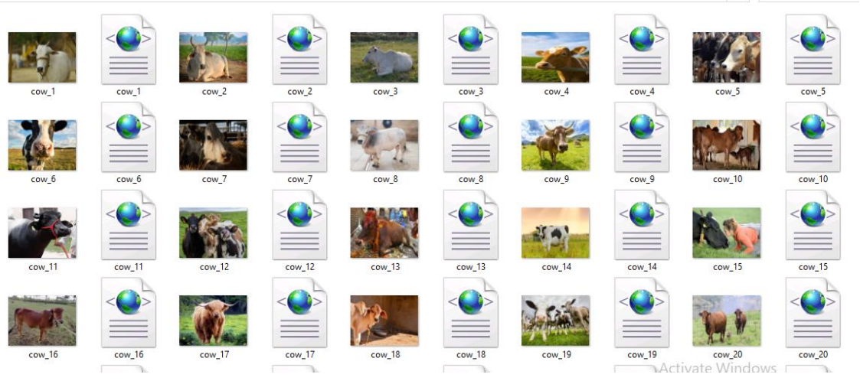
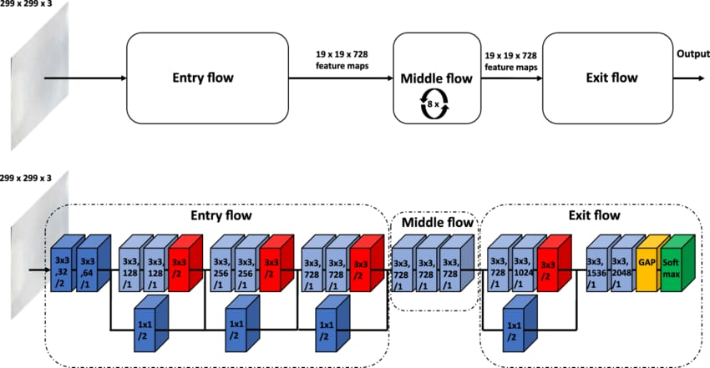
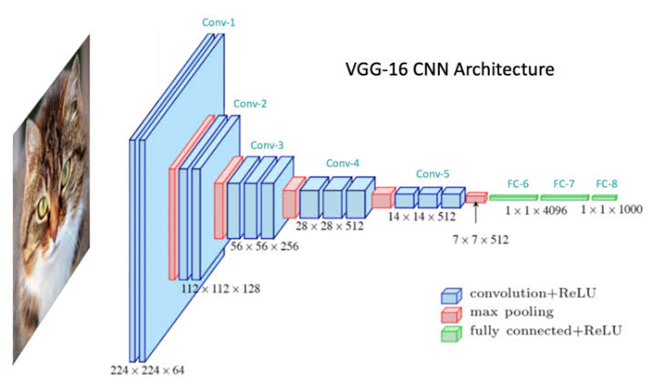

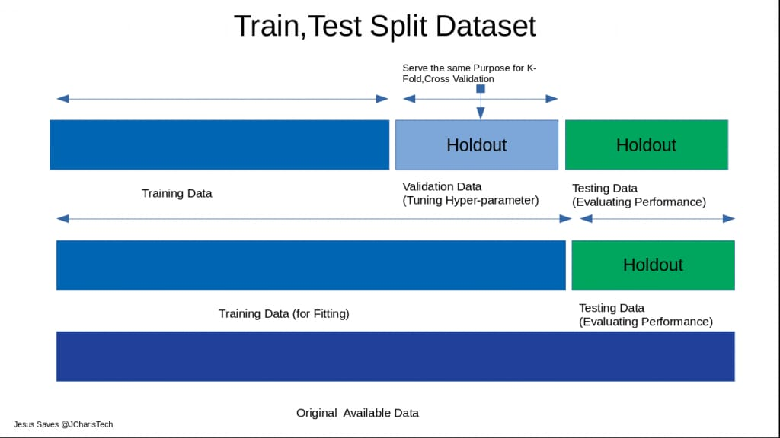
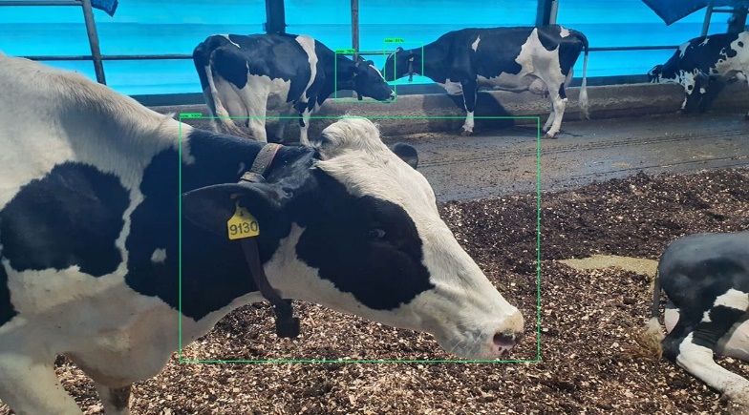
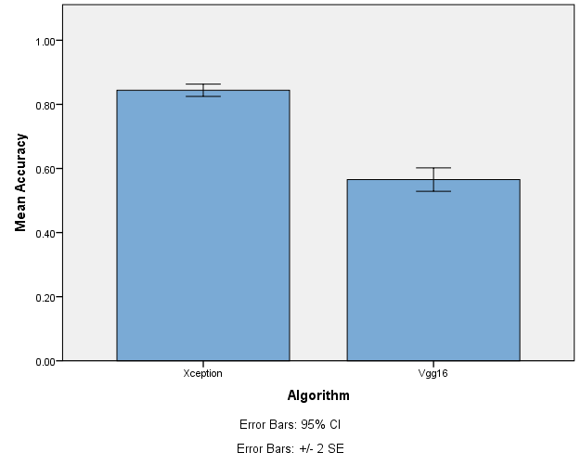
Name: P. Hemaprakash Register Number: 192012046
Guided by Dr. Dinokumar Kongkham
Ms. Poorani.S
Guided by Dr. Mary Valantina. G
Accuracy analysis in detecting animal intrusion in agriculture field's Using novel Xception model compared over VGG16
INTRODUCTION
THE PROJECT'S MAJOR GOAL IS TO IMPROVE FARM SECURITY BY DETECTING ANIMAL INTRUSIONS. THIS IS CRITICAL FOR PREVENTING CROP DAMAGE AND MAINTAINING THE GENERAL HEALTH OF THE AGRICULTURAL ENVIRONMENT.
THE PROJECT LAYS A STRONG EMPHASIS ON ACCURACY ANALYSIS. THIS IS CRITICAL FOR DETERMINING THE DETECTION SYSTEM'S RELIABILITY AND PRECISION IN IDENTIFYING ANIMAL ENTRY INCIDENTS.
THE INCORPORATION OF A FRESH XCEPTION MODEL ADDS AN INTERESTING ELEMENT TO THE PROJECT. EVALUATING ITS PERFORMANCE REVEALS INFORMATION ON THE EFFECTIVENESS OF NEWER MODELS VS ESTABLISHED ONES.
BY COMPARING THE XCEPTION MODEL TO THE WELL-KNOWN VGG16 MODEL, THE PROJECT CREATES A PERFORMANCE BASELINE. THIS COMPARISON HELPS TO UNDERSTAND THE STRENGTHS AND SHORTCOMINGS OF EACH APPROACH IN TERMS OF ANIMAL INTRUSION DETECTION.
Animal Detection In Field's
MATERIALS AND METHODS
Colab & IBM
Input data
Software Tools
Pre-processing
Model Building
END
Comparison in graphical model using SPSS software
Comparison of the accuracies of both algorithms
Output
Split, Train and test
Classification
RESULTS
Independent Samples Test
 |  | Levene's Test for Equality of Variances |  | t-test for Equality of Means
 |  | F | Sig. | t | df | Sig. (2-tailed) | Mean Difference | Std. Error Difference | 95% Confidence Interval of the Difference
 |  |  |  |  |  |  |  |  | Lower | Upper
Accuracy | Equal variances assumed | 3.314 | .085 | 13.440 | 18 | .000 | .27867 | .02073 | .23511 | .32223
 | Equal variances not assumed |  |  | 13.440 | 13.624 | .000 | .27867 | .02073 | .23408 | .32326
Group Statistics
 | Algorithm | N | Mean | Std. Deviation | Std. Error Mean
Accuracy | Xception | 10 | .8440 | .03052 | .00965
 | Vgg16 | 10 | .5653 | .05803 | .01835
Xception and VGG16
Statistical Analysis of Xception and VGG16
The Xception and VGG16 models for detecting animal encroachment in agricultural fields were compared in rigorous laboratory testing, with both models trained on a dataset of annotated photos and tested for accuracy. Simulation results showed that the Xception model achieved a significantly higher accuracy of 84.44% than VGG16's 54.53%, as evidenced by pre- and post-study figures and precision, recall, and confusion matrices, implying that the Xception model is superior for practical deployment in agricultural security systems.
DISCUSSION AND CONCLUSION
A statistical analysis using the Independent Samples T-test with a 95% confidence level and a standard deviation of +/-1 reveals a significance value of p=0.001 (independent sample T - test p<0.05) is obtained and shows that there is a statistical significant difference between the group 1 and group 2.
Xception got a significantly greater accuracy of 84.44% than VGG16's 54.53%. This mismatch shows that Xception's advanced architecture and feature extraction capabilities are more appropriate for this task.
Therefore, there is an improvement in the performance level, and the values of the outcomes are
Xception - 84.44%
Densent169 - 62.60%
According to the study, Xception outperforms VGG16 in terms of animal intrusion detection accuracy. This underscores the importance of advanced model selection in agricultural security applications. Moving ahead, more study can be focused on optimizing Xception's implementation for increased agricultural security.
BIBLIOGRAPHY
Bhandari et al., 2020 D Bhandari, S Rafiq, Y Gat, P Gat, R Waghmare, V Kumar A Review on bioactive peptides: Physiological functions, bioavailability and safety
n et al., 2020a
X Chen, F Fang, S Y Wang
Physicochemical properties and hepatoprotective effects of glycated Snapper fish scale peptides conjugated with xylose via maillard reaction
Food and Chemical Toxicology, 137 (2020), pp. 1-7
Callmann et al., 2020
C E Callmann, M P Thompson, N C Gianneschi
Poly(peptide): Synthesis, structure, and function of peptide-polymer amphiphiles and protein-like polymers
Accounts of Chemical Research, 53 (2020), pp. 400-413

