Slide 1

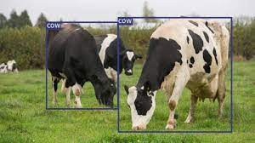
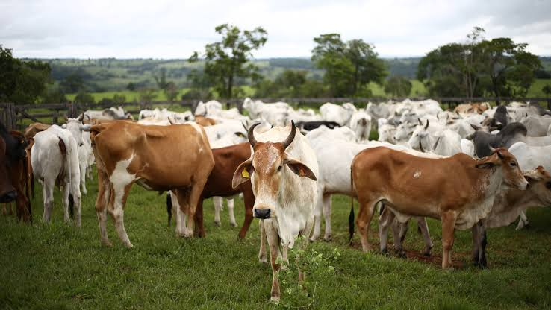
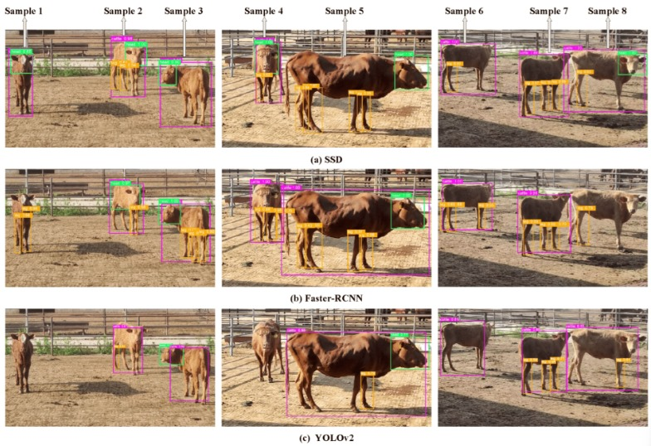
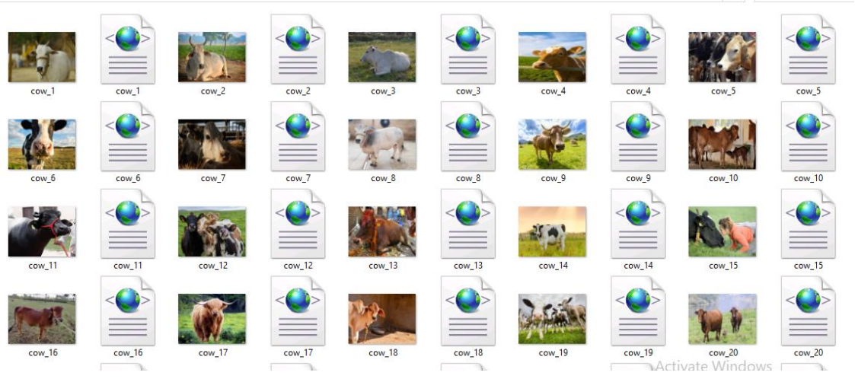
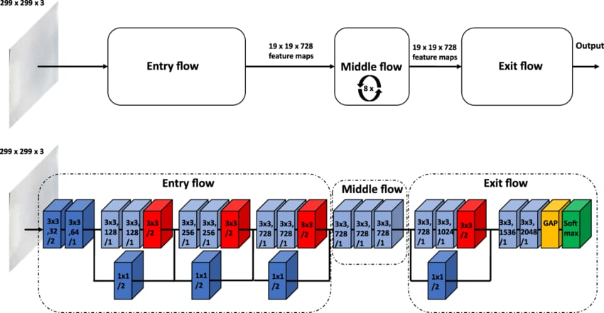
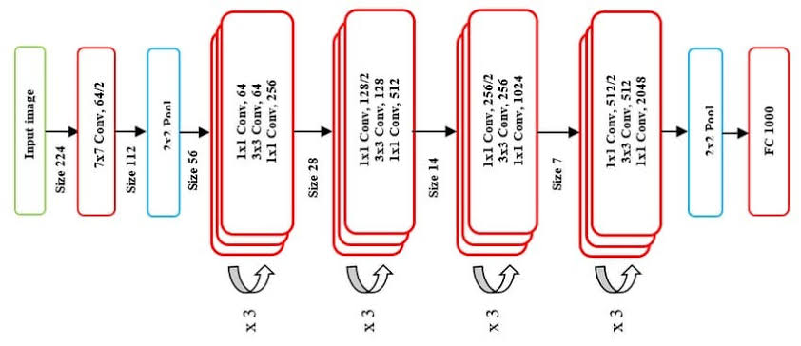

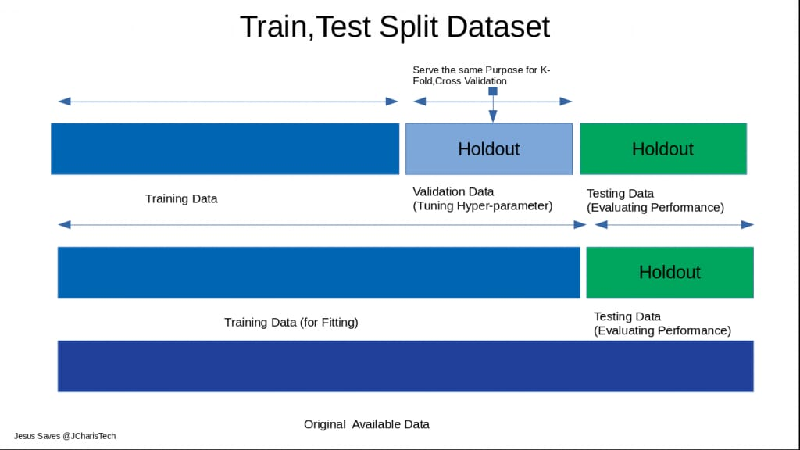
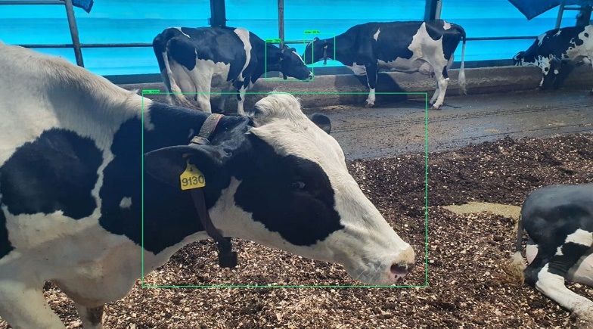
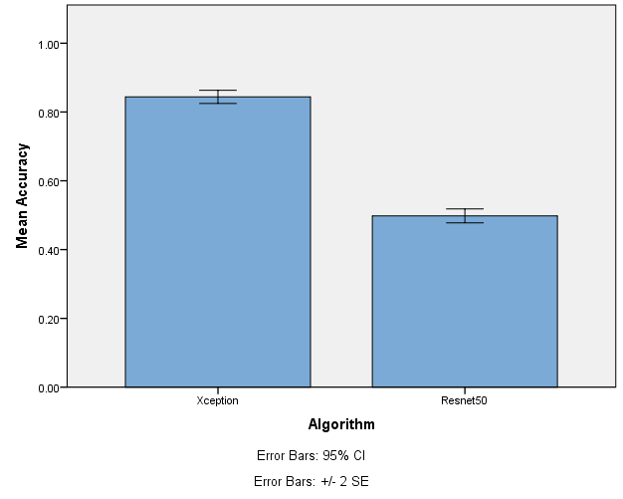
Name: P. Hemaprakash Register Number: 192012046
Guided by Dr. Dinokumar Kongkham
Ms. Poorani.S
Guided by Dr. Mary Valantina. G
Comparative analysis of detecting animals in agriculture field's Using novel Xception model compared over Resnet50 with improved accuracy
THIS MEANS THAT YOU WILL BE COMPARING TWO DISTINCT TECHNIQUES OR MODELS FOR ACHIEVING A SAME GOAL.
THE MAJOR GOAL IS TO CREATE A SYSTEM FOR IDENTIFYING AND LOCATING ANIMALS IN AGRICULTURAL ENVIRONMENTS.
THIS SUGGESTS THE USAGE OF A SPECIFIC DEEP LEARNING ARCHITECTURE, XCEPTION, WHICH IS WELL-KNOWN FOR ITS PERFORMANCE ON IMAGE-RELATED TASKS.
THE COMPARISON INCLUDES ANOTHER DEEP LEARNING MODEL, RESNET50, IMPLYING THAT YOU WILL COMPARE AND CONTRAST THE PERFORMANCE OF XCEPTION WITH RESNET50.
THE ULTIMATE GOAL IS TO IMPROVE THE ACCURACY OF ANIMAL DETECTION IN AGRICULTURAL SETTINGS, MAYBE BY MODIFICATIONS OR OPTIMIZATIONS TO THE CHOSEN MODELS.
INTRODUCTION
Animal Detection In Field's
MATERIALS AND METHODS
Colab & IBM
Input data
Software Tools
Pre-processing
Model Building
END
Comparison in graphical model using SPSS software
Comparison of the accuracies of both algorithms
Output
Split, Train and test
Classification
RESULTS
Independent Samples Test
 |  | Levene's Test for Equality of Variances |  | t-test for Equality of Means
 |  | F | Sig. | t | df | Sig. (2-tailed) | Mean Difference | Std. Error Difference | 95% Confidence Interval of the Difference
 |  |  |  |  |  |  |  |  | Lower | Upper
Accuracy | Equal variances assumed | .018 | .894 | 24.720 | 18 | .000 | .34600 | .01400 | .31659 | .37541
 | Equal variances not assumed |  |  | 24.720 | 17.956 | .000 | .34600 | .01400 | .31659 | .37541
Group Statistics
 | Algorithm | N | Mean | Std. Deviation | Std. Error Mean
Accuracy | Xception | 10 | .8440 | .03052 | .00965
 | Resnet50 | 10 | .4980 | .03206 | .01014
Xception and Resnet50
Statistical Analysis of Xception and Resnet50
Xception spotted animals in farmland with 84.44% accuracy, outperforming ResNet50's 49.80%. Xception's performance on tagged photos indicates that it is better suitable for automated agricultural monitoring. Additional study could refine these models for greater accuracy in a variety of agricultural scenarios.
DISCUSSION AND CONCLUSION
A statistical analysis using the Independent Samples T-test with a 95% confidence level and a standard deviation of +/-1 reveals a significance value of p=0.001 (independent sample T - test p<0.05) is obtained and shows that there is a statistical significant difference between the group 1 and group 2.
This study tested Xception and ResNet50 to detect animals in agricultural fields. Xception attained an accuracy of 84.44%, outperforming ResNet50's 49.80%. Xception's higher performance could be attributed to its capacity to extract complex elements pertinent to agricultural settings.
Therefore, there is an improvement in the performance level, and the values of the outcomes are
Xception - 84.44%
Resnet50 - 62.60%
Xception outperformed ResNet50 in terms of accuracy when detecting farm animals. Future studies could improve Xception further and investigate ensemble learning techniques. This study emphasizes the significance of model selection in creating successful agricultural detecting systems.
BIBLIOGRAPHY
Hunt, Thomas Forsyth, and Charles William Burkett. 1914. Farm Animals: Covering the General Field of Animal Industry.
Xie et al., 2023
Q Xie, Z Zhang, Z Chen, J Sun, M Li, Q Wang, Y J B Pan Integration of Selection Signatures and Protein Interactions Reveals NR6A1, PAPPA2, and PIK3C2B as the Promising Candidate Gene Underlying the Characteristics of Licha Black Pig.
Yang et al., 2021 R Yang, X Guo, D Zhu, C Tan, C Bian, J Ren, Z Huang, Y Zhao, G Cai, D J G Liu Accelerated deciphering of the genetic architecture of agricultural economic traits in pigs using a low-coverage whole-genome sequencing strategy.
Chen et al., 2020a X Chen, F Fang, S Y Wang Physicochemical properties and hepatoprotective effects of glycated Snapper fish scale peptides conjugated with xylose via maillard reaction.

