Slide 1

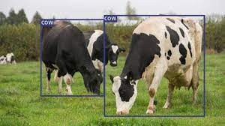
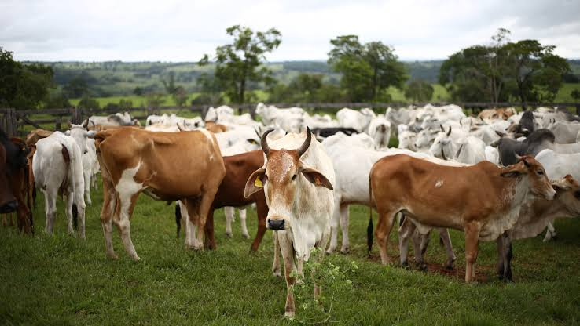
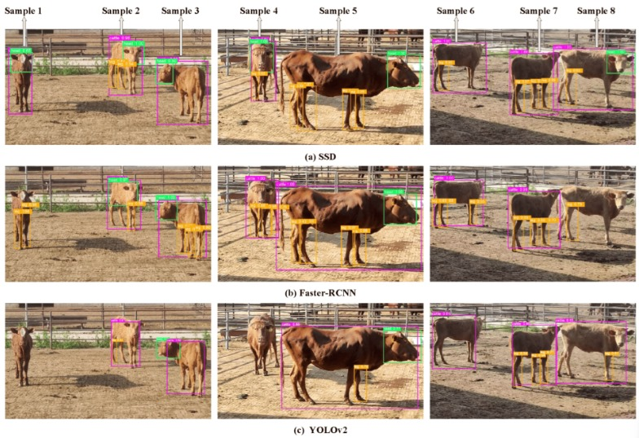
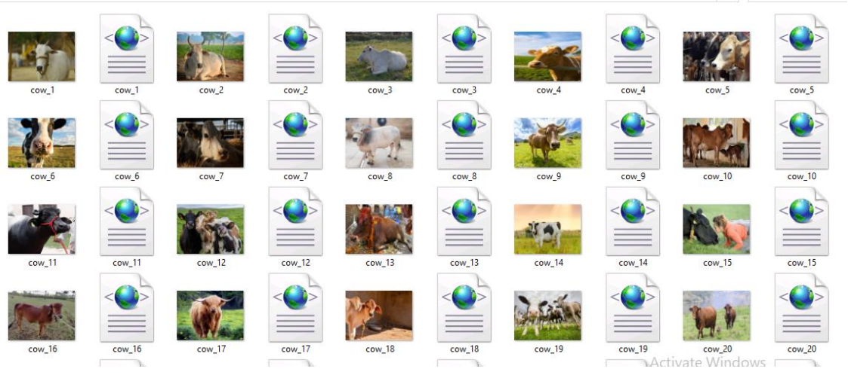
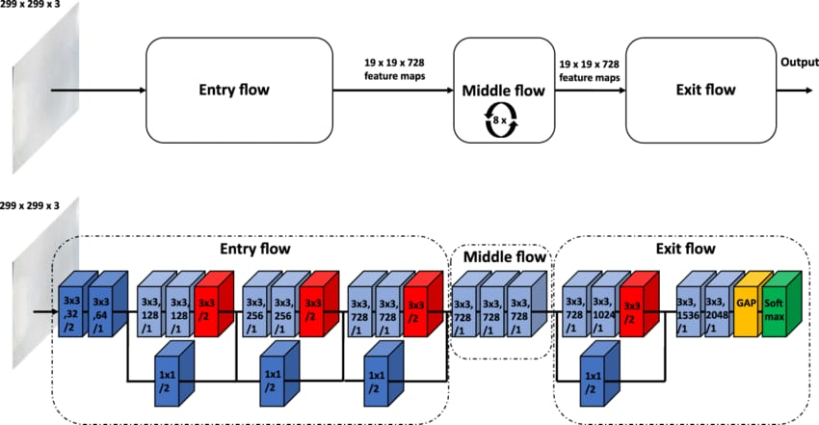
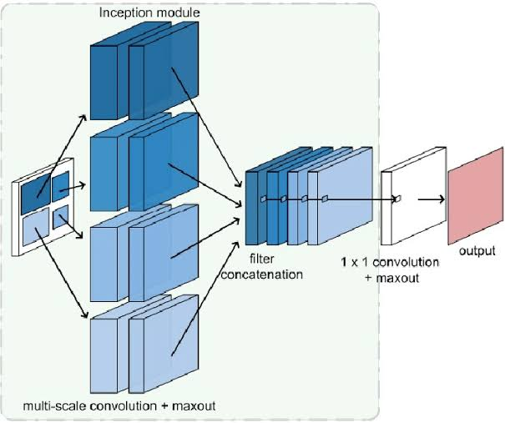

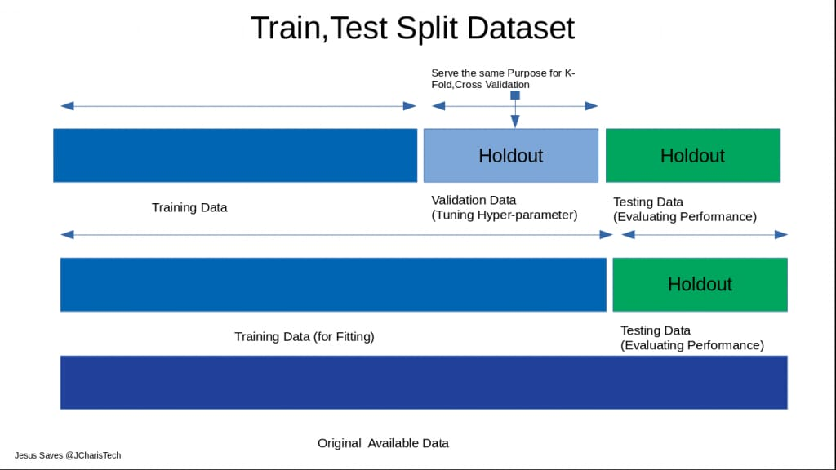
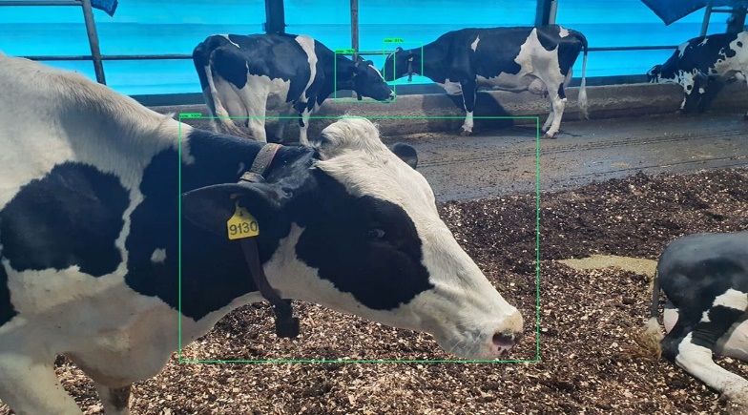
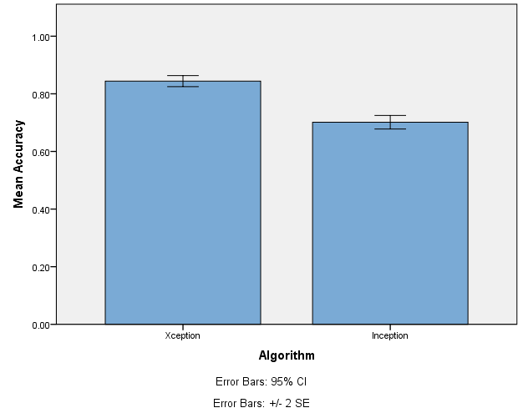
Name: P. Hemaprakash Register Number: 192012046
Guided by Dr. Dinokumar Kongkham
Ms. Poorani.S
Guided by Dr. Mary Valantina. G
Detecting animals in agriculture field's analysis Using Novel Xception model compared over Inception model with improved accuracy
THIS SECTION OUTLINES THE PRIMARY PURPOSE OF YOUR PROJECT, WHICH IS TO CREATE A SYSTEM FOR IDENTIFYING AND DETECTING ANIMALS IN AGRICULTURAL ENVIRONMENTS.
YOU'VE DECIDED ON THE XCEPTION MODEL AS THE CORE DEEP LEARNING ARCHITECTURE FOR YOUR PROJECT. THE TERM "NOVEL" IMPLIES THAT THERE MAY BE CHANGES OR UPGRADES TO THE CLASSIC XCEPTION CONCEPT, MAKING IT UNIQUE OR ADAPTED TO YOUR INDIVIDUAL REQUIREMENTS.
THIS SECTION IMPLIES THAT YOU INTEND TO COMPARE THE PERFORMANCE OF THE SELECTED XCEPTION MODEL AGAINST ANOTHER DEEP LEARNING ARCHITECTURE, SPECIFICALLY THE INCEPTION MODEL. THE GOAL IS TO SHOW THAT YOUR CHOSEN MODEL NOT ONLY PERFORMS WELL, BUT OUTPERFORMS ANOTHER MODEL, MAYBE IN TERMS OF ACCURACY.
THE RESULTS OF THE COMPARISON WILL BE PRESENTED IN A CLEAR AND CONCISE MANNER, WITH A DISCUSSION OF THE FINDINGS IN THE CONTEXT OF EXISTING LITERATURE AND POTENTIAL APPLICATIONS OF THE PROPOSED SYSTEM.
INTRODUCTION
Animal Detection In Field's
accuracies
MATERIALS AND METHODS
Colab & IBM
Input data
Software Tools
Comparison of the accuracies of both algorithms
Pre-processing
Model Building
END
Comparison in graphical model using SPSS software
Output
Split, Train and test
Classification
RESULTS
Independent Samples Test
 |  | Levene's Test for Equality of Variances |  | t-test for Equality of Means
 |  | F | Sig. | t | df | Sig. (2-tailed) | Mean Difference | Std. Error Difference | 95% Confidence Interval of the Difference
 |  |  |  |  |  |  |  |  | Lower | Upper
Accuracy | Equal variances assumed | .233 | .635 | 9.403 | 18 | .000 | .14266 | .01517 | .11078 | .17454
 | Equal variances not assumed |  |  | 9.403 | 17.367 | .000 | .14266 | .01517 | .11070 | .17462
Group Statistics
 | Algorithm | N | Mean | Std. Deviation | Std. Error Mean
Accuracy | Xception | 10 | .8440 | .03052 | .00965
 | Inception | 10 | .7013 | .03702 | .01171
Xception and Inception
Statistical Analysis of Xception and Inception
Xception surpassed Inception in animal detection accuracy (84.44% vs. 70.13%). This demonstrates Xception's superior performance due to its efficient architecture, whereas Inception, despite its established status, fell behind. These findings underscore the significance of selecting the appropriate deep learning models for precision agricultural applications.
DISCUSSION AND CONCLUSION
A statistical analysis using the Independent Samples T-test with a 95% confidence level and a standard deviation of +/-1 reveals a significance value of p=0.001 (independent sample T - test p<0.05) is obtained and shows that there is a statistical significant difference between the group 1 and group 2.
The researchers evaluated the Xception and Inception algorithms for detecting animals in agricultural fields. Xception achieved a better accuracy of 84.44% than Inception's 70.13%. This advantage is due to Xception's more efficient architecture, specifically its depth-wise separable convolutions. The findings highlight the relevance of model selection for reaching peak performance in agricultural monitoring tasks.
Therefore, there is an improvement in the performance level, and the values of the outcomes are
Xception - 84.44%
Densent169 - 62.60%
The study found that the Xception model is more successful for detecting animals in agricultural settings than Inception. Xception's innovative architecture enables better accuracy, showing its potential for improving precision agriculture systems. Future study can look on ways to improve Xception and implement it in real-world agricultural settings.
BIBLIOGRAPHY
Root, J. Jeffrey, Jeremy W. Ellis, and Susan A. Shriner. 2022. “Strength in Numbers: Avian Influenza A Virus Transmission to Poultry from a Flocking Passerine.” Transboundary and Emerging Diseases 69 (4): e1153–59.
Sakamoto, Shinsuke H., Yasuyuki Miyamoto, Rina Ukyo, and Seiji Ieiri. 2022. “Interspecific Variation in Wildlife Responses to Cattle, Swine and Chicken Feed in the Forests Surrounding Poultry Farms.” The Journal of Veterinary Medical Science / the Japanese Society of Veterinary Science 84 (5): 653–59.
Shen, Chenchen, Ruifang Wang, Guangpeng Feng, Feng Zhao, Tao Zhang, and Xiaorong Huang. 2022. “Salinity-Driven Changes in Behavioral Responses of Catadromous.” Animals : An Open Access Journal from MDPI 12 (17). https://doi.org/10.3390/ani12172244.
Traniello, Ian M., Syed Abbas Bukhari, Payam Dibaeinia, Guillermo Serrano, Arian Avalos, Amy Cash Ahmed, Alison L. Sankey, et al. 2023. “Single-Cell Dissection of Aggression in Honeybee Colonies.” Nature Ecology & Evolution 7 (8): 1232–44.

