Slide 1

Deep Learning for Advanced Robot
Perception
Project Presentation
Steering angle prediction for
Self-driving cars from 2D Images
Prakash Baskaran

Slide 2
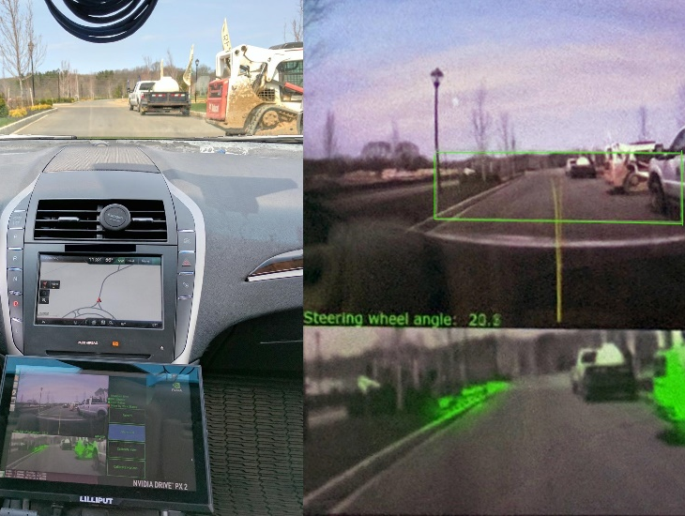
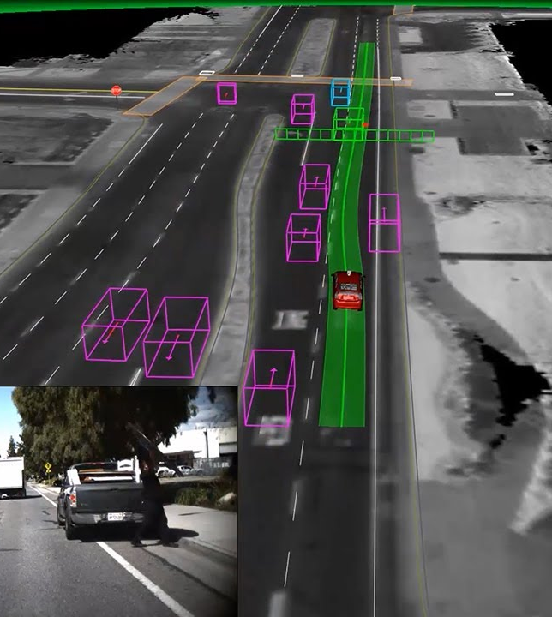
WHY Self - Driving Car ?
Self driving cars are soon expected to be seen on roads in the coming decade and are going to disrupt the automobile market that we know of today.
Udacity has an ongoing challenge to create an open source platform for self-driving car. The second challenge for the Udacity initiative is to teach a car how to drive using only camera and deep learning.

Slide 3
Abstract
In this paper, we propose two deep learning models to learn and predict the steering angle based on the input images. They are :-
An ingenious deep neural network model that includes 2D CNN, Dropout and Network Concatenation.
Apply Transfer Learning method and train the last few layers on an already existing model.

Slide 4
Introduction
We aim at providing a robust end-to-end solution to this problem. The catch here is to eliminate the need for hand-crafted features and instead create a system that first learns the features necessary to predict the steering angle and then trains itself overtime to drive by observing these features. The motivation behind using Convolutional Neural Networks is that they learn features automatically from the training examples and are extremely powerful in image recognition and classification.

Slide 5
Literature Review

Slide 6
ALVINN SYSTEM
The use of neural network in the field of autonomous navigation was spearheaded by D.A Pomerleau who built the Autonomous Land Vehicle in a Neural Network (ALVINN) system in the year 1989. The model takes input from a camera and LIDAR and produces the direction the vehicle should travel in order to follow the road. The ALVINN is relatively a simple 3-layer neural network designed for the task of road following.

Slide 7
NVIDIA
Recently, NVIDIA published a paper on end-to-end deep learning for self-driving cars. The paper discusses a basic CNN model to map raw pixels from a single front-facing camera directly to steering commands. The system was never explicitly trained to detect the outline of roads. But interestingly the system was capable of automatically learning internal representations of the necessary processing steps such as detecting useful road features.

Slide 8
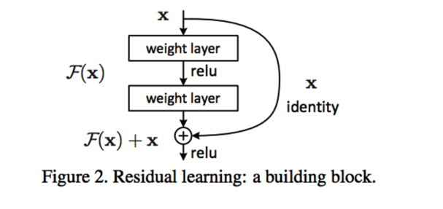
Microsoft ResNet
Microsoft Research Asia had come up with a framework called Deep Residual Learning [7] that mitigates the problem of training deep neural networks. The idea of residual mapping connection is to use network layers to fit a residual mapping instead of directly trying to fit desired underlying mapping. Residual networks ease the training of networks and at the same time, they are substantially deeper than those networks used previously.

Slide 9
Problem Description
To emulate human driving patterns in an autonomous vehicle that is capable of driving in many different situations in real time, taking input only from a single monocular camera, using deep learning techniques.

Slide 10
Dataset
Time-stamped video from the camera is captured simultaneously with the steering angle applied by the human driver.
Steering command is represented as 1/r, where r is the turning radius in meters.
Training images come from 5 different driving scenarios.
Frame rate: 20 fps & Resolution: 640x480
A total of 67574 frames are obtained from these videos.
We further split the data into training, validation and test in a 60/20/20 fashion.

Slide 11
Data Augmentation and Preprocessing
We flip the image vertically by taking its transpose and label the steering angle of the flipped image to be the negative of steering angle of the original image.
We also randomly take some images and change the brightness of the image by altering the HSV scale to increase the density of the dataset.
For each image, we normalize the pixel values from [0,255] to [0,1] by dividing the image matrix by 255. We further resize the image to 192x256.

Slide 12
Network Architecture

Slide 13
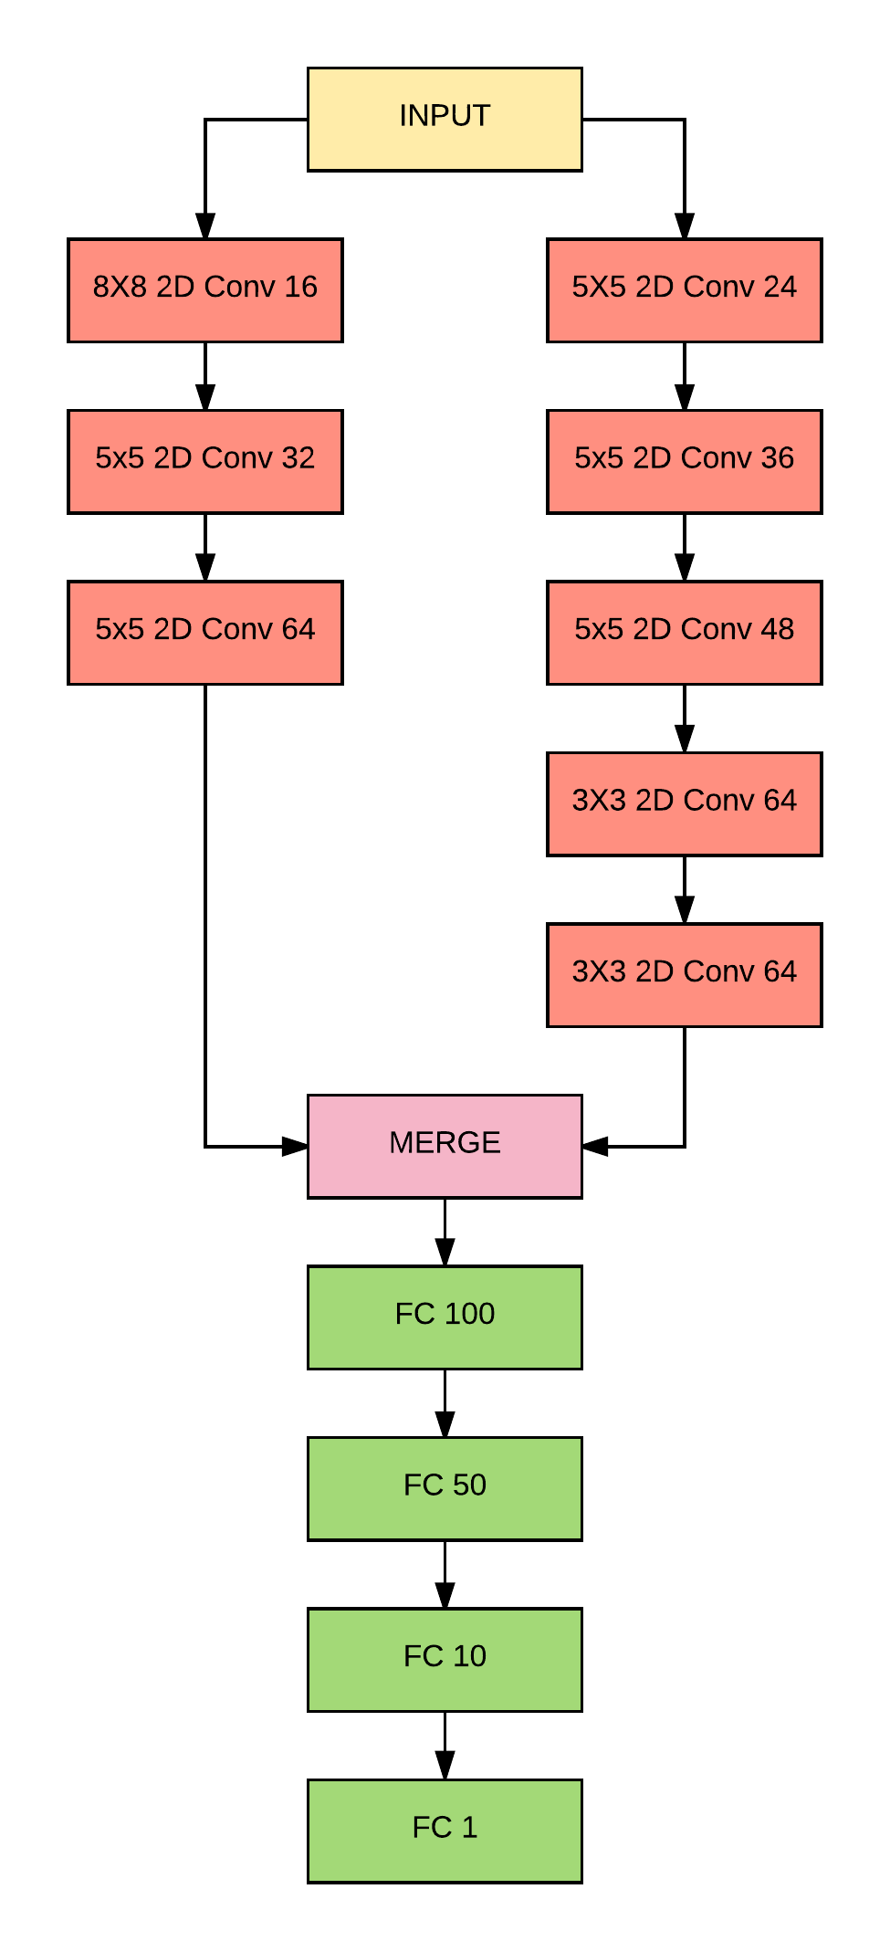
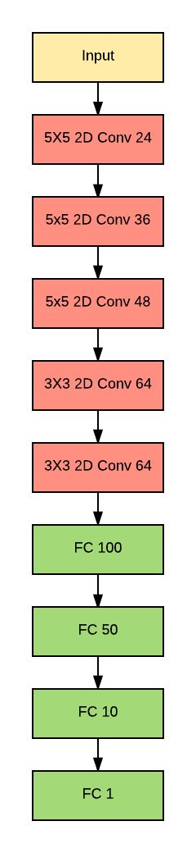
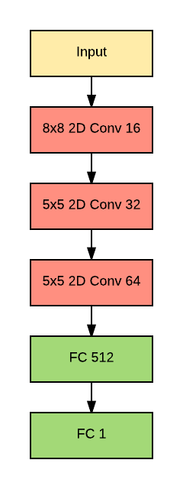


Comma AI model
NVIDIA model
Merged model

Slide 14
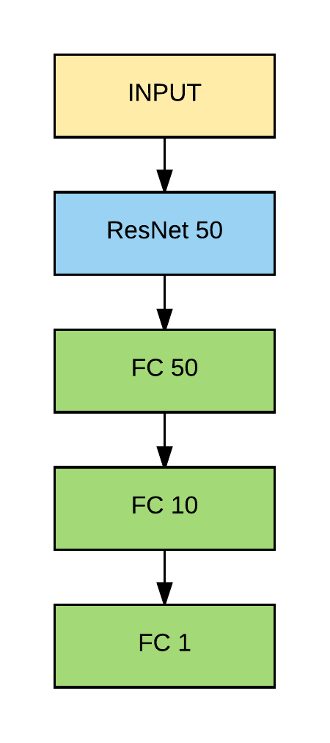
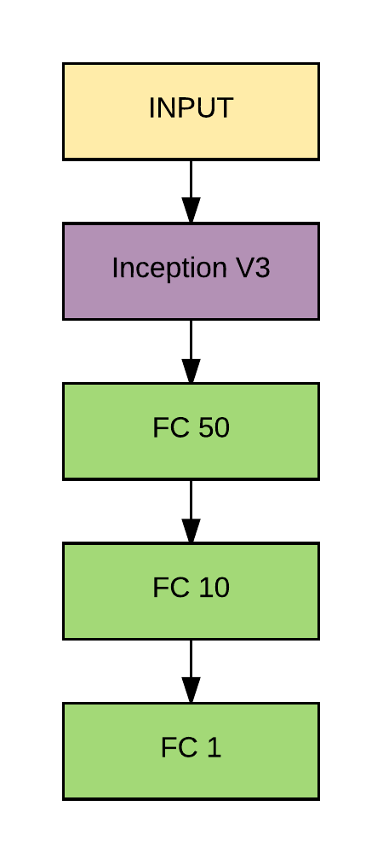
Transfer Learning

Slide 15
Experimentation

Slide 16
Algorithm
Load the training data.
Normalize the data and the split the data into training, validation and test.
Input the model that we wish to train.
Compile the model with an appropriate optimizer and loss function.
Enter the number of Epochs and Batch size.
Fit the model batch-by-batch by using a suitable batch generator function.
Monitor the validation loss and save the model weights.
Terminate the training if the model seems to overfit the data.
Evaluate the model on the test data and plot the results.

Slide 17
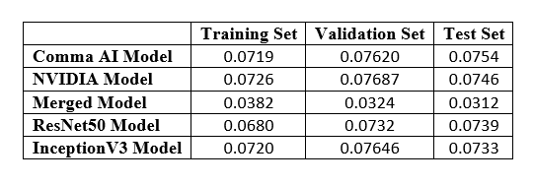
Results

Slide 18
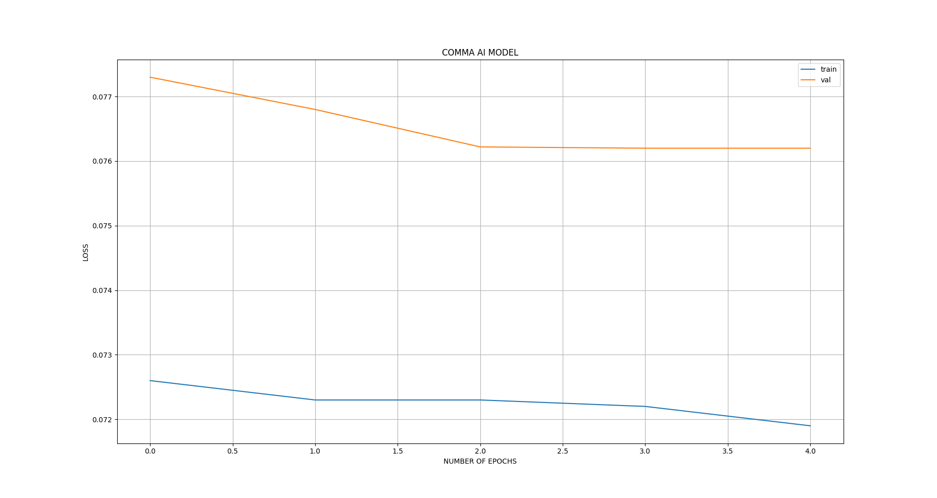
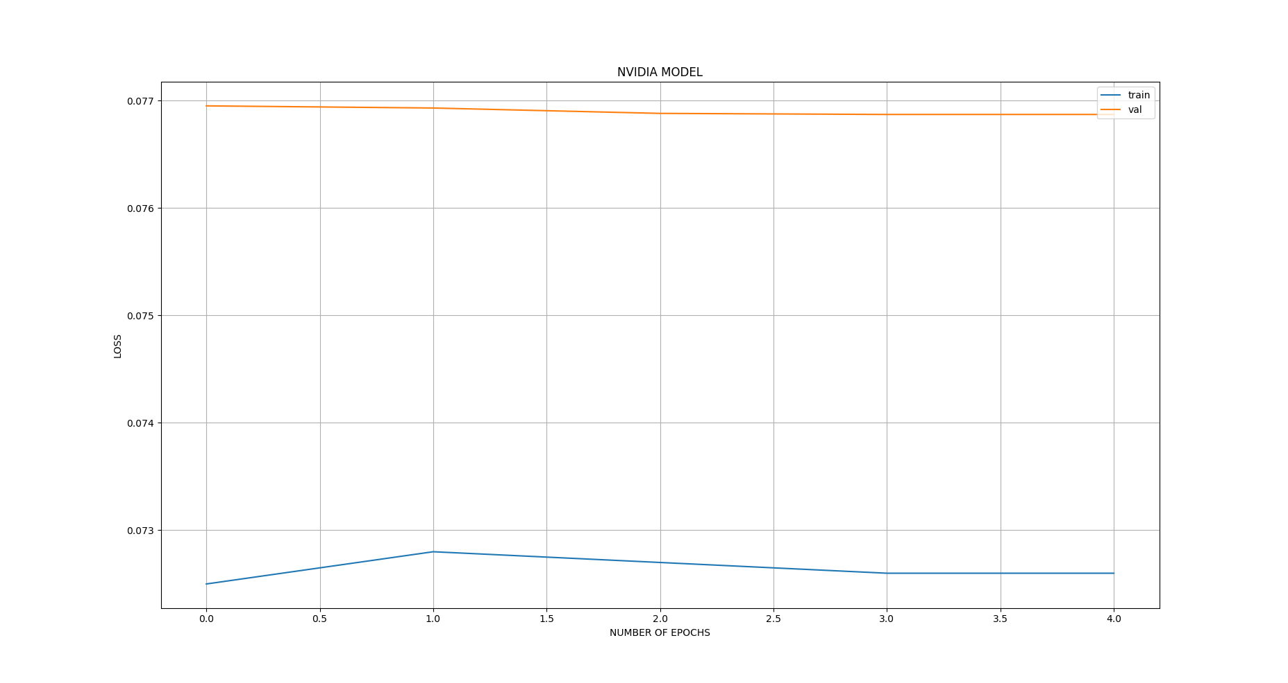
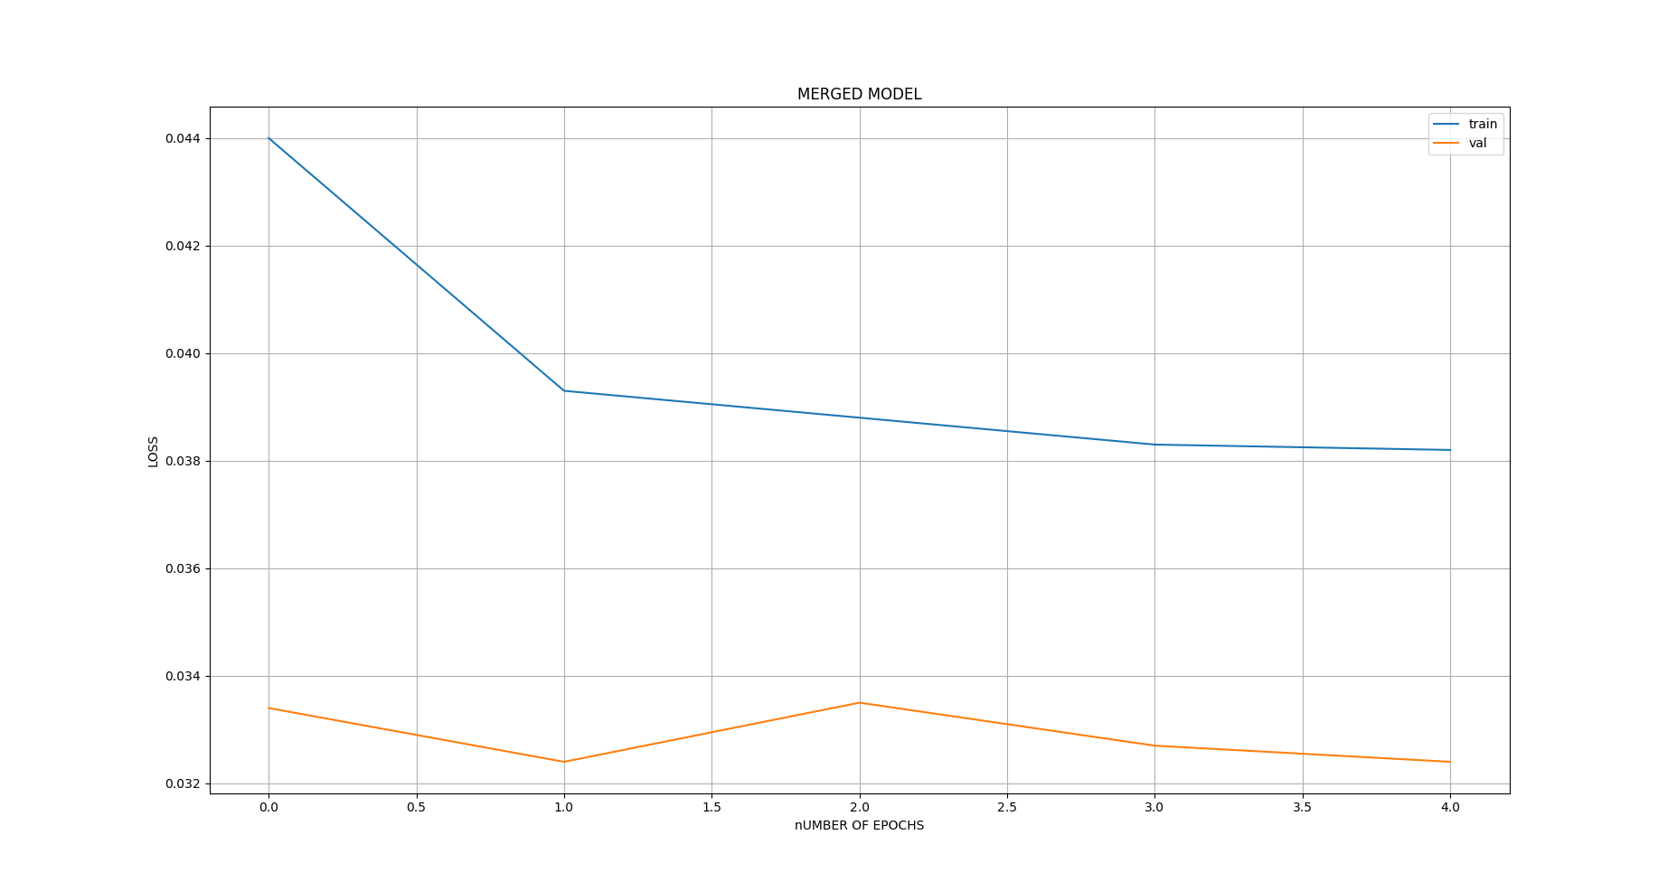
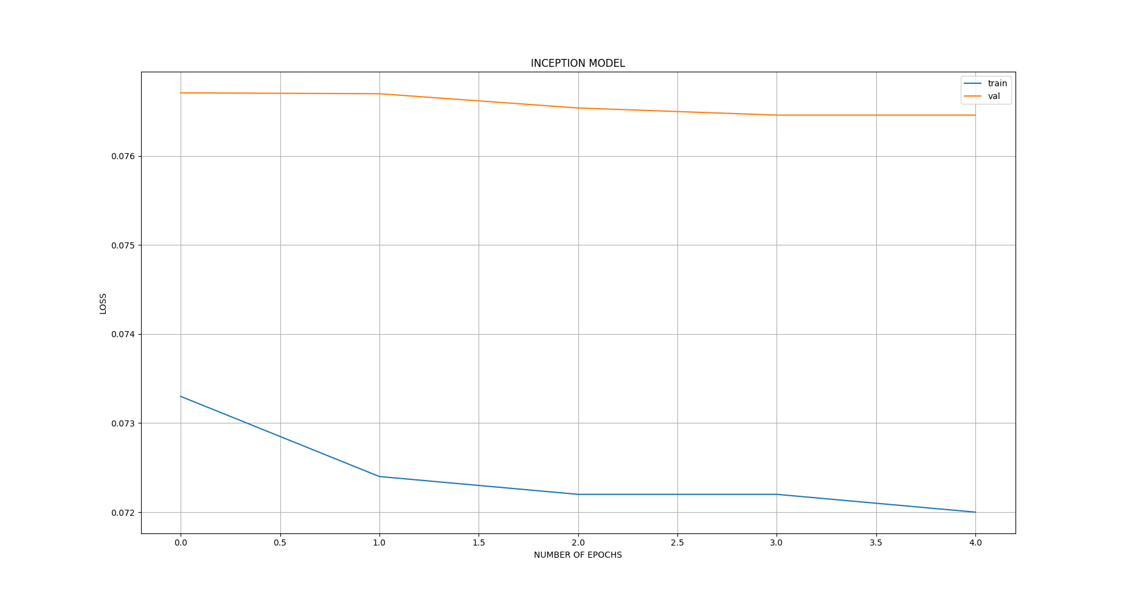
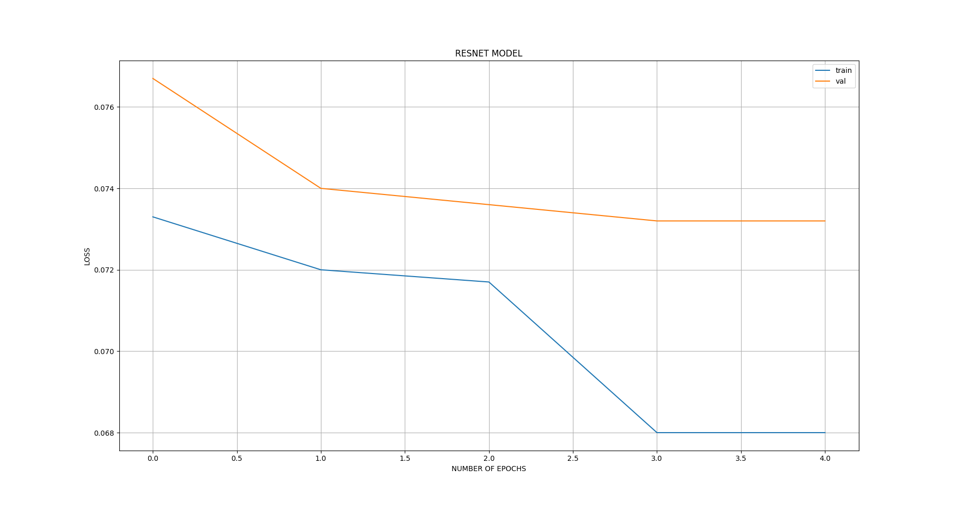
Training Loss vs Validation Loss

Slide 19
Conclusion
The test data loss was the least for the merged model. This justifies the hypothesis we made on our merged model.
In future we plan to expand the network by having a larger and deeper network with LSTM units to extract and process the temporal information.
We also observe that transfer learning method performed fairly well even though we had blocked all the layers from learning.
This also suggests that transfer learning might yield better results if we had not blocked the entire network and allowed some part of the network to be trained on our dataset.

Slide 20
References
N. Srivastava, G. Hinton, A. Krizhevsky, I. Sutskever, and R. Salakhutdinov, “Dropout: A simple way to prevent neural networks from overfitting,” Journal of Machine Learning Research 15 1929-1958, 2014.
M. Bojarski, D. Testa, D. Dworakowski, B. Firner, P. G. B. Flepp, L. D. Jackel, M. Monfort, U. Muller, and J. Zhang, “End to end learning for self-driving cars,” arXiv preprint arXiv:1604.07316, 2016.
A. Karpathy, G. Toderici, S. Shetty, T. Leung, R. Sukthankar, and L. Fei-Fei, “Large-scale video classification with convolutional neural networks,” In Proceedings of the IEEE conference on Computer Vision and Pattern Recognition, 2014.

Slide 21
J. Deng, W. Dong, R. Socher, J. Li, K. Li, and F.-F. Li, “Imagenet.”
D. A. Pomerleau, “Alvinn, an autonomous land vehicle in a neural network,” Technical report, Carnegie Mellon University, Computer Science Department, 1989.
K. He, X. Zhang, S. Ren, and J. Sun, “Deep residual learning for image recognition,” arXiv preprint arXiv:1512.03385, 2015.
E. Santana and G. Hotz, "Learning a Driving Simulator", arXiv:1608.01230v1, 2016.
C. Szegedy, V. Vanhoucke, S. Ioffe, J. Shlens and Z. Wojna, “Rethinking the Inception Architecture for Computer Vision”, arXiv:1512.00567v3, 2015.
S. Du, H. Guo, and A. Simpson, “Self-driving car steering angle prediction based on image recognition,” http://cs231n.stanford.edu /reports/2017/pdfs/626.pdf, 2017.

Slide 22


