Slide 1
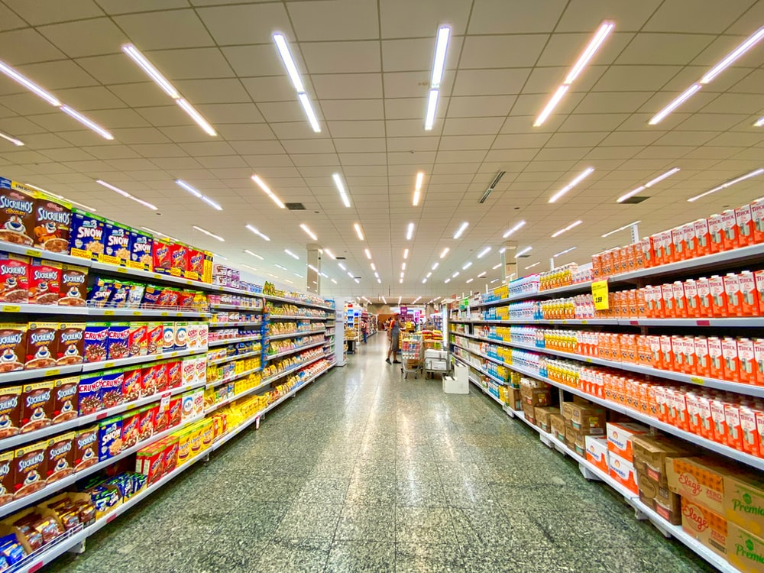
SUPER STORE Data Analysis(2011-2015)
Presenting
PRAKASH.K

Slide 2
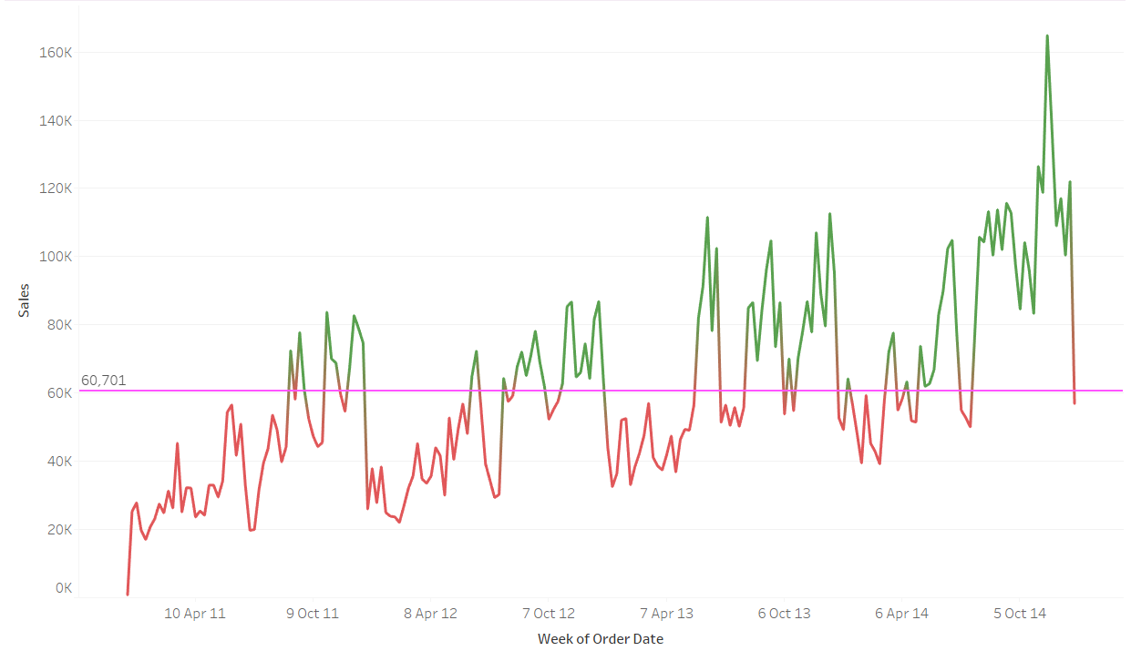
Week Wise Sales
ANALYSIS : From this LINE
CHART we can
understand that
sales are not
increasing or
decreasing
constantly

Slide 3
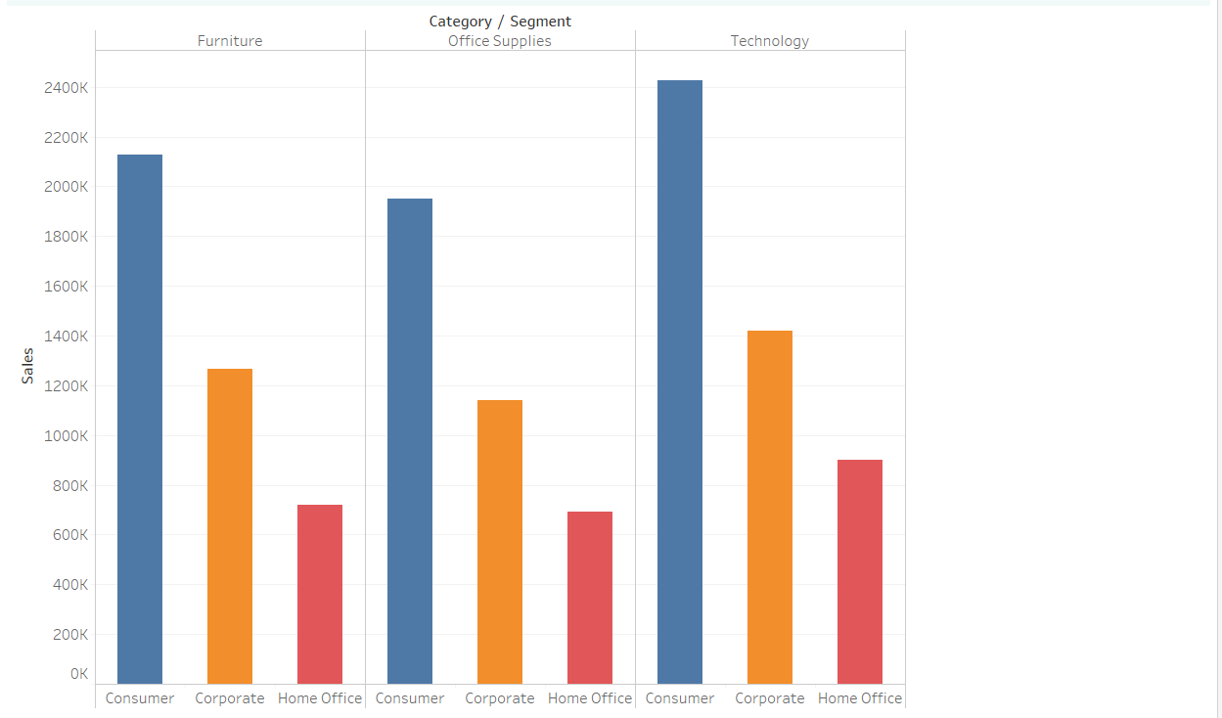
Category – wise Sales
ANALYSIS:
In the bar chart
among the Three
segments we can
notice that
CONSUMER
segment has
highest sales in all
three categories

Slide 4
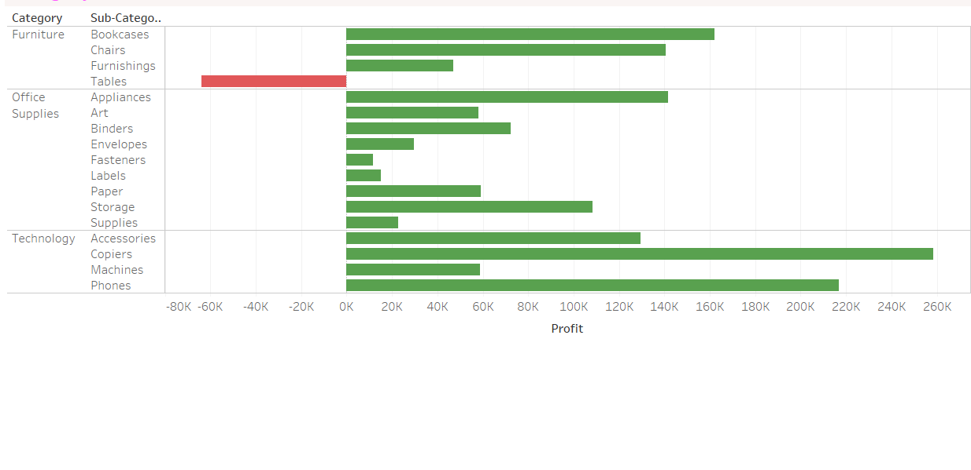
Category – Wise Profit
ANALYSIS :
From the chart
we can observe
that almost
every sub-
category has
Profits unlike
TABLES and
BOOKCASES
,COPIERS AND
PHONES are giving
good amount of
PROFITS

Slide 5
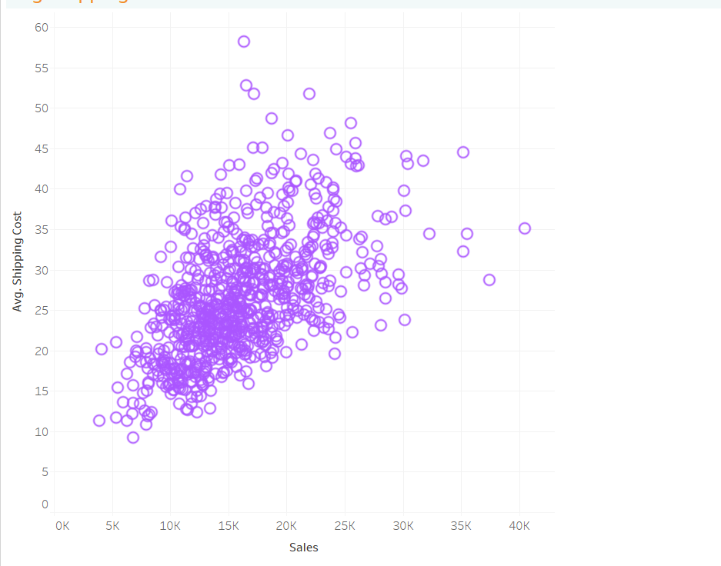
Average - shipping price VS Sales
ANALYSIS :
From the SCATTER
PLOT we can notice
that when the
average shipping
price is grater than
35 ,the amount of
sales are Decreasing

Slide 6
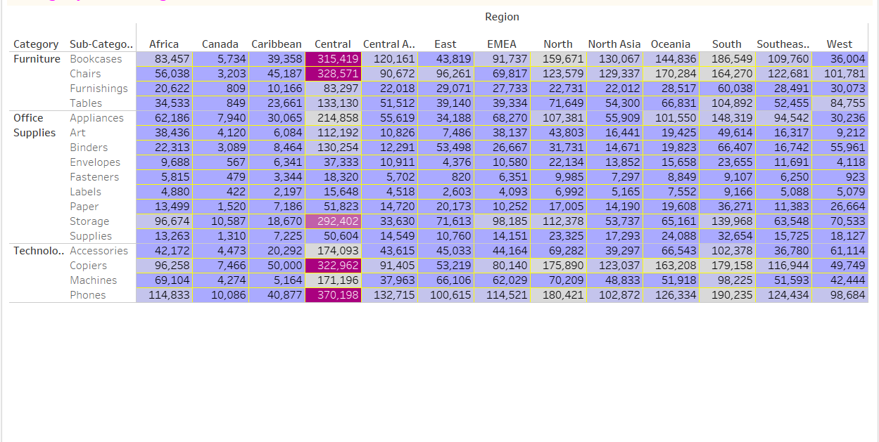
Region – Wise Category Measures
ANALYSIS :
From this Heat
map we can
observe that
CENTRAL Region
has highest SALES ,
QUANTITY and
PROFITS

Slide 7
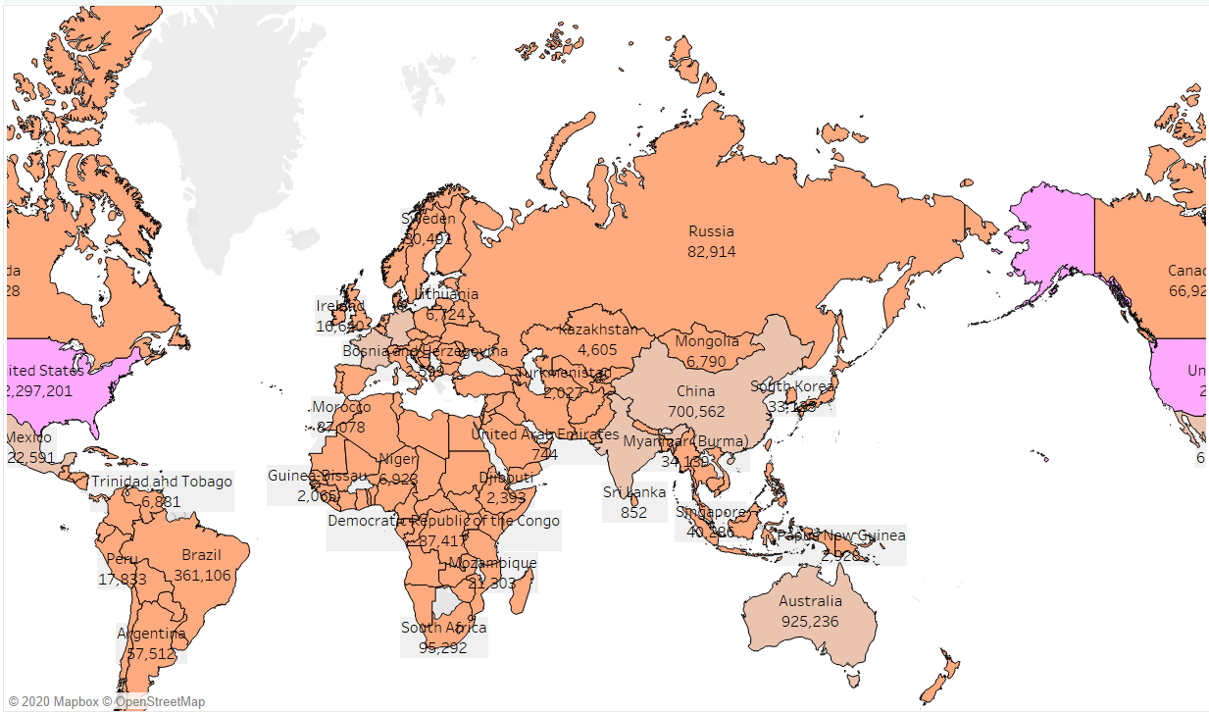
Country – Wise Measures
ANALYSIS :
From the above
Map chart we can
notice that
UNITED STAES ,
AUSTRALIA and
FRANCE are the
top 3 countries
which has higher
sales and Quantity
and UNITED STATES
, INDIA and CHINA
has higher PROFITS

Slide 8
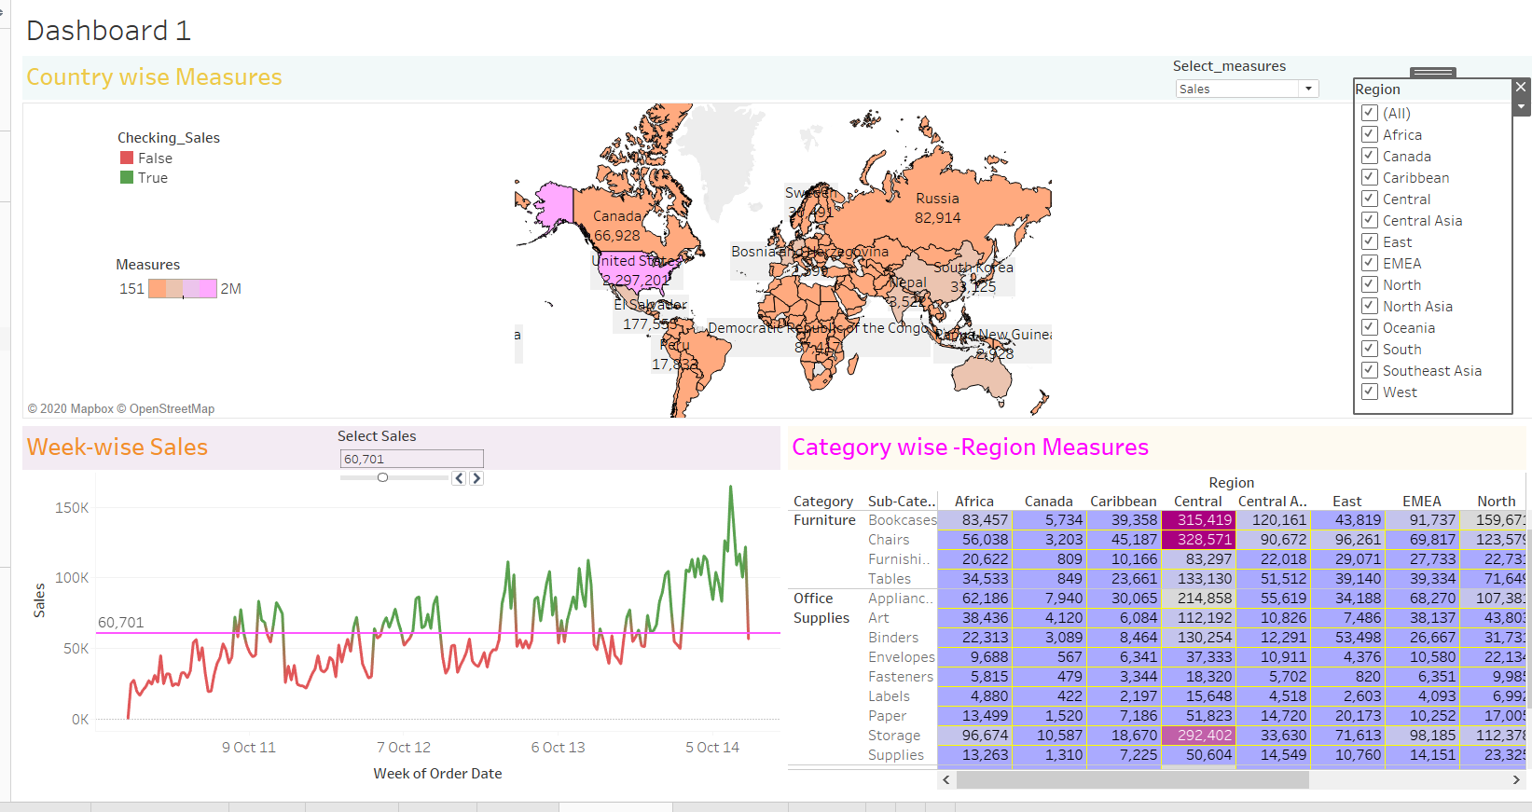
DASHBOARD - 1

Slide 9
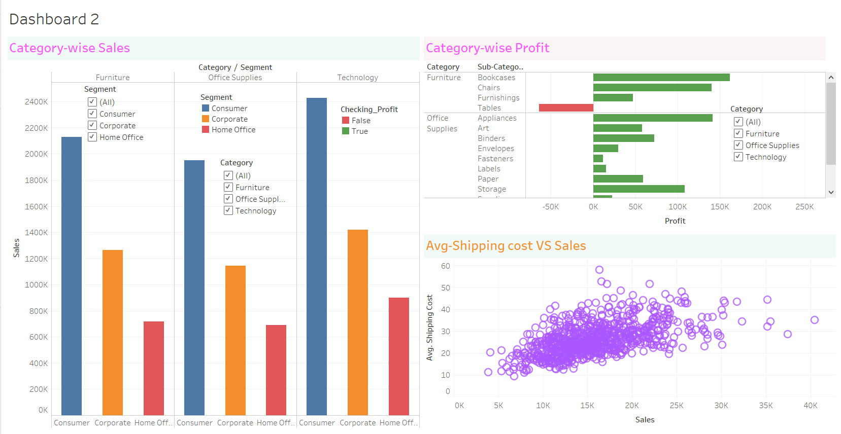
DASHBOARD - 2

Slide 10
Click here to open dataset link
Click here to View My presentation

Slide 11


