Slide 1
SECURE DATA HIDING IN IMAGE USING STEGANOGRAPHY
CAPSTONE PROJECT
Presented By:
Student Name : PRAJAPATI PRAKASHKUMAR N.
College Name & Department : GEC MODASA , COMPUTER ENGINEERING

Slide 2
OUTLINE
Problem Statement
Technology used
Wow factor
End users
Result
Conclusion
Git-hub Link
Future scope

Slide 3
Problem Statement
Ensuring secure data concealment while maintaining confidentiality is a challenge in digital communication. Traditional encryption methods make hidden data detectable, whereas steganography embeds sensitive information within image pixels without altering visual integrity. The goal is to develop an efficient algorithm for embedding and extracting encrypted messages while preserving image quality and security.

Slide 4
Technology used
Programming Language: Python
Cryptography: AES-256
Steganography: Image pixel manipulation using OpenCV
GUI Framework: CustomTkinter for a modern, user-friendly interface
File Handling: Tkinter.filedialog for selecting and saving images
Security: Password-based encryption and decryption
Platform & Compatibility :
Supported OS: Windows, macOS, Linux
Python Version: 3.8+
Dependencies: opencv-python, cryptography, customtkinter, tkinter (built-in)

Slide 5
Wow factors
Dual-Layer Security – AES-256 encryption with steganography for enhanced data protection.
Visually Imperceptible Embedding – Conceals data without altering image quality.
Secure Authentication Mechanism – Password verification for controlled access.
Optimized Performance – Fast encryption and decryption with minimal processing impact.
Scalable and Versatile Application – Suitable for secure communication and digital watermarking.

Slide 6
End users
Journalists & Whistleblowers
Cybersecurity Professionals
Government & Intelligence Agencies
Researchers & Academics
General Users Seeking Secure Communication

Slide 7
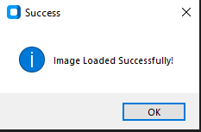
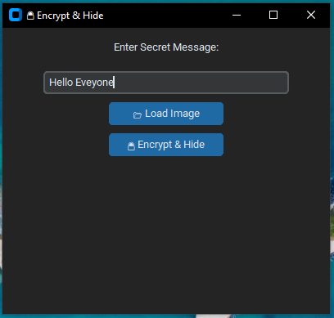
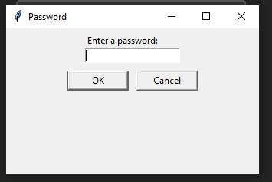
Results

Slide 8
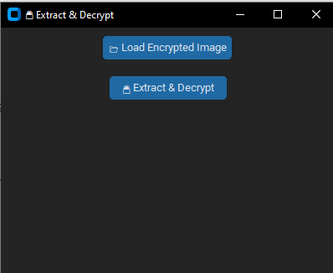
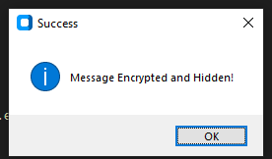
Result

Slide 9
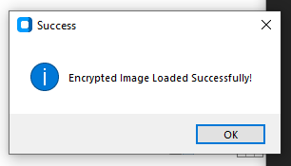
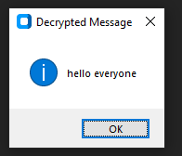
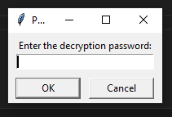
Result

Slide 10
Conclusion
This project successfully integrates AES-256 encryption with steganography, providing a secure and efficient method for concealing sensitive messages within images. The password-protected access ensures only authorized users can retrieve hidden data, enhancing confidentiality. With a user-friendly and modern GUI, the system is accessible to both technical and non-technical users.

Slide 11
GitHub Link
https://github.com/prakash2011/StegoSecure.git
Download Github zip file : https://github.com/prakash2011/StegoSecure/archive/refs/heads/main.zip

Slide 12
Future scope(optional)
Cloud-Based Secure Storage – Integrating cloud services for secure message storage and retrieval.
AI-Based Steganalysis Resistance – Developing techniqueto counter AI-driven detection of steganographic content.
Mobile Application Development – Expanding the project into a mobile application for wider accessibility and convenience.

Slide 13
THANK YOU

