Slide 1

Digital Portfolio
STUDENT NAME: PRAKASH.R
REGISTER NO:2422J0140
NMID : 1A35AB9ED8A3321A187466CECF8E9C09
DEPARTMENT: BCA
COLLEGE: KPR COLLEGE OF ARTS, SCIENCE AND RESEARCH
1

Slide 2
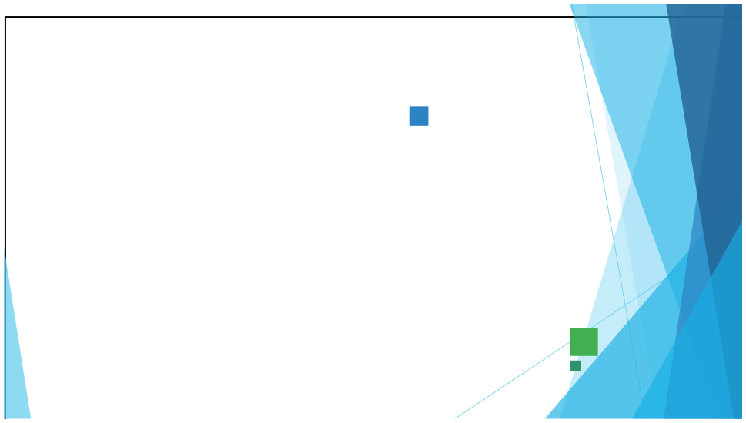
PROJECT TITLE:
Web Development Portfolio
Using HTML, CSS, and JavaScript
2

Slide 3


AGENDA
1. 2. 3. 4. 5. 6. 7. 8. 9. 10.
Problem Statement Project Overview End Users Tools and Technologies Portfolio design and Layout Features and Functionality Results and Screenshots Conclusion Github Link Results and Screenshots
3/21/2024 Annual Review
3

Slide 4


PROBLEM STATEMENT
Many students struggle to present their projects and technical skills to recruiters. A PDF resume does not reflect creativity or hands-on knowledge. To solve this, a web-based portfolio can be developed using HTML, CSS, and JavaScript to display personal details, projects, and contact information in a visually appealing and interactive format.
4

Slide 5

PROJECTOVERVIEW
This project focuses on creating a personal portfolio website using HTML, CSS, and JavaScript. The portfolio will serve as a digital resume for students to present their skills, academic projects, and achievements in a structured and visually appealing way. HTML will be used to design the structure and content of the website. CSS will provide styling, layouts, and responsiveness across devices. JavaScript will add interactivity, such as navigation menus, animations, and form validation.
5

Slide 6

WHO ARE THE END USERS?
Recruiters & Employers
.
.Teachers / Academic Evaluators
.Peers & Collaborators .General Audience / Clients
6

Slide 7



TOOLS AND TECHNIQUES
Tools:
. Visual Studio Code (VS Code) . Web Browsers (Chrome) . Git Hub
Techniques:
. HTML . CSS . JavaScript
7

Slide 8


POTFOLIO DESIGN AND LAYOUT
1)Header / Navigation Bar
2)Home / Introduction Section
3)About Section
4)Projects Section
5)Contact Section
6)Footer
8

Slide 9
FEATURES AND FUNCTIONALITY
Features:
• • •
Clean and responsive design
Easy navigation with a header menu
Separate sections: About, Projects, Contact
Functionality:
• • •
HTML: Provides structure for sections and content
CSS: Adds styling, color schemes, and responsive layout
JavaScript:
• • •
Form validation Button actions (alerts, navigation) Interactive elements (menu toggle, animations)

Slide 10
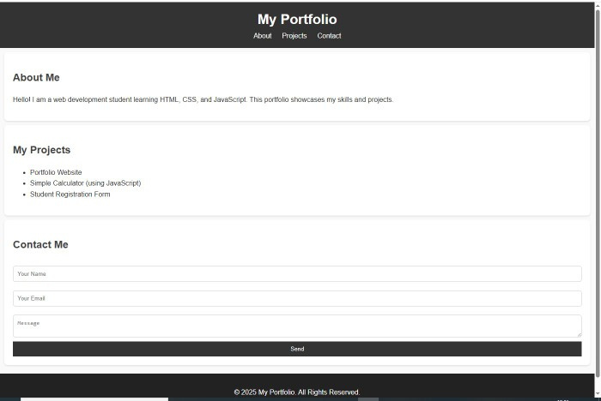
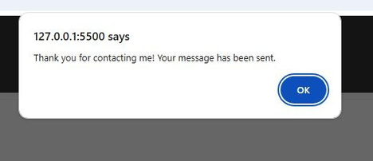

RESULTS AND SCREENSHOTS
3/21/2024 Annual Review
10

Slide 11
CONCLUSION
•
A portfolio website was created using HTML, CSS, and JavaScript to showcase skills and projects.
•
The site provides a simple, responsive, and interactive platform for students.
•
The project enhanced knowledge of front-end web development and practical implementation.
11

