Slide 1
PRAKASH R.
821721104306
BE COMPUTER SCIENCE AND ENGINEERING
SIR ISSAC NEWTON COLLEGE OF ENGINEERING AND TECHNOLOGY

Slide 2

RAIN PREDICTION(ANN)

Slide 3


AGENDA
The agenda for rain prediction encompasses crucial stages in developing an effective forecasting system. It begins with an introduction highlighting the significance of rain prediction across various sectors. Data collection from diverse sources is followed by preprocessing to ensure data quality.
Introduction to Rain Prediction.
Data Collection and Preprocessing.
Feature Selection and Engineering.
Model Selection: Comparing ML models.
Model Training and Evaluation: Metrics and validation.
Integration and Deployment: Real-time monitoring.
Case Studies: Applications in agriculture, urban planning.
Future Directions: Research and challenges.
Q&A Session.
Conclusion: Summarize, provide resources, encourage collaboration.
3/21/2024 Annual Review

Slide 4

PROBLEM STATEMENT
The problem statement revolves around developing a reliable rain prediction system to aid various sectors such as agriculture, transportation, and disaster management. It involves collecting and preprocessing data from multiple sources, selecting suitable features, training and evaluating machine learning models, and deploying the system for real-time monitoring and decision-making.
The challenge is to create an accurate rain prediction system crucial for sectors like agriculture, transportation, and disaster management. This involves integrating diverse data sources, optimizing feature selection, training and evaluating machine learning models, and deploying a system capable of real-time monitoring and response to mitigate risks and enhance preparedness in rain-related events.

Slide 5

PROJECT OVERVIEW
The project aims to develop a robust rain prediction system vital for sectors like agriculture, transportation, and disaster management. It involves integrating diverse data sources, optimizing feature selection, training machine learning models, and deploying a real-time monitoring system to mitigate risks and enhance preparedness for rain-related events.
This project entails the creation of a comprehensive rain prediction system, crucial for sectors such as agriculture, transportation, and disaster management. By integrating diverse data sources, optimizing feature selection, and deploying machine learning models, it aims to provide real-time monitoring and enhance preparedness for rain-related events, mitigating associated risks.

Slide 6
WHO ARE THE END USERS?
The end users of the rain prediction system include farmers, transportation authorities, emergency responders, urban planners, and disaster management agencies. They rely on accurate forecasts to make informed decisions and mitigate the impact of rain-related events on their operations and communities.
End users encompass a diverse range of stakeholders, including farmers, transportation companies, emergency services, urban planners, and disaster management agencies. They rely on precise rain forecasts to optimize agricultural practices, plan transportation routes, coordinate emergency responses, and mitigate the impact of rain-related events on infrastructure and communities.
The end users also include outdoor event organizers, construction companies, water resource management authorities, and tourism agencies. They depend on accurate rain predictions to plan activities, manage construction schedules, allocate water resources efficiently, and ensure the safety and enjoyment of tourists and residents alike.

Slide 7

YOUR SOLUTION AND ITS VALUE PROPOSITION
Solution: Our solution is a sophisticated rain prediction system that utilizes state-of-the-art machine learning algorithms and real-time data integration techniques. It combines data from various sources, including satellite imagery, weather stations, and radar data, to generate highly accurate forecasts. Value Proposition: Our rain prediction system provides immense value by offering precise forecasts to end users across sectors such as agriculture, transportation, disaster management, and more. By enabling informed decision-making, optimizing operations, and mitigating risks associated with rain-related events, our system enhances preparedness, minimizes disruptions, and maximizes efficiency and resilience in diverse environments.

Slide 8

THE WOW IN YOUR SOLUTION
The “wow” factor in our solution lies in its ability to deliver exceptionally accurate rain predictions in real-time, thanks to cutting-edge machine learning algorithms and seamless integration of diverse data sources. This level of precision empowers end users to proactively plan and adapt to changing weather conditions, ultimately minimizing disruptions, optimizing resource allocation, and enhancing overall resilience in the face of rain-related events.
Our solution’s “wow” factor extends beyond just accurate rain predictions; it’s about revolutionizing how stakeholders across various sectors interact with and respond to weather events. By providing real-time insights and actionable information, our system empowers users to make informed decisions, mitigate risks, and optimize operations, ultimately driving efficiency, resilience, and sustainability in the face of unpredictable weather conditions.
3/21/2024 Annual Review

Slide 9
MODELLING
Modeling in our rain prediction system involves utilizing advanced machine learning algorithms to analyze historical weather data and generate predictive models. We employ techniques such as regression, decision trees, neural networks, and ensemble methods to capture complex relationships between various weather variables and rainfall patterns. Through rigorous training and evaluation, our models continuously improve their accuracy and reliability, enabling us to provide precise forecasts for end users in real-time.
Our modeling approach goes beyond traditional methods by integrating sophisticated techniques such as deep learning and ensemble modeling. Deep learning algorithms, like convolutional neural networks (CNNs) and recurrent neural networks (RNNs), allow us to capture intricate spatial and temporal patterns in weather data. Ensemble modeling combines multiple individual models to create a more robust and accurate prediction by leveraging the strengths of different algorithms. This comprehensive approach ensures the highest level of accuracy in our rain prediction system, setting it apart from conventional forecasting methods.

Slide 10
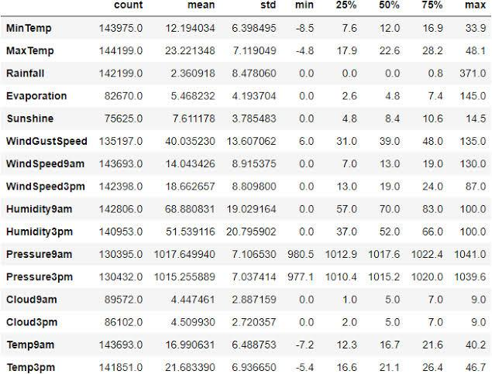
RESULTS
RAIN PREDICTION USING ANN
n

